Slide 1


An alternative strategy for finding protective variants and novel therapeutic targets in AD
Brian Kraemer, PhD
Veterans Affairs Puget Sound Health Care System
University of Washington

Slide 2
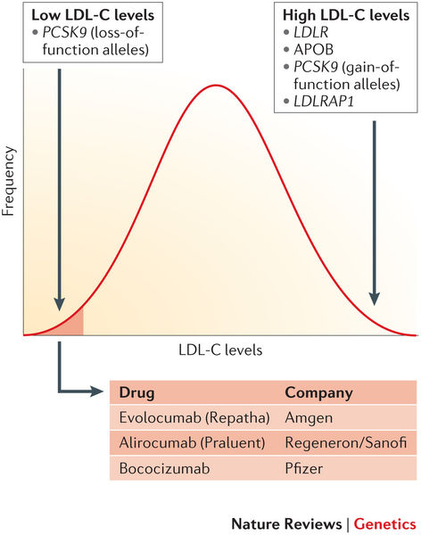
Why focus on protective variants?
Lessons from PCSK9 & Heart Disease
Human genetics nominates novel drug targets
Drug targets with genetic support are more than twice as likely to succeed in clinical trials
Protective loss-of-function is the prize
  Phenocopy perfect inhibition
  Demonstrate potential on-target safety
  Perfectly validate therapeutic target
We need to identify protective variants for the pathologies of Alzheimer’s Disease, can C. elegans help?

Slide 3
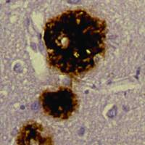
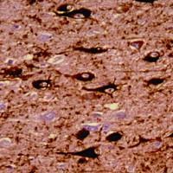
Alzheimer’s Pathology
Plaques (Aβ) Tangles (tau)
Notes:
Alzheimer's disease is the most common neurodegenerative disorder.
While the genetics of early onset AD is relatively well understood, and clearly implicates plaques in AD
The neurofibrillary tangle pathology more closely correlates with neurodegeneative changes.

Slide 4
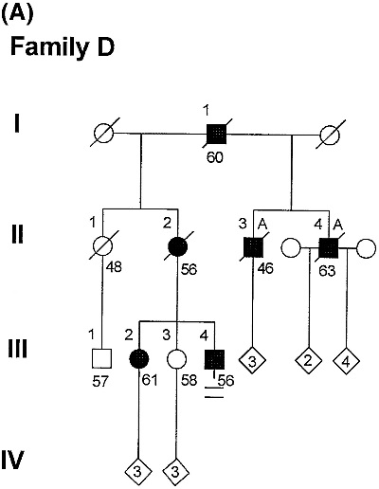
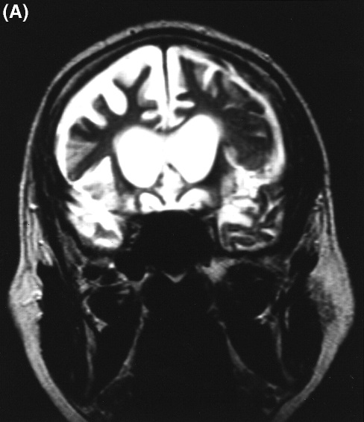
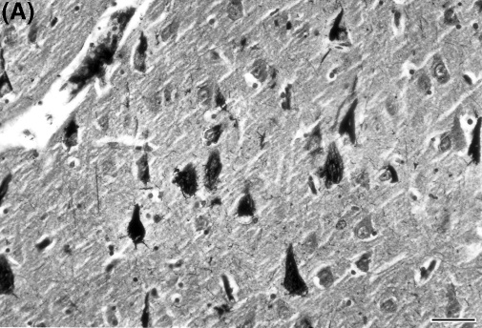
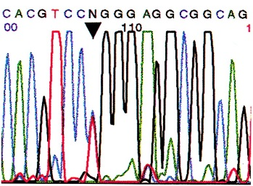
Molecular Genetics of Tau
Familial frontotemporal lobar degeneration (FTLD) is an autosomal dominant disorder
tau gene (MAPT) mutations cause FTLD
FTLD-tau exhibits AD-like tau pathology including tangles
(in the absence of plaques)
Thomas D. Bird et al. Brain 1999;122:741-756

Slide 5
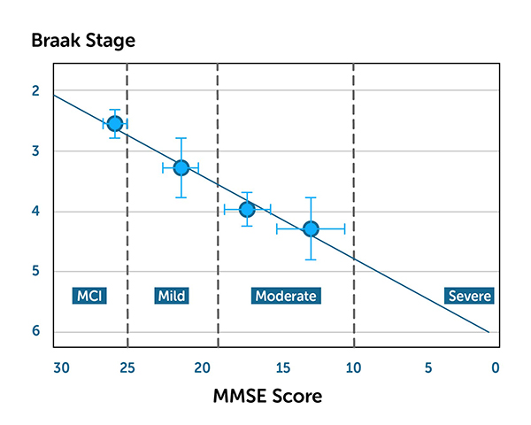
Alzheimer’s Disease: tangle distribution correlates with cognitive decline
Tau Pathology
Cognitive Decline
Adapted from TauRx

Slide 6
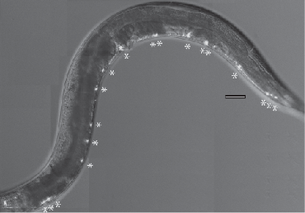
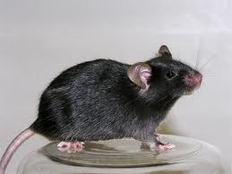
The Translational Approach:
Kraemer Group
Screening based discovery in human tau transgenic C. elegans.
Validate findings in human cells over-expressing tau
Hypothesis testing in transgenic mice
Translation
Human tau transgenic
C. elegans
Human cell model of tau aggregation
Human tau transgenic mice

Slide 7
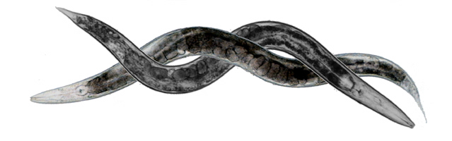
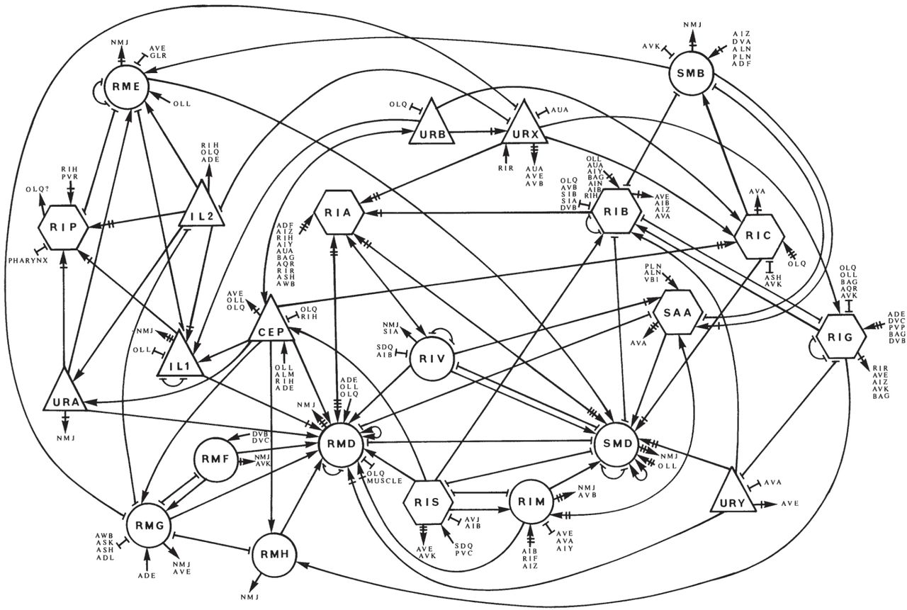
Why start with worms?
Human
Caenorhabditis elegans
10 Mb
I II III IV V X
Experimental Advantages:
21
~23,290 genes
~3300 MB
~100,000,000,000 neurons
~21,730 genes ~100 MB
302 neurons
Rapid tempo – 3 day lifecycle
Neuronal wiring diagram
Cell lineage
Simple behavior
Transparent
Rapid transgenics
Conserved Genes
Genetics/Genome Editing
  Protective Variants
Notes:
Why use the worm, C. elegans to model human disease?
The simple answer is for experimental advantages.
Worms have a short generation time—they are fast– they live ~15 days on average.
Transgenics is relatively quick and easy.
A complete wiring diagram of the nervous system is available
The cell lineage for somatic cells is known and essentially invariant.
Worms have simple well studied behavior.
Worms are optically transparent, live in vivo imaging is routine.
Worms have powerful forward genetic tools.
Worms are much simpler than humans.

Slide 8
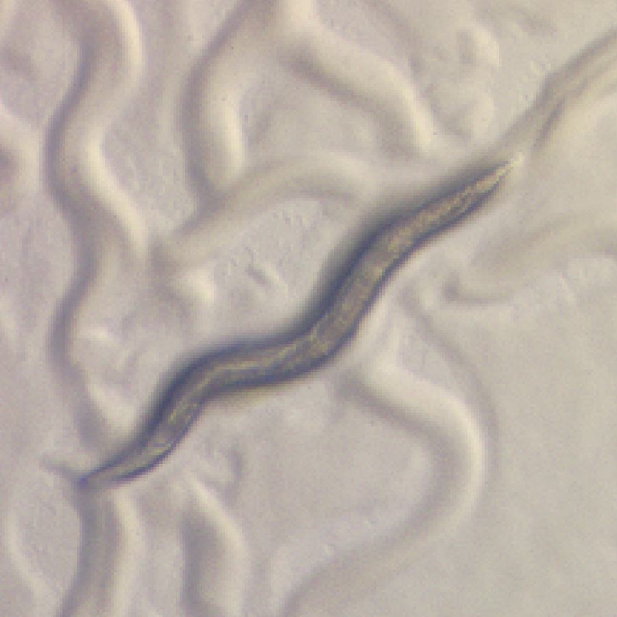
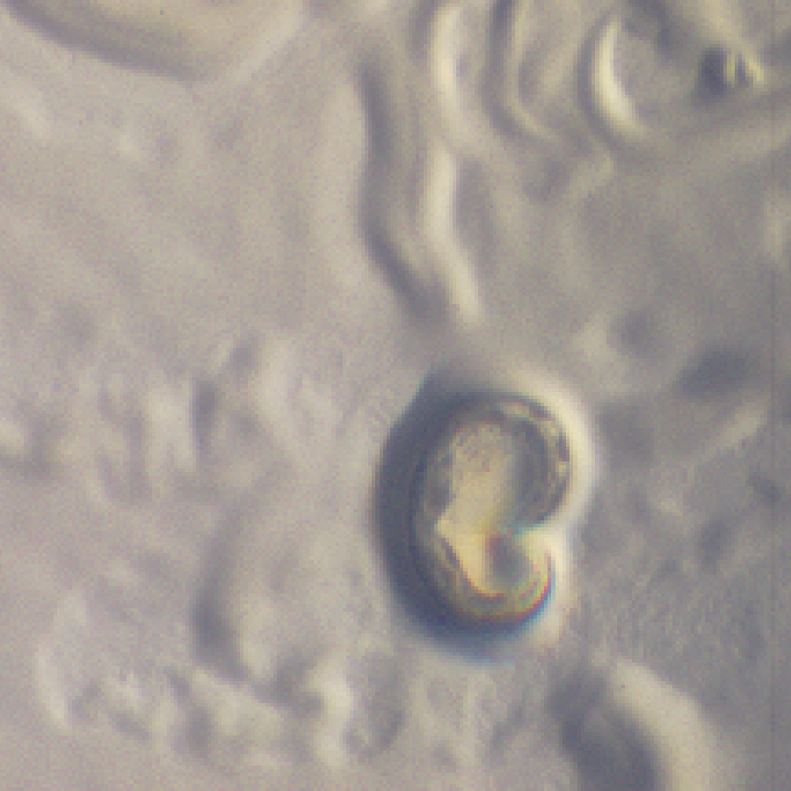
C. elegans as a model for tauopathy
Tau transgenic C. elegans exhibit:
• Progressive behavioral phenotype
• Insoluble tau, hyperphosphorylation
• Axonal degeneration
• Neuronal loss
• Intracellular tau aggregates
• FTDP-17 mutations - more pronounced phenotype
Absent:
• Filamentous aggregated tau (NFT’s)
non-Tg
Tau Tg
(^{V}337^{M})
Kraemer, et al 2003 PNAS 100: 9980-

Slide 9
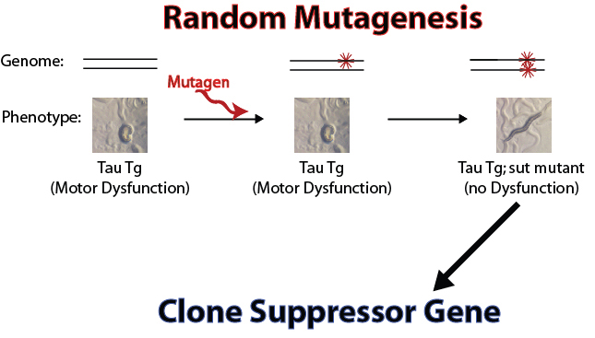
Classical Genetics: phenotype drives discovery
Protective loss of function mutations identify suppressors of tauopathy (sut genes)
Notes:
To find genes required for tau neurotoxicity we conducted a forward genetic screen for mutations
that make worms resistant to the neurotoxic effects of tau.
This approach is only feasible in the simplest and most rapidly growing models.
So we exposed the T337 strain, which has a strong Unc phenotype, to a chemical mutagen.
Mutagenesis randomly disrupts genes throughout the genome.
We sorted through millions of mutagenized progeny, selecting for those that have restored motor function
We then performed a secondary screen on candidate mutants selecting those with unchanged tau expression.
Candidate mutants were characterized further for parameters of locomotion and then positional cloning began.
Through a labor intensive series of genetic mapping, genomic rescue, and sequencing steps we are then able
to clone the mutated gene responsible for tau suppression and subsequently learn the
Suppressor gene identity.
At this point we have cloned two suppressors of tau (sut) genes, SUT-1 and SUT-2

Slide 10
Protective Gene Variations Modifying Tauopathy
Gene Identified | Approach | Reference
DOPA Decarboxylase | Reverse Genetic Screen | Kow, et al 2018
D2/D4 Receptors | Small Molecule Screen | McCormick, 2013
XBP-1 | Reverse Genetic Screen | Kraemer, et al 2006
sut-2 | Forward Genetic Screen | Guthrie, et al 2011
sut-6 | Forward Genetic Screen | unpublished
sut-4/5/20/21 family | Forward Genetic Screen | unpublished
TTBK1/2* | Forward & Reverse Genetic Screens | Taylor et al, 2018
Calcineurin* | PPI Screen | Liachko, et al 2016
* Also modify TDP-43 proteinopathy

Slide 11
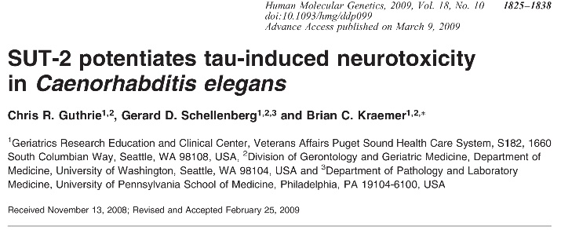
SUT-2 KO protects against tau in simple systems
What about mice?

Slide 12
Humans and worms have one SUT-2 homolog with conserved CCCH domains
Notes:
SUT-2 is a well conserved protein in animal phyla.
All sequenced genomes have a single SUT-2 like homolog. This family of proteins has been poorly characterized to date and little is known about function
The mammalian protein we call MSUT2.
The SUT-2 family of proteins has 5 c-terminal CCCH type ZF domains of unknown function
A conserved N-terminal domain and both NLS and NES sequences, although their placement within the protein is not well conserved.
ZF domains are well conserved with exact spacing of putative Zinc chelating residues. Nematode species have an inserted sequence between ZFs 3 and 4 that is not seen in mammals.
Related CCCH type zinc fingers have been shown to bind to a variety of macromolecules including RNA, DNA, and protein.

Slide 13
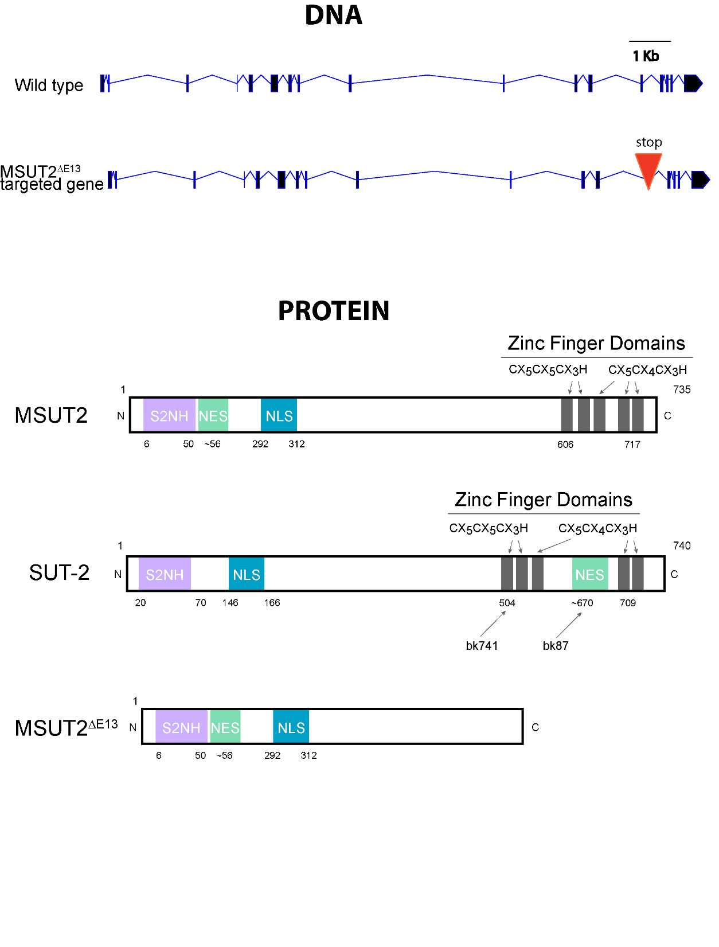
Targeting the Mouse MSUT2 locus
In press at Science Translational Medicine

Slide 14



Constitutive MSUT2 KO Mice Are Viable
Phenotypes
Healthy
Partial Fertility
Neurologically normal
Cognition ~normal
Poor maternal care for young
MUT2 Protein
Experiment:
X
MSUT2 KO Tauopathy Mouse (PS19)
Can MSUT2 KO protect against tauopathy in mice?

Slide 15
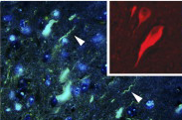
PS19 tauopathy mice
Human Tau transgenic expressing P301S mutant tau
Early tau hyperphosphorylation
Synapse loss & neuroinflammation
Behavior & memory dysfunction
Progressive tangle formation
Progressive neuronal loss
Premature Death
Yoshiyama, et al. 2007, Neuron

Slide 16
Why start with worms?
MSUT2 KO -- less phosphorylated tau
9 month PS19 Stratum Oriens, stained with phospho-tau monoclonal antibody AT180 (pT231)
In press at Science Translational Medicine

Slide 17
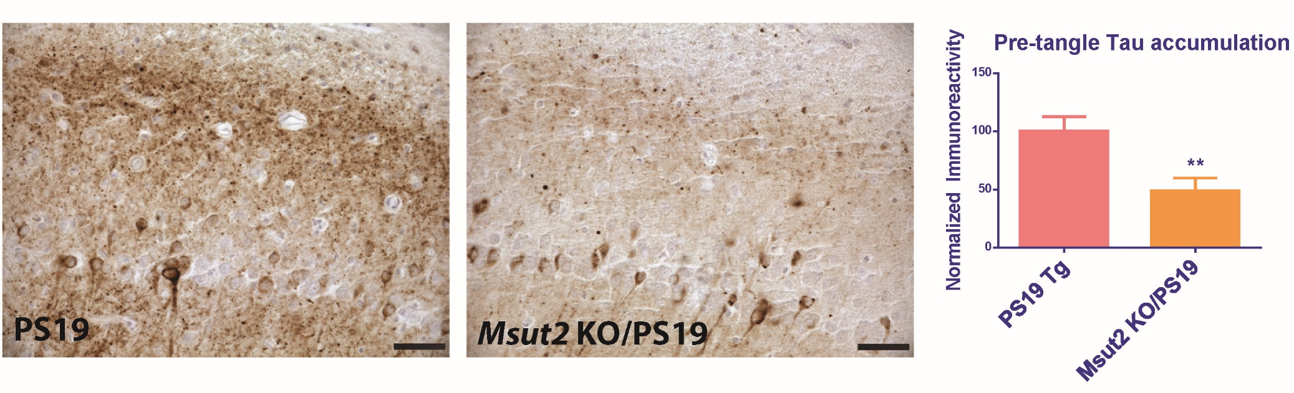
MSUT2 KOs have less pre-tangle tau
p=0.0042
Stratum Oriens, ICH with MC1
(pretangle conformation specific tau monoclonal antibody MC1)
In press at Science Translational Medicine

Slide 18
MSUT2 KO mice have fewer Tangles
Gallyas Silver stain for NFTs
In press at Science Translational Medicine

Slide 19
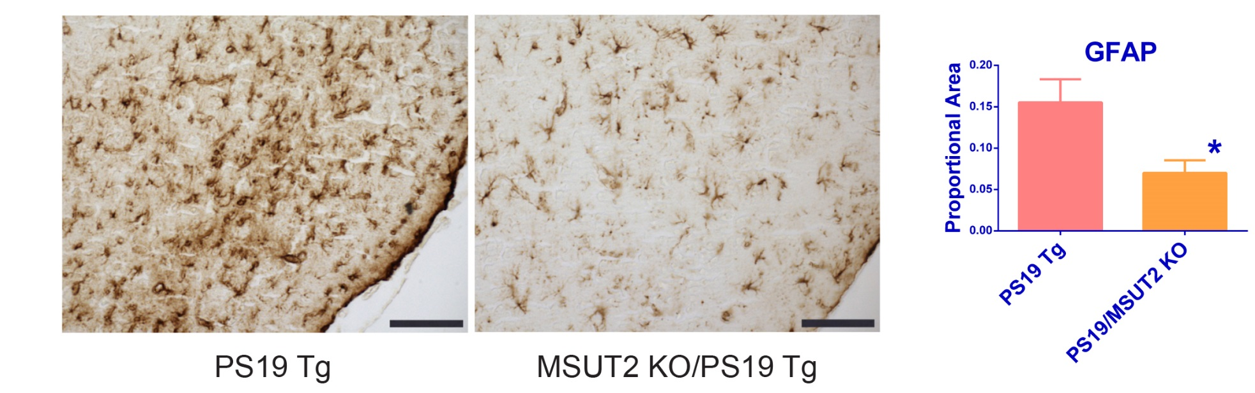
MSUT2 KO mice have less astrocytosis in response to pathological tau
p=0.01
Entorhinal Cortex, GFAP stain for reactive astrocytes

Slide 20
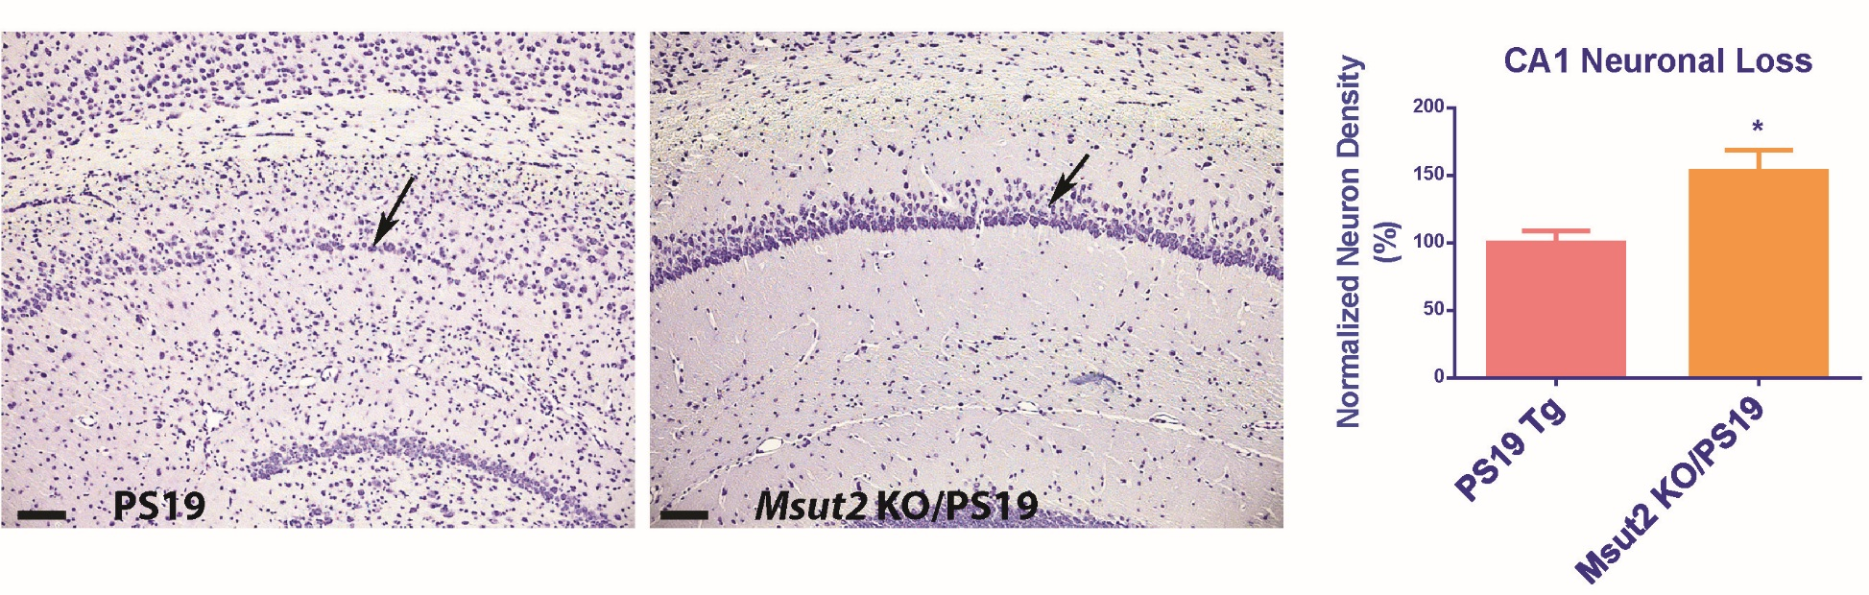
MSUT2 KO mice have less neuronal loss
p=0.0062
Hippocampus CA1 region, Cresyl Violet stain for neuronal cell bodies
In press at Science Translational Medicine

Slide 21
MSUT2 KO protects against tau learning and memory deficits
P=0.002
P=0.02
BARNES MAZE
In press at Science Translational Medicine

Slide 22
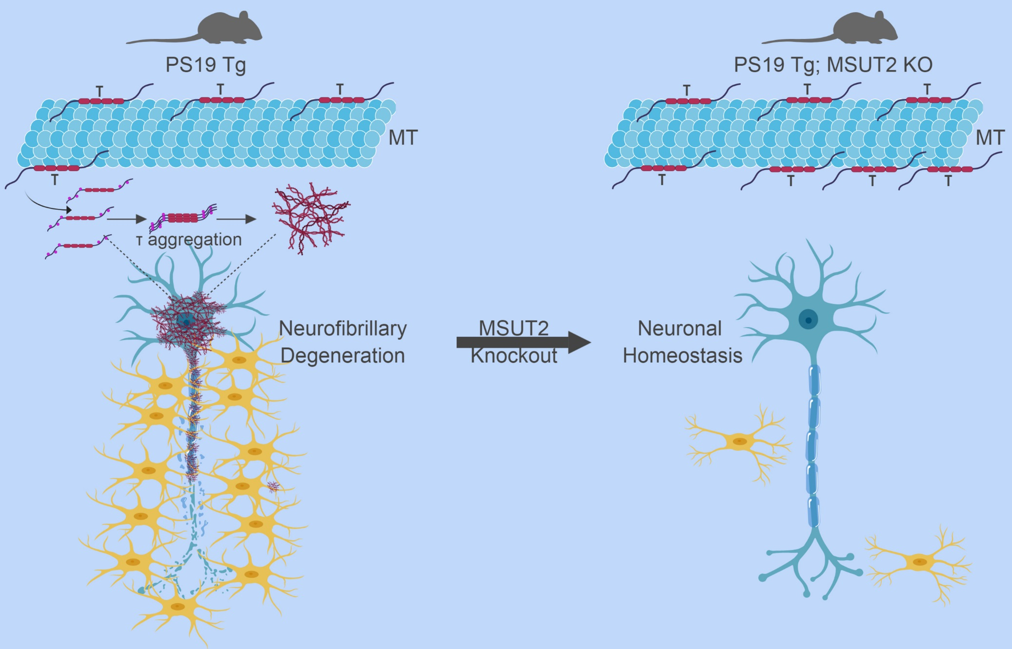
Summary of MSUT2 KO studies:
MSUT2 KO ~ sut-2(null)
Mice worms
In press at Science Translational Medicine

Slide 23

Manipulating MSUT-2 levels in mice
What happens to tau pathology when MSUT2 is overexpressed in tau mice?
Approach:
Inject AAV9 particles into tau Tg mice
Virus encoding:
a) Human MSUT2
or
b) GFP
Tau4RTg2652 tauopathy mice

Slide 24
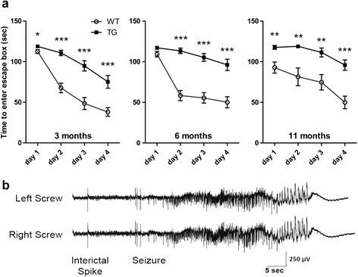
Tau4RTg2652 tauopathy mice
Human Tau transgenic expressing wild type 1N4R tau
Early tau hyperphosphorylation
Mild Behavior & memory dysfunction
Mild accumulation of oligomeric and pre-tangle tau
No neurofibrillary tangle
No neuronal loss
No obvious progression
Mild Tg Mouse Model of early tauopathy
Gallyas Silver Stain
Human AD Tau4RTg2652
Wheeler, et al. 2015, Acta Neuropath.

Slide 25
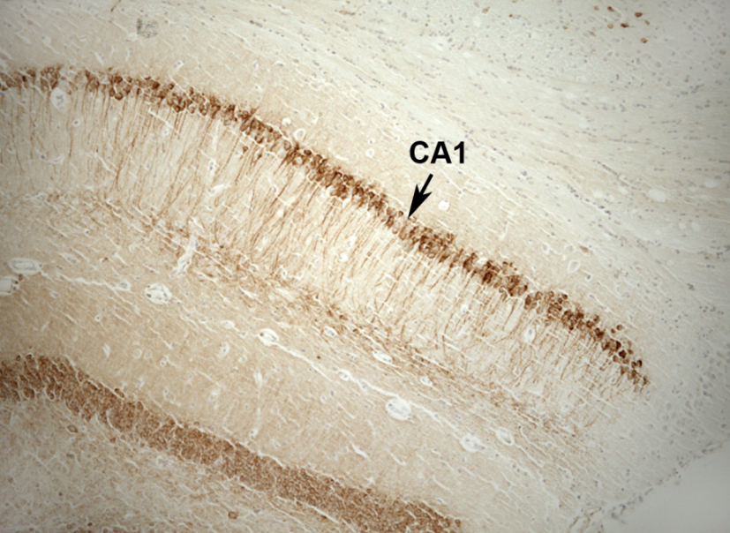
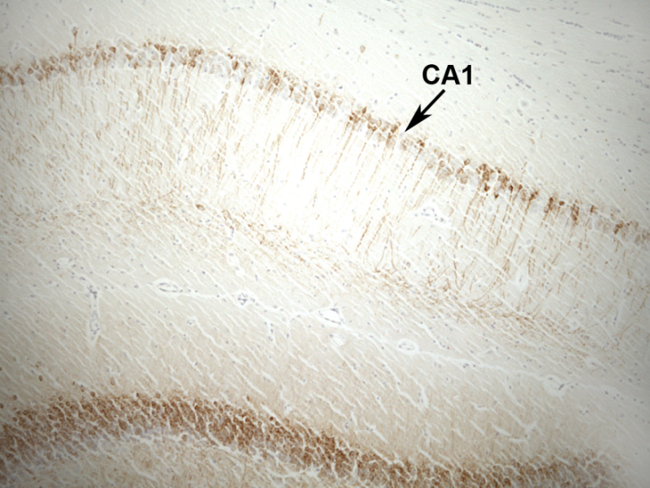
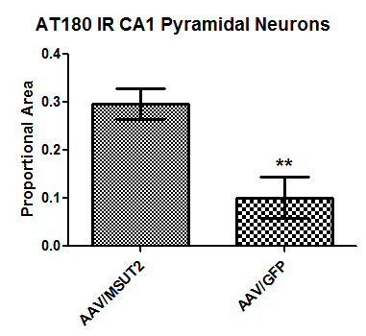
Adeno-Associated Viral Vector expression of MSUT2 exacerbates tau neuropathology
Ipsilateral
Ipsilateral
MSUT2 Injected
GFP Injected
AT180 IHC pTau (T231)
P=0.0044
In press at Science Translational Medicine

Slide 26
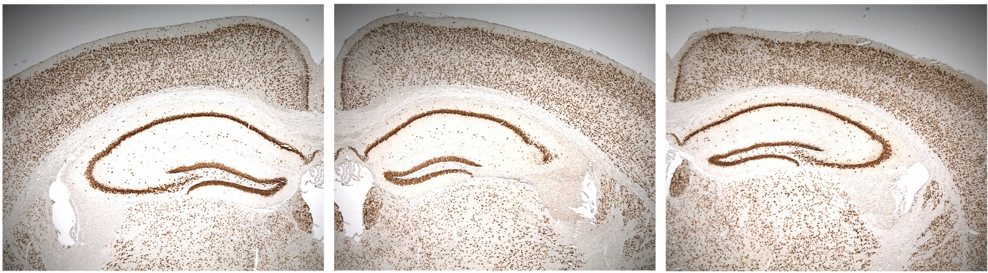
MSUT2 overexpression kills CA3 neurons in the hippocampi of tau transgenic mice
Contralateral
Ipsilateral
Ipsilateral
MSUT2 Injected
MSUT2 Injected
GFP Injected
NeuN immunostaining for neurons in Tau4RTg2652, 1 month post injection
In press at Science Translational Medicine

Slide 27
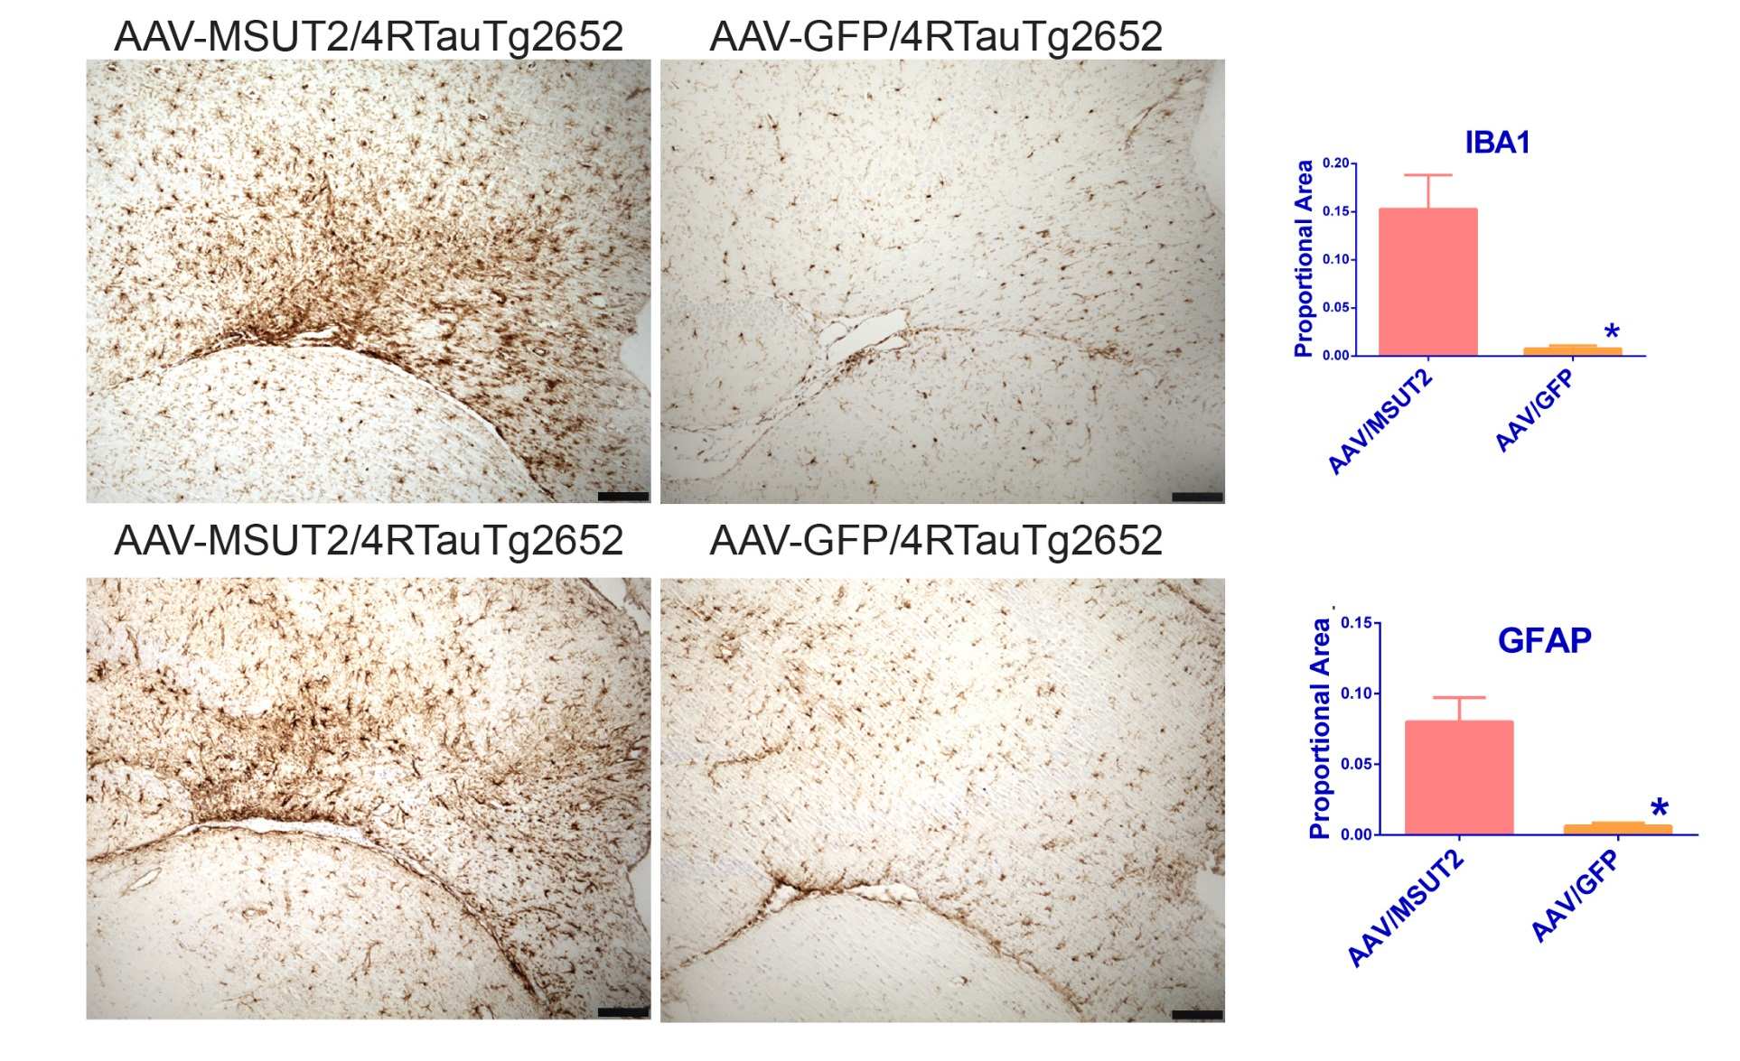
MSUT2 AAV injected mice have extensive neuroinflammatory changes
P=0.024
P=0.022
Hippocampus CA3 region, IBA1 stain for microglia; GFAP for astrocytes

Slide 28
MSUT2 overexpression and knockout have reciprocal consequences for tauopathy in tau Tg mice.
Loss of MSUT2 | MSUT2 Overexpression
Decreases pTau | Increases pTau
Reduces tau aggregates | Increases tau aggregates
Protects against neuron loss | Drives tau neuron loss
Decreases Neuroinflammation | Increases Neuroinflammation
Reduces cognitive deficits | ?
But what is MSUT2 molecular mechanism?

Slide 29
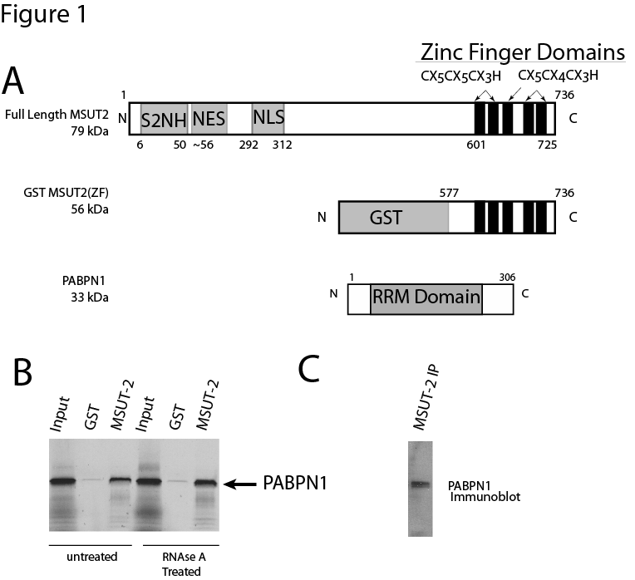
Molecular Function: MSUT2 binds to PABPN1
In press at Science Translational Medicine

Slide 30
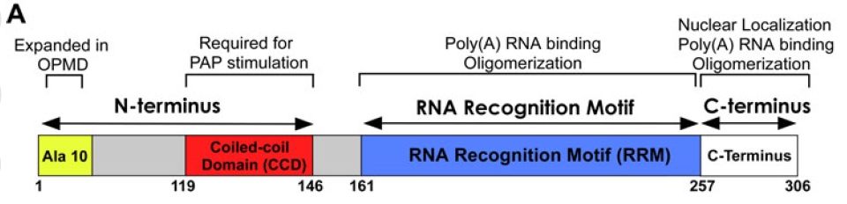
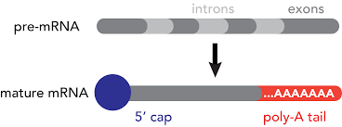
PABPN1
Poly(A) RNA Binding Protein- Nuclear 1
Responsible for proper maturation and export of mRNA to cytoplasm
  Recruits PolyA Polymerase to newly cleaved messages to extend polyA tail
  Controls polyA tail length in nucleus
  Forms reversible aggregates near nuclear speckles
  GCG repeat expansions cause Ocular Pharyngeal Muscular Dystrophy
    (dementia/tauopathy)
Banerjee, et al. 2003 PMID2361051

Slide 31
MSUT2 colocalizes with nuclear
poly(A) RNA
PolyA
MSUT2-PolyA Co-localization
In press at Science Translational Medicine

Slide 32
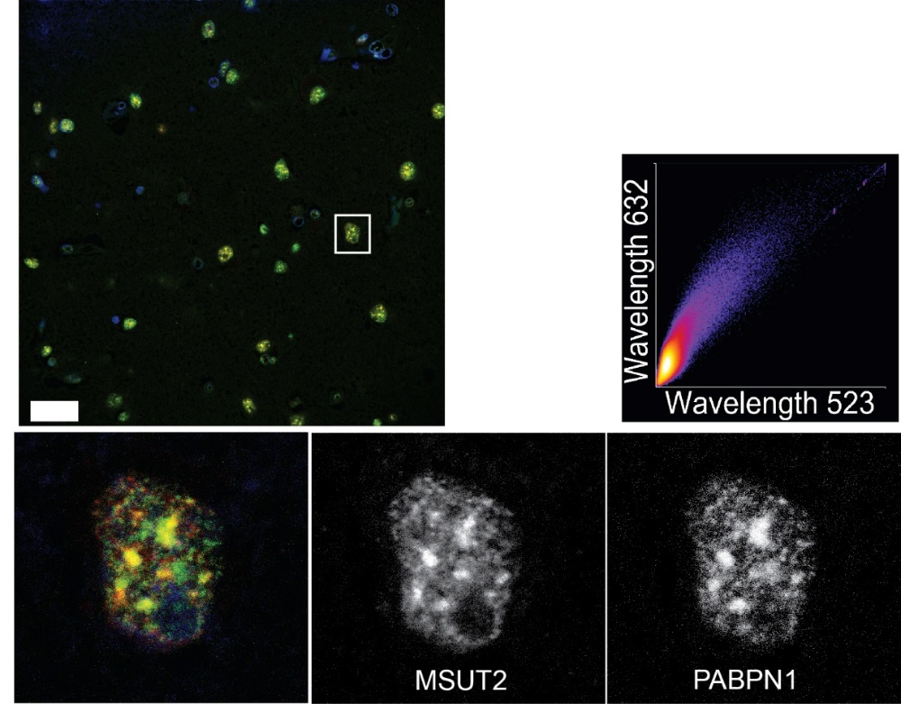
MSUT2 colocalizes with PABPN1
PABPN1+MSUT2 = PMC
MSUT2
CLC=0.88
PABPN1
Proximity
Ligation Assay: PABPN1/MSUT2

Slide 33
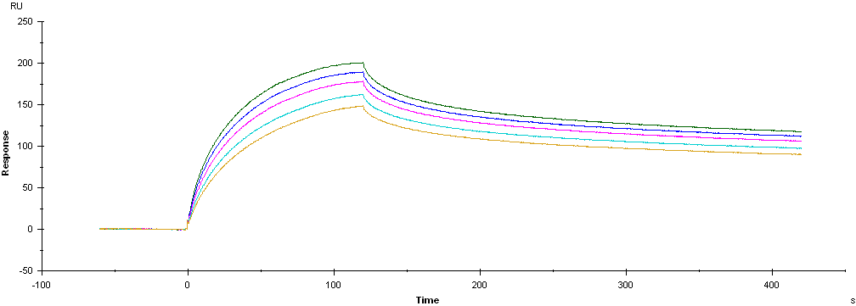
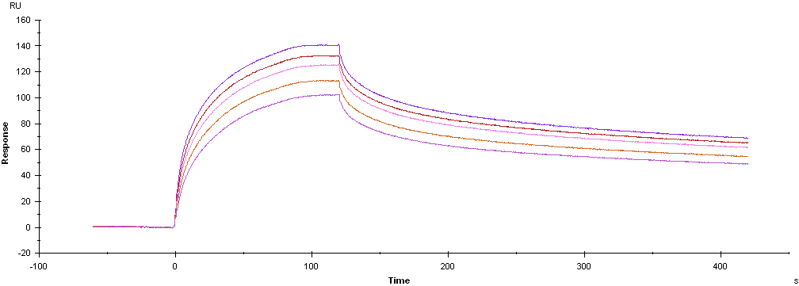
MSUT2 has high affinity for polyA RNA
MSUT2 K_{D}: 60 + 15 nM
(concentration range 0.6 to 1 uM)
PABPN1 K_{D}: 237 + 21 nM
(concentration range 0.6 to 1 uM)
In press at Science Translational Medicine

Slide 34
MSUT2 and PABPN1 exert reciprocal effects on p-tau accumulation
mock
MSUT2 siRNA
PABN1 siRNA
P-tau (AT180= pThr231)
MSUT2
In press at Science Translational Medicine

Slide 35
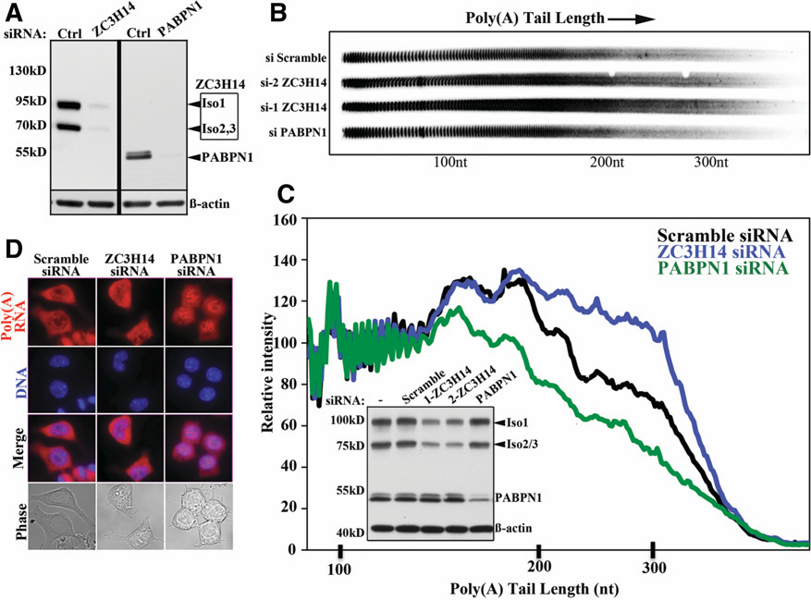
MSUT2 and PABPN1 exert reciprocal effects on mRNA polyA tail length
Kelly et al. 2014. RNA 20: 1-8
MSUT2 = ZC3H14

Slide 36
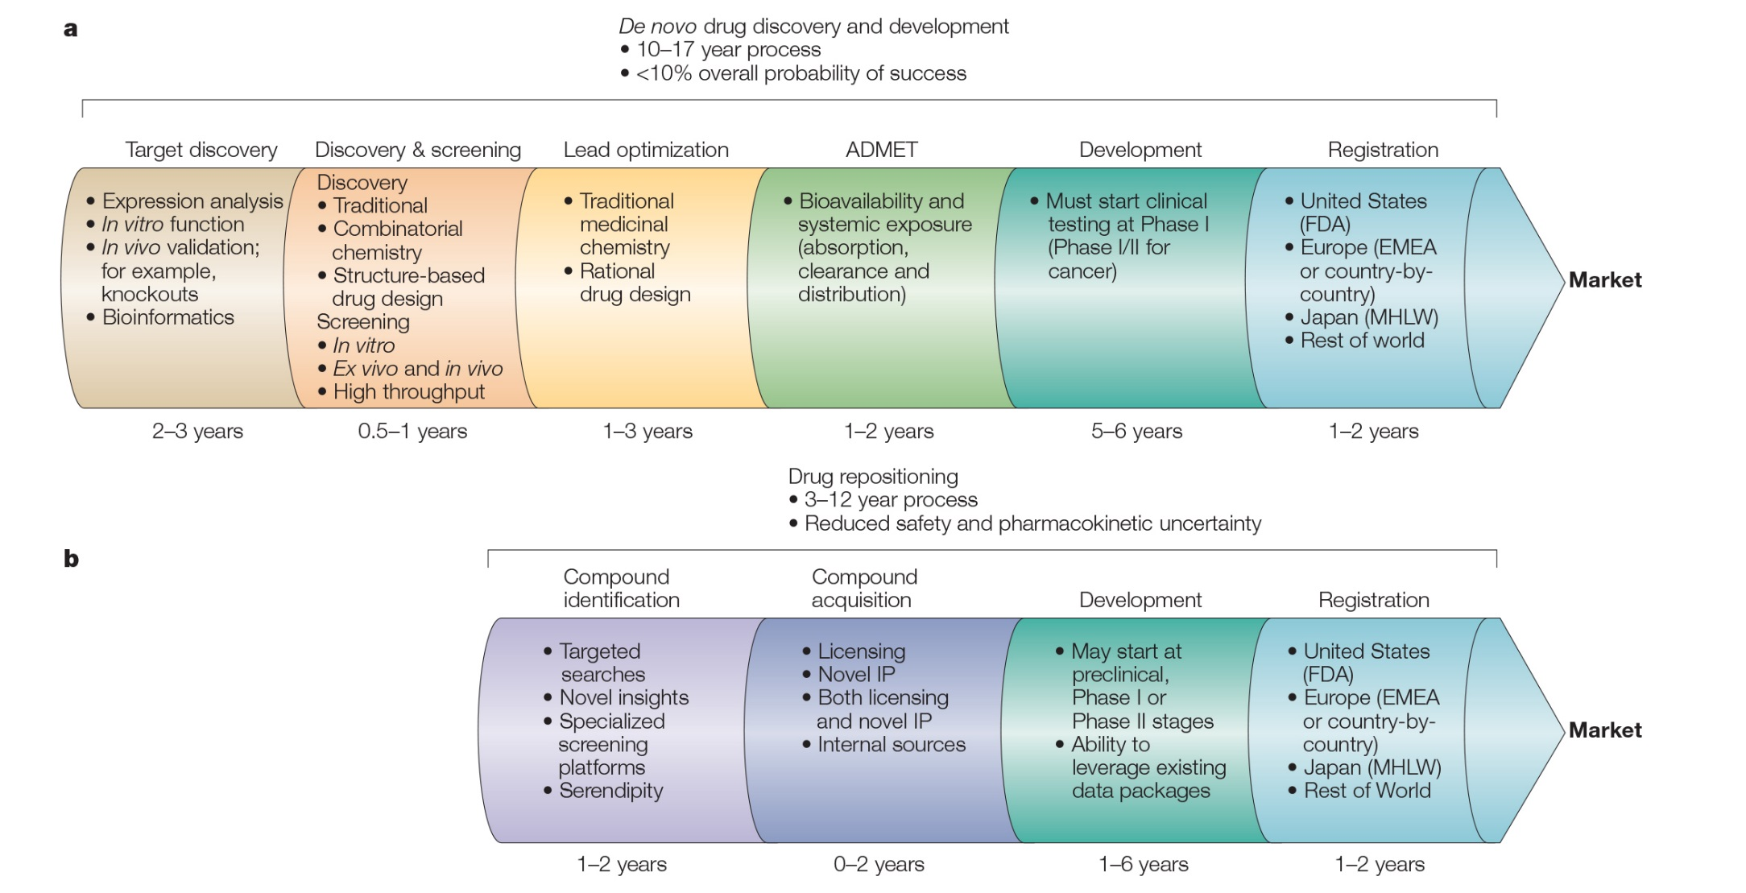
Is MSUT2 Druggable?
Can MSUT2 serve as a drug repurposing target?
Ashburn & Thor, NRDD

Slide 37
A Screen for Small molecule Inhibitors of MSUT2 RNA binding

Slide 38
1 2 3 4
5 6 7 8

Slide 39
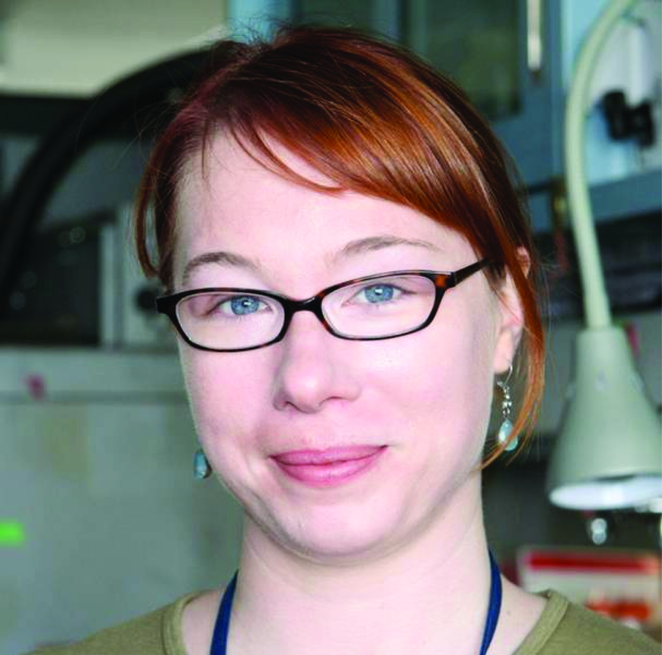



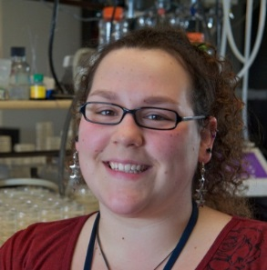

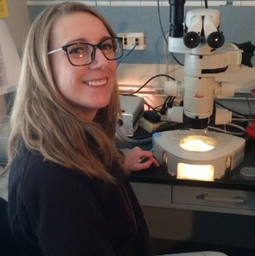

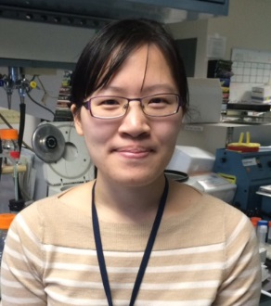

Acknowledgements
Jeanna
Wheeler
Jeremy
Baker
Elaine
Loomis
Sarah
Waldherr
Rebecca
Kow
Pam
McMillan
Nicki
Liachko
Ali
Saxton
Tim
Strovas
Sarah
Benbow
Research Funding:
Department of Veterans Affairs
National Institute on Aging
National Institute on Neurological Disease and Stroke
Collaborators:
Jerry Schellenberg
Tom Bird
Murray Raskind
Virginia Lee
John Trojanowski
Reagents:
Andrew Fire
Nick Kanaan
Peter Davies
C. elegans Genetics Center
Japanese Biorepository
KOMP
Human Tissue Specimens:
Dirk Keene
Not Pictured: Rikki Uhrich, Kelsey Price,
Aristide Black, and Misa Baum

Slide 40
Questions?

Slide 41

Science in Seattle!
Mt. Rainier
Kraemer Lab
UW Postdoc openings in the Kraemer Group
See https://apply.interfolio.com/69079
For details contact Brian:
kraemerb@uw.edu

Slide 44
In AD, some MSUT2+ neurons have tangles.
MSUT2
PABPN1 and AD
P-tau

Slide 45
PABPN1 and MSUT2 are co-depleted in some AD cases (low PMC)
Control AD, + AD, depleted
MSUT2
PABPN1
PABPN1+MSUT2 = PMC
Unpublished

Slide 46
AD cases with depletion of PMC have earlier age at AD onset
Age at onset 8.0 years earlier, Age at onset 10.8 years earlier,
p= 0.031 p= 0.0093

Slide 47
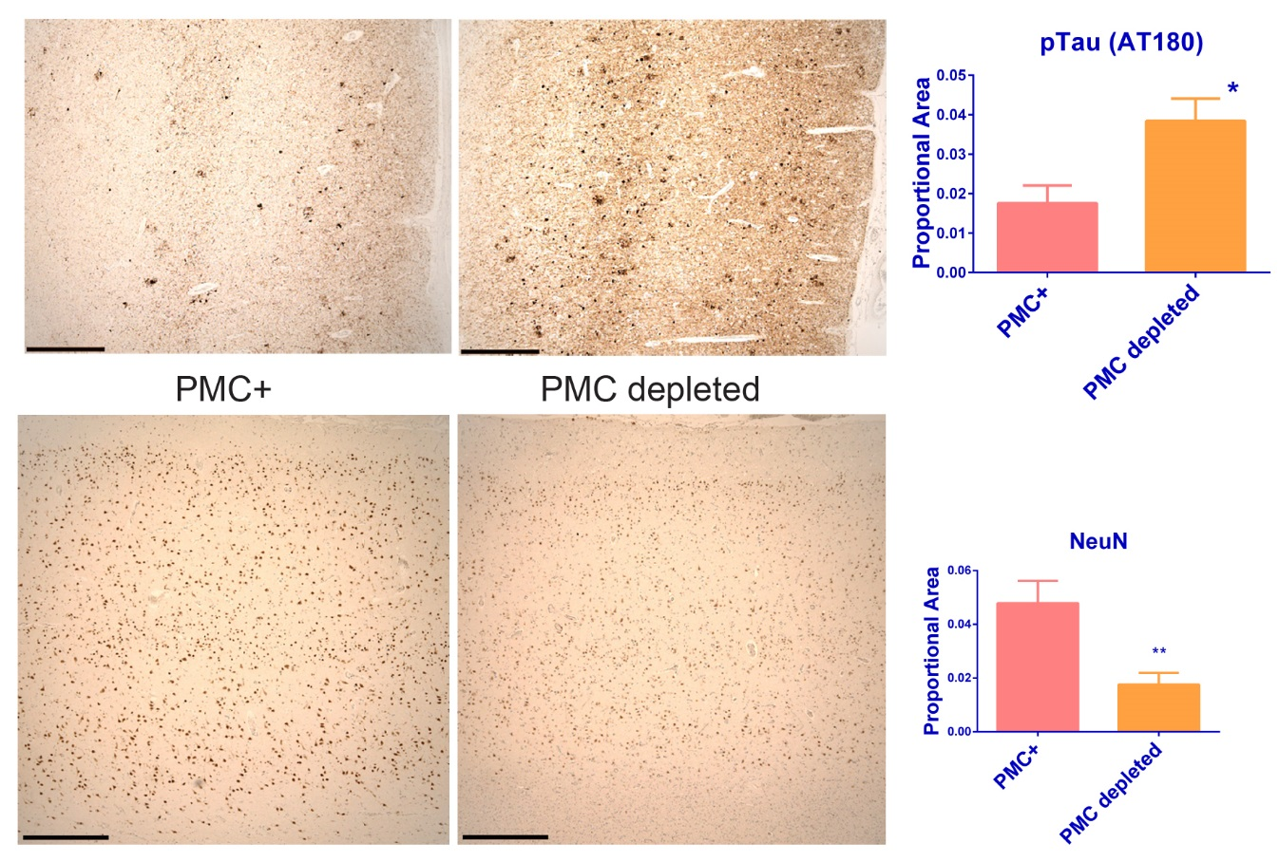
Alzheimer's cases with low PMC abundance have exacerbated neurofibrillary degeneration
AT180
NeuN

Slide 48
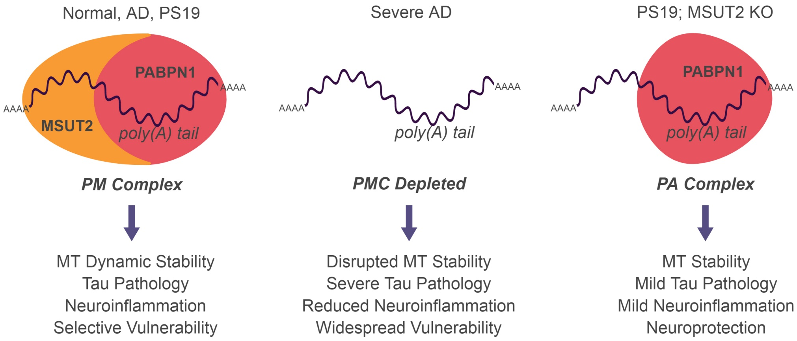
Polyadenylation machinery as a control point in tau mediated neurodegeneration
PABPN1+MSUT2 = PMC

