Slide 1



Complementary Strategies for Probing the Genetic Architecture of Disease and Biological Function
Philip L. De Jager, M.D. Ph.D.
Weil-Granat Professor of Neurology
Director, Center for Translational & Computational Neuroimmunology
Chief, Division of Neuroimmunology
Taub Institute on Alzheimer’s disease and the Aging Brain

Slide 2
Disclosures
Advisory Board: Roche, Biogen, Celgene, Neuroinflammation Newco
Investigator-initiated project support: Roche, Biogen
Grant support: NIA, Chan-Zuckerberg Initiative, Ludwig foundation

Slide 3
Genetic architecture of myeloid proteins: defining the regulatory architecture of AD genes

Slide 4
Do Alzheimer’s disease loci influence myeloid protein expression in trans?
CD33
TREM2
TREM1
?
PTK2B
NME8
Tested SNPs
AD susceptibility
CSF biomarkers
AD pathology endophenotypes
?
CD33
rs3865444^{C}
PTK2B
rs28834970^{C}
NME8
TREM2
TREM1
rs2718058^{A}
rs6910730^{G}
Chan et al Nat Neuro 2015

Slide 5
Do Alzheimer’s disease loci influence myeloid protein expression in trans?
23 AD-related genetic variants
Cytometric immunophenotyping of Peripheral Blood Mononuclear Cells from:
  ImmVar Project (n=113; mean age=32)
  Harvard Aging Brain Study (n=31; mean age=76)
MARKER | KNOWN FUNCTION
CD33 | Inhibitory receptor expressed by myeloid cells
TREM1 | Surface receptor on myeloid cells that ampliﬁes inflammatory responses (e.g. cytokine secretion)
TREM2 | Surface receptor on myeloid cells that has an anti-inflammatory role in the brain; involved in phagocytosis
TREML2 | Surface receptor on myeloid cells; function not as obvious
TYROBP | Transmembrane adaptor protein for TREM1 and TREM2
PTK2B | Tyrosine kinase required for normal macrophage polarization and migration towards sites of inflammation; regulates cytoskeleton rearrangement and cell spreading
NUP160 | Part of nuclear pore complex, which mediates nucleoplasmic transport (mRNA export)

Slide 6
AD trans pQTLs
Anti-CD33
antibody
TREM1/TREM2 ratio ↓
Full-length CD33 ↑
TREM2 ↑
TREM1 ↓
PTK2B ↑
NME8 ?
PTK2B mRNA ↑
NME8 mRNA ↑
Full-length CD33 mRNA ↑
TREM2 mRNA
TREM1 mRNA
TREM1
PTK2B
NME8
CD33
TREM2
rs2718058^{A}
rs3865444^{C}
rs6910730^{G}
rs28834970^{C}
AD risk ↑
AD risk ↑
Chan et al Nat Neuro 2015

Slide 7
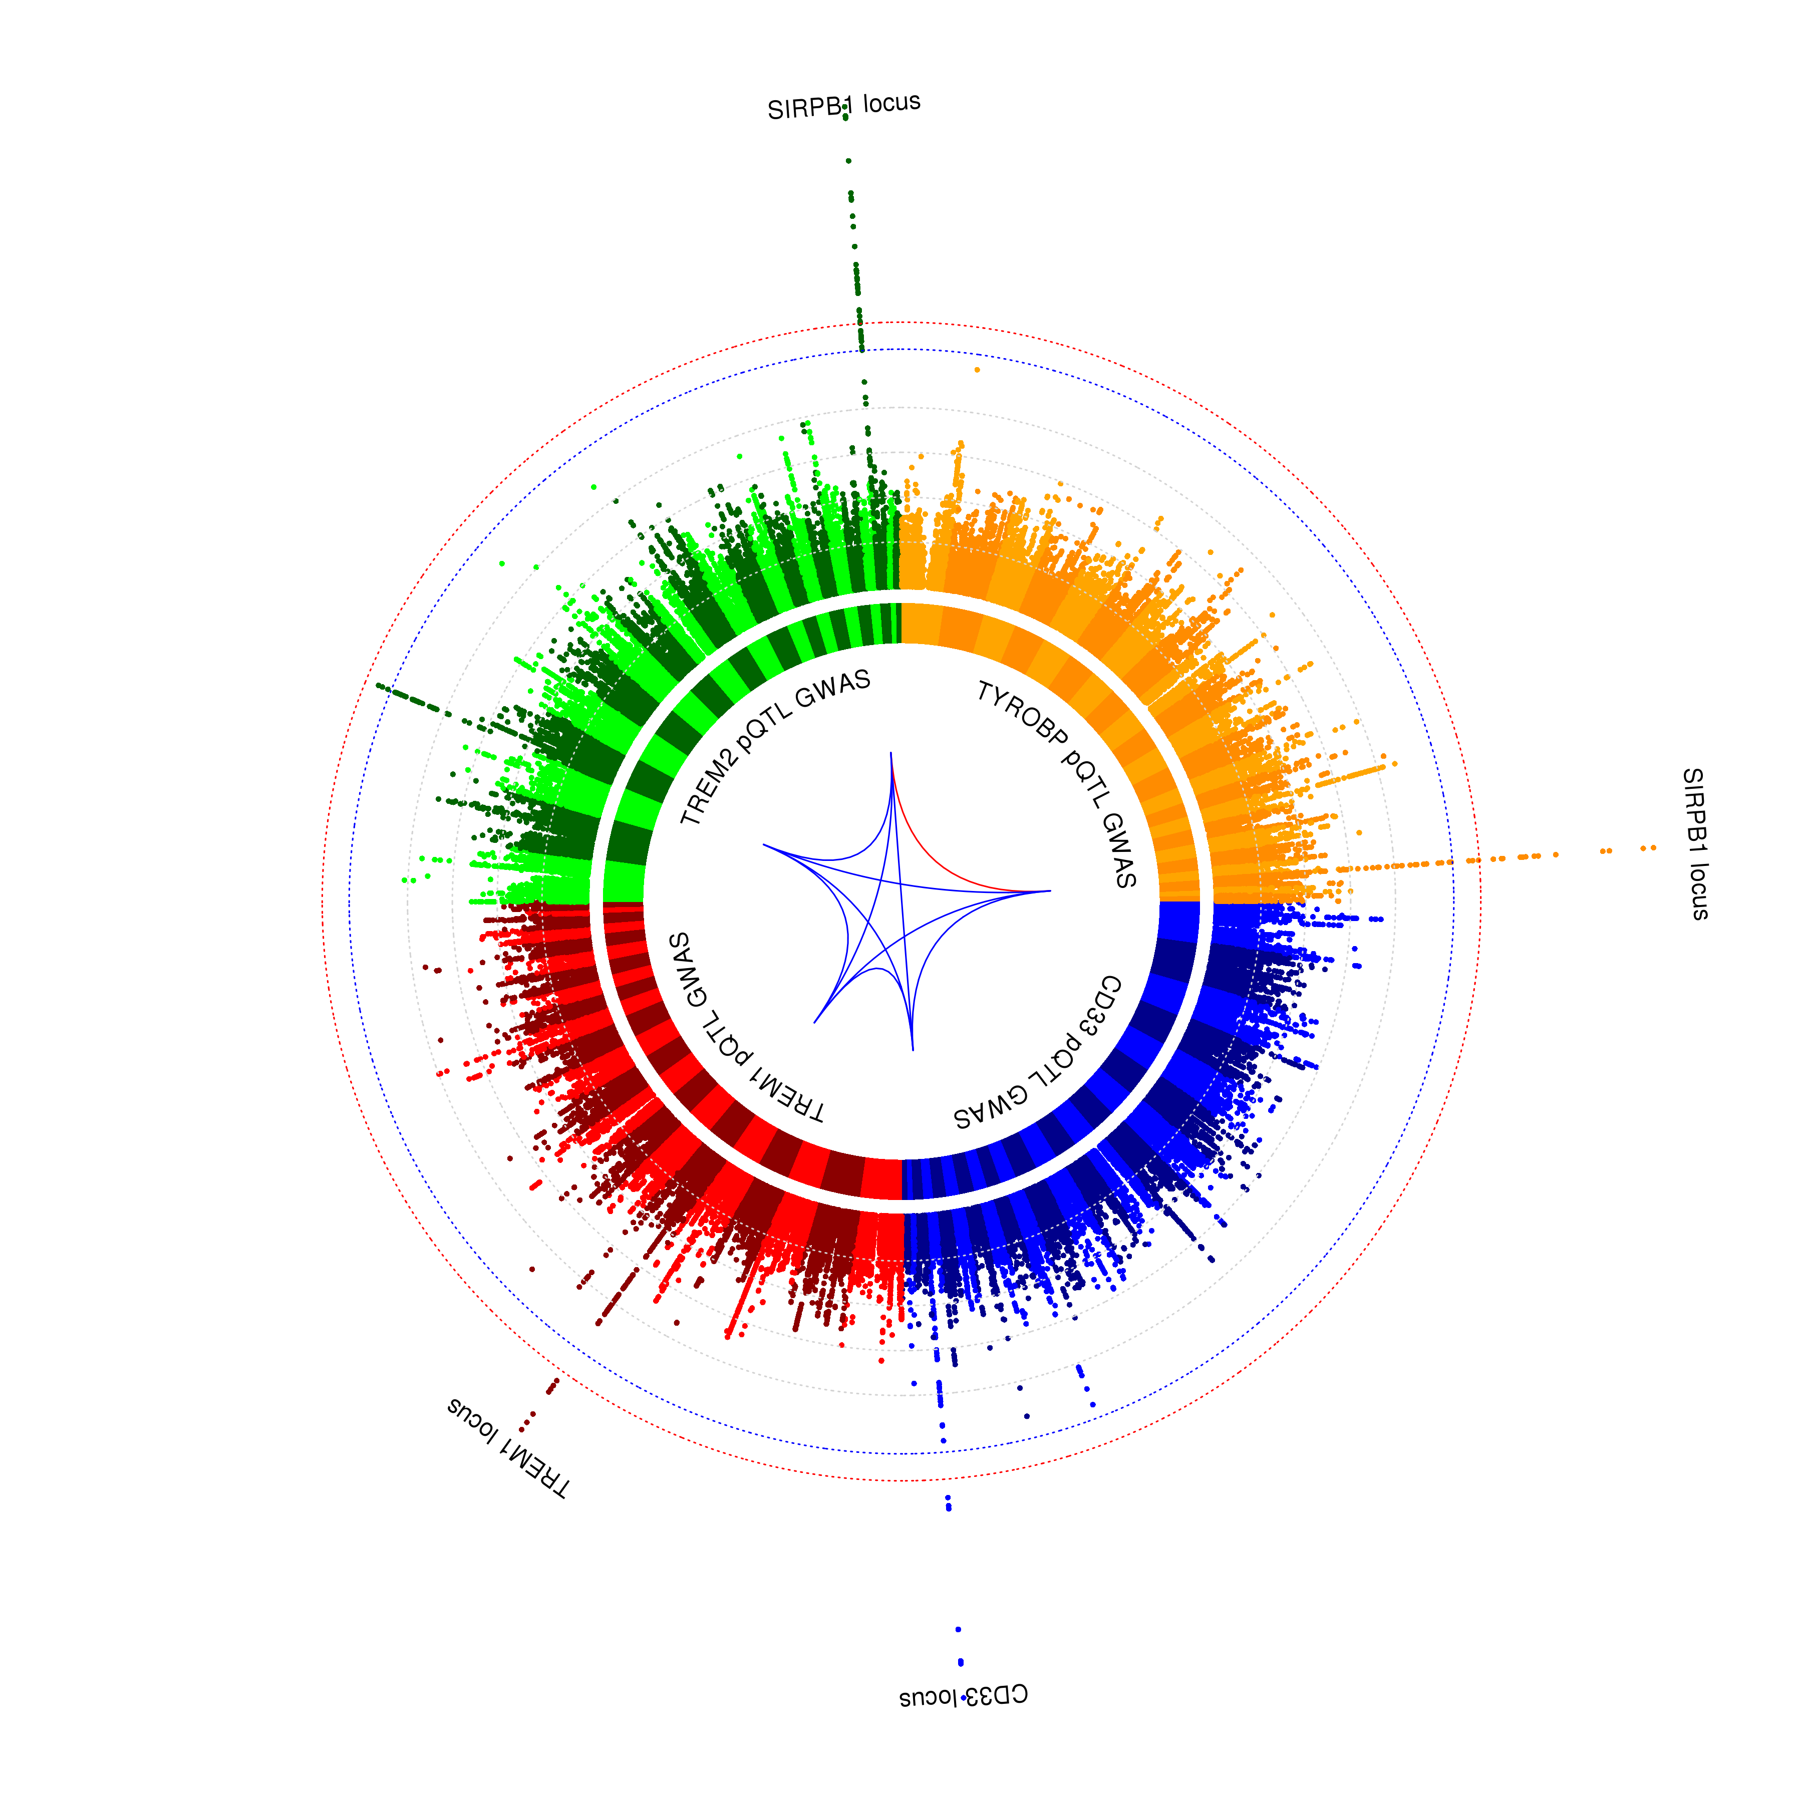
GWAS for 4 AD myeloid proteins
Four Manhattan plots of the protein QTL GWAS of the immune AD proteins in monocytes:
CD33 (blue)
TREM1 (red)
TREM2 (green)
TYROBP (orange)
226 subjects, PhenoGenetic (n=165) & HABS (n=61)
SIRPB1 locus influences both TREM2 and TYROBP expresssion

Slide 8
SIRPB1 locus
TYROBP: rs2453814 is the top SNP
TREM2: rs62623705 is the top SNP
TYROBP and TREM2 protein expression on monocytes are controlled by distinct SIRPB1 variants

Slide 9
Polygenic analysis
CD33
SIRPB1
TREM1
TREM2
TYROBP

Slide 10
SIRPB1 locus
A
rs2253814 influences SIRPB1 expression in monocyte-derived microglia-like cells
rs62623705 influences TREM2 in an independent collection of PD monocytes

Slide 11
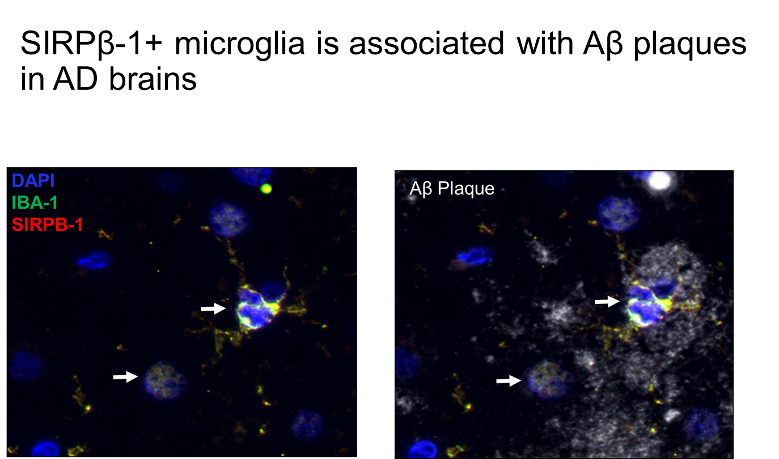
SIRPB1 locus influences phagocytosis

Slide 12
Knockdown of SIRPB1 affects TYROBP and TREM2
A
B
C
D
Lentivirus mediated shRNA triggered knockdown of SIRPB1 in healthy subjects causes reduction in beta amyloid uptake ability and lowers TREM2 and TYROBP expression in MDMi. A) SIRPB1. B) TREM2. C) TYROBP. D) Uptake

Slide 13
SIRPB1 as a regulator of TYROBP and TREM2
SIRP locus regulates the level of protein expression of TYROBP & TREM2 – mechanism remains to be dissected
SIRPB1 most likely culprit
Known to be involved in murine microglial phagocytosis in mice. Enhanced expression increases phagocytosis
SIRPB1 has a suggestive enrichment in rare AD variants in the ADSP discovery analysis. No replication.
SIRPB-1
TREM2
Aβ uptake
TYROBP
No change
SIRPB1 mRNA
Spice variant SIRPB1
TREM2 mRNA
SIRPB1
rs62623705 A_G
TREM2
rs2235814T_G

Slide 14
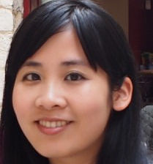
Proteomic dissection of BIN1 isoforms in AD
Mariko Taga, PhD

Slide 15
Structure of BIN1
20 Exons with 5 main domains: N-BAR; PI (phosphoinositide) binding module; CLAP (clathrin and AP2) binding domain; MBD (Myc-binding domain); SH3 (Src homology 3) domain.
N-Terminal
C-Terminal
Sense and induce Membrane curvature
Activation of BIN1 to induce membrane curvature
Endocytosis function
Regulation of c-Myc, a transcription factor regulating histone acetylation
Involved in downstream signaling protein recruitments

Slide 16
Identifying cell distribution of BIN1 exons
Andrea Crotti (Biogen)
BIN1 gene
Isoform 1
Isoform 2
Isoform 3
Isoform 4
Isoform 8
Isoform 12
Isoform 1
Isoform 4
Isoform 5
Isoform 6
Isoform 1
Isoform 2
Isoform 3
Isoform 5
Isoform 7

Slide 17

Targeted BIN1 peptide analysis
Vlad Petyuk, PhD
Astrocyte - Neurons
Astrocyte - Neurons - Microglia
Selected Reaction Monitoring (SRM) proteomics
Frozen tissue from dorsolateral prefrontal cortex (n=1377)
7 peptides were attributed to different domain of BIN1 protein
Association between peptide abundance and AD pathology

Slide 18
Dissecting pathologic association of BIN1 isoforms
The association of the alternatively spliced exon 7 of BIN1 with AD is primarily driven by tangles: reduced exon 7 with increasing tangle burden
Tangles
Adjusted for amyloid
Adjusted for tangles
Notes:
When we adjust for the burden of tangles, most of the association with amyloid is no longer significant, aside for the peptide that bridges exons 7 and 8, which is diminished by 49.2%

Slide 19
Resolving the affected cell type for the BIN1 exon association
Sense and induce Membrane curvature
BIN1 exon7 protein expression decreased in astrocytes
No change in neurons
Quantified with CellProfiler and CellProfiler Analyst (automatic segmentation of histological images and count the number of cells expressing each marker combination)

Slide 20
Summary
Broadening of molecular intermediate phenotypes to enable genetic screens for regulators of AD genes – SIRPB1
  Genetic dissection of molecular networks
Moving to the protein level – resolving proteoform associations for well-validated AD genes
  Independent effects of different sources of variation – genetic & non-genetic
  Dissect the most relevant domain of the target protein

Slide 21
Acknowledgements
Center for Translational & Computational Neuroimmunology
RUSH University
  David Bennett
  Chris Gaiteri
  Julie Schneider
  Lei Yu
De Jager lab
  Lien Beckers
  Claudiu Diaconu
  Seth Levin
  Yiyi Ma
  Zoe Pelly
  Kathryn Rimmer
  Tina Roostaei
  Hanane Touil
  John Tuddenham
  Charles White
  Hyun-Sik Yang
Bradshaw lab
Elyaman lab
PNNL
Vlad Petyuk
Klein lab
Menon lab
UBC
Sara Mostafavi
Bernard Ng
Olah lab
Sher lab
BWH
Tracy Young-Pearse
Broad Institute
Aviv Regev
Naomi Habib
Taga lab
Columbia MS Center
  Claire Riley
  Vicky Leavitt
  Libby Levine
  Rebecca Farber
  Wendy Vargas
Funding Sources
  NIH: NIA, NIGMS, NINDS
  Thompson Foundation (TAME- AD)
  Ludwig Foundation
  National MS Society
  Biogen, Eisai, Sanofi/Genzyme, UCB, Lundbeck, Genentech, Roche

Slide 22

The Center for Translational & Computational Neuroimmunology
&
Multiple Sclerosis Center
Transforming the management of neuroimmunologic function in neurodegenerative diseases

