Slide 1
How can we best use Alzheimer’s Disease genetics in drug discovery?
David A Collier PhD
Basavraj Hooli PhD, Michael Hutton PhD, Ron DeMattos PhD, Yushi Lui PhD, Yupeng Li PhD, Suchira Bose PhD, Neil Pearson, PhD, Brian Eastwood PhD, Emma Laing PhD
Eli Lilly and Company
12/11/2019

Slide 2
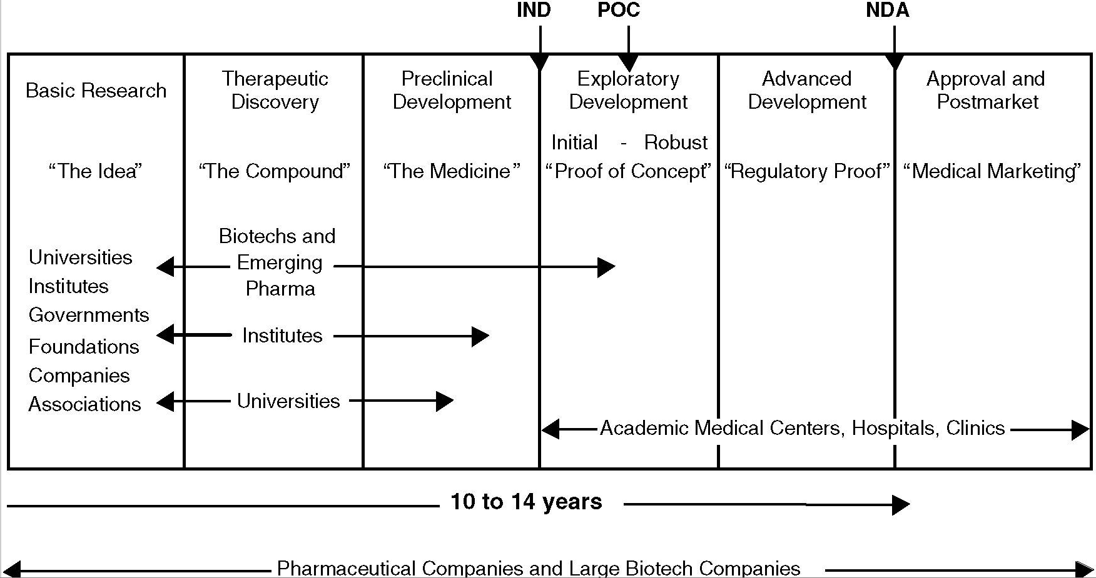
The drug development process

Slide 3
Plan
Eli Lilly Research and Development focus
Neurodegeneration pipeline
Disease modification strategy in AD
Amyloid plaque clearance therapy
Tangle (NFT) pathology “spreading” therapy
External partnerships: IMI2 “IMPRIND”
What we think is a good drug target and how genetics can inform this
GWAS, neuroimmunology and the IMI2 project “PHAGO”
Pathways, networks and the Accelerating Medicines Partnership for AD (2.0)

Slide 4



Research and development focus
Therapeutic Area Focus
Neurodegeneration
Diabetes
Oncology
Immunology
Pain
Increased access to external innovation
Getting medicines
to patients faster
Greater
value/benefit

Slide 5
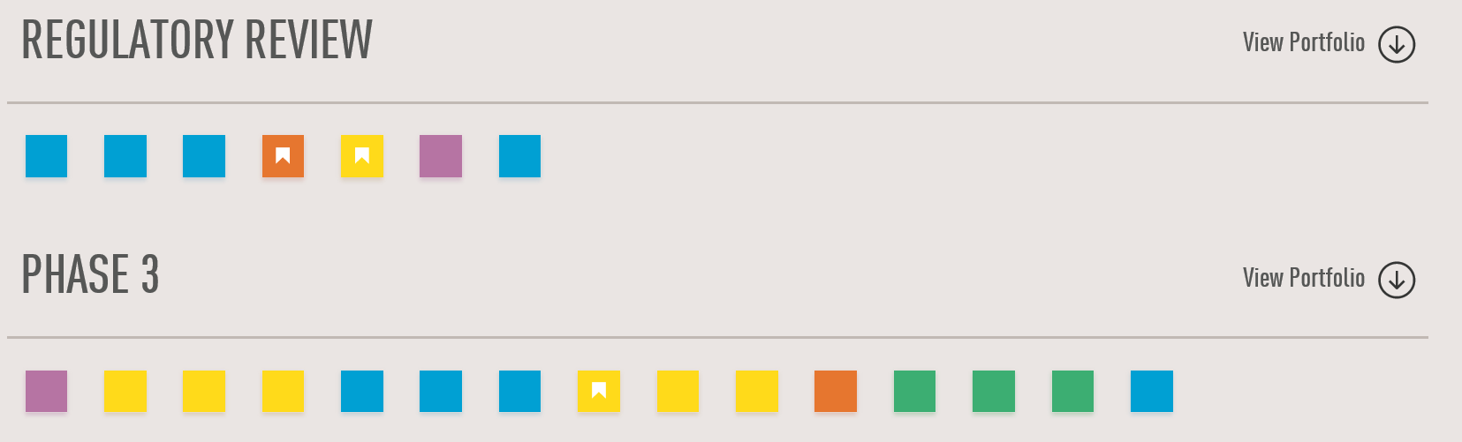
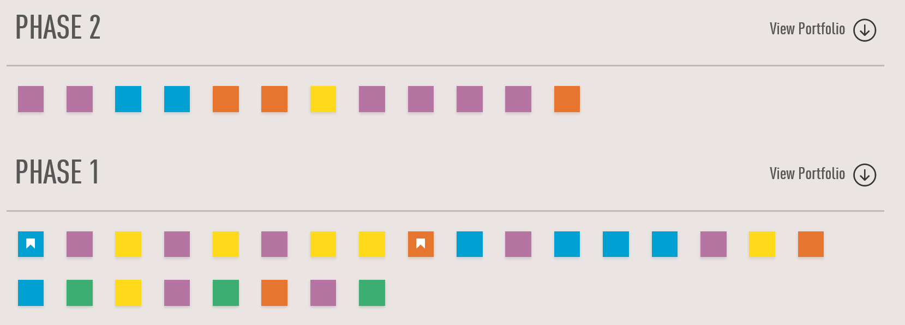
Lilly pipeline

Slide 6
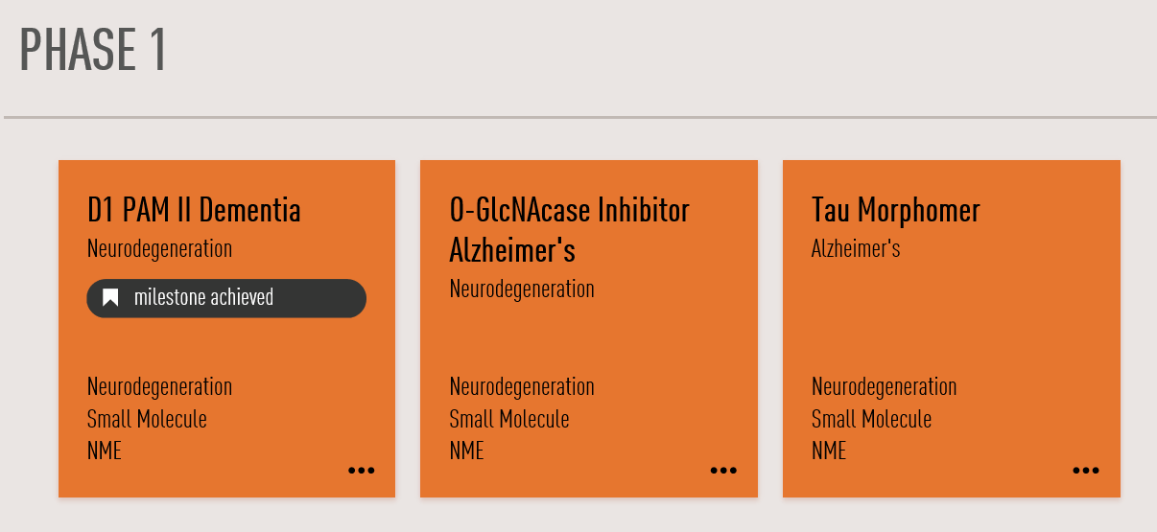
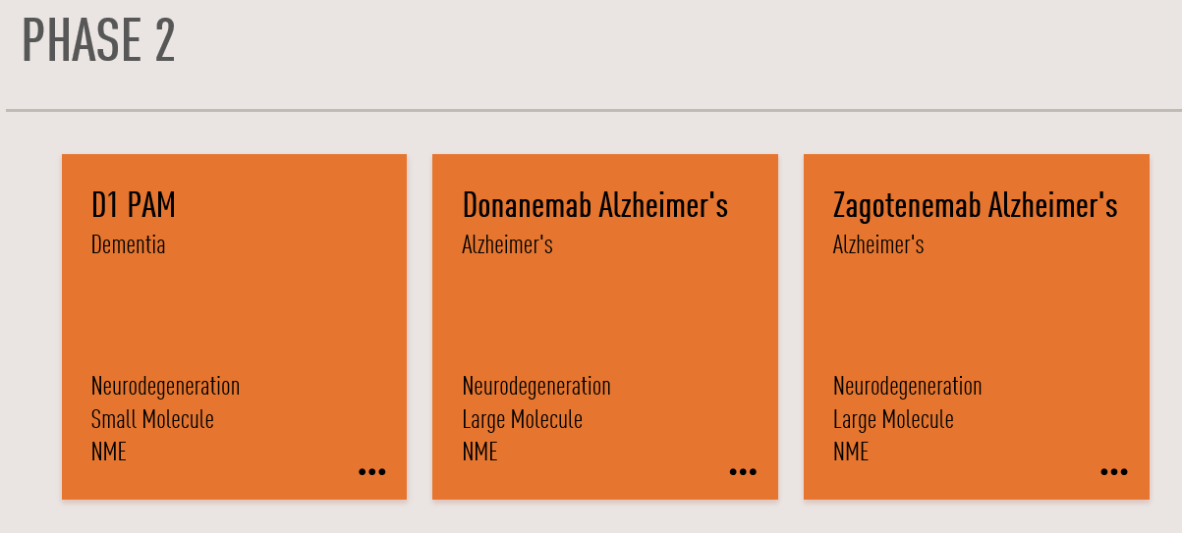
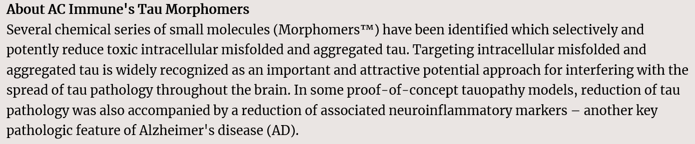
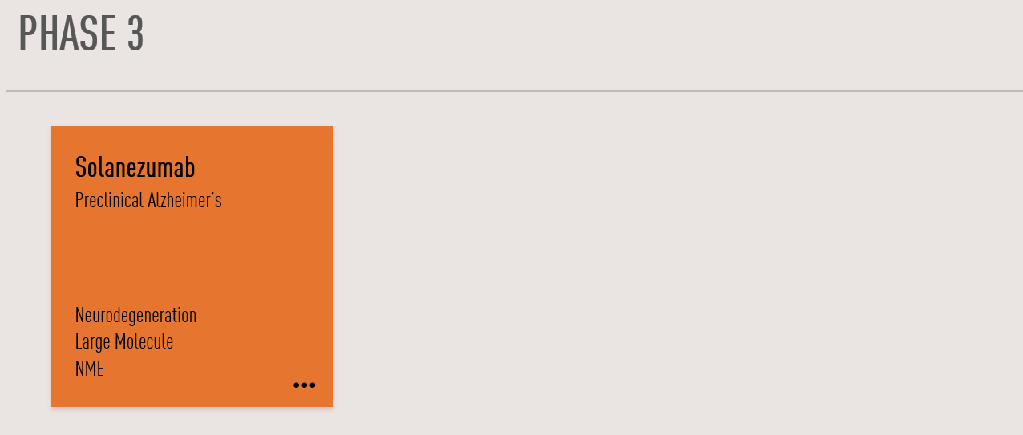
Lilly neurodegeneration

Slide 7
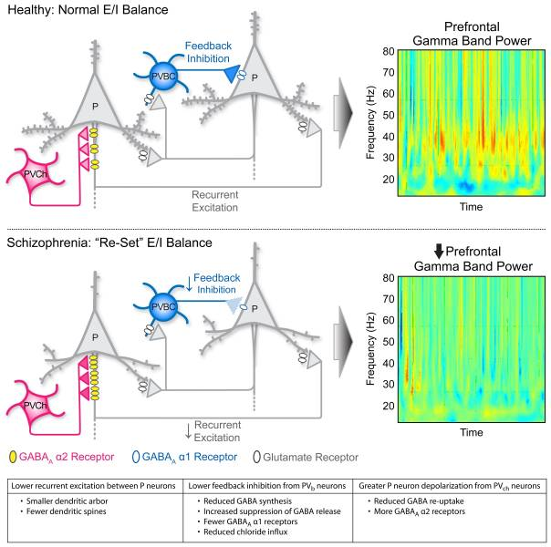
Disease Modification
Targeting multiple stages in the disease cascade
APP
β-amyloid deposits
Tau therapies
Anti-Tau mAb
Small Molecule approaches
Tau ASOs
BACE1
Aβ42
monomers
Oligomers
BACE inhibitors
Production
of Aβ
Tau pathology
Neuronal dysfunction and clinical symptoms
γ-secretase
Have not shown clinical benefit in Phase 3 in Alz Dis
Anti-Aβ mAb:
Soluble Aβ
solanezumab
Anti-Aβ mAb:
Deposited β-amyloid
Aducanumab, BAN0241, N3pG mAb (Lilly)
Inflammation
Excitotoxicity
Symptom relief
Aβ Clearance
mechanisms
Promising early stage trial clinical outcomes in Alz Dis
Copyright © 2018 Eli Lilly and Company
8

Slide 8
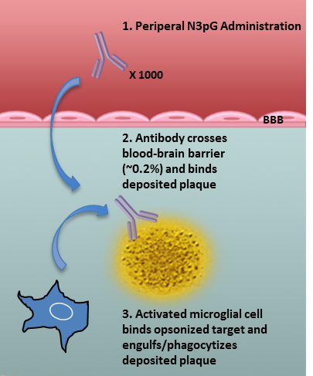
Anti-N3pG Aβ mAb drives Amyloid Plaque Clearance (Phase 2)
Amyloid PET change by dose level in Phase 1b study (donanemab)
N3pG mAb mechanism of action
Rapid Clearance of Amyloid after N3pG Antibody Treatment
Placebo
10mg/kg Single Dose
20mg/kg Single Dose
10mg/kg Q4W
20mg/kg Q4W

Slide 9
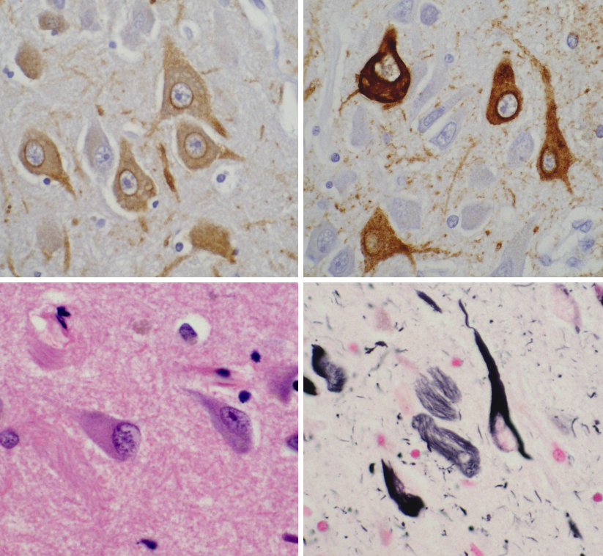
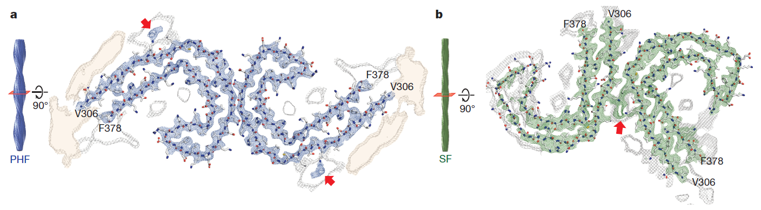
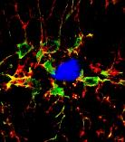
Neurodegeneration: Focus is on disease modification (AD, PD and related conditions linked to protein misfolding)
Misfolded proteins
β-amyloid, tau, synuclein, TDP-43
1. Aggregation and Spreading 2. Proteostasis
3. Neuroinflammation
Modify microglia and astrocyte activation to enhance neuroprotection and reduce chronic inflammation
Inhibit the accumulation of misfolded, aggregated protein species in Alzheimer’s, Parkinson’s and related disorders
Symptomatics/plasticity: limited to D1 PAM development

Slide 10
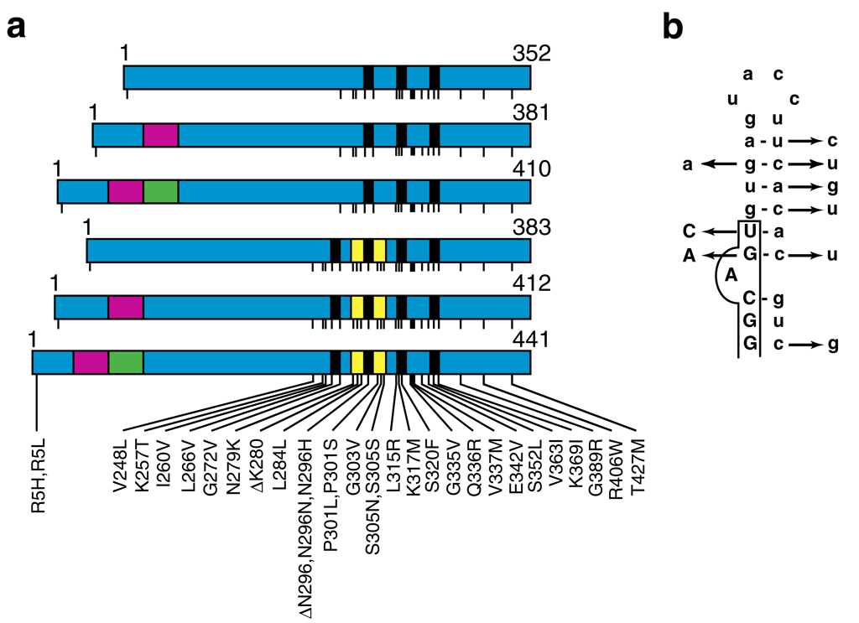
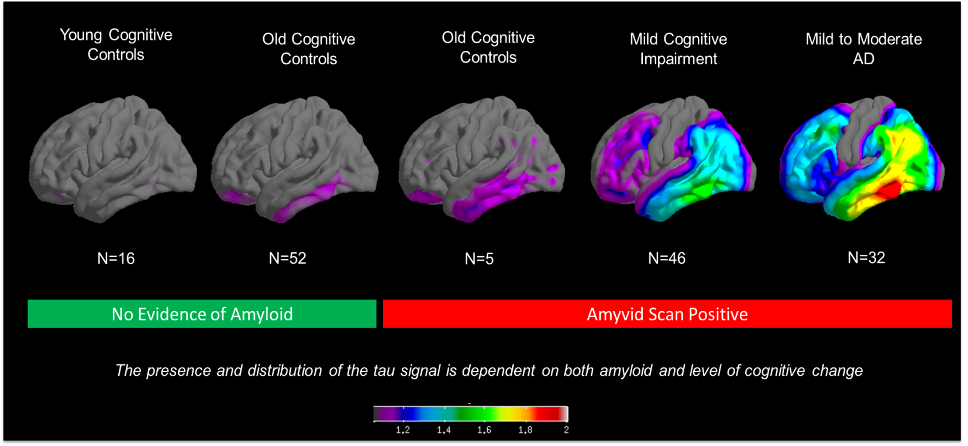
Tau pathology as a therapeutic target
Human genetic, neuropathological and neuroimaging evidence
1. Mutations in MAPT cause neurodegeneration
(Frontotemporal Dementia)
2. Tau pathology correlates with AD clinical progression (Flortaucipir)
Hutton et al, Nature 1998; Goedert, Mov. Disord 2005
β-Amyloid deposition does not correlate with neurodegeneration or clinical progression

Slide 11
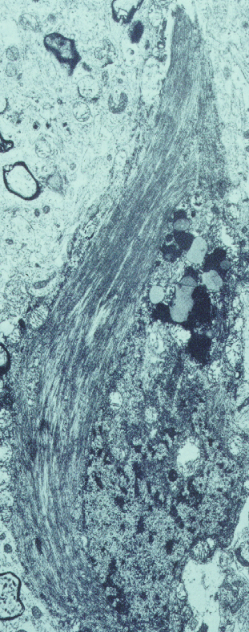
Tau-based therapeutics: Blocking the intracellular accumulation and transneuronal spread of aggregated tau
4. Spreading/propagation
Tau mAbs
Active tau vaccines
NEURON 2
+
.
.
.
.
.
P
.
.
.
.
.
.
.
.
.
.
.
P
.
.
.
.
.
P
.
.
P
.
.
.
.
.
.
.
.
.
.
.
P
.
.
.
.
.
.
.
.
.
.
.
.
.
.
.
.
.
.
P
.
.
.
P
P
.
P
1. Microtubule stabilizers
Epothilone D (BMS)
TPI-287 (UCSF, Phase 1)
NEURON 1
P
Fragmentation
...
P
...
+
...
.
.
P
.
P
.
P
.
.
.
.
.
.
.
.
.
P
.
.
...
P
.
.
.
.
.
.
.
.
.
.
.
.
.
.
.
.
.
.
.
.
.
.
P
.
.
...
.
.
.
.
.
.
.
.
.
...
P
.
.
...
.
.
.
.
.
P
P
.
.
.
.
.
.
...
.
.
.
.
.
P
.
.
.
.
.
P
.
.
P
.
.
.
.
.
.
...
.
...
.
.
.
.
P
.
.
.
.
.
.
.
.
.
.
.
.
.
.
.
...
P
.
...
P
Tau stabilizes
microtubules
Unbound
tau
Small tau
assemblies
Stable tau filaments
Tangles
2. Expression/Proteostasis
Tau ASOs (IONIS/Biogen)
Autophagy activators
USP14 (DUB) inhibitors
3. Misfolding/Aggregation
Tau aggregation inhibitors
O-GlcNAcase inhibitors
Kinase/phosphatase modulation
11

Slide 12
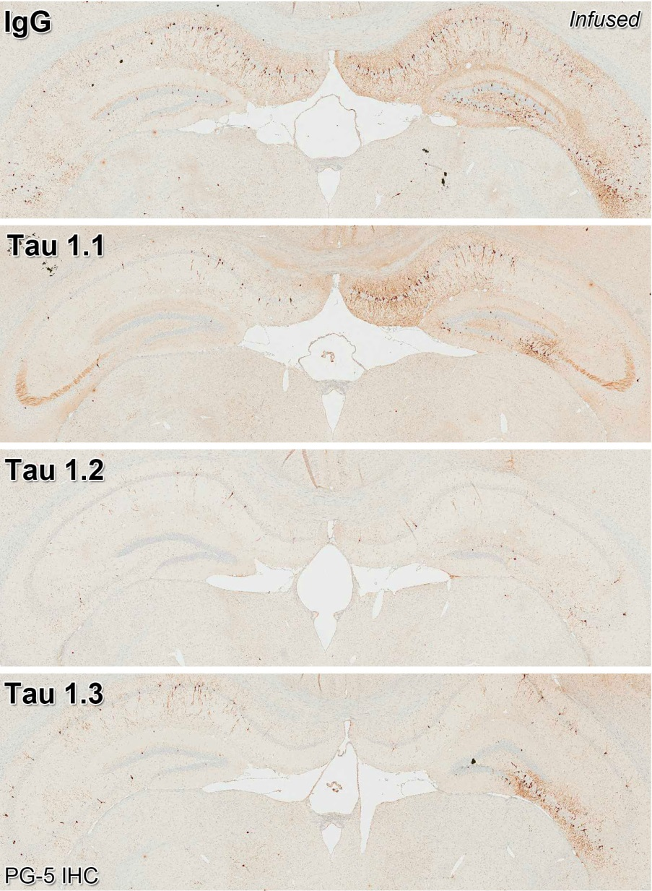
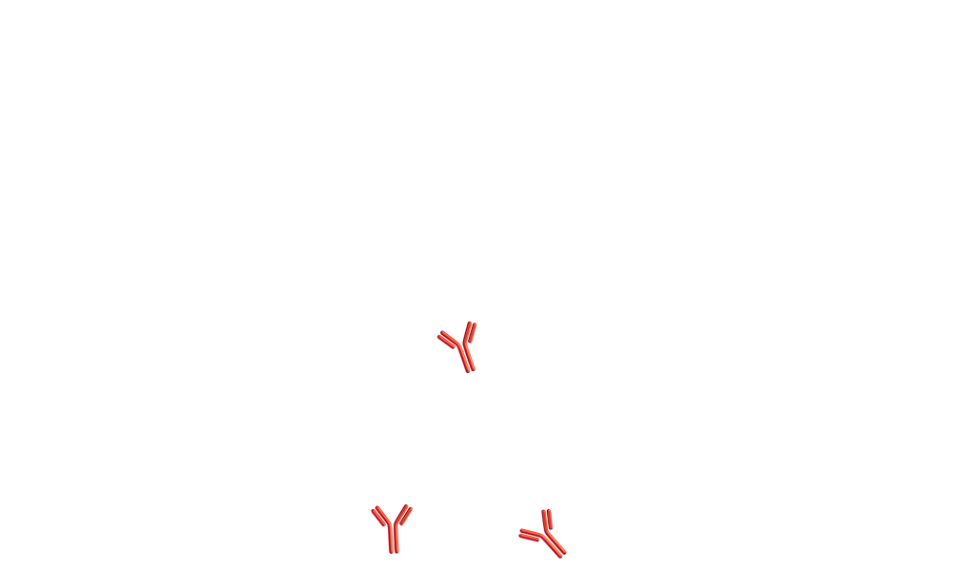
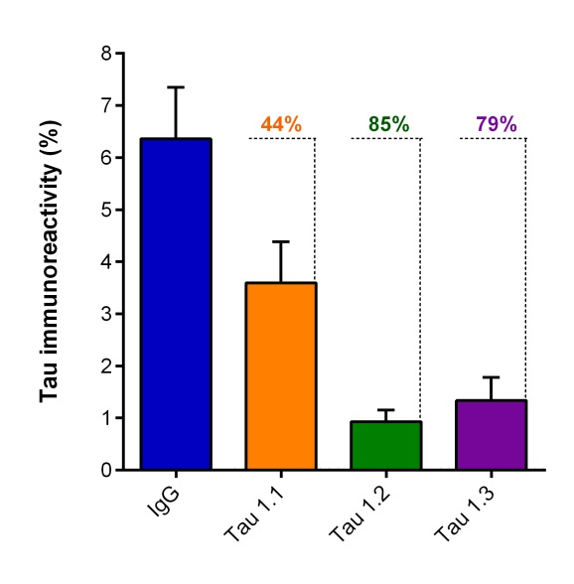
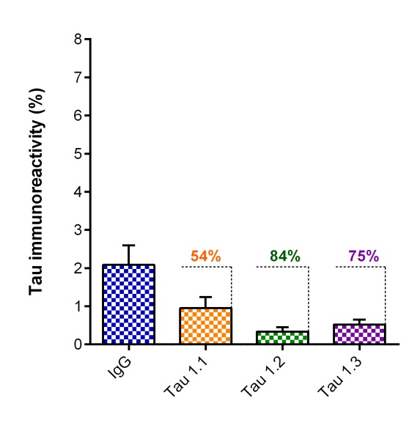
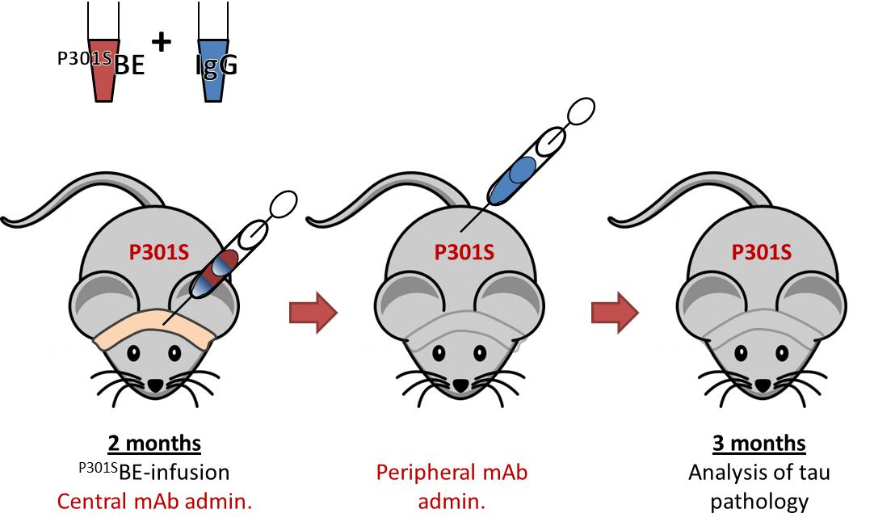
Tau Therapeutic antibodies can block Tangle (NFT) pathology “spreading”Phase 2 clinical trials (zagotenemab)
Soluble tau aggregates
Immunotherapy (passive)
Antibody Neutralization of Toxic Tau Spread
Neurofibrillary Tangle Bearing Neuron
Infused
Contralateral
Alam et al. 2017 https://www.alzheimersanddementia.com/article/S1552-5260(17)33143-6/pdf

Slide 13
External Partnerships are Critical
Collaborations complement all phases of our Alzheimer’s program
ACTIVITY | COLLABORATION
Target Identification and Preclinical Development | Dementia Consortium, AMP-AD: Identify new targets beyond current amyloid and tau focus. Albert Einstein College of Medicine: Tau therapeutic mAbs
Phase 2/3 Portfolio | AstraZeneca: Alliance to develop a novel BACE inhibitor
Disease Biomarker Discovery and Validation | ADNI and AMP-AD: Focused on delivering surrogate disease biomarkers Siemens: Acquired tau tracer program AV-1451
Secondary Prevention Trials | DIAN and A4: Solanezumab clinical studies in asymptomatic patients at high risk of developing AD
Clinical Trial Design and Implementation | IMI EPAD, CEOi GAP, CAMD: Clinical POC platform (EPAD/CEOi GAP) and improving Phase 3 efficiency (CEOi GAP/CAMD)
Environmental Evolution | IDEAS Consortium: Establish coverage of evidence of amyloid imaging GSA Consortium: Establish common tools for cognitive screening

Slide 14

IMPRiND: Inhibiting Misfolded Protein Propagation in Neurodegenerative Diseases
Aim: Identify druggable targets modulating misfolded proteins
Duration: March 2017 - February 2021
Budget: ~ 9.2 million Euros.
Project Coordinator: Professor George Tofaris, University of Oxford
Project Leader: Christiane Volbracht, Senior Scientist, Lundbeck A/S.
Lilly Lead - Suchira Bose
Blocking aggregate propagation in neurodegenerative diseases. IMPRiND – Inhibiting Misfolded protein Propagation In Neurodegenerative Diseases – is an international consortium that aims to map and target critical steps in the propagation of misfolded tau and α-synuclein, considered the main culprits of neurodegeneration in Alzheimer's and Parkinson's disease respectively.

Slide 15
IMPRiND: Inhibiting Misfolded Protein Propagation in Neurodegenerative Diseases
Seeds: Identify disease-relevant misfolded assemblies, imprint their biological properties in vitro and/or in cellulo and generate homogeneous populations in order to assay and interfere with their pathogenic effects.
Assays: Develop and miniaturise assays to monitor up-take, secretion, clearance and oligomerisation measure markers of early proteotoxicity that are suitable for high throughput or high content screens
Screens: Perform genetic screens based on disease-relevant gene/protein networks and assess druggability of identified targets.
Validation: Deliver robust validation assays for these molecular events in complex cellular systems with greater functional resemblance to the native milieu of the brain such as iPSC-based models and organotypic cultures
Translational models: Improve existing animal models in order to standardise pathological readouts for in vivo validation of modifiers, correlate them with novel markers to accelerate the assessment of therapeutic interventions and relevance to humans.

Slide 16
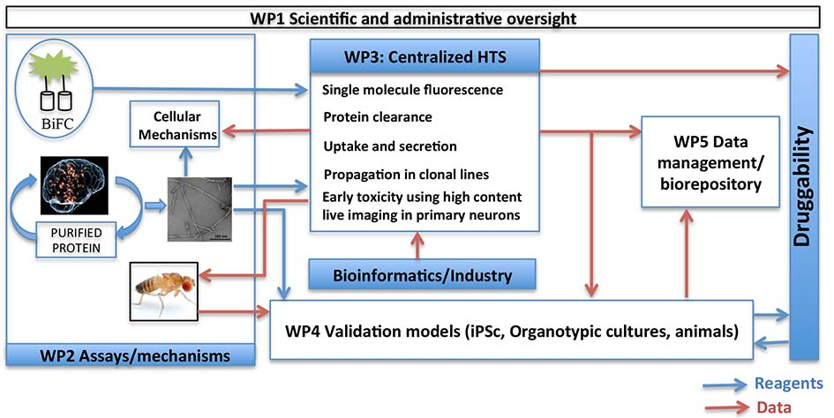
IMPRiND: Inhibiting Misfolded Protein Propagation in Neurodegenerative Diseases
Project Organisation
Year 1-2: Imprint and characterise human derived pathological syn/tau. Develop and miniaturize high-throughput assays
Year 2-3: Perform genetic screen informed by GWAS and Bioinformatics
Year2-4: Validate key screen hits in complex models (IPSc, slice culture, Tg models)

Slide 17






IMPRiND: Key WorkPackage Deliverables
WP2: Thomas Jahn (Abbvie) & Ronald Melki (CNRS)
Task 1: Characterize and amplify disease-relevant proteopathic assemblies.(CNRS, UCam, UOxf, LMB, HLU, Janssen, Lilly)
Task 2: Measure propagation of oligomeric or seed-competent assemblies (UMG-GOE, UOxf, LMB, HLU, Janssen, Lilly)
Task 3: Delineate mechanisms that regulate the clearance of misfolded α-synuclein and tau in neuronal cell lines (UOxf, BRFAA)
Task 4: Use high content imaging based on calcium and neurite length as a measure of early cellular dysfunction in response to α-synuclein or tau misfolding (UBX, AU, DZNE, Janssen, Abbvie)
WP3: Fiona Elwood (Novartis) & Peter Heutink (DZNE)
Task 1: Generate list of potential targets for high throughput cellular screening (DZNE, Novartis, Lilly)
Task 2: Miniaturize assays and generate focused genetic libraries (HLU, Novartis and corresponding WP2 participants)
Task 3: Perform focused genetic screens (HLU, Novartis)
Task 4: Initial assessment of toxicity, cellular response and druggability of hits (DZNE, HLU, Novartis, Dundee)
Task 5: Bioinformatics, annotation and data integration (DZNE, Lilly)
WP4: Esther Schenker(Servier) & Erwan Bezard (UBX)
Task 1: Select most appropriate in vitro and in vivo models for validation of newly identified targets: (UCAM, BRFAA, UBX, DZNE, CNRS, Janssen, Lilly)
  Establish complex in vitro models for a-synuclein and tau propagation (IPSc, slice culture, microfluidics)
  Establish and prioritize animal models for screen validation (includeng zebrafish and non-human primate model)
Task 2: Validate newly identified targets (UCAM, DZNE, UOxf,Janssen) Lentivirus overexpression or shRNA KD or compound treatment
Task 3: Establish novel markers of propagation (BRFAA, DZNE, AbbVie) In vivo microdialysis, ISF-derived tau, Neurofilament light chain levels etc

Slide 18
IMPRiND: Inhibiting Misfolded Protein Propagation in Neurodegenerative Diseases

Slide 19
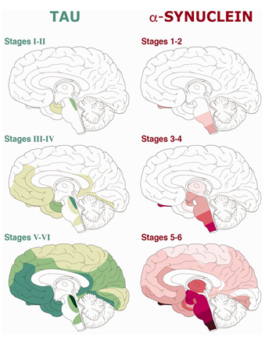
IMPRiND: Inhibiting Misfolded Protein Propagation in Neurodegenerative Diseases
Protein assemblies
Identified the most optimal method to isolate brain-derived tau assemblies from AD brains in collaboration at three sites, including quality control and quantification of tau assemblies for screening and validation platforms
Supply of well-characterized recombinant α-synuclein assemblies to facilitate testing, genetic screens and the development of validation models to all partners and successful amplification of brain-derived seeds in tissue from PD and MSA cases

Slide 20
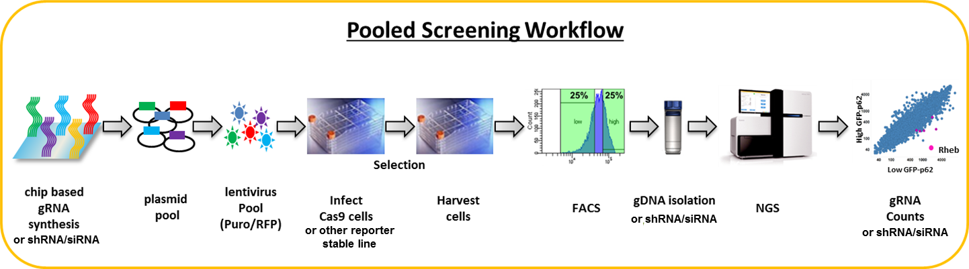
IMPRiND: Inhibiting Misfolded Protein Propagation in Neurodegenerative Diseases
Screens: α-syn
CRISPR screen in WT mCherry-SNCA SH-SY5Y cell lines using pre-formed α-syn fibrils (PFFs) (Lilly, Oxford, Novartis)
Targeted to ~1200 genes from genetics, proteostasis and α-syn interactome
Genome-wide screen now completed - analysis ongoing

Slide 21
IMPRiND: Inhibiting Misfolded Protein Propagation in Neurodegenerative Diseases
Screens: tau
CRISPR screen in P301S cell lines using P301S seed (Lilly, Novartis)
Targeted to ~1200 genes from genetics, proteostasis and tau interactome
Genome-wide screen also now completed - analysis ongoing
shRNA 300 pre-selected genes in wt rat neurons/AD seed (Novartis, DNZE)
100 prioritized hits in P301L Tg primary neurons with P310L seed, siRNA
VALIDATION – in vivo models

Slide 22
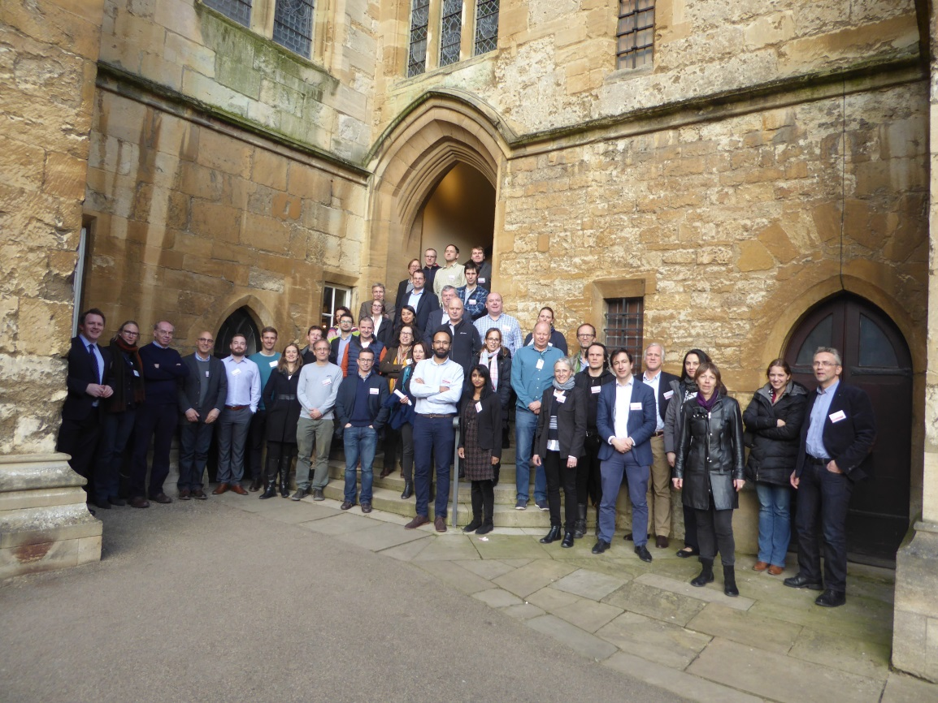
This project receives funding from the Innovative Medicines Initiative 2 Joint Undertaking (www.imi.europa.eu) under grant agreement No 116060. This Joint Undertaking receives support from the European Union’s Horizon 2020 research and innovation programme and EFPIA.
This work is supported by the Swiss State Secretariat for Education‚ Research and Innovation (SERI) under contract number 17.00038.
The opinions expressed and arguments employed herein do not necessarily reflect the official views of these funding bodies.

Slide 23
What makes a good drug target?
Human validation evidence
  Genetic association, functionally mapped to gene (with supporting genetic phenotypes)
  Consistent genomic association (expression, proteomic, eQTL, epigenetic)
  Specific or enriched in disease cells (e.g. brain, cell type)
  Disease module or pathway
  Temporal association with disease
  Genetic screens (in human cell system)
Therapeutic hypothesis
  Modality: agonist, antagonist, allosteric modulator, indirect modulation
  Disease stage: prevention, early, or later
  Expected clinical benefit

Slide 24
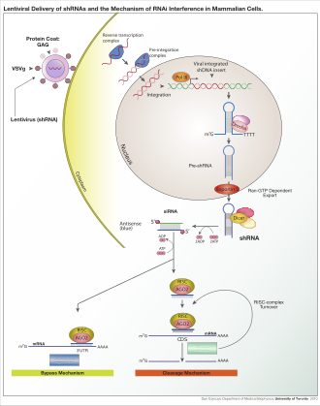
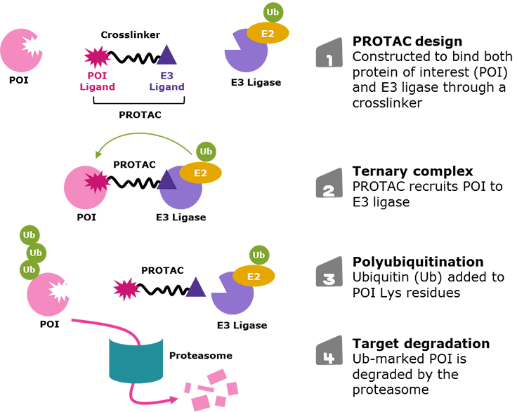
The drug development toolbox
Traditional modalities
  Small molecules
  Proteins and peptides
  Large molecules (antibodies)
New modalities
  RNAi
  ASO
  CRISPR
  Next generation peptides
  Targeted protein degradation (PROTAC)
Image: Sigma-Aldrich
Image: Wikipedia/U Toronto

Slide 25
Feasibility
Tractability
  Target qualification: Mechanistic understanding from model organisms
  Other proximal targets
  Assay, translational cellular and animal models, and SM, antibody or new modality druggability; tool molecules
  Biomarker: target engagement, pharmacodynamic, efficacy
  Path to Proof-of-concept
  Patient benefit and trial outcome measures
  Competitive landscape
Safety
  On target toxicity
  Mechanistic toxicity
  Therapeutic window

Slide 26
Genetics in drug development
Gene centric approaches
  Rare variant model: e.g. protective loss of function
  Allelic series: estimates from different types of disease associated variants from a single gene (e.g. rare and common alleles)
  Common disease associated variants (GWAS) with mapping and functional annotation
Integrative approaches
  Networks or pathways generated from genomic data (e.g. gene expression, proteomics, PPI) combined with genetic annotation, pathway and literature knowledge
Robert M. Plenge Priority index for human genetics and drug discovery
Nature Genetics volume 51, pages1073–1075(2019)

Slide 27
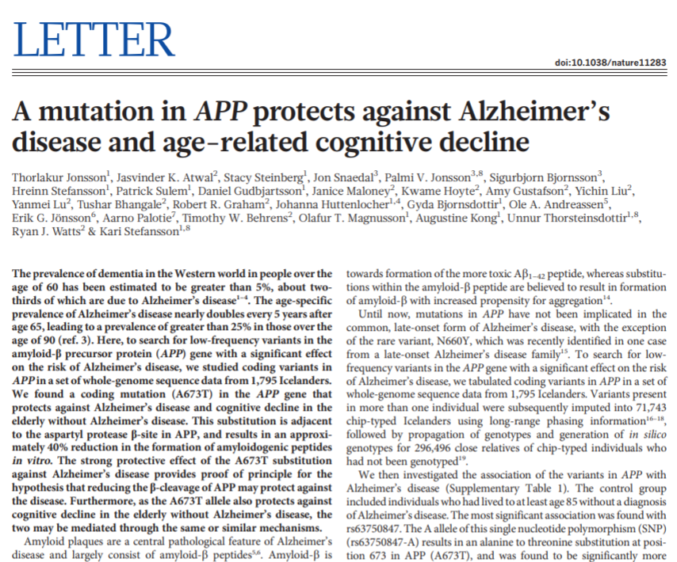
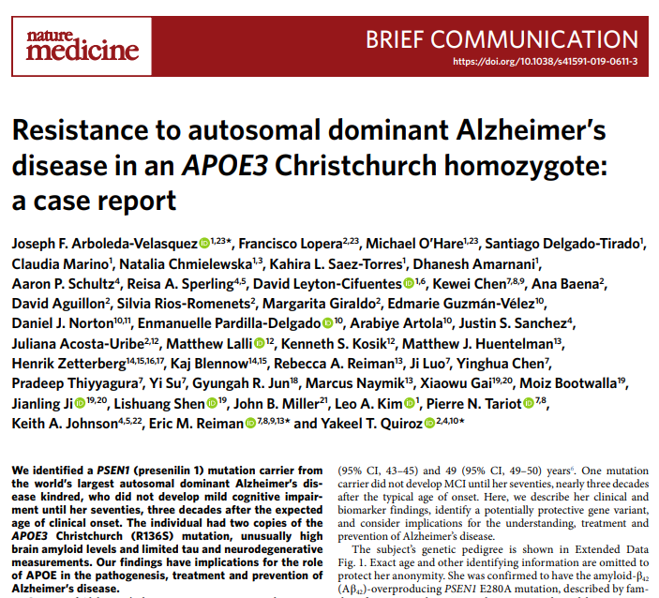
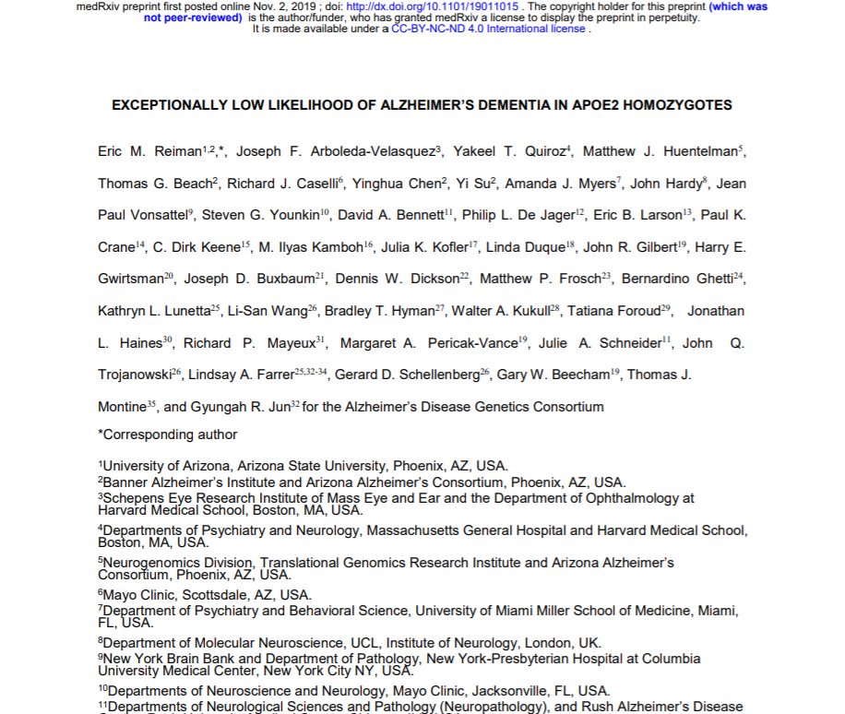
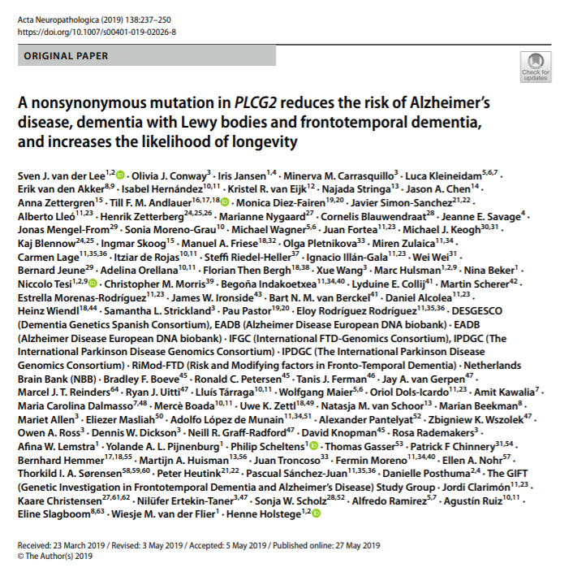
Protective genetic variants in Alzheimer’s disease

Slide 28
Is PLCG2 a drug target?
rs72824905-G (p.Pro522Arg) reduces risk of AD, DLB, FTD (AD: 0.57 [0.45-0.78]).
PLCG2 is expressed in microglia and peripheral immune cells
The p.Pro522Arg variant may weakly activates enzyme function, suggesting that activation of PLCG2 and not inhibition could be therapeutically beneficial in AD
Dominantly inherited autoinflammatory diseases with immunodeficiency (PLAID, APLAID) and Crohn’s disease caused by dominant, gain of function PLCG2 mutations
PLAID: spontaneous activation. APLAID: hypermorphic enzymatic activity
Magno, L et al. Alzheimer’s disease Phospholipase C-gamma-2 (PLCG2) protective variant is a functional hypermorph bioRxiv 409706; doi: https://doi.org/10.1101/409706
de Lange KM Genome-wide association study implicates immune activation of multiple integrin genes in inflammatory bowel disease. Nat Genet. 2017 Feb;49(2):256-261. doi: 10.1038/ng.3760. Epub 2017 Jan 9.
Zhou et al. 2012. A hypermorphic missense mutation in PLCG2, encoding phospholipase Cγ2, causes a dominantly inherited autoinflammatory disease with immunodeficiency. Am. J. Hum. Genet . 91:713.
Ombrello et al. N Engl J Med. 2012 Jan 26;366(4):330-8. doi: 10.1056/NEJMoa1102140. Cold urticaria, immunodeficiency, and autoimmunity related to PLCG2 deletions.
van der Lee et al. A nonsynonymous mutation in PLCG2 reduces the risk of Alzheimer's disease, dementia with Lewy bodies and frontotemporal dementia, and increases the likelihood of longevity. Acta Neuropathol. 2019 Aug;138(2):237-250. doi: 10.1007/s00401-019-02026-8.
Sims R, van der Lee SJ, Naj AC, Bellenguez C, Badarinarayan N, Jakobsdottir J et al (2017) Rare coding variants in PLCG2, ABI3, and TREM2 implicate microglial-mediated innate immunity in Alzheimer’s disease. Nat Genet 49:1373–1384. https://doi. org/10.1038/ng.3916

Slide 29
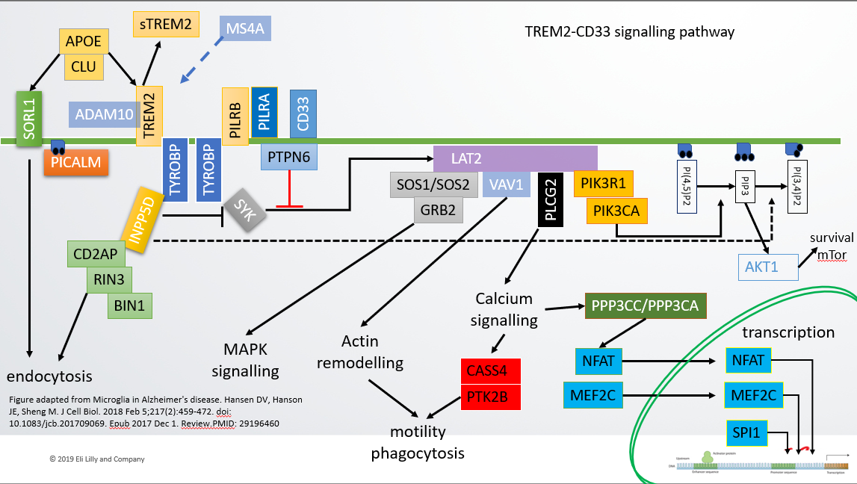
Feasibility: PLCG2
Human validation evidence
  Functional genetic association, expressed in microglia, disease module or pathway
Therapeutic hypothesis
  Modality: agonist, positive allosteric modulator
  Disease stage: prevention, early, or later?
  Expected clinical benefit?
Tractability
  Target qualification: Mechanistic understanding of biology/pathway from model organisms
  Other proximal targets we can explore
  Translational cellular and animal models, and assay
  SM, antibody or new modality druggability; tool molecules
Safety
  On target toxicity
  Therapeutic window

Slide 30
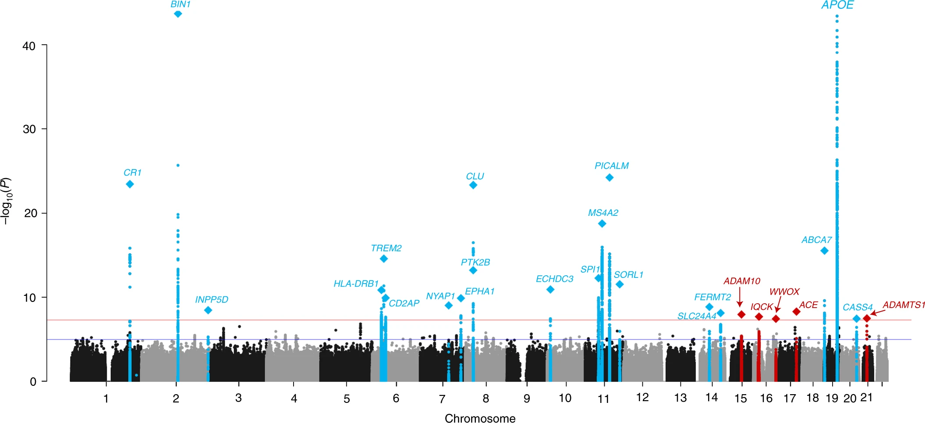
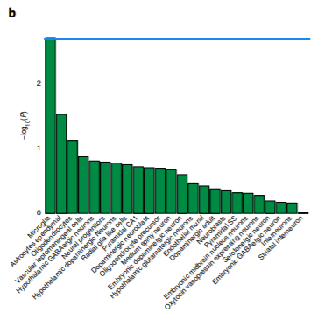
Alzheimer’s disease GWAS
Figure from Jansen Nature Genetics | VOL 51 | MARCH 2019 | 404–413 |
Kunkle BW Genetic meta-analysis of diagnosed Alzheimer's disease identifies new risk loci and implicates Aβ, tau, immunity and lipid processing. Nat Genet. 2019 Sep;51(9):1423-1424. doi: 10.1038/s41588-019-0495-7. PMID: 3141720

Slide 31
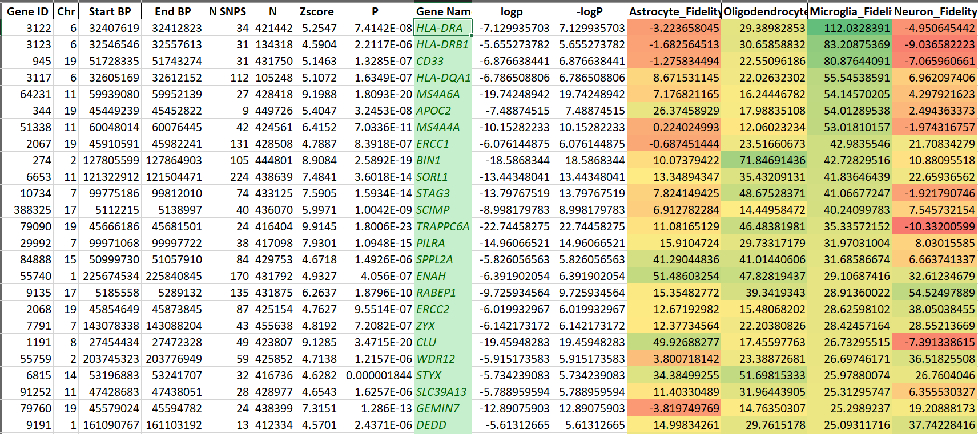
Gene association score vs microglial fidelity
MAGMA scores from Jansen: Nature Genetics | VOL 51 | MARCH 2019 | 404–413 |
Brain cell-type fidelity scores: Kelley KW, et al. Variation among intact tissue samples reveals the core transcriptional features of human CNS cell classes.Nat Neurosci. 2018 Sep;21(9):1171-1184. doi: 10.1038/s41593-018-0216-z.

Slide 32
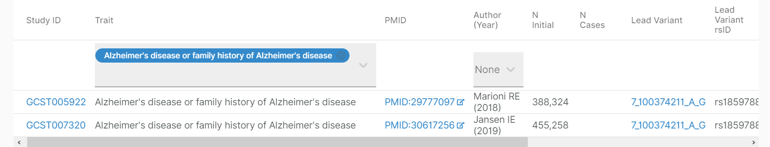
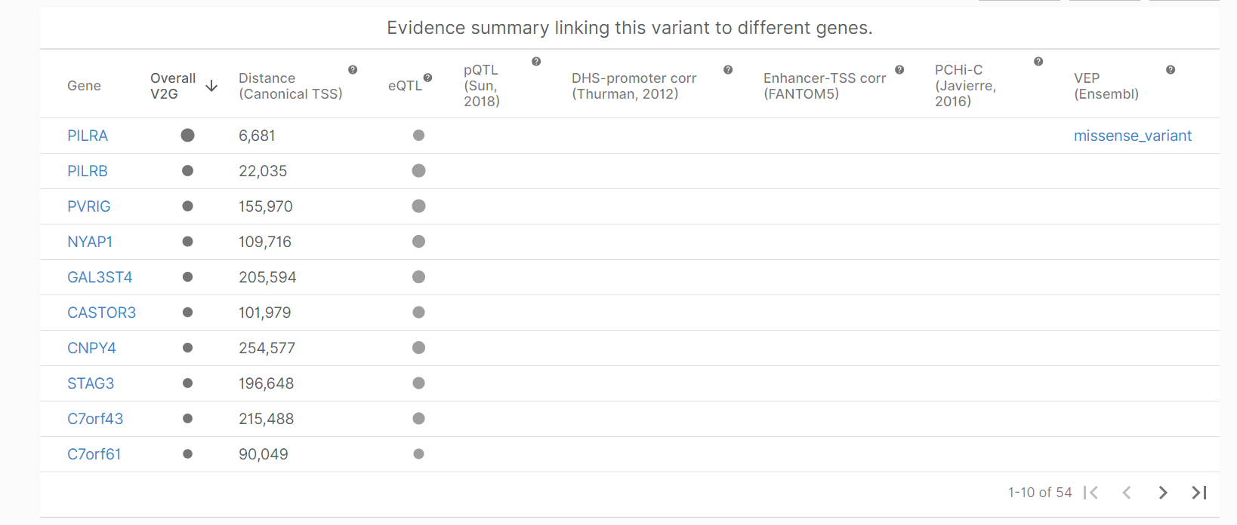

Which gene?
Amlie-Wolf A, et al. Inferring the Molecular Mechanisms of Noncoding Alzheimer's Disease-Associated Genetic Variants. J Alzheimers Dis. 2019;72(1):301-318. doi: 10.3233/JAD-190568.
Novikova, G et al. Integration of Alzheimer’s disease genetics and myeloid genomics reveals novel disease risk mechanisms bioRxiv 694281; doi: https://doi.org/10.1101/694281
FUMA GWAS: Functional Mapping and Annotation of Genome-Wide Association Studies https://fuma.ctglab.nl
MAGMA: Generalized gene-set analysis of GWAS data https://ctg.cncr.nl/software/magma
INFERNO: inferring the molecular mechanisms of noncoding genetic variants https://bitbucket.org/wanglab-upenn/INFERNO/

Slide 33
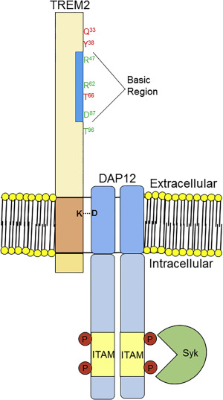
TREM2, CD33 and TYROBP in Alzheimer’s disease (2013)
Genome-wide association analysis reveals putative Alzheimer's disease susceptibility loci in addition to APOE. Bertram L, et al. Am J Hum Genet. 2008 Nov;83(5):623-32. doi: 10.1016/j.ajhg.2008.10.008. Epub 2008 Oct 30.
CD33 Alzheimer's disease locus: altered monocyte function and amyloid biology. Bradshaw EM, et al. Nat Neurosci. 2013 Jul;16(7):848-50. doi: 10.1038/nn.3435. Epub 2013 May 23.
Variant of TREM2 Associated with the Risk of Alzheimer’s Disease Thorlakur Jonsson, et al. N Engl J Med. N Engl J Med. 2013 Jan 10; 368(2): 107–116. Published online 2012 Nov 14. doi: 10.1056/NEJMoa1211103
TREM2 Variants in Alzheimer's Disease Rita Guerreiro, et al. N Engl J Med. 2013 Jan 10; 368(2): 117–127.
Integrated Systems Approach Identifies Genetic Nodes and Networks in Late-Onset Alzheimer’s Disease Bin Zhang, et al. Volume 153, Issue 3, 25
Figure: Ulrich et al., Elucidating the Role of TREM2 in Alzheimer’s Disease Neuron 94, ISSUE 2, P237-248,

Slide 34

sTREM2
MS4A
APOE
TREM2-CD33 signalling pathway
Genetic association
CLU
SORL1
ADAM10
TREM2
PILRB
PILRA
CD33
PICALM
PTPN6
LAT2
TYROBP
TYROBP
SOS1/SOS2
VAV1
PIK3R1
PI(4,5)P2
PIP3
PI(3,4)P2
PLCG2
SYK
GRB2
PIK3CA
INPP5D
survival
mTor
CD2AP
AKT1
RIN3
BIN1
Calcium
signalling
PPP3CC/PPP3CA
Actin
remodelling
transcription
MAPK
signalling
NFAT
NFAT
endocytosis
CASS4
PTK2B
MEF2C
MEF2C
Figure adapted from Microglia in Alzheimer's disease. Hansen DV, Hanson JE, Sheng M. J Cell Biol. 2018 Feb 5;217(2):459-472. doi: 10.1083/jcb.201709069. Epub 2017 Dec 1. Review.PMID: 29196460
motility
phagocytosis
SPI1

Slide 35
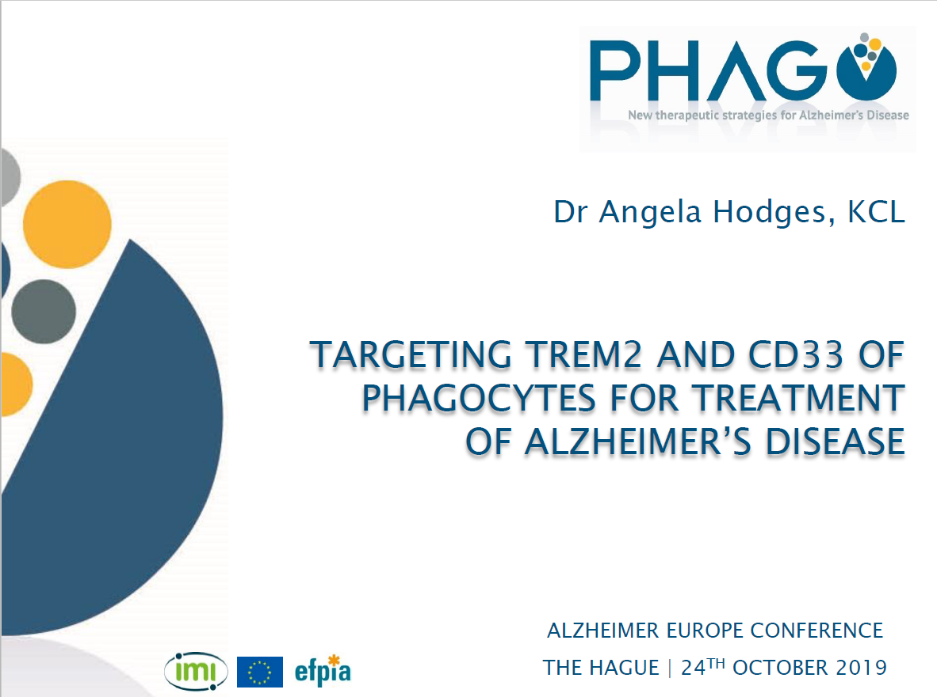


Slide 36
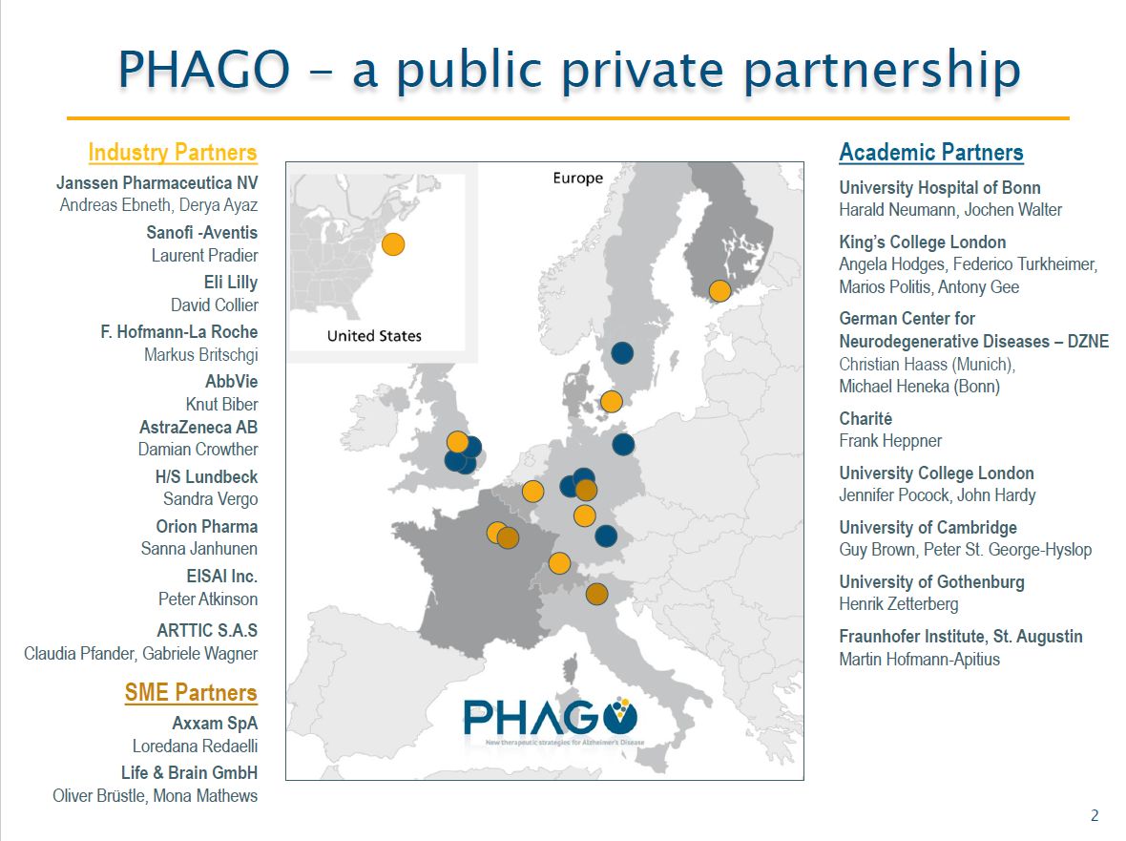

Slide 37
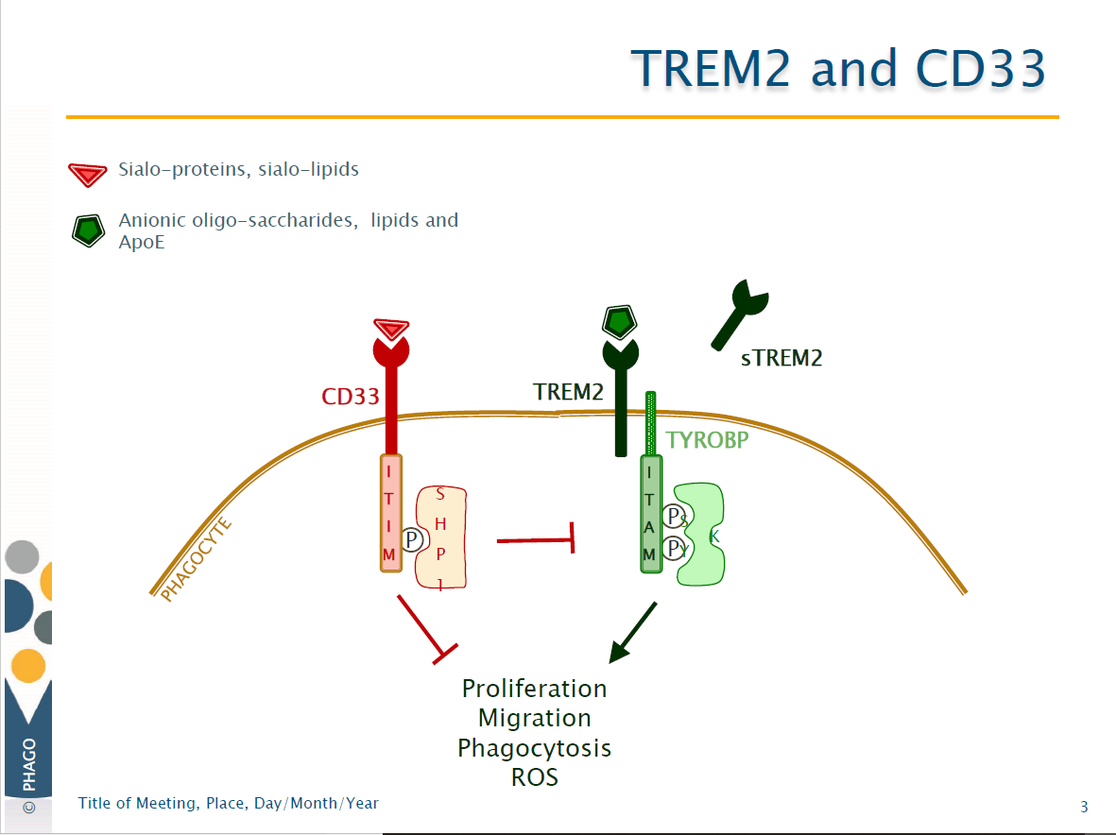

Slide 38
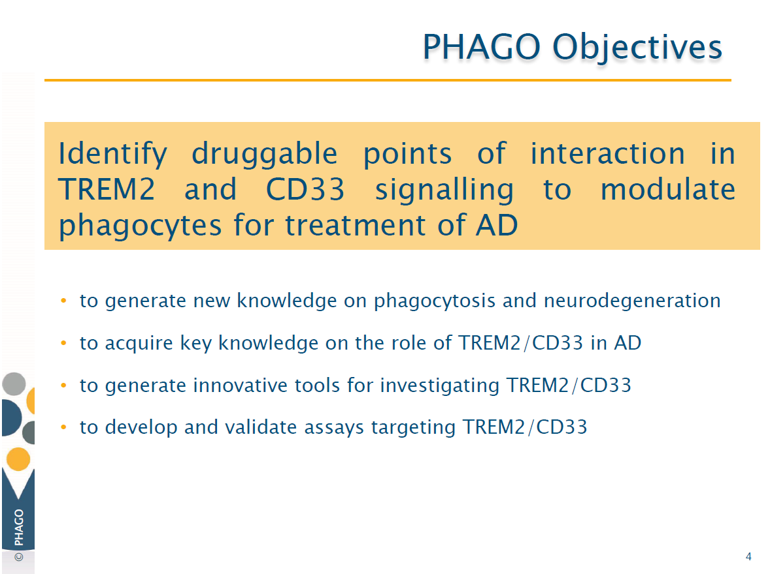

Slide 39
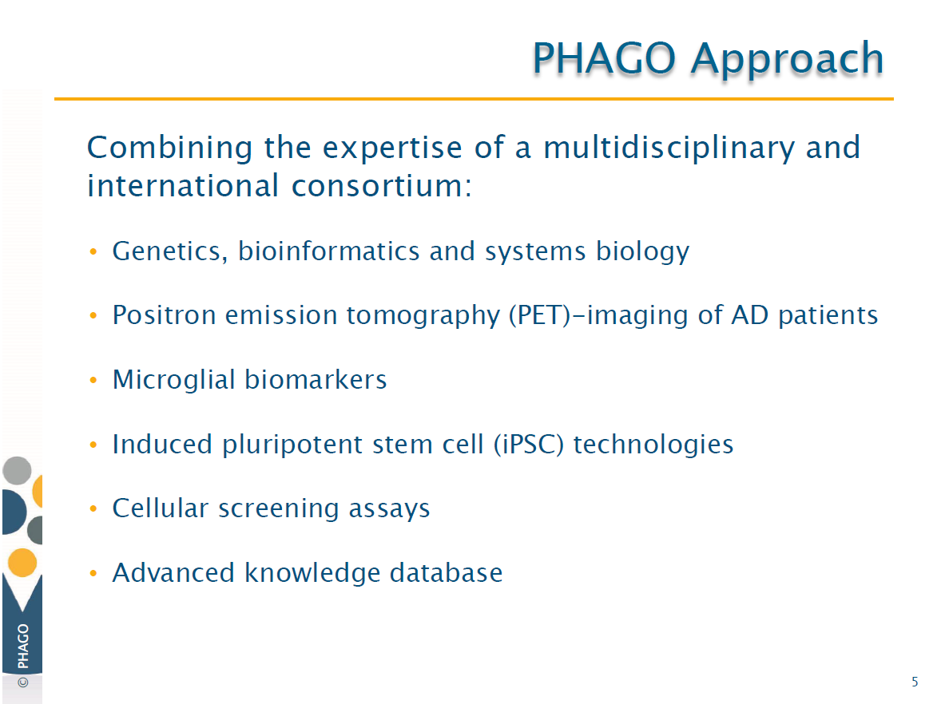

Slide 40
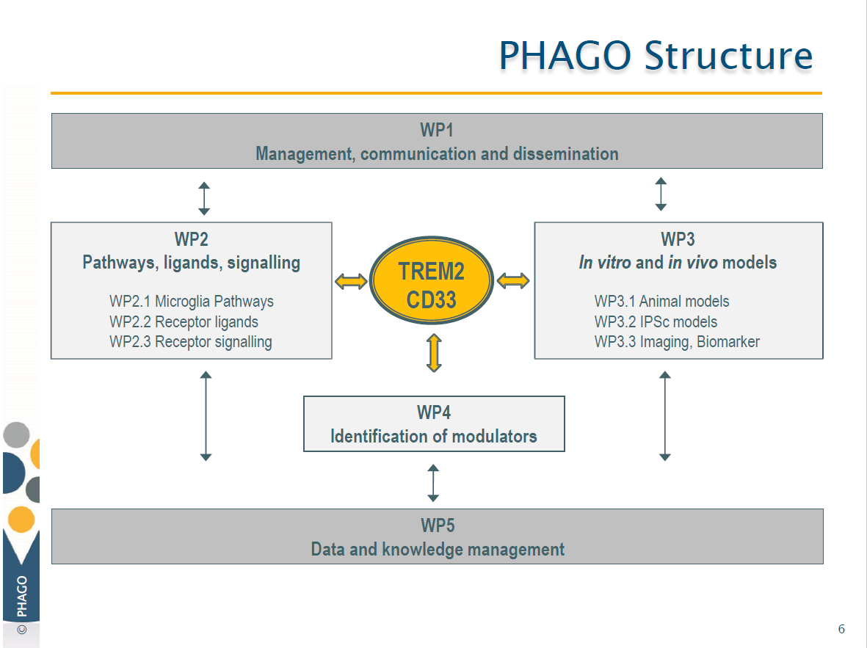

Slide 41
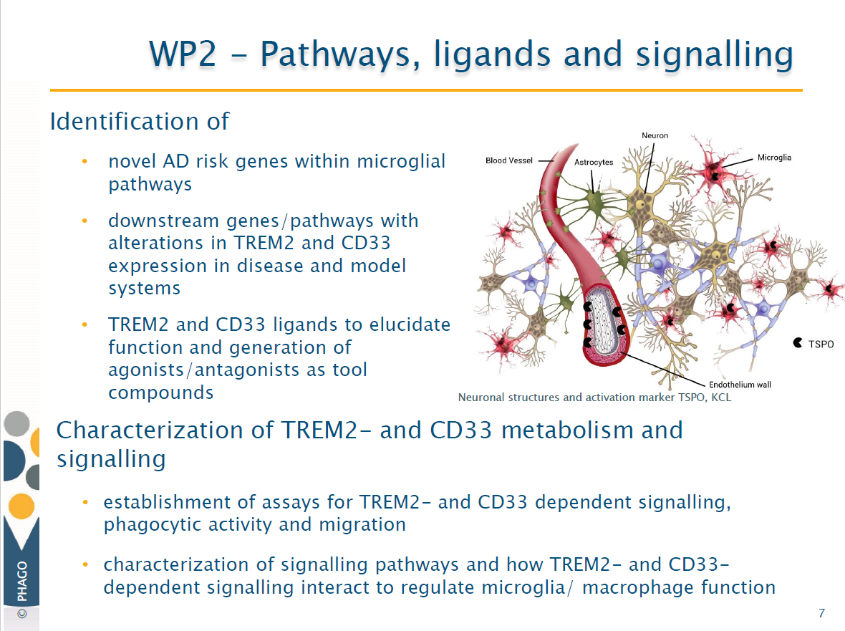

Slide 42
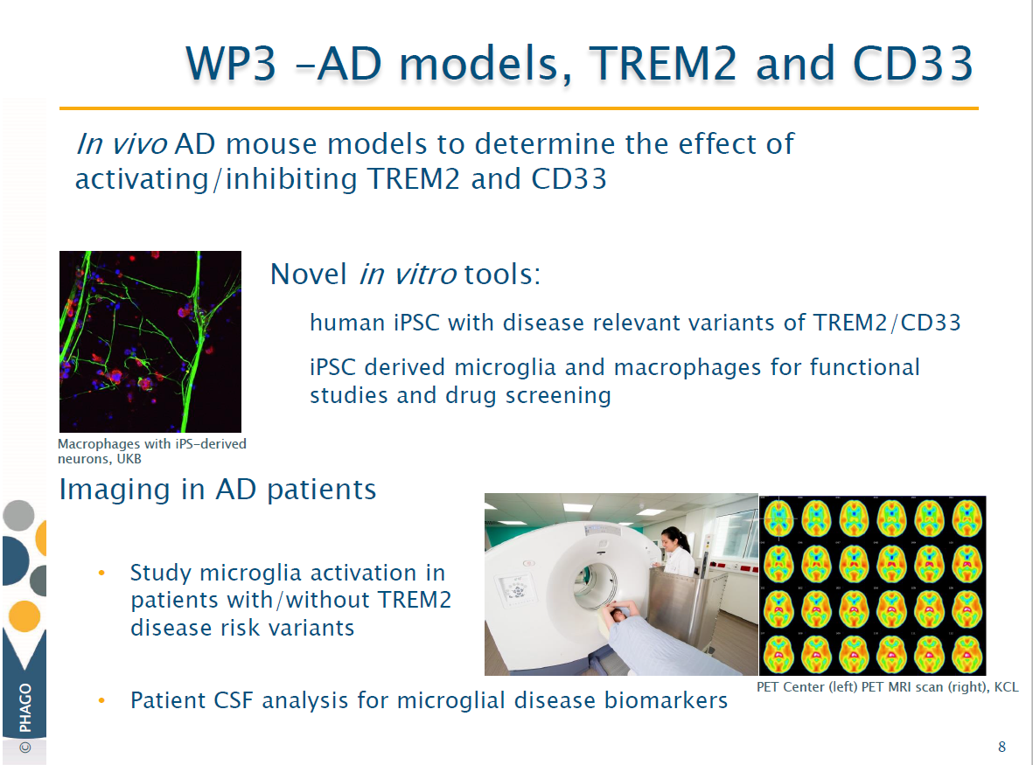

Slide 43
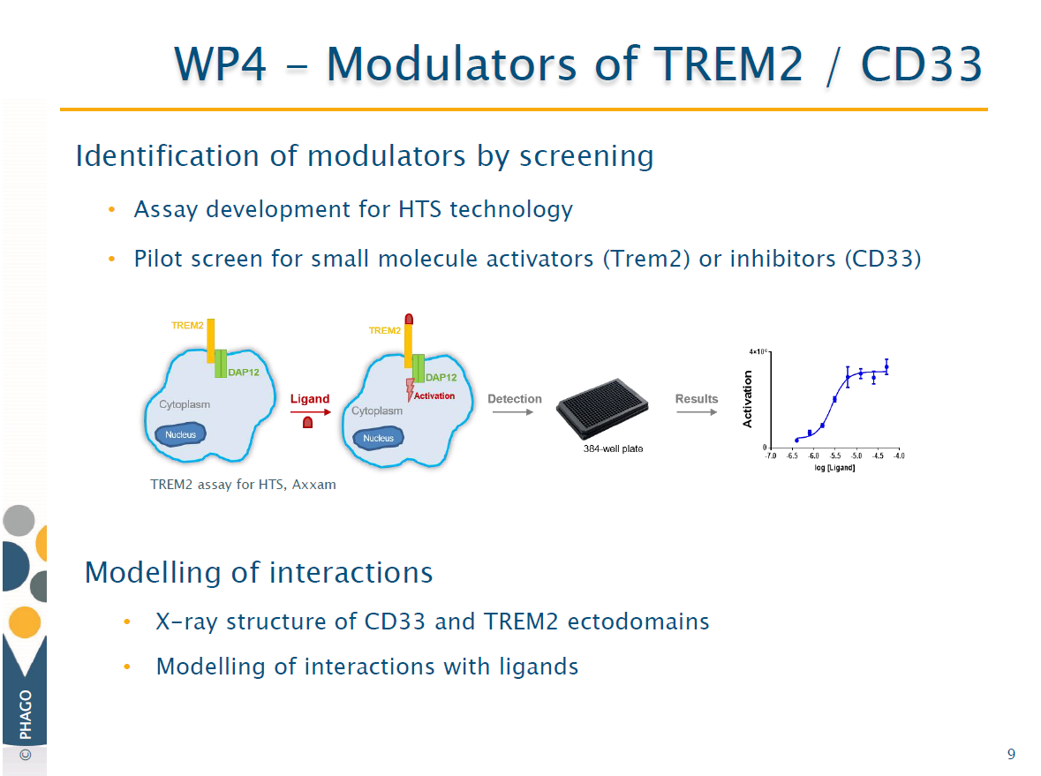

Slide 44
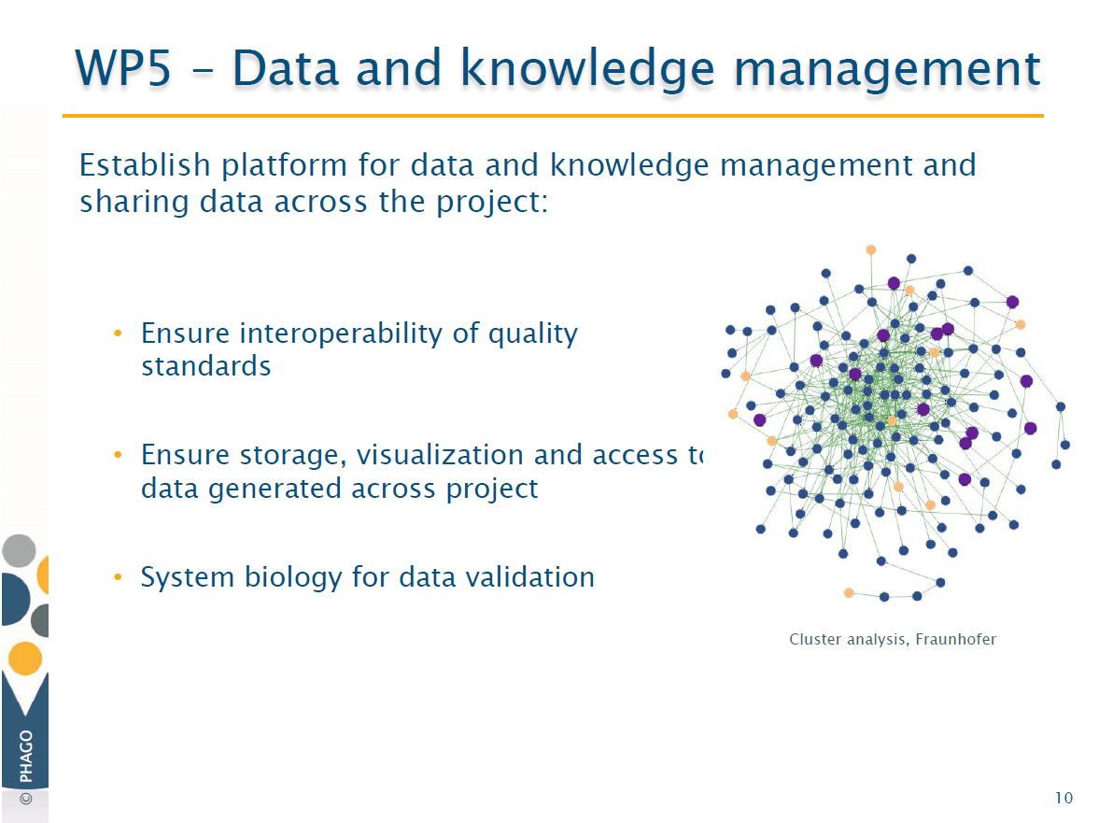

Slide 45
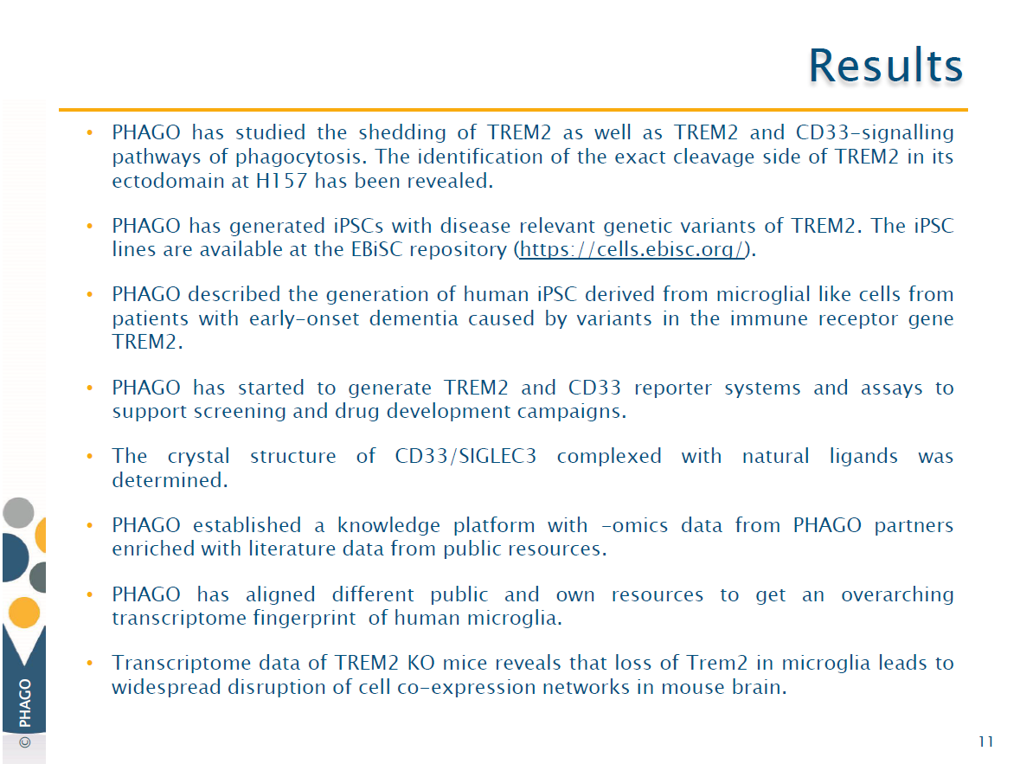

Slide 46
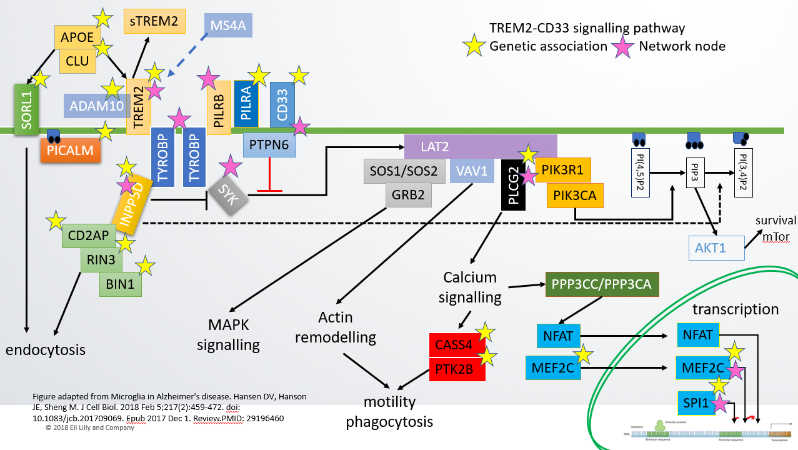
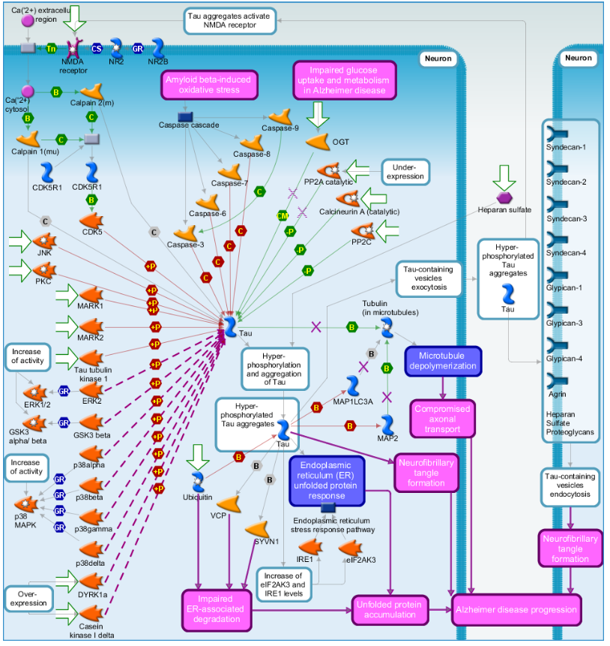




Microglia: TREM2-CD33 signalling pathway knowledge
KEGG maps (MAPK signalling, phagocytosis, actin remodelling)
Phagocytosis network (Metacore from Clarivate Analytics)

Slide 47




Molecular interaction network / pathway models
Static undirected, functional molecular interaction network (e.g. co-expression network)
Static directed molecular interaction network or pathway
Dynamic, qualitative simulations of directed molecular interaction network or pathway
Dynamic, quantitative/ kinetic simulations of directed molecular interaction network or pathway
MODELLING APPROACH
Possible for entire biological system
Possible for entire biological system
Possible for focused network/ pathway
Possible for focused network/ pathway
Level of mechanistic insight
OUTPUT
Functional association
Regulation, activity flow
System ‘states’ leading to desired output
Kinetics
Downstream effects, can simulate perturbations incl. compound, dosage in different populations (virtual trial); causal analysis with/without –omics. May identify one/multiple targets, key drivers of the observed states, ability to differentiate
Downstream effects, potential for causality analysis (inference) when combined with –omics. May identify one/multiple targets – nodes able to regulate (can explain) the observed response.
Downstream effects, can simulate different perturbations incl. knock out/change in molecular activity; causal analysis with/without
-omics. May identify one/multiple targets, key drivers of the observed states, ability to differentiate
USE FOR TARGET ID/ VALIDATION
General connectivity. May identify one/multiple targets – those nodes with the most connections.
Level of existing knowledge/input data
REQUIRED INPUT
Id of molecules in the system
and -omics data. Optional: literature, genetics
Id of molecules in the system, evidence or inference of regulation. Optional: -omics data for causality inference
Id of molecules in the system, evidence or inference of regulation. Knowledge of outputs (e.g. pathway up/down) and the path of influence by the system. Optional: -omics data
Id of molecules in the system, evidence or inference of regulation. Rates of regulation. Knowledge of outputs (e.g. pathway up/down) and the path of influence by the system. Optional: -omics data

Slide 48



Bayesian networks: the integrative approach

Slide 49

ALZHEIMER’S DISEASE
$225M program, to identify and characterize new therapeutic targets and to shorten the development time of new AD drugs.
Two Components:
Biomarkers in Clinical Trials
Target Discovery and Preclinical Validation

Slide 50




ALZHEIMER’S DISEASE: Target Discovery and Preclinical Validation
Launched in 2014
Apply a systems biology approach to discover and validate the next generation therapeutic targets using an open science research model:
  Generate high quality molecular data (genomic, proteomic, metabolomic) from postmortem brain tissue and plasma samples from well phenotyped cohorts and AD brain banks.
  Build network models of targets/pathways
  Carry out early target validation in multiple cell-based and animal models.
  Develop a data portal to enable rapid and broad sharing of data and analytical results.
Predictive Modeling
Molecular Profiling
Experimental
Validation
AMP-AD
KNOWLEDGE
PORTAL
Rapid and Broad Sharing of Data
6 Academic Teams
Emory University
50

Slide 51
ALZHEIMER’S DISEASE: Target Discovery and Preclinical Validation
AMP-AD 1.0 key achievements
COMPLETED:
  Centralized data resources developed for sharing raw and processed data, analytical results and methods and target nominations: AMP-AD Knowledge Portal and web-based interactive platform, AGORA.
  Rich, high quality, genomic, proteomic and metabolomic human data made available via the Knowledge Portal and being widely used: ~3000 users to date; 60% academia, 40% biotech/pharma.
  Network models of disease pathways/targets developed and made available via the Portal.
  Over 500 novel candidate targets identified and made available via the AGORA platfom along with supporting evidence and extensive druggability information.
  INITIATED
  Single cell RNAseq profiling (human and mouse brain)
  Biomarker discovery pilot projects – (RNAseq, proteomic, metabolomic – CSF and plasma)
51

Slide 52



AMP-AD Knowledge Portal
1. Reuse
2. Transparency
3. Independent evaluation
Insights
e.g., targets
Analytical results
e.g., eQTL, networks, diff expn
Algorithms
e.g., RNAseq processing, proteomic analysis, single cell RNA
Data
Raw and processed versions of AD Consortia data
Notes:
Data contributed by AMP-AD and affiliated consortia (M2OVE-AD, MODEL-AD and Resilience-AD) is uploaded to and managed through the Synapse platform, and accessed by the research community through the Knowledge Portal. Data of x-team interest is processed using common pipelines and used in Working Groups focusing on a variety of analytical questions. Agora hosts evidence coming out of individual teams or x-team analysis for whether or not genes are associated with AD and hosts a list of over 500 nascent drug targets.

Slide 53

Agora: Sharing Analytical Results and Insights
Discover and evaluate hypotheses that other researchers are exploring, in the form of nominated targets.
Evaluate your own hypotheses, by viewing curated, AMP-AD verified systems biology evidence for any gene of interest .
https://agora.ampadportal.org/

Slide 54
542 unique targets/53 targets* nominated by more than one team
Tdark
Tclin
TARGET DEVELOPMENT LEVEL – IDG designation
Tclin: Proteins annotated as drug targets
Tchem: Proteins for which potent small molecules are known
Tbio: Proteins for which some of the biology is known
Tdark: These proteins lack antibodies, publications or Gene RIFs
Tchem
Tbio
Additional 44 instances of different teams nominating members of the same gene family, totaling ~100 genes
(i.e. SYT12,Emory team, SYT13 MSSM team)

Slide 55

Agora: Nominated Targets

Slide 56
Agora Targets- Druggability Rankings
AMP-AD Pharma partners rated targets genome-wide across 6 dimensions:
  Small Molecule Druggability
  Antibody feasibility
  Safety
  Tissue Engagement
  Feasibility
  New Modality

Slide 57
ALZHEIMER’S DISEASE: Target Discovery and Preclinical Validation
  AMP-AD 2.0 Teams
  AMP-AD Data Coordinating Center (U24)
Sage Bionetworks
Academic Teams (U01):
Duke U-Indiana U-Helmholtz U
Icahn Institute at Mount Sinai
Arizona State University
Columbia-Rush
Emory-Baylor
UFL-Mayo-ISB

Slide 58
ALZHEIMER’S DISEASE: Target Discovery and Preclinical Validation
RFA-AG18-013/RFA-AG18-014
Foundational Grants for AMP-AD 2.0
1
2
Maximize the use of existing data and generate additional molecular profiling data (human and mouse) for use in target and biomarker discovery
3
Increase the bandwidth and develop new methods for functional validation of novel targets
Sustain and expand the capabilities of the AMP-AD Knowledge Portal and the AGORA platform
4
Develop methods for integrative network analyses to discover patient stratification biomarkers and to enable disease sub-classification
Opportunity to renew and expand the public private partnership

Slide 59

AMP-AD 2.0
Precision Medicine Approach to Target and Biomarker Discovery
TARGETS
and BIOMARKERS
New Disease Insights
OPEN Data and Methods

Slide 60



Other GWAS phenotypes

Slide 61




Genetics of disease progression in Alzheimer’s disease:
Basavraj Hooli, Yushi Lui, Yupeng Li Eli Lilly and Company
Basavaraj Hooli
Amyloid Plaques
Neurofibrillary Tangles
Lancet Neurol. 2010 Jan; 9(1): 119. doi: 10.1016/S1474-4422(09)70299-6 Image courtesy of Clifford Jack and Lancet Neurology

Slide 62
Background
The current approach to devising therapeutics in (Alzheimer’s disease) AD is aimed at slowing down disease progression
Most genetic studies reported to date reveal genetic variants that increase risk for AD onset, and these genes show little or no role in modulating neurodegeneration rate
Genes and molecular pathways driving the disease progression, Tau spread, neuroinflammation need to be fully established to support novel drug target discovery
Our goal is to use the large collections of past AD clinical trial datasets to elucidate the molecular mechanism driving Alzheimer’s disease progression

Slide 63
Summary of Lilly cohort for novel target discovery efforts
Trial Alias | Baseline (n) | Cohort Details | Duration (wks) | Longitudinal Biomarkers
LILLY PATIENT COHORT
EXPEDITION 1/2 | 900 | Mild/Moderate AD | 80-135 | Genomic, PET, Clinical, fluid
EXPEDITION 3 | 2100 | Mild-AD | 80 | Genomic, PET, Clinical, fluid
DAYBREAK/AMARANTH* | 6000 | Late MCI/Mild-AD | <104 | Genomic, PET, Clinical, fluid
Semagacestat | 825 | Moderate AD | 104 | Genomic, Clinical, fluid
AVID - A05 | 205 | MCI/Mild-AD, Unaffected controls | 80 | Genomic, PET, Clinical, fluid
EXTERNAL DATASETS
ADNI | 800 | Early/Late MCI, AD, Controls | ~25 | WGS, Genomic, PET, Clinical, fluid
AMP-AD | 1900 | ROS-MAP AD patients | Varies | Genomic, neuropathological, clinical
ASYMPTOMATIC PATIENTS (TBD)
A4 Study | 1000 | Prodromal AD, completion in 2022 | 240 | Genomic, PET, Clinical, fluid
LEARN | 500 | Potential collaboration | 240 | Genomic, PET, Clinical, fluid

Slide 64
Genetics of rate of disease progression in Alzheimer’s disease
Imputed genotype data (GSA array) from Lilly trial participants: ~10k patients
Longitudinal GWAS in all participants (~11M SNPs)
  Mixed model repeated measurements (MMRM) analyses were used to test the association between allele dosage and longitudinal changes (compared to baseline) in various cognitive measures, ADAS-Cog13, MMSE, ADL etc
  Early sporadic AD analysis; Longitudinal GWAS in patients <65 years at BL
  Cohort were split into discovery and validation, meta-analyses ongoing
  Follow-up analyses of top variants for association with various biomarkers is planned for 2020, e.g. Tau PET, MRI, NFL etc.
Incorporated eQTL data from AMP-AD to get preliminary understanding of gene(s) connected to the top genetic variants associating with rate of disease progression

Slide 65

Acknowledgements
Lilly Genetics and Bioinformatics: Emma Laing, Basavraj Hooli, Neil Pearson, Neil Humphryes-Kirilov, Laura Addis, Essi Asunmaa, Andrew McCarthy, Aiden Nickerson, Yupeng Li, Sarubini Kananathan, Dorothea Vellame, Bradley Miller, Jian W Wang, Hong Wang, Jeffrey Dage
Erl Wood Biology: Suchira Bose, Charlotte Dunbar, Joanna Wolak, Oihanna Eirea, Fiona Menzies
R.IT: James Scherschel, Derek Marren, Naveed Shaikh
Global Statistical Sciences (GSS): Brian Eastwood, David Airey, Yushi Liu, Ixavier Higgins
Computational Chemistry (C3): David Evans, Lewis Vidler, Layla Hosseini-Gerami
Discovery Chemistry Research and Technology
Neuroscience, Indianapolis
NIH, FNIH: Suzana Petanceska, Rosa Canet-Aviles
SAGE Bionetworks: Lara Mangravite, Ben Logsdon
sage

Slide 66


Erl Wood Neuroscience – thank you!

Slide 67


Slide 68
Backups/spares

Slide 69
TREM2 ligands
TREM2 interacts directly with various forms of Aβ, with highest affinity interactions observed between TREM2 and soluble Aβ42 oligomers
There is interaction between APOE3, APOE4 and TREM2 - pre-incubation with Aβ is shown to block the interaction of APOE in cellular assays. Thus:
  A high affinity interaction between TREM2 and Aβ oligomers that can block interaction with another ligand and
  AD-associated TREM2 variants bind Aβ with equivalent affinity but show loss of function in terms of signalling and Aβ internalization.
Galectin-3 is an endogenous TREM2 ligand and detrimentally regulates inflammatory response in Alzheimer's disease
Aminophospholipids, phosphatidylserine and phosphatidylethanolamine are signal-transducing TREM2 ligands on apoptotic cells
Lessard et al. EMBO Mol Med. 2018 Nov;10(11). pii: e9027. doi: 10.15252/emmm.201809027
Boza-Serrano et al. Acta Neuropathol. 2019 Aug;138(2):251-273. doi: 10.1007/s00401-019-02013-z.
Aminophospholipids are signal-transducing TREM2 ligands on apoptotic cells.
Shirotani K Sci Rep. 2019 May 17;9(1):7508. doi: 10.1038/s41598-019-43535-6. PMID: 31101881

Slide 70
IMPRiND: Inhibiting Misfolded Protein Propagation in Neurodegenerative Diseases
Publications
Mavroeidi, P et al., Endogenous oligodendroglial alpha-synuclein and TPPP/p25α orchestrate alpha-synuclein pathology in experimental multiple system atrophy models. Acta Neuropathologica (2019). doi:10.1007/s00401-019-02014-y
Bieri, G., et al. LRRK2 modifies α-syn pathology and spread in mouse models and human neurons. Acta Neuropathologica (2019). doi:10.1007/s00401-019-01995-0
Gribaudo, S., et al. Propagation of α-Synuclein Strains within Human Reconstructed Neuronal Network. Stem Cell Reports (2019). doi:10.1016/j.stemcr.2018.12.007
Shrivastava, A. N., et al. Clustering of Tau fibrils impairs the synaptic composition of α3‐Na+/K+‐ATPase and AMPA receptors. The EMBO Journal e99871 (2019).
Chabrat, A., et al. Pharmacological Transdifferentiation of Human Nasal Olfactory Stem Cells into Dopaminergic Neurons. Stem Cells International (2019). https://www.hindawi.com/journals/sci/2019/2945435/.
Katsinelos, T., et al. The Role of Antibodies and Their Receptors in Protection Against Ordered Protein Assembly in Neurodegeneration. Frontiers in Immunology 10, (2019).
Vasili, E., et al. Spreading of α-Synuclein and Tau: A Systematic Comparison of the Mechanisms Involved. Frontiers in Molecular Neuroscience 12, (2019). Zhang, W et al. Heparin-induced tau filaments are polymorphic and differ from those in Alzheimer’s and Pick’s disease. bioRxiv 468892 (2018). doi:10.1101/468892
Fenyi, A et al. Assessment of the efficacy of different procedures that remove and disassemble alpha-synuclein, tau and A-beta fibrils from laboratory material and surfaces. Scientific Reports 8, 10788 (2018). doi:10.1038/s41598-018-28856-2
Kundel, F., et al. Measurement of Tau Filament Fragmentation Provides Insights into Prion-like Spreading. ACS Chemical Neuroscience 9, 1276-1282 (2018).
Goedert, M., et al. Tau Filaments and the Development of Positron Emission Tomography Tracers. Frontiers in Neurology 9, (2018). doi:10.3389/fneur.2018.00070
Falcon, B, et al. Structures of filaments from Pick’s disease reveal a novel tau protein fold. Nature 561, 137-140 (2018). doi:10.1038/s41586-018-0454-y
Falcon, B., et al. Tau filaments from multiple cases of sporadic and inherited Alzheimer’s disease adopt a common fold. Acta Neuropathologica 136, 699-708 (2018).
Koros, C., et al. 123I-FP-CIT SPECT [(123) I-2β-carbomethoxy-3β-(4-iodophenyl)-N-(3-fluoropropyl) nortropane single photon emission computed tomography] Imaging in a p.A53T α-synuclein Parkinson’s disease cohort versus Parkinson’s disease: Movement Disorders 33, 1734-1739 (2018).
Spillantini, M. G. & Goedert, M. Neurodegeneration and the ordered assembly of α-synuclein. Cell and Tissue Research 373, 137-148 (2018).
Tofaris, G. K. A Critical Assessment of Exosomes in the Pathogenesis and Stratification of Parkinson’s Disease. Journal of Parkinson’s Disease 7, 569-576 (2017).
Fitzpatrick, A. W. P., et al. . Cryo-EM structures of tau filaments from Alzheimer’s disease. Nature 547, 185-190 (2017). doi:10.1038/nature23002
Stefanis, L., et al. How is alpha-synuclein cleared from the cell? Journal of Neurochemistry doi:10.1111/jnc.14704

Slide 71


Slide 72
sTREM2
MS4A
TREM2-CD33 signalling pathway
Genetic association Network node
APOE
CLU
SORL1
ADAM10
TREM2
PILRB
PILRA
CD33
PICALM
PTPN6
LAT2
TYROBP
TYROBP
SOS1/SOS2
VAV1
PIK3R1
PI(4,5)P2
PIP3
PI(3,4)P2
PLCG2
SYK
GRB2
PIK3CA
INPP5D
survival
mTor
CD2AP
AKT1
RIN3
BIN1
Calcium
signalling
PPP3CC/PPP3CA
Actin
remodelling
transcription
MAPK
signalling
NFAT
NFAT
endocytosis
CASS4
PTK2B
MEF2C
MEF2C
Figure adapted from Microglia in Alzheimer's disease. Hansen DV, Hanson JE, Sheng M. J Cell Biol. 2018 Feb 5;217(2):459-472. doi: 10.1083/jcb.201709069. Epub 2017 Dec 1. Review.PMID: 29196460
motility
phagocytosis
SPI1

Slide 73
IMPRiND: Inhibiting Misfolded Protein Propagation in Neurodegenerative Diseases
Seeds: Identify disease-relevant misfolded assemblies, imprint their biological properties in vitro and/or in cellulo and generate homogeneous populations in order to assay and interfere with their pathogenic effects.
Assays: Develop and miniaturise assays to monitor up-take, secretion, clearance and oligomerisation using bimolecular fluorescence complementation of oligomeric species or transfer of untagged assemblies to fluorescently labelled fibril-naïve cells and measure markers of early proteotoxicity that are suitable for high throughput or high content screens
Screens: Perform genetic screens based on disease-relevant gene/protein networks and assess druggability of identified targets.
Validation: Deliver robust validation assays for these molecular events in complex cellular systems with greater functional resemblance to the native milieu of the brain such as iPSC-based models and organotypic cultures or simple model organisms such as Drosophila or zebrafish.
Translational models: Improve existing animal models in order to standardise pathological readouts for in vivo validation of modifiers, correlate them with novel peripheral or in situ markers using microdialysis to accelerate the assessment of therapeutic interventions and relevance to humans, e.g. by transplantation of human iPSC neurons in animals.

Slide 74


