Slide 1

Alzheimer’s Disease Genetics Consortium
10th Year Anniversary Symposium
Philadelphia, PA
November 12, 2019
”Progress and Opportunities Towards Advancing the National Plan to Address Alzheimer’s Disease"
Eliezer Masliah
Division of Neuroscience,
National Institute on Aging, NIH

Slide 2
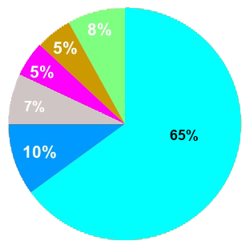
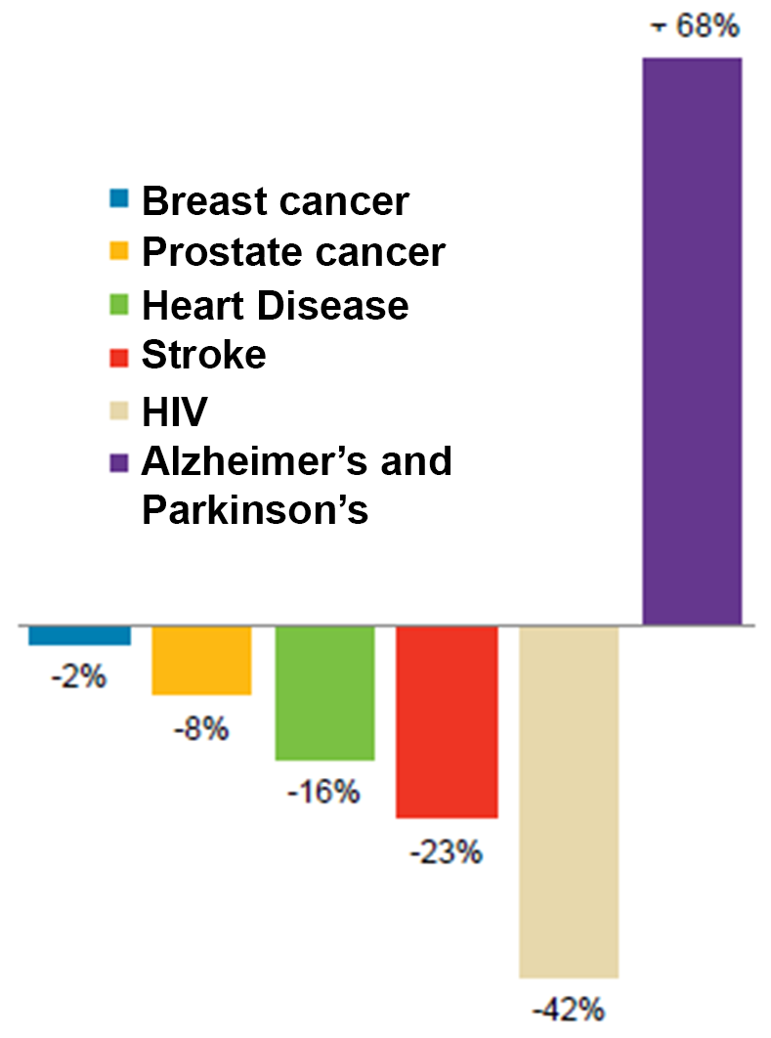
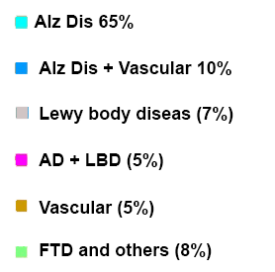
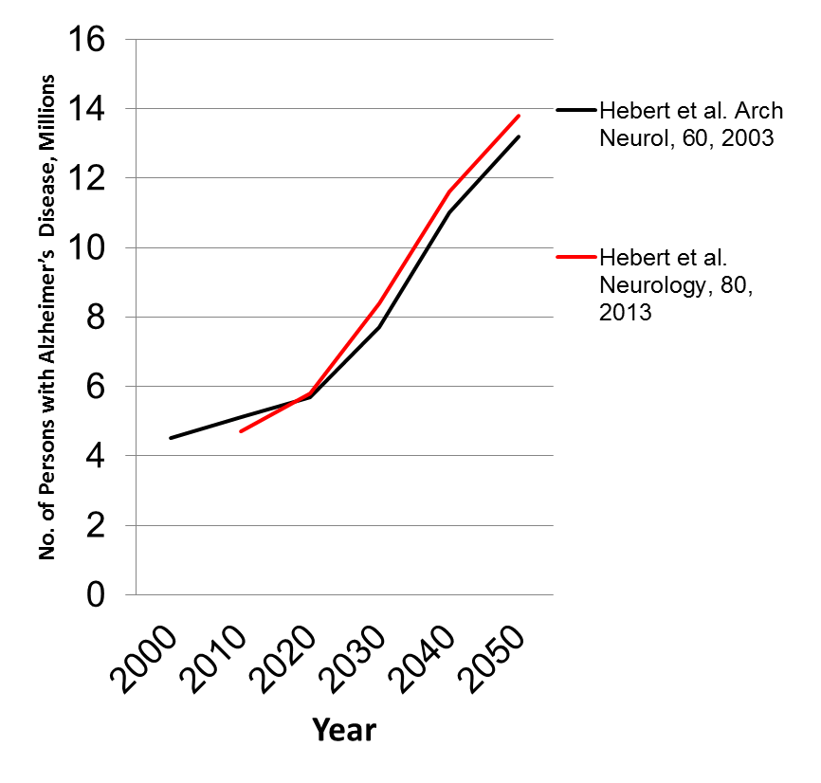
Death rates due to Alzheimer’s disease, Parkinson’s disease and related disorders continue to go up
2017- 5.3 M with AD
2050- 14M with AD
$200 Billion a year

Slide 3
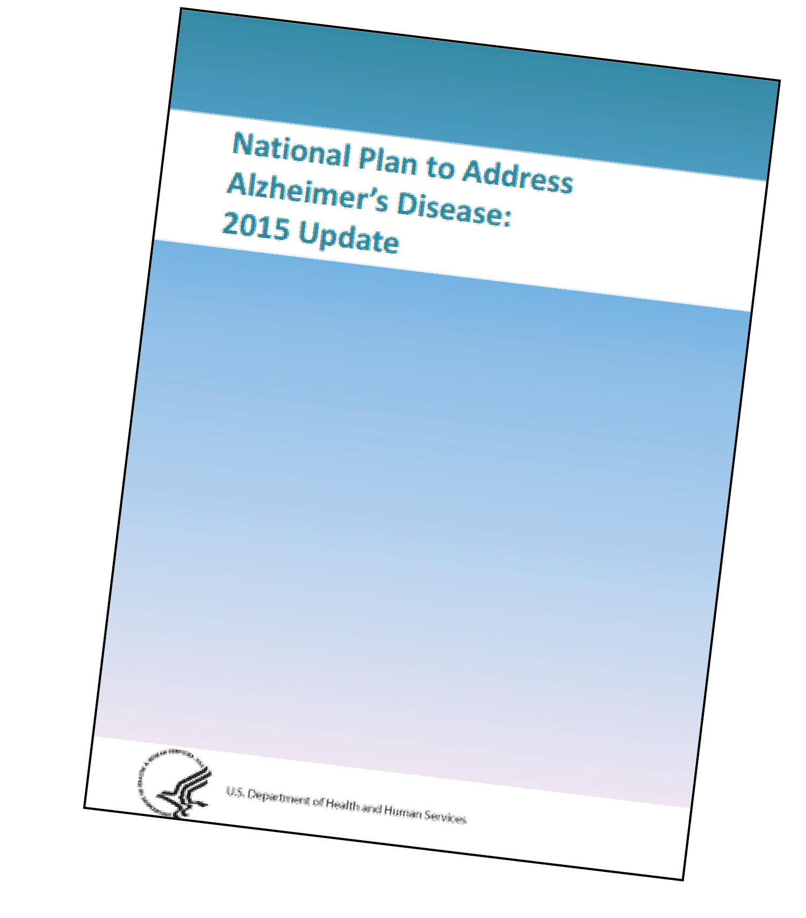
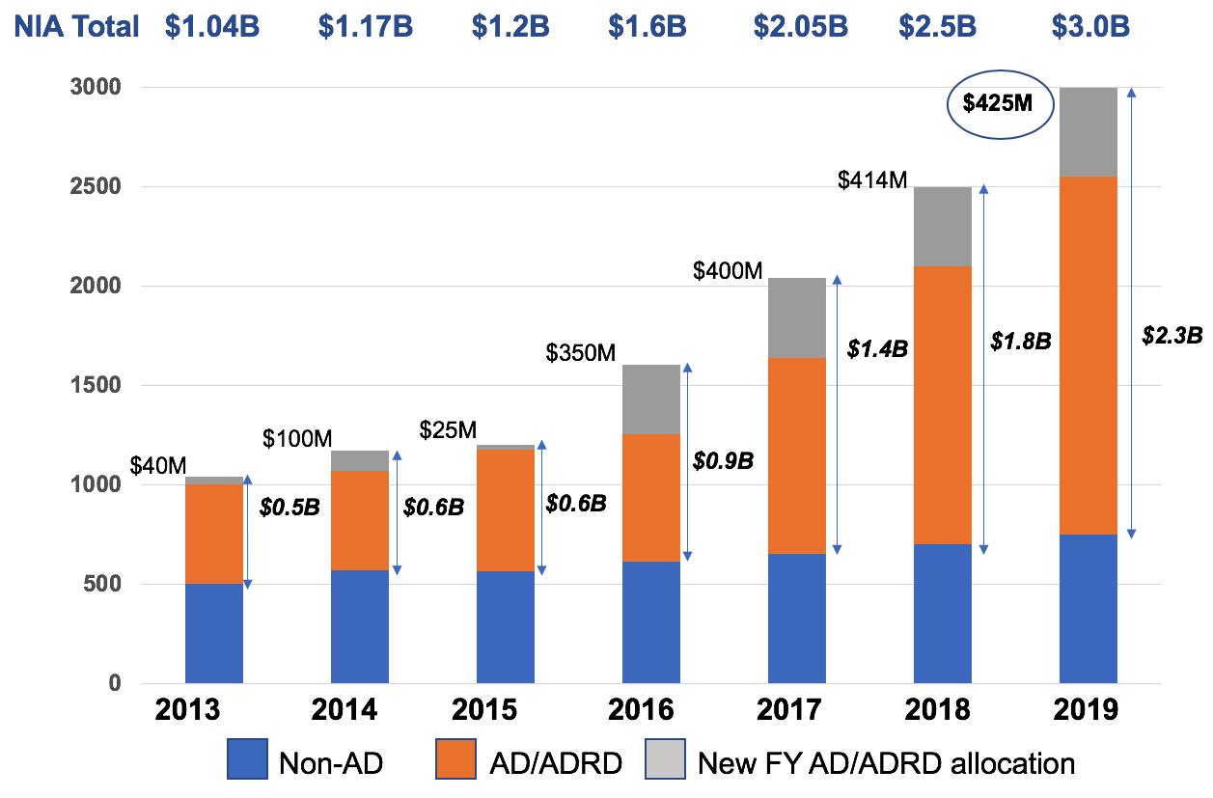
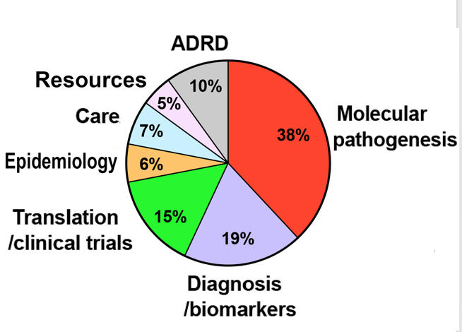
US National Plan to Address AD https://aspe.hhs.gov/national-alzheimers-project-act
The National Alzheimer’s Project Act (NAPA) signed 2011.
The primary research goal of the NAPA is to prevent the onset of and develop effective treatments for AD by 2025.
The plan also covers other dementias- DLB, FTD and VCID

Slide 4
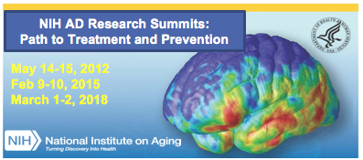
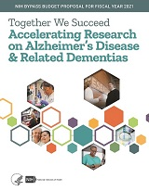
NIA collaborates with other NIH institutes and the community to advance NAPA goal for 2025
NAPA
PUBLIC
AD Bypass Budget
Scientific community
2018
ADRD
2016
AD
2018
ADRD
2019
Care
2020
Scientific community recommendations
2019
NIA
Milestones
2020
NIH
NINDS
NHLBI
others
FOA’s
2021
Grants
AD and ADRD (LBD, FTD, VCID)

Slide 5
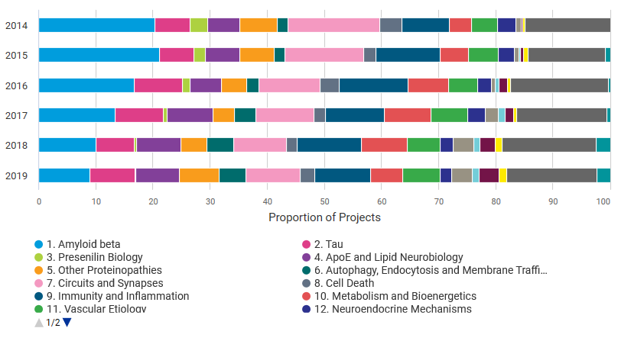
Comparison of NIA Projects by year (2014-2019)
Category A – Molecular pathogenesis

Slide 6
Recruitment to a Growing AD/ADRD Workforce
~1/4 of NIA’s Alzheimer’s and related dementias awardees from Fiscal Year 2015-2018 were either new or early stage investigators
~1/3 of NIA’s Alzheimer’s and related dementias awardees were new to the field
* More training grants including K, F’s, T’s and NIA Participation in RFA-HL-18-023 "Stimulating Access to Research in Residency (StARR) (R38)

Slide 7
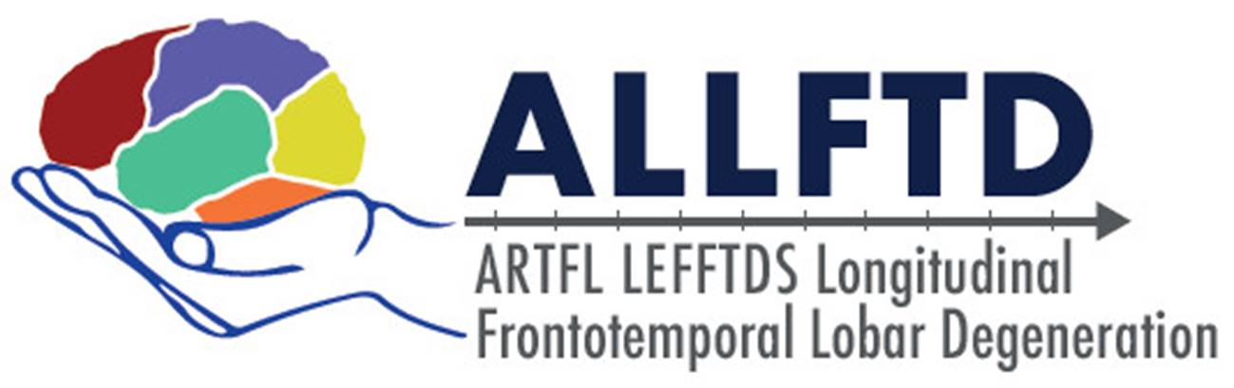


Recent NIA collaborative programs in ADRD with NINDS and NHLBI
Examples of Ongoing Trans-NIH Collaborations
NINDS and NIA are funding natural history studies in FTLD
Study of individuals with a clinical diagnosis of FTD to help determine the clinical, genetic and biomarker profiles
Study of families that have one of the three most common gene variants associated with FTD to learn more about the natural history
The Atherosclerosis Risk in Communities Study (15,000 participants)
Midlife risk factors for cognitive decline, MCI and AD
Resilience and Reserve
Cognitive testing, brain imaging, accelerometry, hearing
PAR-19-167: Development and Validation of Advanced Mammalian Models for Alzheimer's Disease-Related Dementias (ADRD) (R61/R33 Clinical Trial Not Allowed)

Slide 8
NIA AD/ADRD Administrative Supplements – Impact on Future Applications
~1/3 of the 2018 supplement awardees submit R01s or R21s
~300 AD/ADRD administrative supplements awarded to NIH grantees with awards not focused on AD/ADRD
>20% of this 1/3 are successful in receiving funding on their first try
FY18
FY19
*as of September 30, 2019

Slide 9
Some NIA-AD Research Priorities
Greater integration among basic, preclinical and clinical AD programs
2018 NIA-AA Research Framework
for Alzheimer Disease
BIOMARKERS
National Strategy to enhance recruitment for AD clinical studies
Enhance
clinical trials
Pipeline
“More shots on goal”

Slide 10
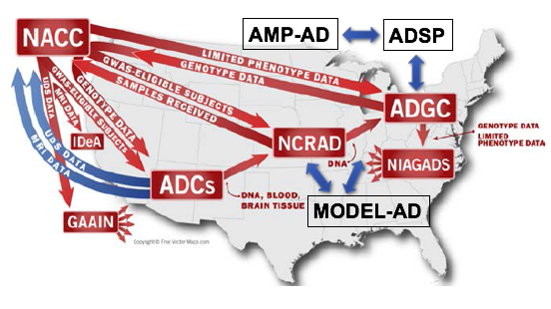

Interactions among NIA sponsored centers
NIA Program Directors: Nina Silverberg, Laurie Ryan, Suzana Petanceska,
Larry Refolo, Marilyn Miller, Dallas Anderson
ADSP- Alz Dis sequencing program
AMP-AD- Accelerating medicines partnership
ACTC- Alz Dis Clinical trials consortium
ADNI- Alz Dis Neuroimaging initiativ
ADC’s- Alz Dis Centers
NACC- National AD coordinating center
MODEL-AD- Model Organism Develop and Evaluation for Late-onset AD
NCRAD- Natl Centralized Repository AD
P20- Exploratory grants ADRC’s
RFA-AG-20-023

Slide 11
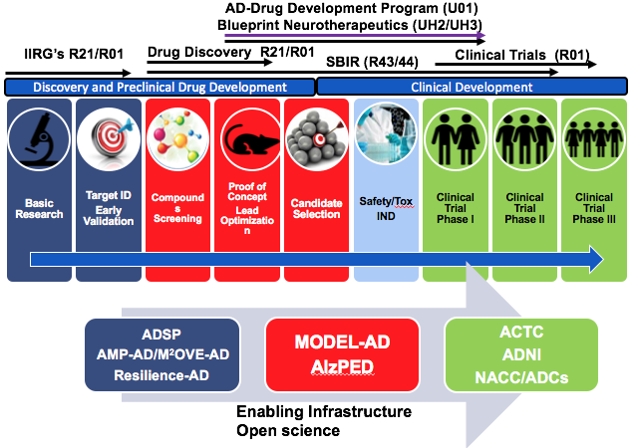
NIA-AD programs from “bench to bedside”
NIA Program Director: Laurie Ryan
PI’s:
Paul Aisen
Reisa Sperling
Ron Peterson
Conduct clinical trials (Phase I to III) of promising pharmacological and non-pharmacological interventions for cognitive and neuropsychiatric symptoms.
Core principles: data sharing, transparency, rigor in science

Slide 12
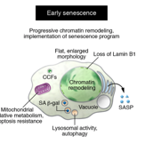
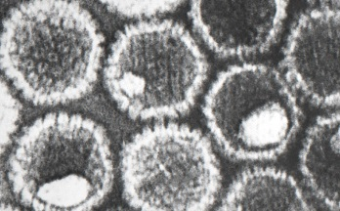
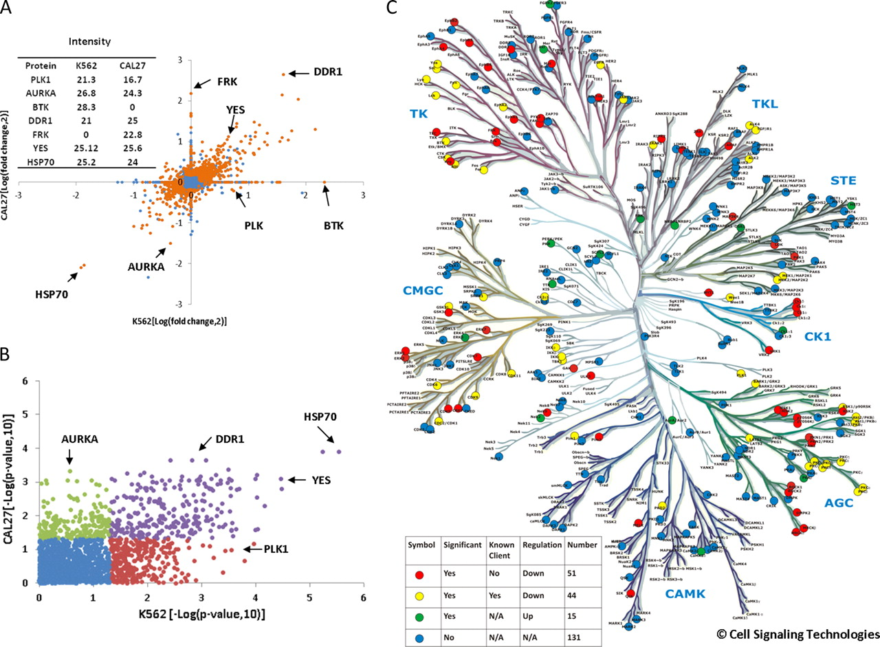
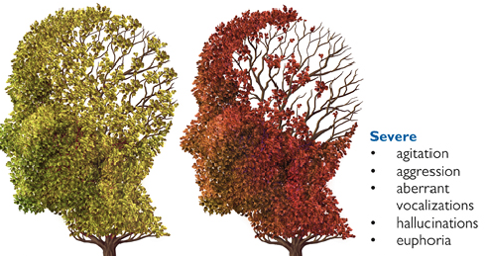
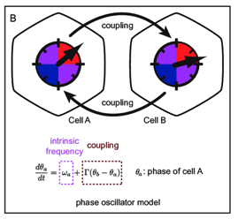
Alzheimer’s Disease and Related Dementias FOAs http://www.nia.nih.gov/AD-FOAs
MOLECULAR BASIS FOR AD HETEROGENEITY
and mixed pathology
DYNAMIC INTERACTION BETWEEN PERIPHERAL SYSTEMS AND BRAIN AGING/AD
UNDERSTANDING NEURODEGENERATION IN THE CONTEXT OF AGING
COMLEX BIOLOGY OF RESILIENCE
SEX DIFFERENCES AND AD RISK
CELL SENESCENCE
UNDERSTANDING THE COMPLEX BIOLOGY OF AD/ADRD
COMMON MECHANISMS OF NEURODEGENERATION
MICROBIAL PATHOGENS
PROTEOME REGULATION
MECHANISMS OF NPS IN AD
OSCILLATORY
GENE EXPRESSION
OLIGOMER/PFF SEED BANK

Slide 13
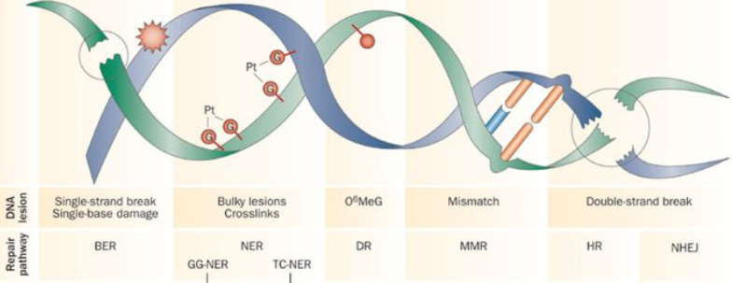
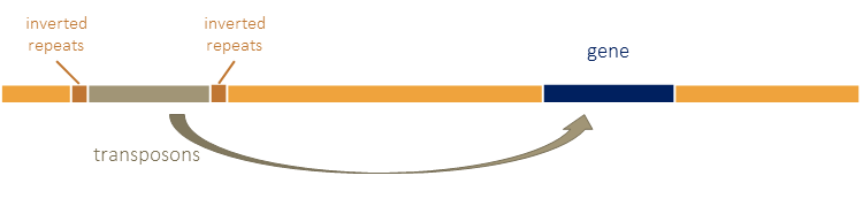
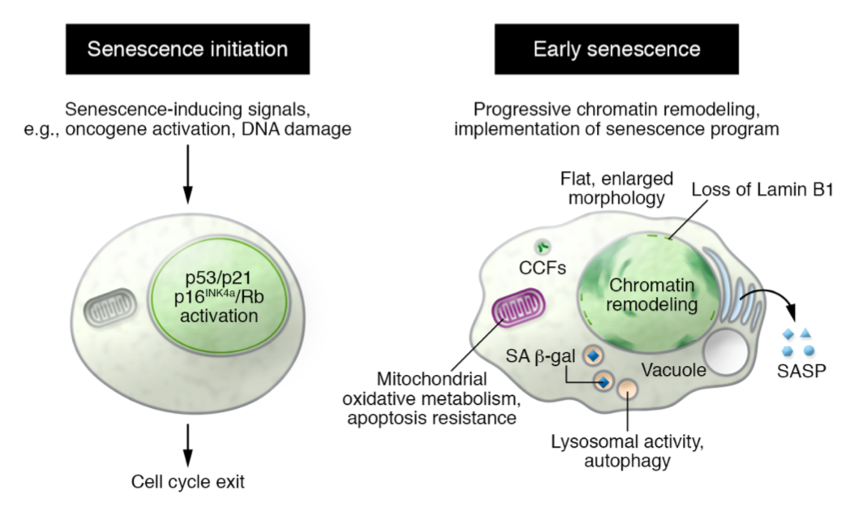


Understanding AD in the context of Aging
HIV-1, HHV, other pathogens
Trauma, chemicals radiation, radicals, stress, metabolic, viruses
DNA damage
Proteostasis
Mitochondria
Inflammation
Endosomes
Growth Factors
Epigenetics
DNA damage
Senescent cells
Immune surveillance
Aging
Proteinopathy
Abeta
Tau
Synuclein
TDP43
Others
Transposable elements
senescence/immune surveillance
T cells
Mac’s
NK’s
Synapse damage
Neurodegeneration

Slide 14
Some NIA-AD Research Priorities
Greater integration among basic, preclinical and clinical AD programs
2018 NIA-AA Research Framework
for Alzheimer Disease
BIOMARKERS
National Strategy to enhance recruitment for AD clinical studies
Enhance
clinical trials
Pipeline
“More shots on goal”

Slide 15
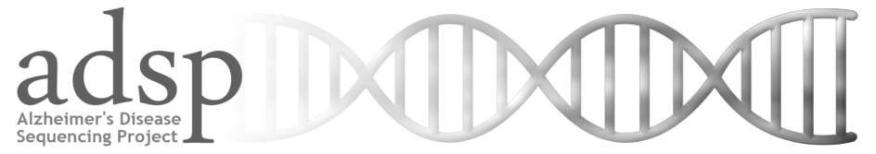
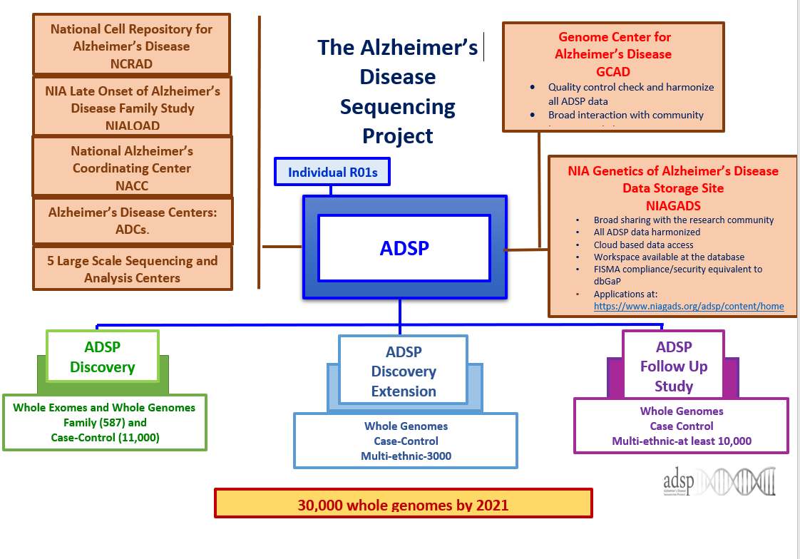
PI: G. Schellenberg; L. San U Penn; NIA Program Director: Marilyn Miller
Alzheimer’s Disease Genetics Consortium
Characterize and follow cohorts
Perform genetic studies using diverse approaches
Provide samples to the ADSP

Slide 16
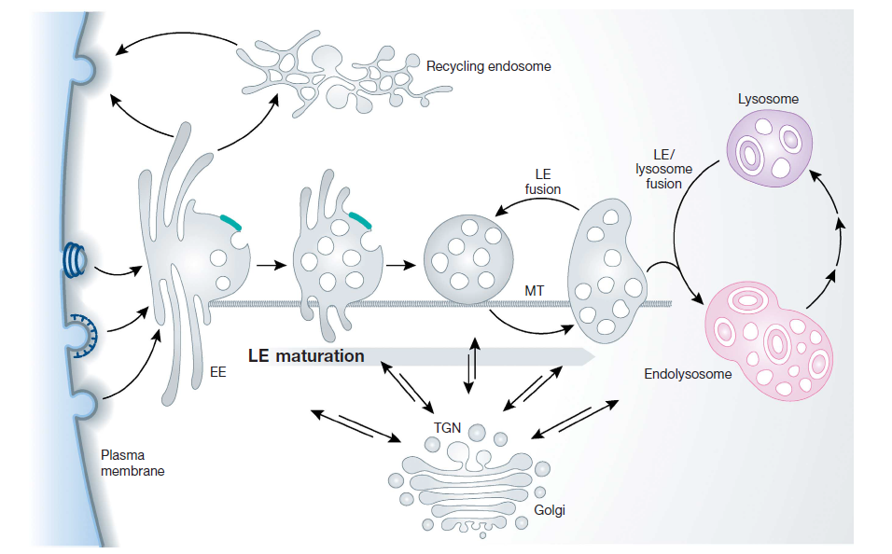
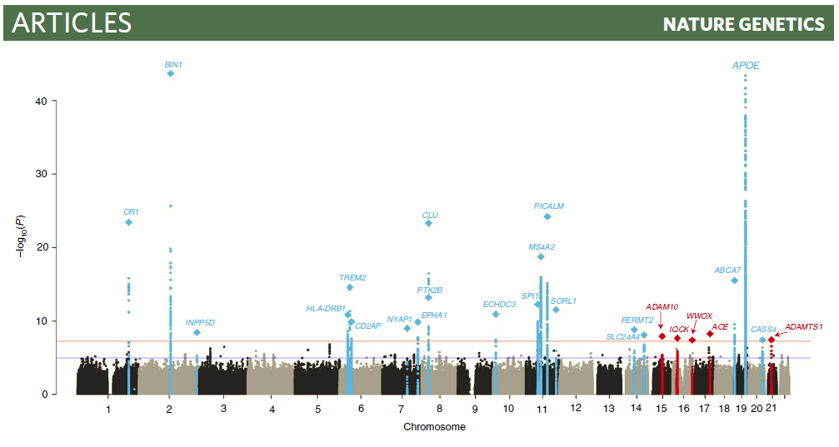
ADGC and ADSP recent accomplishments
ADGC
Identification of numerous rare variants - examples:
  Microglial associated genes/loci- TREM2, PLCG2, BI3.
  MAPT region signal in APOE-ε4 negative subjects.
  HLA risk haplotype.
  Loss of function (LOF) SORL1.
  African American LOF ABCA7 mutation.
  Caribbean Hispanic AKAP9 in LOAD families.
Robust expansion of ethic cohorts: US - African American (AA), and Hispanic (HISP) cohorts; expansion of ethnic diversity extends into the global arena.
Methods development: pipelines for identification of cis-acting regulatory elements.
Broad impact on AD genetics: published 105 peer reviewed manuscripts since 2008.
ADSP
Development of a highly productive multi-ethnic large-scale sequencing study that serves as a flagship research resource for NIA, ensuring broad data sharing with the community at large.
Whole exome case-control sequence study: identification of numerous genomic regions that overlap with GWAS signals, require further exploration, and provide promise for additional sequencing analysis.
Major implication for whole genome sequencing: most signals for AD are not in the coding region of the gene.
Determination that there is no strong protective variant signal in the Alzheimer’s genome.

Slide 17
Next steps on the AD sequencing program
ADSP, ADGC, ADC’s, NACC, Epidemiology programs
Genetic and Genomic Data
Phenotypic Data
Functional Genomics
Data Harmonization
Inter-operability with other NIA and NIH programs
AI/ML approaches
Increase sharing
Endophenotypes Endophenotypic measures
Polygenic risk scores
Personalized Medicine

Slide 18
National Alzheimer’s Coordinating Center (NACC)
Data Harmonization Efforts Underway
Initial efforts have been driven by the Alzheimer’s Disease epidemiologists, geneticists, clinicians, and epidemiologists; several individual efforts underway
Database | Type of data | Level of data | Description
NACC | Uniform Data Set (UDS) | Individual (38,836) | Longitudinal clinical evaluation of ADC subjects; select those with genetic data
 | Minimum Data Set (MDS) | Individual (74,397) | Retrospective data from ADS subjects; select those with genetic data
 | Neuropathology + UDS | Individual (5,443) | Autopsy data for a subset of UDS; select those with genetic data
 | Neuropathology + MDS | Individual (11,128) | Autopsy data for a subset of MDS subjects; select those with genetic data
 | Imaging | Individual (5,058) | Research structural MRI data for a subset of UDS subjects; select those with genetic data

Slide 19




Enhancing inter-operability of ADC with NIAGADS and ADGC efforts via NACC
NCRAD ADC Biospecimen Catalog
  NACC shares limited clinical data with NCRAD for its online catalog
Data available at NIAGADS
  NACC receives inventory of genetic data available to share with investigators
Data exchanged with ADGC
  NACC shares data file with ADGC to define cases and controls
  NACC receives genetic data that is made available to ADCs
NACC
NIAGADS
ADGC
NACC COLLABORATIONS
GUID- global unified ID

Slide 20
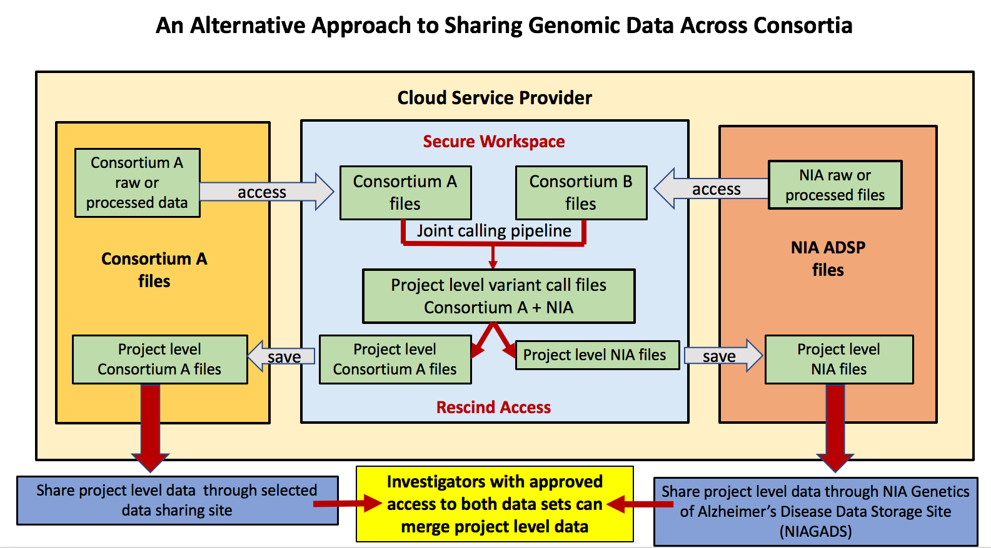
Improving genomic data sharing across NIH programs
(eg: TOP-MED NHLBI)

Slide 21
Enhancing inter-operability between ADSP and AMP-AD and translation
ADSP
Genetic and Genomic Data
Phenotypic Data
Functional Genomics
RNA
Transcriptomics
RNAseq
Expression Profiles
DNA
GWAS
Exome Chip
Whole Exome/Genome Sequence Data
Data Harmonization
Epigenome
Protein
MS Proteomics
Protein-Protein
Interactions
AMP-AD
Metabolites
MS Metabolomics
Metabolic pathways
Model AD
In vivo AD models: Ensure rapid availability of animal models, protocols and validation data
Translational Centers
To speed, diversify Alzheimer's drug discovery. The Alzheimer Centers for the Discovery of New Medicines are designed to diversify and reinvigorate the Alzheimer's disease drug development pipeline.
AD Clinical Trials

Slide 22



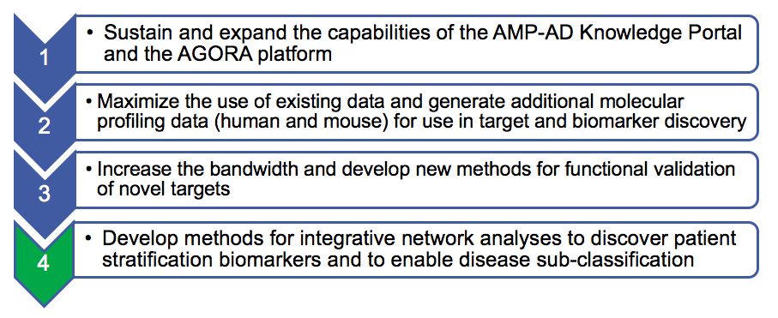

  AMP-AD Target Discovery and Preclinical Validation Project 2.0 (RFA AG18-013 / RFA AG18-014)
NIA Program Director: Suzana Petanceska
Generate
High-dimensional multi-omic data:
~2,500 human brains;~1000 blood samples
Integrate
Molecular profiling
Predictive Modeling
Experimental validation
www.synapse.org.ampad
Data
Network models
Code
AMP-AD Knowledge Portal
DATA SHARING
Duke U-Helmholtz U-U of Rotterdam
Icahn Institute at Mount Sinai
Arizona State University
Columbia-Rush
Emory-Baylor
UFL-Mayo-ISB
UCLA
AMP-AD Data Coordinating Center (U24):
Sage Bionetworks

Slide 23

agora.ampadportal.org
Some candidate targets
Progress over 4 years:
Centralized data resource established- AMP-AD portal
All data sharing deliverables met
A variety of experimental validation models developed
Novel biomarker discovery initiated
Over 500 candidate targets nominated; currently undergoing data-driven prioritization for further preclinical validation
AMP-AD Candidate
Targets
Notes:
RH to present

Slide 24
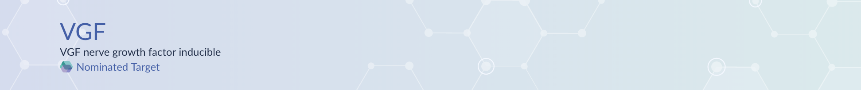
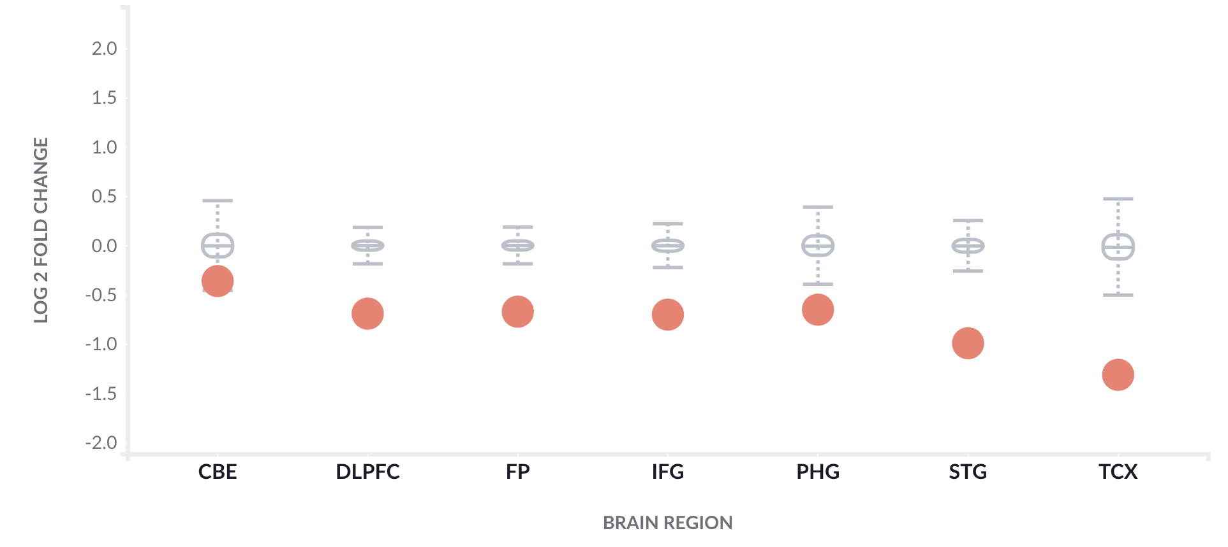
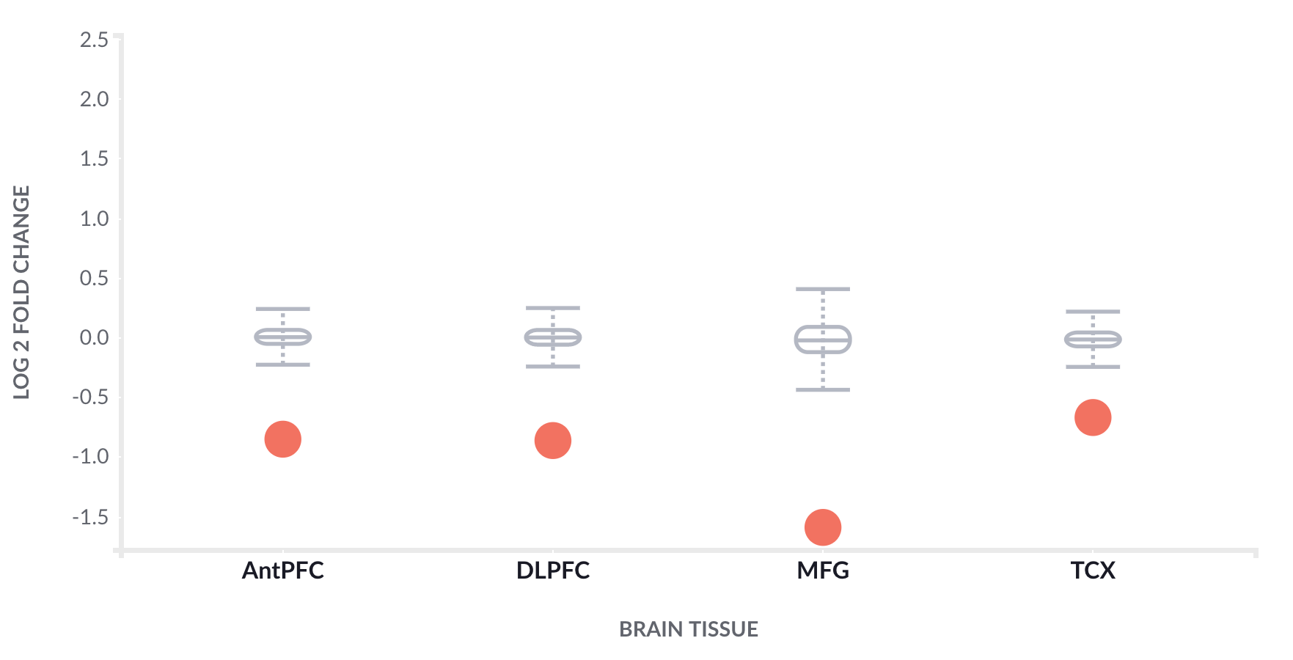
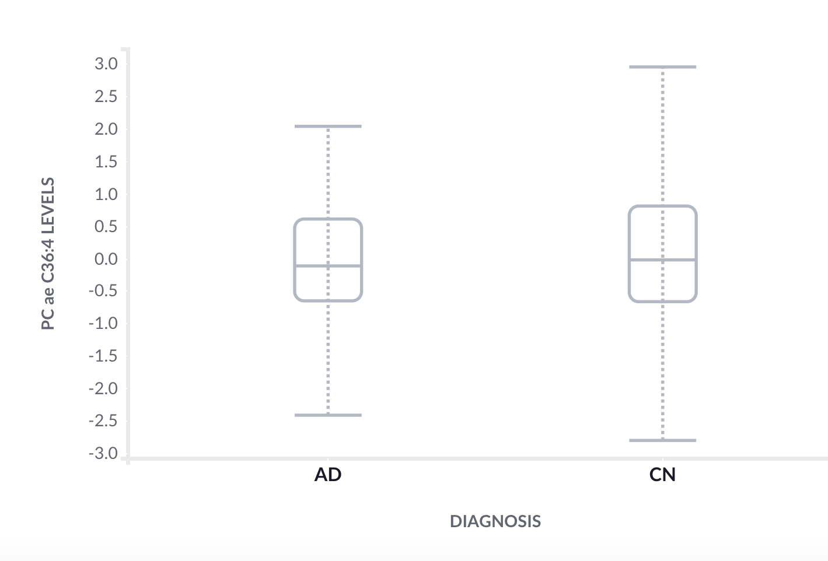
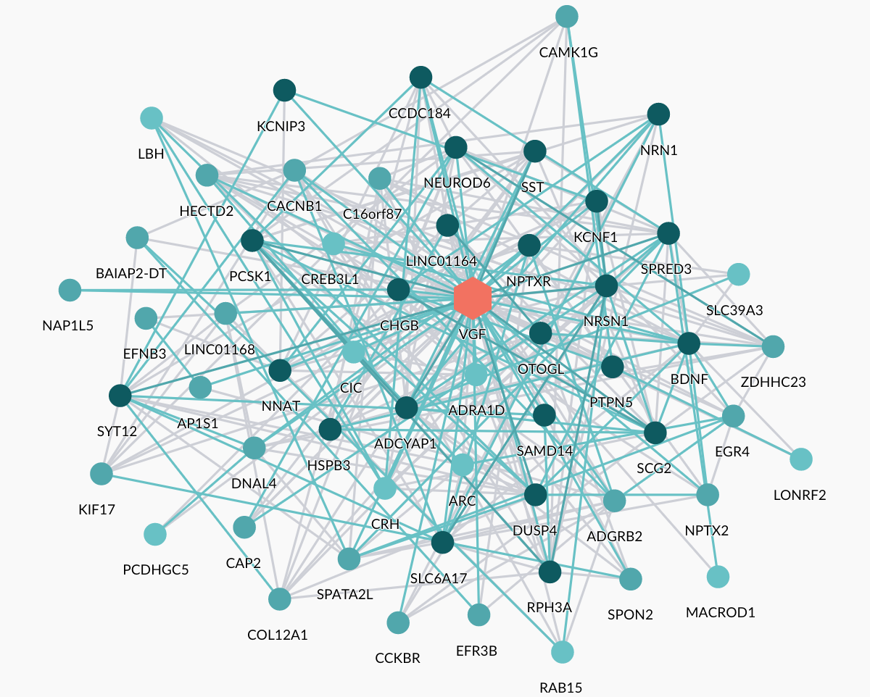
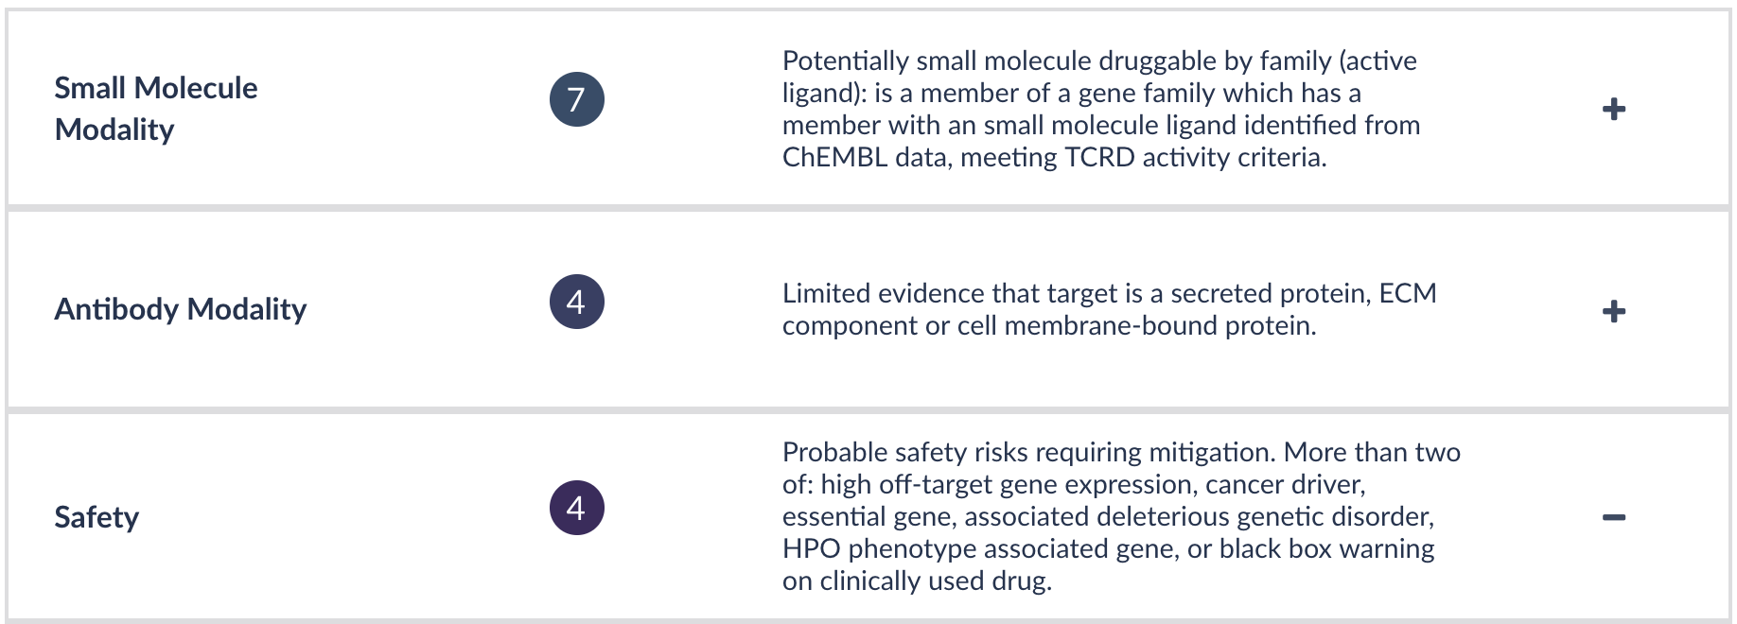
Expressed in a subpopulation of neuroendocrine cells, and is upregulated by nerve growth factor.
Similarities with the secretogranin/chromogranin family, however, its exact function is not known.
Multiple VGF peptides decreased in MCI and AD Spellman et al. 2015
RNA
Protein
Metabolites
Druggability

Slide 25
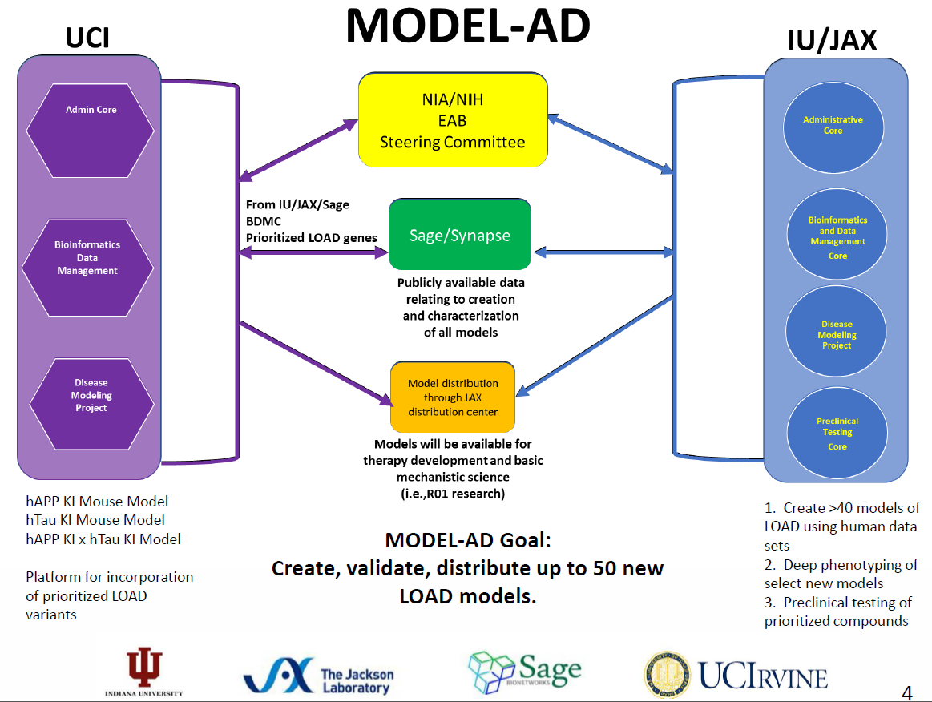
NIA Translational Centers for Animal Model Resources
NIA Lead: Larry Refolo
PI: Frank LaFerla
PI: Bruce Lamb
TREM2
APOE
ABCA7
CR1
PLCG2
SORL1

Slide 26

NIA AD Translational Research Program
Enabling Infrastructure for Data Driven and Predictive Drug Development
Target ID
Early Validation
Assay
Development
Screening
Proof
of
Concept
Lead
Optimization
Candidate
Selection
IND-enabling
toxicology
Phase I
Phase II
Phase III
Drug
Approval
AMP-AD and Affiliated Consortia
MODEL-AD
AlzPED
ACTC
ADNI
AMP-AD Biomarkers
ABC-DS
AD Translational Centers
for New Medicines
Launched October 2019
MISSION: Diversify and accelerate therapy development for AD through open source tools, reagents and methods for robust validation of candidate targets delivered by AMP-AD and other discovery programs, and by integrating enabled targets into drug discovery campaigns $73M commitment over the next 5 years
26
Notes:
RH to present

Slide 27
NIA sponsors over 200 AD trials and interventions
35 Early-stage (Phase I and II Clinical Trials)
  Amyloid (10)
  Receptors (4)
  Neuroprotection (4)
  Metabolism and Bioenergetics (2)
  Vasculature (2)
  Growth Factors and Hormones (2)
  Multi-target (2)
  Inflammation (2)
  Oxidative Stress (2)
  Other (5)
8 Late-stage (Phase II and III Clinical Trials)
  Amyloid (6)- DIAN-TU, A4, API-ADAD, API-E4, others
  Vasculature (2)- SPRINT-MIND, ASPREE
86 Non-Pharmacological Interventions
  Exercise (19)
  Diet (6)
  Cognitive Training (21)
  Assistive Tech. (8)
  Sleep (5)
  Combination Therapy (10)
  Other (17)
8 Clinical Therapy Development for the Neuropsychiatric Symptoms of AD/ADRD
  Pharmacological (5)- lithium, methylphenidate, escitalopram, dronabinol, others
  Non-Pharmacological (3)- CAP, PATH
61 Care and Caregiver Interventions
  PWD (35) for family (36)
5 Delirium/pot-operative cognitive decline
  Anesthesia (1), Sleep (1), Device (1), Combination (1), Cognitive training (1)
NPS 4%
Early
Stage
17.5%
Late
Stage
4%

Slide 28
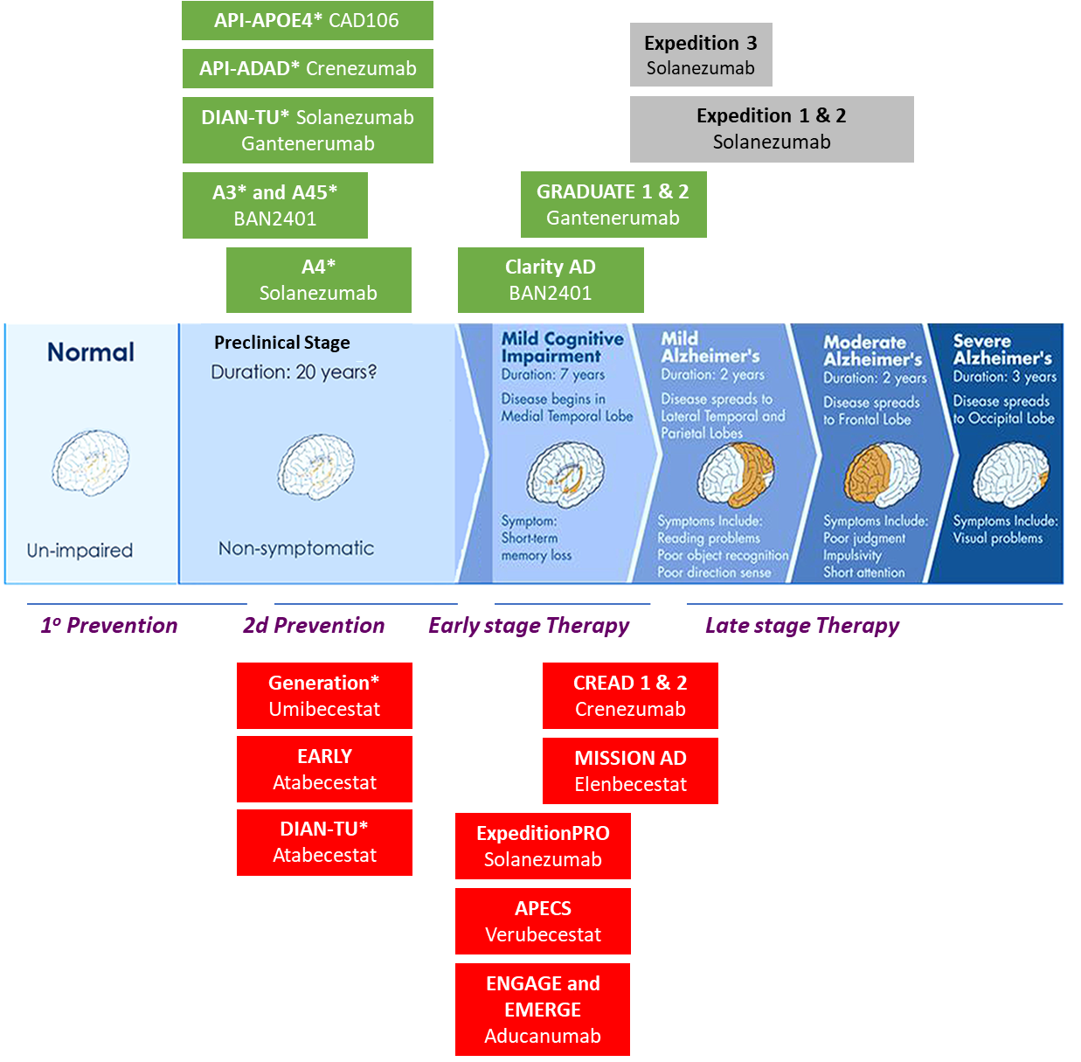
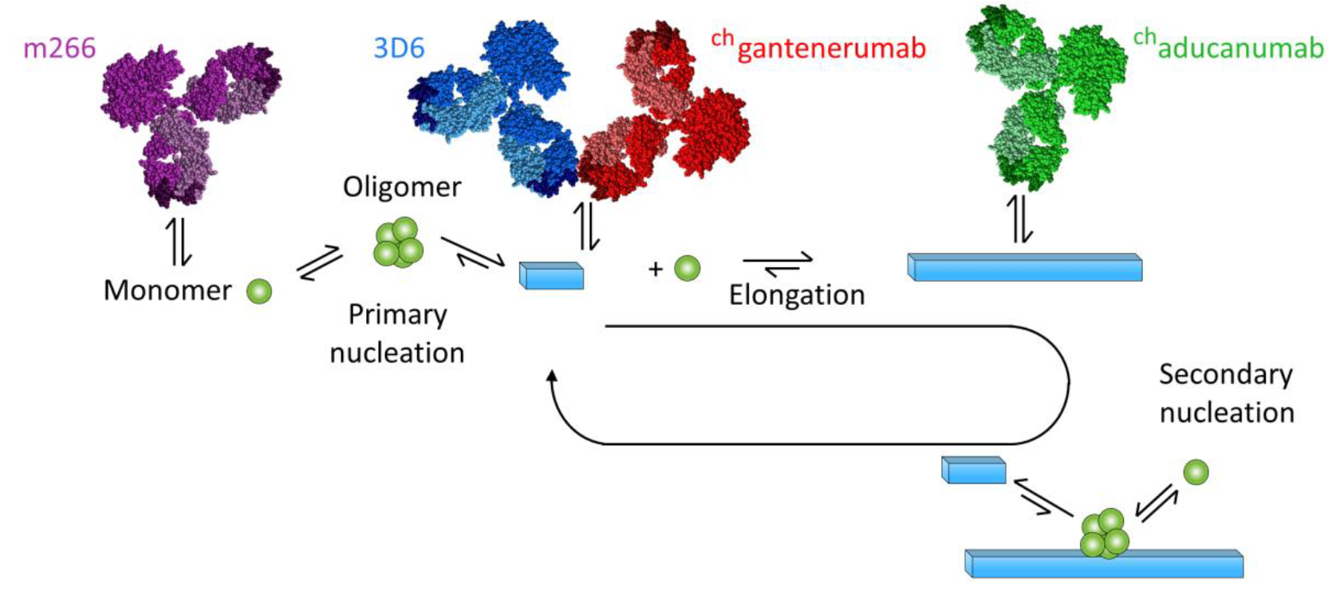
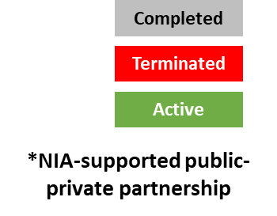
Alzheimer’s Disease Immunotherapy and BACE inh Phase III Trials
Linse et al bioRxiv 2019
Revived?

Slide 29
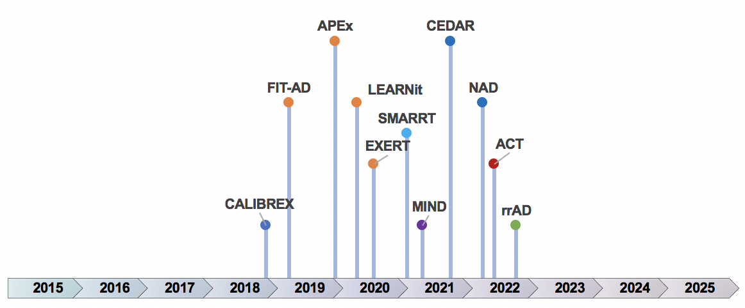
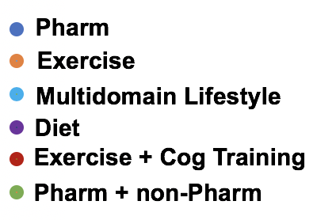
Active NIA-AD Phase II/III clinical trials in AD toward 2025
DHA
IVIG
Intranasal
Insulin
DIAN-TU
Adaptive
A4
Hope4
MCI
CITALOPRAM
A3
A4/5
ADAPT
NSADS
ASPREE
RAGE
inh
Generation
API-E4
DIAN-TU
NEXTgen
API-
Aducanumab
ADMET
(RITALIN)
SPRINT-MIND
API-Colombia
LM11A-31
(NGF)

Slide 30
Why do we need genetics for clinical trials?
Eliminate the use of genetically mixed subjects
Identify subgroups of patients with the same endophenotypic data
Identify subgroups of patients with the same genetic and genomic data profiles
Select specific groups of subjects who demonstrate matching polygenic risk scores
Match endophenotypes, genetic/genomic data profiles, and polygenic risk scores and identify subjects in subgroups
Identify drug targets suited to specific endophenotypes in clinical trials together instead of using all endophenotypes.
Do better drug targeting by matching drugs to genes

Slide 31
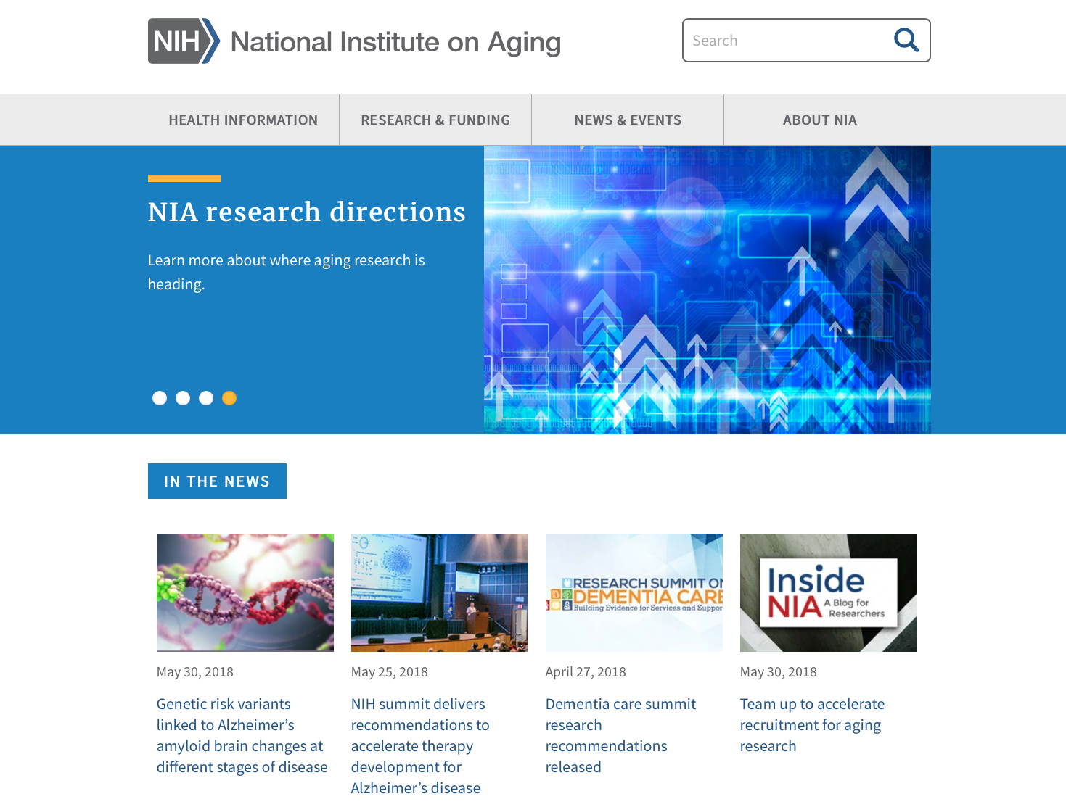
Concept Approvals:
https://www.nia.nih.gov/approved-concepts
General FOAs:
https://www.nia.nih.gov/research/funding
Alzheimer’s Disease and Related Dementias FOAs:
http://www.nia.nih.gov/AD-FOAs
Follow our “Inside NIA” blog: https://www.nia.nih.gov/research/blog

