Slide 1
The quest for polygenic determinants on Alzheimer’s Disease
Chun Chieh Fan, MD, MSc, PhD
Center for Human Development, UCSD
Center for Multi-Modal Imaging and Genetics, UCSD

Slide 2
In memory of Rahul Desikan
Mentor, Collaborator, Pioneer, Fighter, Survivor
and my dear friend

Slide 3
Overview
The polygenicity of Alzheimer’s Disease
Cross traits component: on Pleiotropy
Temporal component: on polygenic hazards
Conclusion

Slide 4
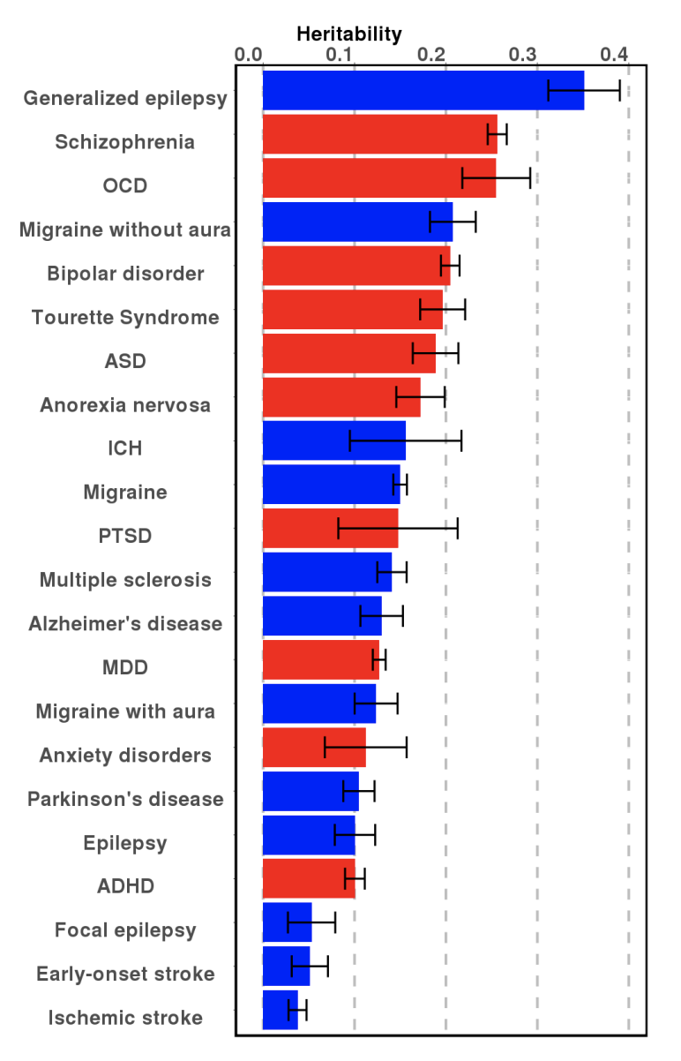
The quest for polygenic effects beyond APOE
Heritability including APOE
  Twin heritability: 58 – 79%
  Chip heritability: 24 – 33%
  SNP heritability (ldsc): 7.1%
Heritability after controlling for APOE
  Chip heritability: 20%
  SNP heritability (ldsc): 6.37%
(Lee et al, 2012; Cuyvers and Sleegers, 2016; Brainstorm, 2018; Kunkle et al., 2019)

Slide 5
The pleiotropic effects
A genetic variants have effect on more than one trait
Vertical Pleiotropy (Causal Mediators)
Horizontal Pleiotropy (Share loci)
Linkage
Zhu et al., 2016

Slide 6
Exploiting the pleiotropy – sFDR framework
(Schork et al., 2013)
(Andreassen et al., 2013)
Andrew
Schork
Anders
Dale
Ole
Andreassen
Wesley
Thompson

Slide 7
FDR_{conj} = max(FDR_{AD|XXX}, FDR_{XXX|AD})
Given ADGC summary statistics
Controlled APOE effects
AD and Lipids/CRP
(Desikan et al., 2015)
AD and Immune Diseases
(Yokoyama et al., 2016)
AD and PD
(Desikan et al., 2015)

Slide 8
The implication for conditional analysis
Not only for improving statistical power
  The potential shared mechanisms
  Generating hypothesis for the potential causal mediating factors
For AD:
  The tau related process and MAPT
  The role of immune response
  The relationship with lipid processing

Slide 9
(Kunkle et al., 2019)

Slide 10
Polygenic Hazard Score for Alzheimer’s Disease
Some clues for time-dependent process
  APOE shifts the onset age of late onset Alzheimer’s disease
  High genetic risks tend to have younger age-at-onset
Building a polygenic model reflecting the time-dependent process
    ADGC
    Phase 1 for training (6409 AD, 9386 Controls)
    Phase 2 for validating (6984 AD, 10972 Controls)
Cox proportional hazard model
  Stepwise selection through Martingale residuals

Slide 11
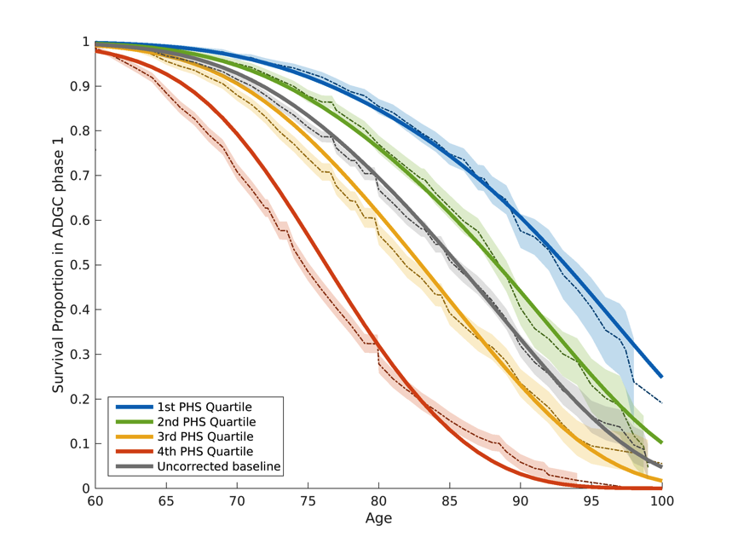
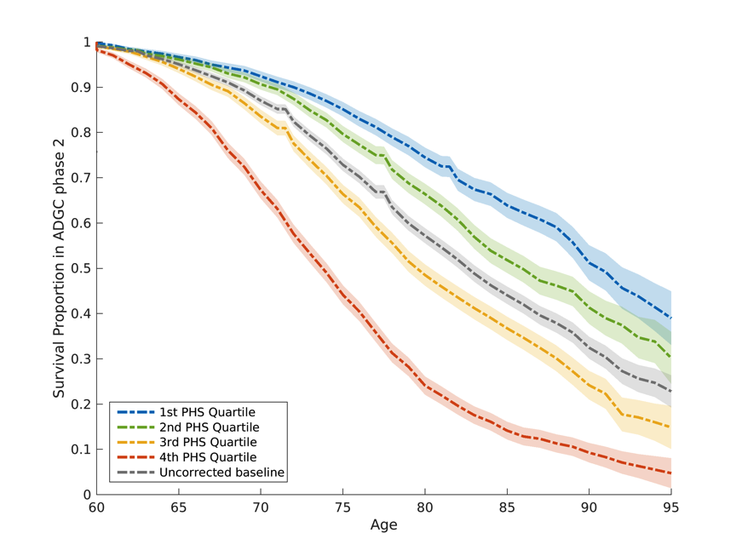
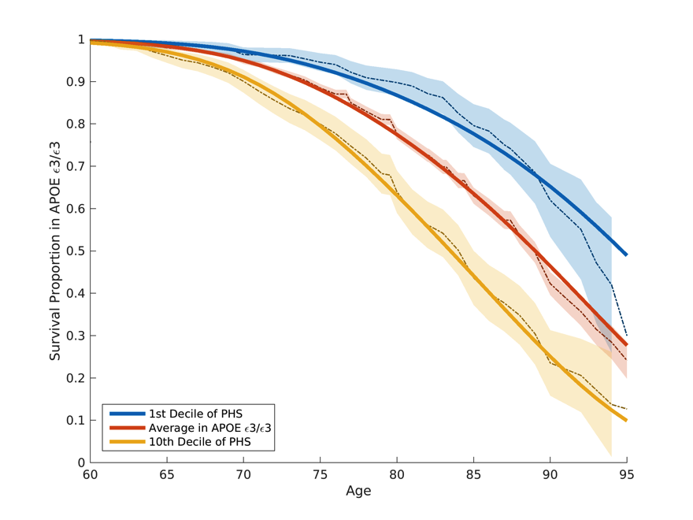
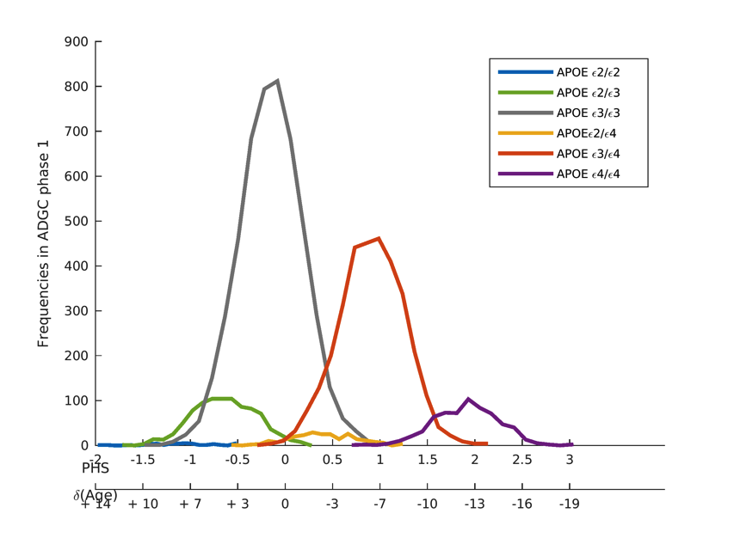
PHS as age-dependent risk stratifier
(Desikan and Fan et al., 2017, Plos Medicine)

Slide 12
PHS as a biomarker for AD
(Tan et al., 2018)
(Tan et al., 2019)
Chin Hong Tan

Slide 13
Polygenic component on sex differences
(Fan et al., 2019)

Slide 14
The implication for hazard analysis
Thinking about incidence rate differences
  The trade off between prevalence data and incidence info
For AD:
  The polygenic components also have time dependent properties
  The genetic basis for rate differences
    Cognitive reserve and age-dependent rates (Jansen et al., 2019)
      Sex differences?

Slide 15
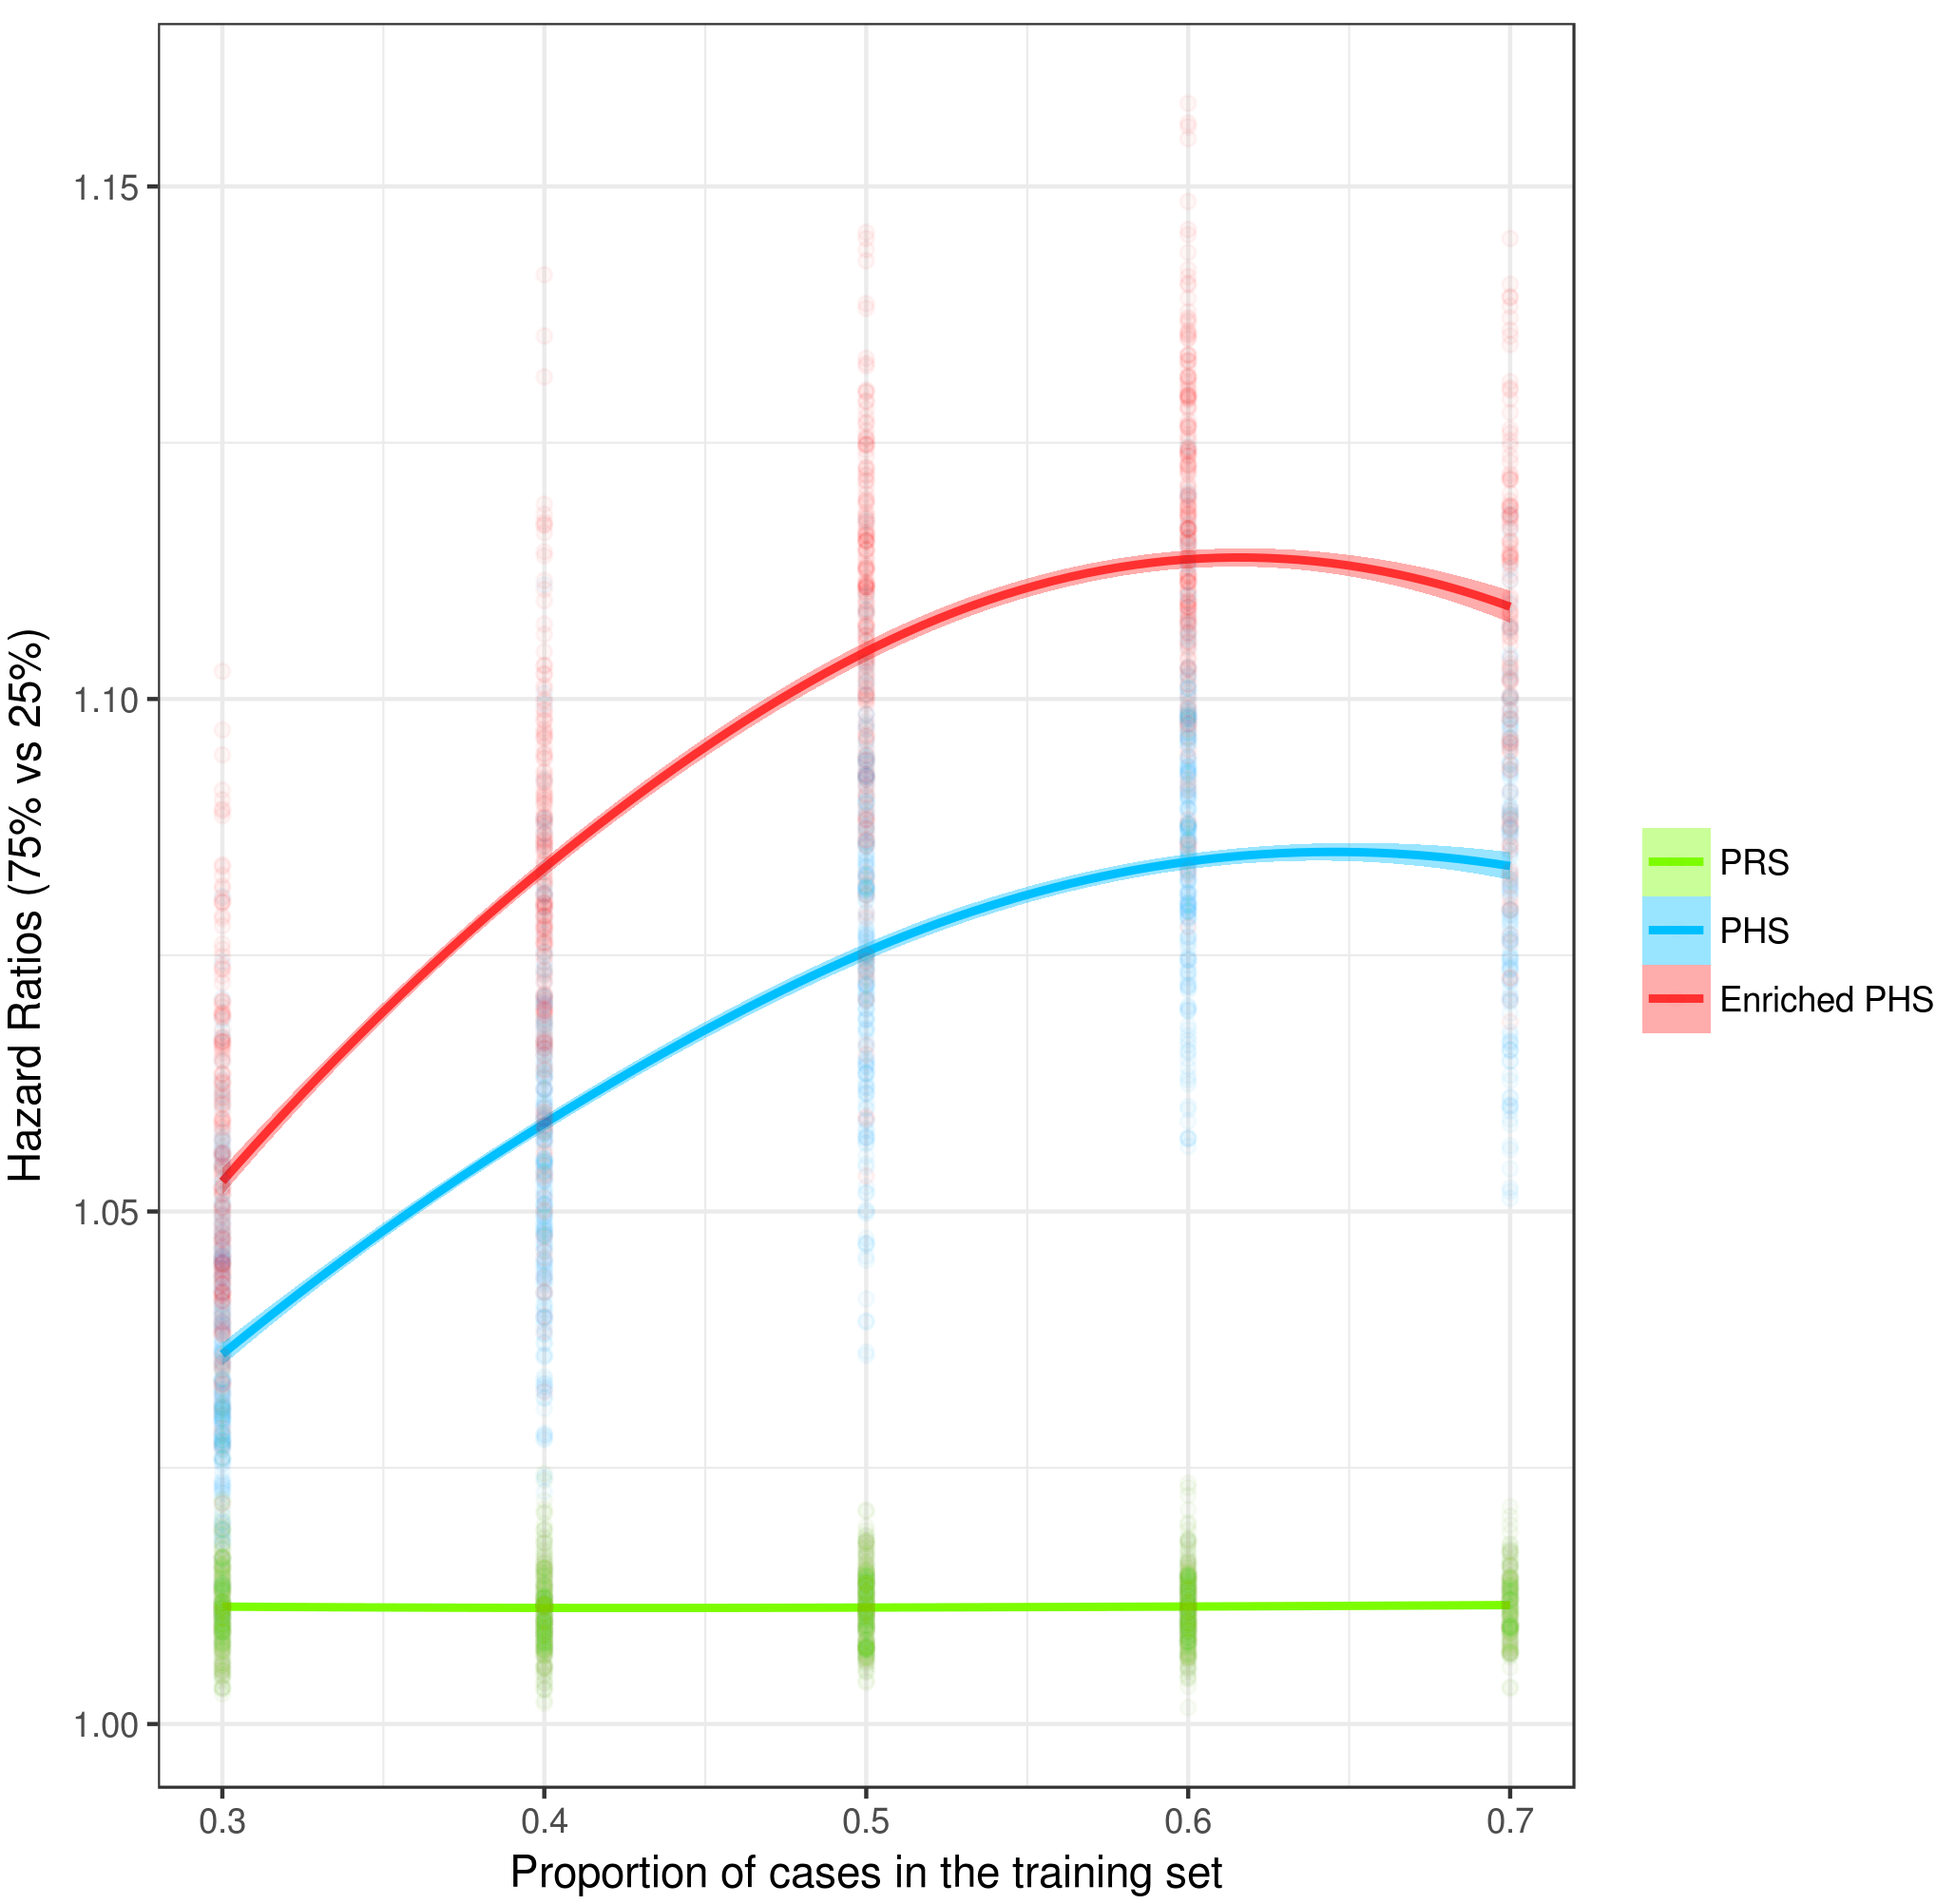
Next Step:
Combing pleiotropy and hazard scoring

Slide 16

Acknowledgement
Rahul Desikan
Anders M. Dale
Terry Jernigan
Wesley K. Thompson
Rong Zablocki
Ole Andreassen
Jennifer Yokoyama
Sarah Banks
Chin Hong Tan
Iris Broce

Slide 17
THANK YOU

