Slide 1
Neuropathology & Genetics of Parkinsonism
Dennis W. Dickson MD
Department of Neuroscience
Mayo Clinic, Jacksonville, FL

Slide 2
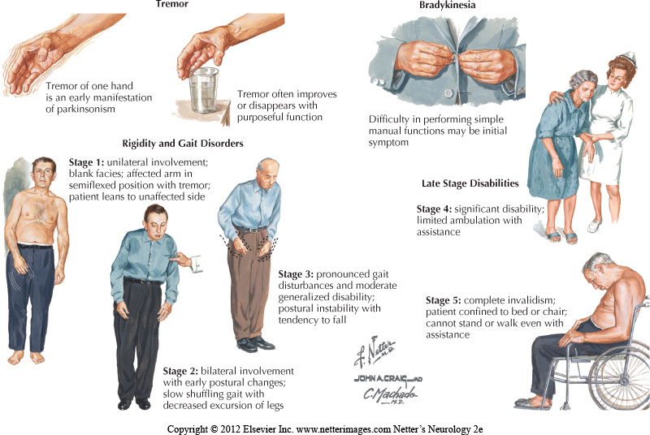
Parkinsonism: clinical syndrome

Slide 3
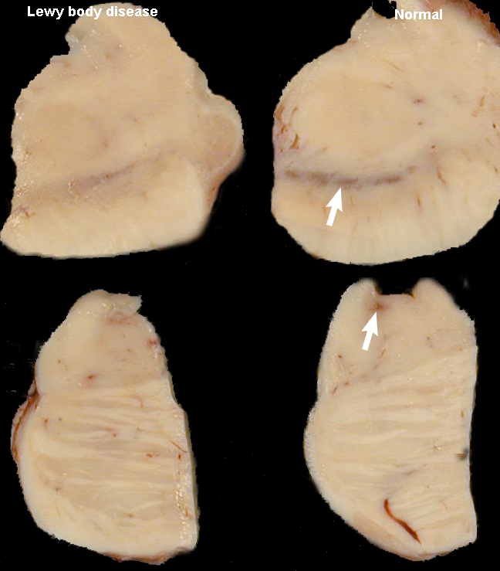
Macroscopic findings in Parkinsonism
Loss of neuromelanin pigmentation of substantia nigra (dopaminergic neurons) and locus ceruleus (noradrenergic neurons)

Slide 4
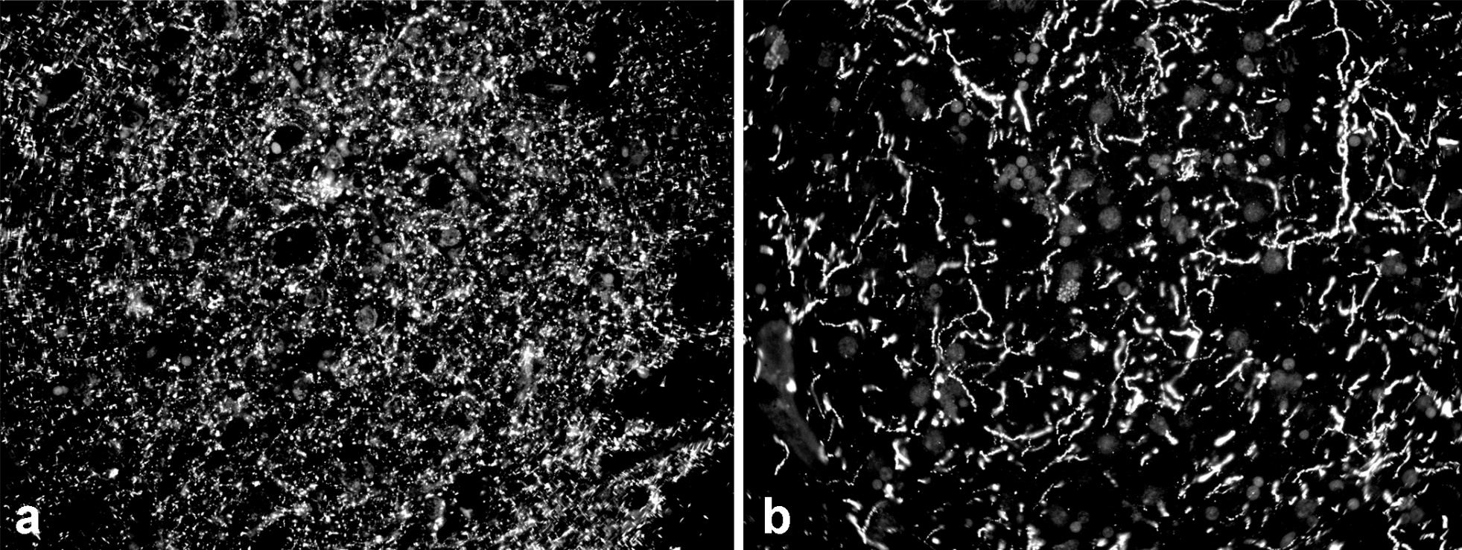
Tyrosine hydroxylase immunoreactivity in striatum
a – normal; b – Parkinson’s disease
(dopaminergic deficiency)

Slide 5
Age related decreases in striatal dopaminergic innervation in normal controls

Slide 6
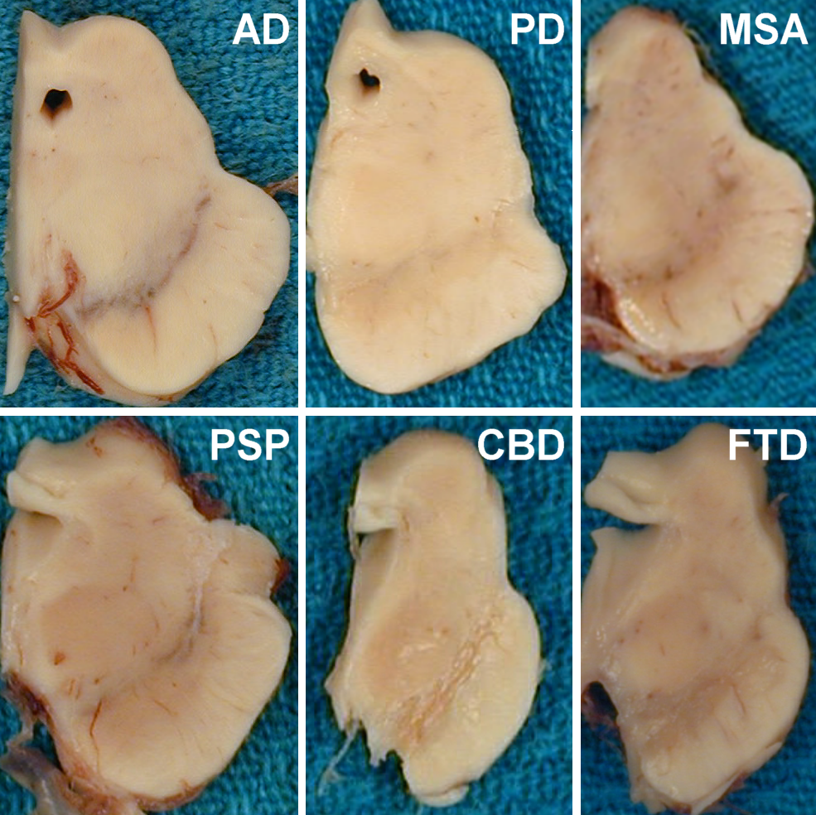
Substantia nigra in Parkinsonism
S. nigra neuronal loss common to all disorders associated with parkinsonism
normal pigment in AD
PD = Parkinson’s disease
MSA = multiple system atrophy
PSP = progressive supranuclear palsy
CBD = corticobasal degeneration
FTD = frontotemporal dementia

Slide 7
Synucleinopathies
Parkinson’s disease (PD), Parkinson disease dementia (PDD) and dementia with Lewy bodies (DLB)
Lewy body dementia = PDD + DLB

Slide 8
Genetics of Lewy body dementia
SNCA – coding and multiplication
  A53T and E46K – atypical Parkinsonism with dementia
  SNCA triplication and duplication
GBA – rare and common variants (E326K)
APOE – common variants (APOE4)

Slide 9
Copy number variation (CNV) in DLB
Whole genome sequencing 1454 autopsy confirmed DLB and 1525 controls
  International consortium of DLB with cases from brain banks in US and Europe
Genome-wide significant CNVs identified in 5 regions
  Lysosomal gene (LAPTM4B)
  NME1
  SPAG9
  SNCA
  MAPT
Kun-Rodrigues C, et al. A comprehensive screening of copy number variability in dementia with Lewy bodies. Neurobiol Aging 2019;75:223.e1-223.

Slide 10
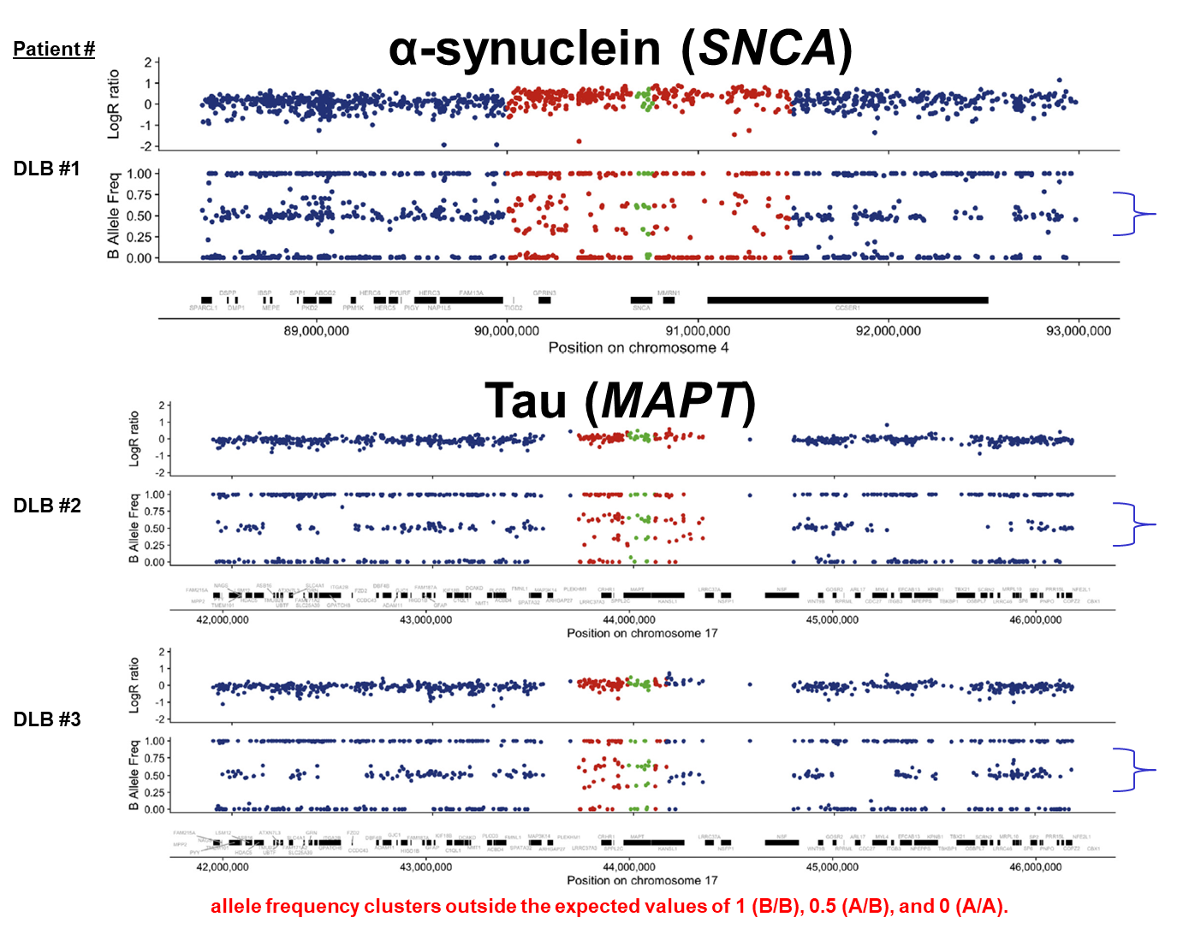

Slide 11
GBA and LBD
Gaucher disease (GD) - frequent lysosomal storage disease due to mutations in glucocerebrosidase 1 (GBA)
Glucocerebrosidase (GCase) hydrolyses glycolipid glucocerebroside to ceramide and glucose
Epidemiological show association between GBA and both PD and LBD
Suggests a role for lysosomal dysfunction in PD and LBD
Gatto EM, et al. Parkinsonisms and glucocerebrosidase deficiency: A comprehensive review for molecular and cellular mechanism of glucocerebrosidase deficiency. Brain Sci. 2019;9(2). doi: 10.3390/brainsci9020030

Slide 12
GBA associated with dementia in PD
733 patients had GBA genotyping (including clinical and autopsy-confirmed cases)
Most common variants: N370S (n=8) and L144P (n=10)
Most common nonsynonymous SNP: E326K (n=32)
Davis MY, et al. Association of GBA mutations and the E326K polymorphism with motor and cognitive progression in Parkinson disease. JAMA Neurol 2016;73:1217-1224

Slide 13
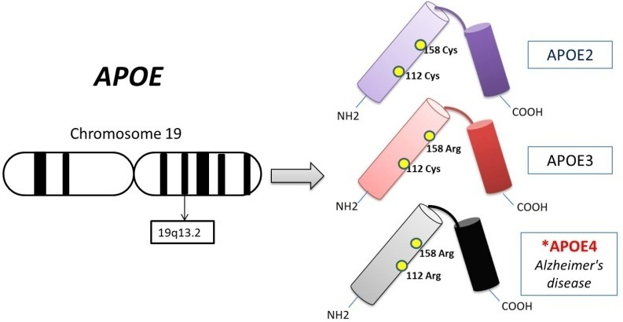
Apolipoprotein E & Lewy body disease
Three genetic variants of gene located on chromosome 19 – APOE4 is risk for AD
APOE4 is not a risk factor for PD.
APOE4 is a risk factor for DLB.

Slide 14
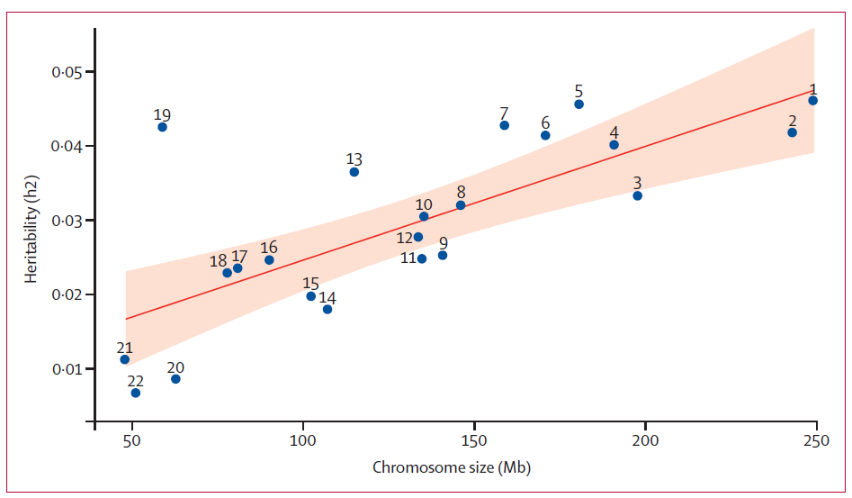
Chromosome 19 locus in DLB
Two-Stage GWAS
1743 DLB (1324 autopsy), 4454 controls (1216 DLB vs 3791 controls in discovery stage; 527 vs 663 in replication stage)
Associations found:
  APOE: OR 2.40, 95% CI 2.14–2.70; p=1·05 × 10⁻⁴⁸
  SNCA: OR 0.73, 0.66–0.81; p=6.39 × 10⁻¹⁰
  GBA: OR 2.55, 1.88–3.46; p=1·78 × 10⁻⁹
Heritability (y axis) per chromosome is plotted against chromosome length (x axis). The red line represents heritability regressed on chromosome length and the shaded area represents the 95% CI of the regression model.
Guerreiro R, et al. Investigating the genetic architecture of dementia with Lewy bodies: a two-stage genome-wide association study. Lancet Neurol 2018;17:64-74.

Slide 15
Increased Lewy body pathology in APOE4
Dickson DW, et al APOE ε4 is associated with severity of Lewy body pathology independent of Alzheimer pathology. Neurology 2018;91(12):e1182-e1195

Slide 16
Genetic evidence for MAPT in PD (2009)
PD GWAS
www.pdgene.org
SNCA
MAPT
# | Gene | Polymorphism | Ethnicity | OR (95% CI) | P-value
1 | SNCA | rs356220 | All | 1.30 (1.26-1.35) | 3.35E-52
2 | MAPT | MAPT_H1H2 | Caucasian | 0.78 (0.75-0.80) | 2.06E-49
3 | GBA | GBA_N370S | All | 3.36 (2.63-4.29) | 3.14E-22
4 | LRRK2 | rs34778348 | Asian | 2.23 (1.89-2.63) | 2.97E-21
5 | PM20D1 | rs11240572 | All | 0.74 (0.69-0.80) | 1.01E-14
6 | GAK | rs1564282 | All | 1.29 (1.20-1.38) | 6.54E-13
7 | MCCC1 | rs11711441 | All | 0.84 (0.80-0.89) | 8.72E-12
8 | STK39 | rs2102808 | All | 1.28 (1.19-1.38) | 1.54E-11
9 | BST1 | rs4698412 | All | 0.87 (0.83-0.91) | 2.28E-10
10 | GPNMB | rs156429 | All | 0.89 (0.86-0.93) | 2.69E-10
Meta-analysis indicates MAPT is a risk factor for PD.
Simon-Sanchez J, et al. Genome wide association study reveals genetic risk underlying Parkinson's disease. Nat Genetics 41:1308, 2009.

Slide 17
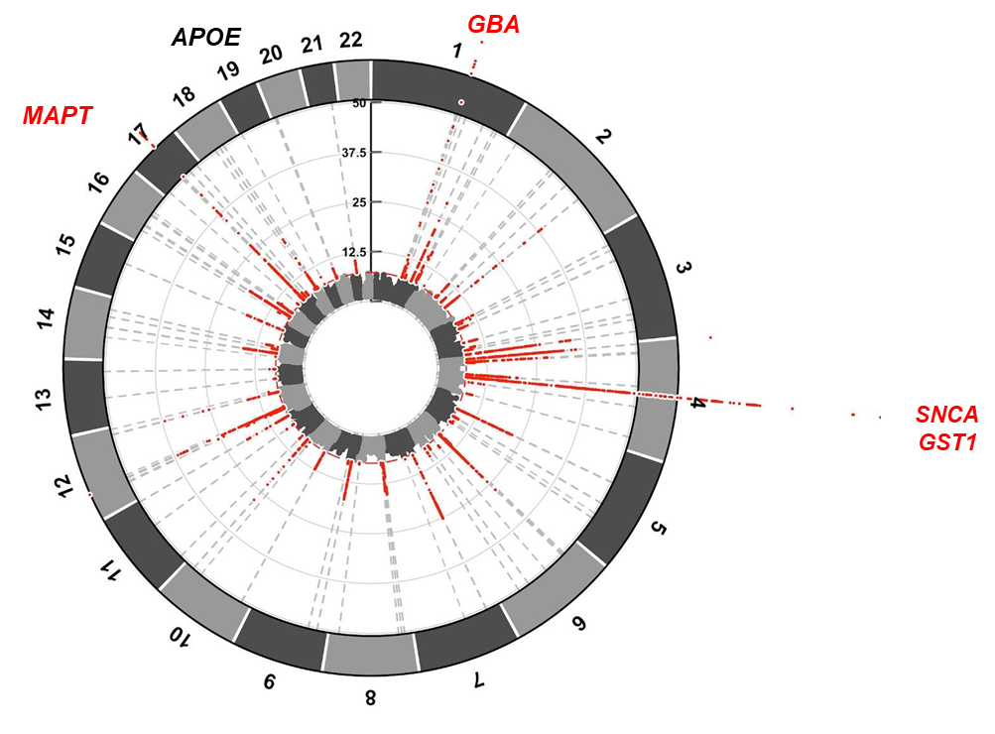
PD GWAS (2018)
38,000 PD patients
1.4 million controls
11.4 million SNPs
39 novel risk loci
92 independent genome-wide significant signals
53 previously unknown
Nalls M, et al. Parkinson’s disease genetics: identifying novel risk loci, providing causal insights and improving estimates of heritable risk. BioRχiv 2018.

Slide 18
MAPT H1/H1 is not increased in autopsy-confirmed Lewy body disease (Mayo Clinic autopsy series)
Pathologic Dx | N | M:F | H1 frequency | P value vs. control | H1/H1 frequency (%) | P value vs. control
All LBD | 296 | 144:152 | 79.4 | 0.251 | 65.2 | 0.690
Pure LBD | 94 | 63:31 | 78.2 | 0.226 | 64.9 | 0.737
Mixed LBD (AD or other pathology) | 202 | 81:121 | 80.0 | 0.331 | 65.3 | 0.724
Controls | 61 | 32:29 | 84.4 | … | 68.0 | …
Unpublished data
See also: de Silva R, et al. The tau locus is not significantly associated with pathologically confirmed sporadic Parkinson’s disease. Neurosci Lett 2002;330:201–203.

Slide 19
Possible explanations for MAPT as a genetic risk factor for PD
Admixture of parkinsonian tauopathies (e.g., PSP) with strong genetic association with MAPT in clinical PD GWAS studies?
  MAPT association was not found in autopsy-confirmed PD GWAS (Beecham et al.)
  484 PD and 1,145 controls; genotyped and imputed to 3,922,209 loci
Tau and α-synuclein share common pathways.
  Physiological
    Axonal transport – structural MAPs
    Synaptic function
      Shared kinases – PKA, Fyn & GSK3β
  Pathological
    Fibrillation (cross-seeding)
      Tau in Lewy bodies
      Tau and α-synuclein fibrils within neurons
Beecham GW, et al. PARK10 is a major locus for sporadic neuropathologically confirmed Parkinson disease. Neurology 2015;84:972-80

Slide 20
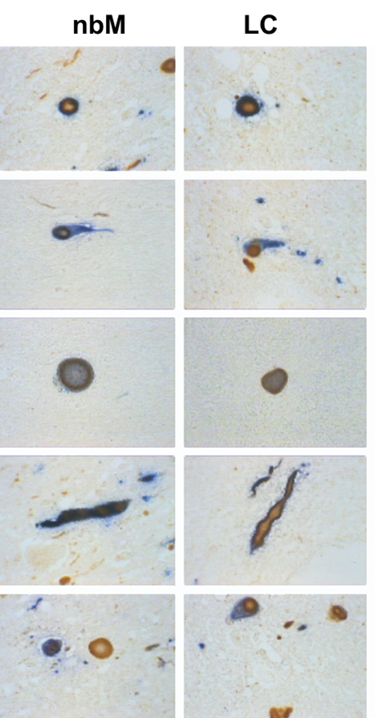
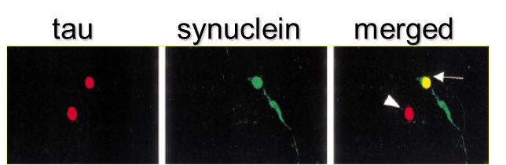
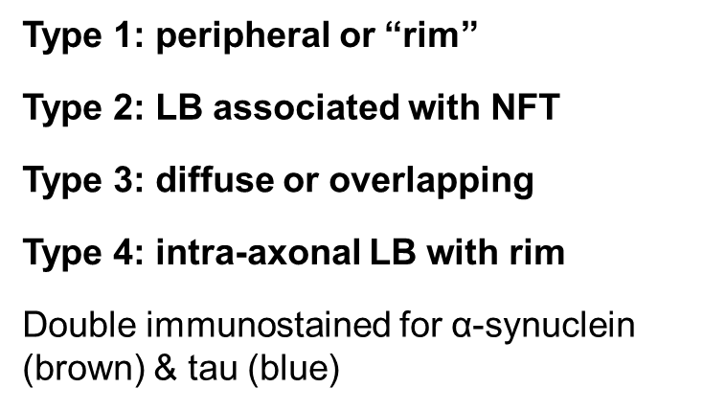
Tau in Lewy bodies
Tau in Lewy bodies most often in regions vulnerable to tau – basal nucleus and locus ceruleus (coincidental?)
Ishizawa T, et al. Colocalization of tau and alpha-synuclein epitopes in Lewy bodies. J Neuropathol Exp Neurol 2003; 62:389-397.

Slide 21
Parkinsonian tauopathies
Progressive supranuclear palsy (PSP) and corticobasal degeneration (CBD)

Slide 22
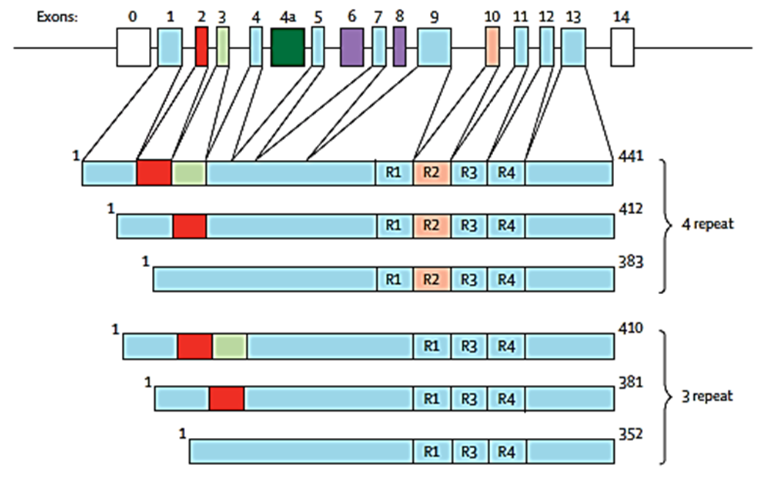
Alternative mRNA splicing of the tau gene on chromosome 17 generates 6 major isoforms
Exon 10
4R tau
R = repeats
(30-32 aa) in microtubule binding domain
3R tau
Spillantini MG, Goedert M. Tau pathology and neurodegeneration. Lancet Neurol 2013;12:609-22.

Slide 23
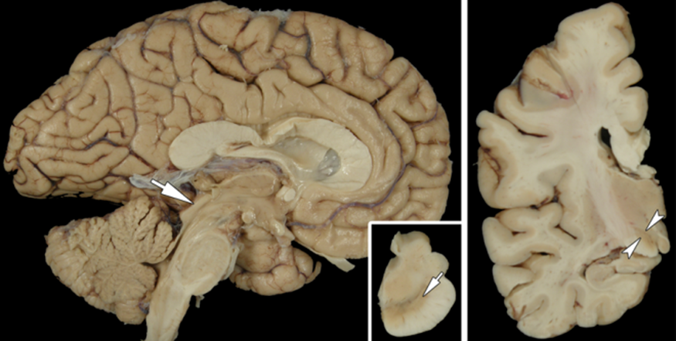
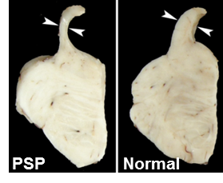
Progressive supranuclear palsy
Midbrain atrophy
Depigmentation of substantia nigra
Subthalamic nucleus (STN) atrophy
Atrophy of superior cerebellar peduncle
Globose NFT in SN
Neuronal loss and gliosis in STN
Grumose (synaptic) degeneration in cerebellar dentate nucleus
Globose NFT (tau)
Tufted astrocytes
Coiled bodies (oligodendroglia)

Slide 24
Corticobasal degeneration
Focal cortical atrophy, often parasagittal frontoparietal
Thin corpus callosum
Loss of neuromelanin pigment in substantia nigra
Ballooned cortical neurons
Astrocytic plaques
Pleomorphic neuronal lesions
Corticobasal bodies (substantia nigra)
Corticobasal bodies
Neuropil threads

Slide 25
A personal history of the genetics of PSP
Collaborative research on path-confirmed PSP
  Sample sharing
    USA – Saitoh, Schellenberg
    UK – Hardy, Houlden, de Silva
    Germany – Muller, Hoglinger
    Belgium – Van Broeckhoven
  Consortia
    CurePSP genetics consortium
      GWAS
      WES
      WGS
    UG3 NINDS grant (Coppola/Geschwind)
  ADSP and other AD genetics consortia
    Mayo Clinic (Drs. Younkin, Golde and Taner)
    PSP as a disease control (tau pathology without amyloid)

Slide 26
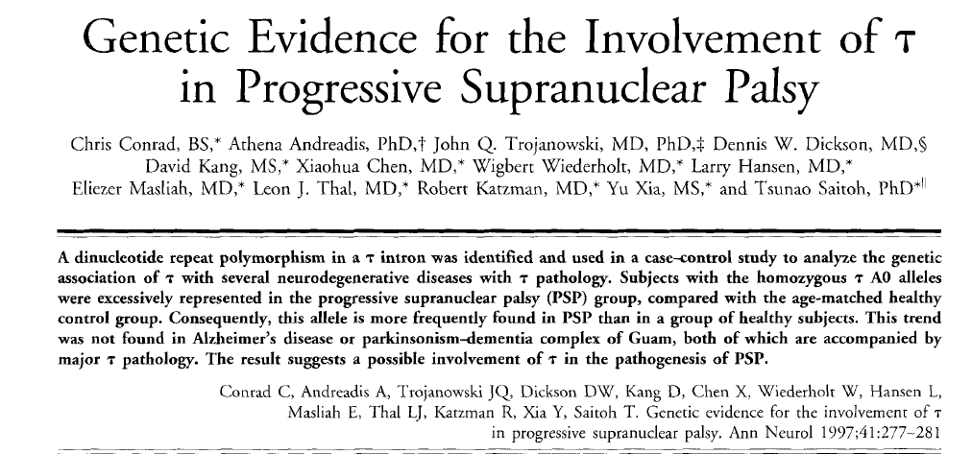
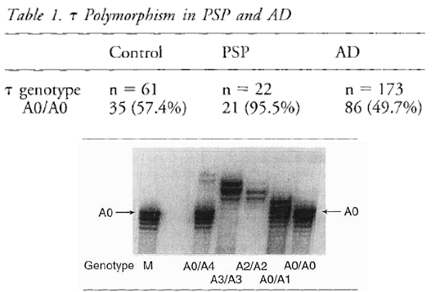
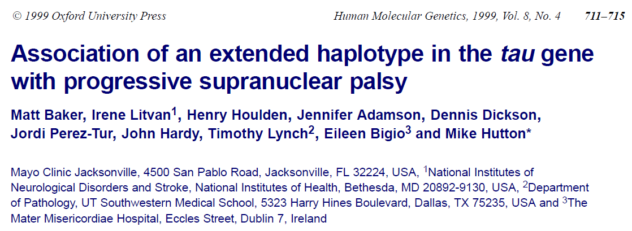
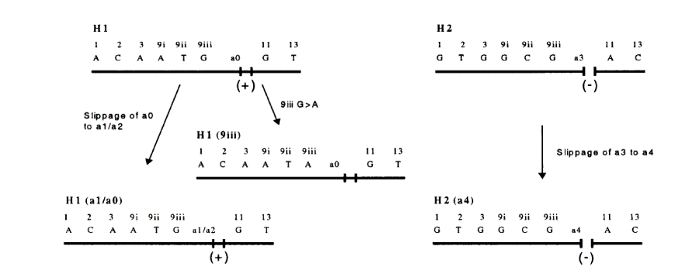
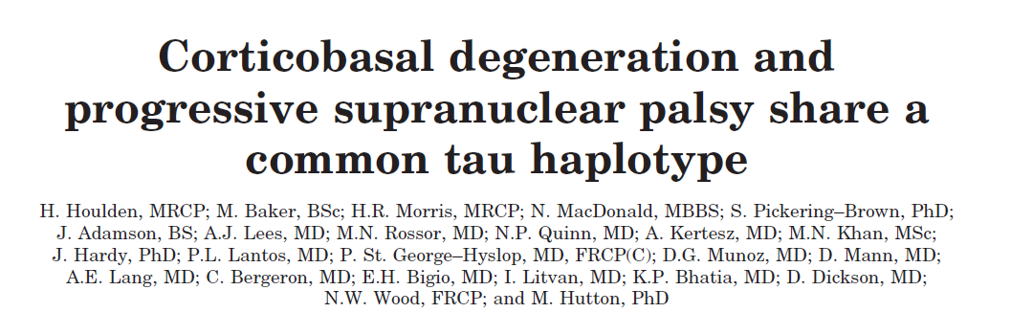
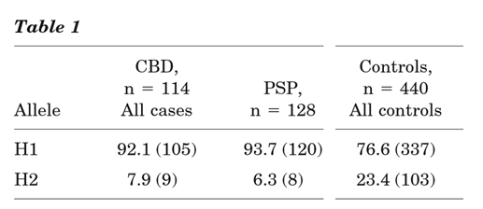
1997
1999
2001

Slide 27
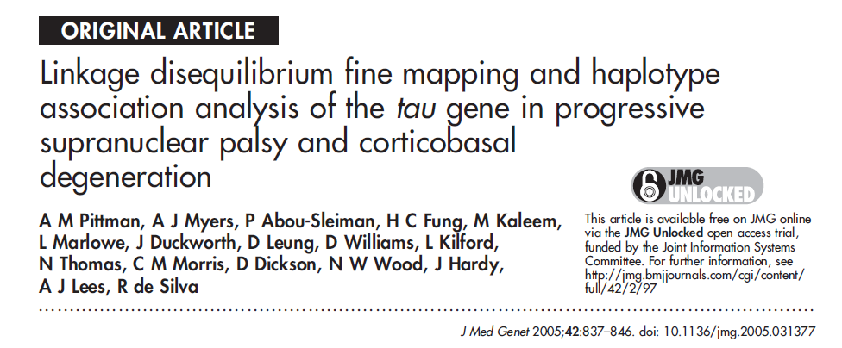
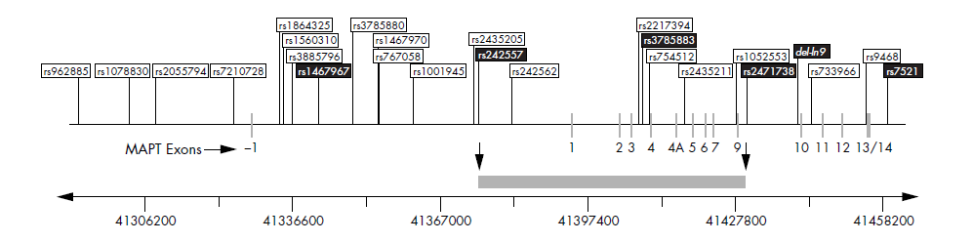
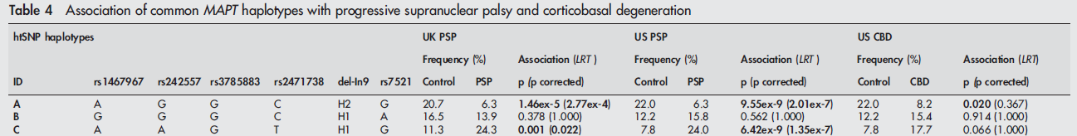
Refinement of MAPT
risk locus for PSP

Slide 28
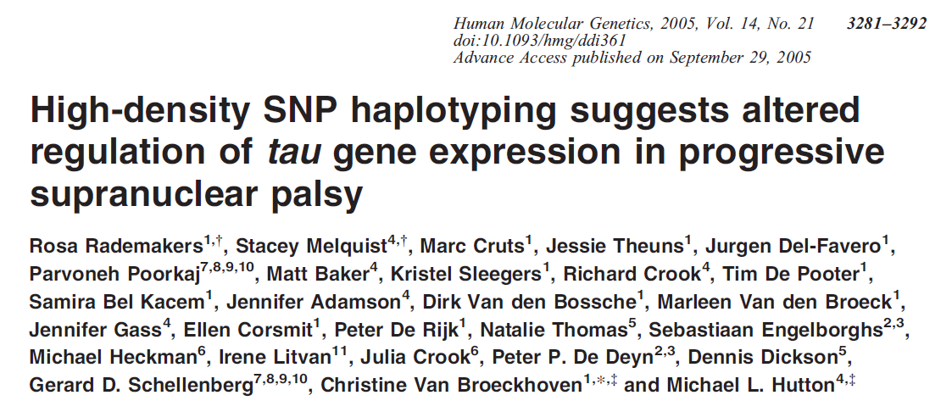
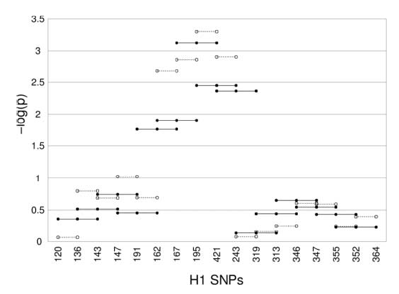
Refinement of MAPT
risk locus for PSP

Slide 29
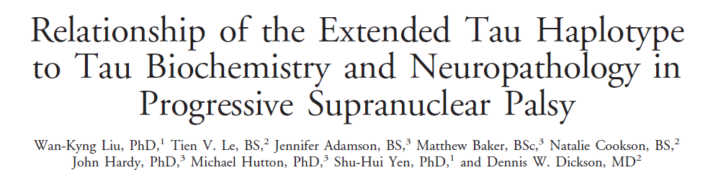
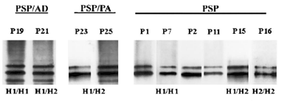
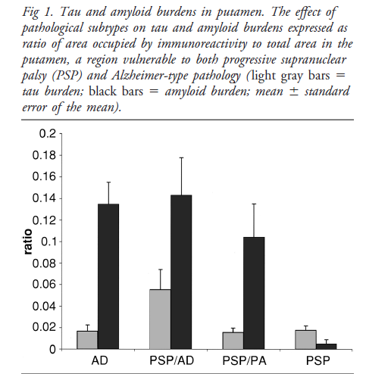
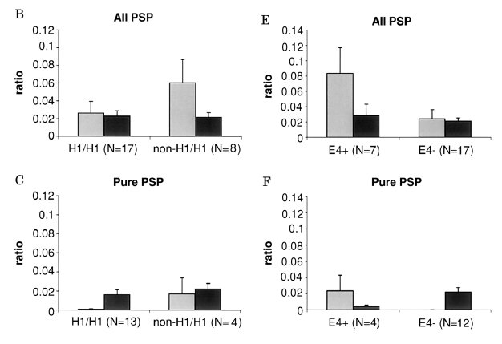
Heterogeneity of biochemical profile of insoluble tau in PSP is related to APOE not MAPT.
PA = pathological aging (high plaque, minimal tangles)
AD = Alzheimer disease (high plaque, moderate to frequent tangles)

Slide 30
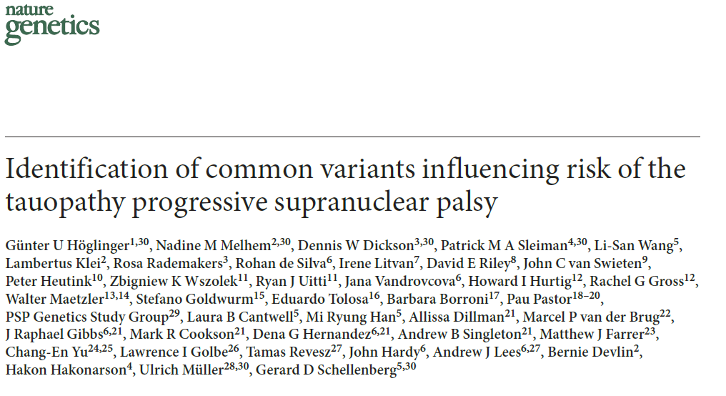
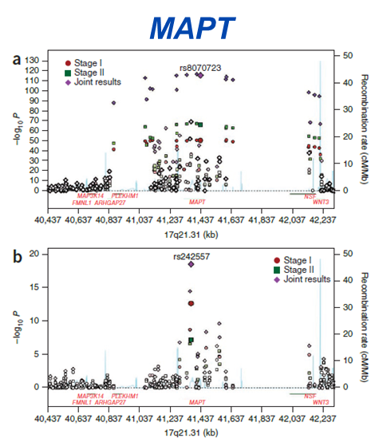
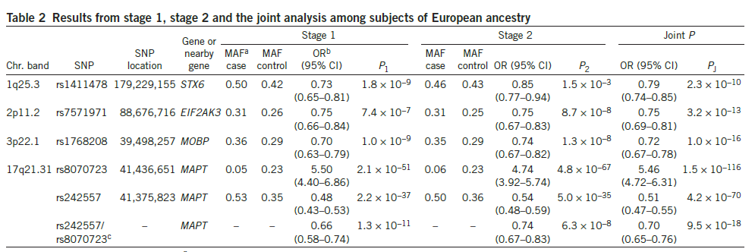
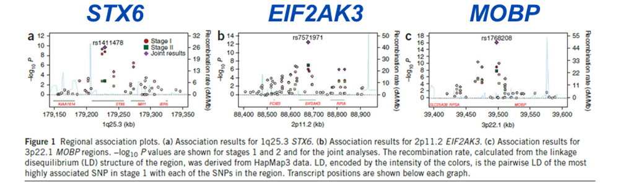
PSP GWAS 2011
Non-tau genes
Syntaxin 6 - catalyzes synaptic vesicle fusion with membranes
MOBP – myelin oligodendro-cyte binding protein
EIF2AKe – PERK, unfolded protein response

Slide 31
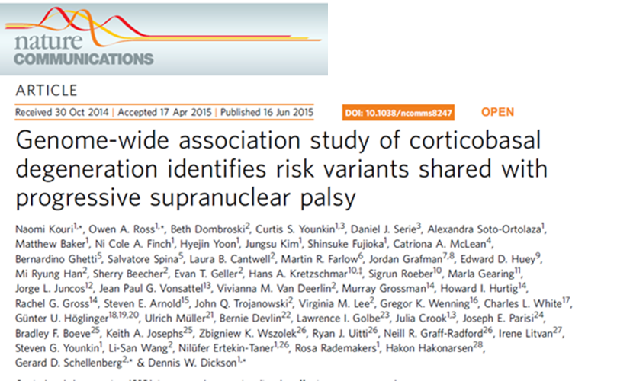
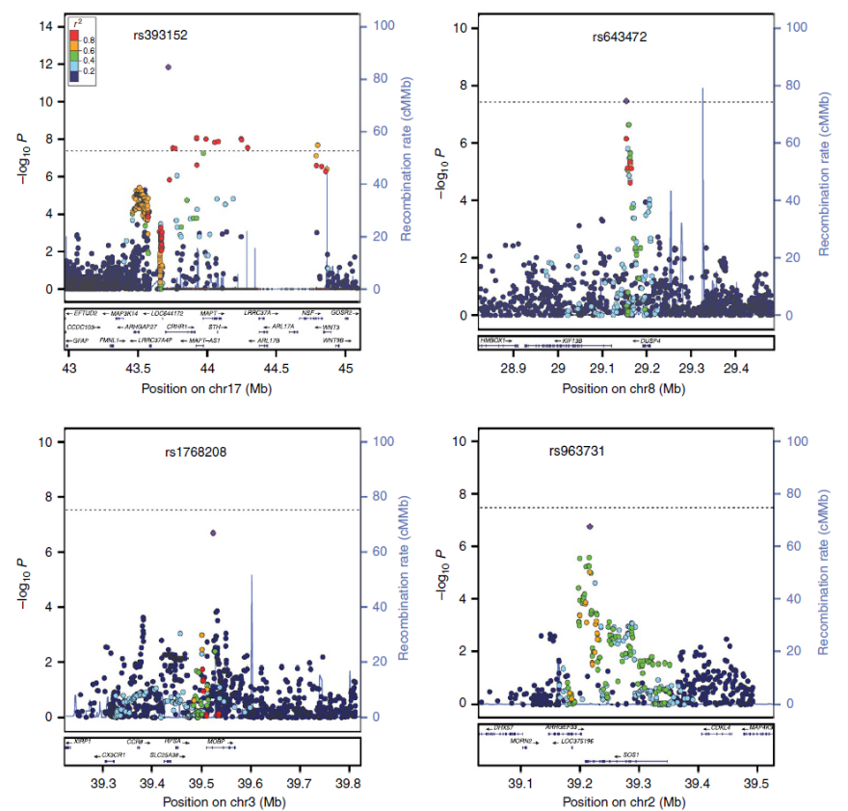
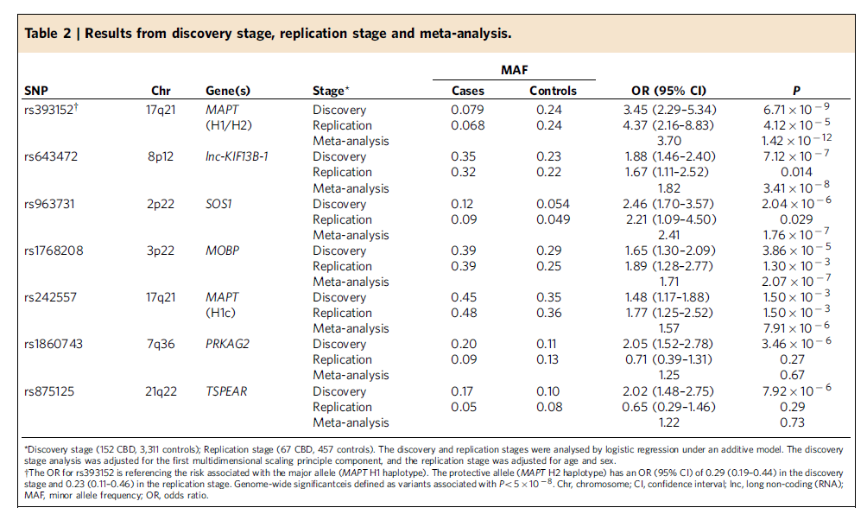
CBD GWAS
(2015)
Genome wide significance (<10⁻⁸)
  Chr 17 – MAPT (H1/H2)
  Chr 8 – KIF13B-1
Trend
  Chr 3 – MOBP (10⁻⁷)
  Risk loci: shared and different from PSP

Slide 32
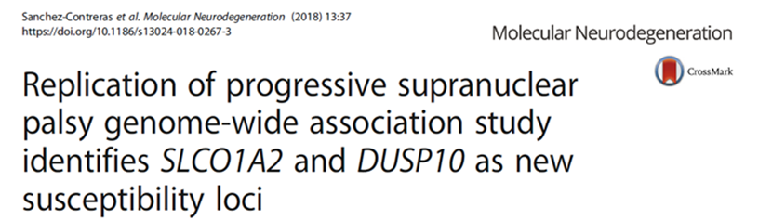
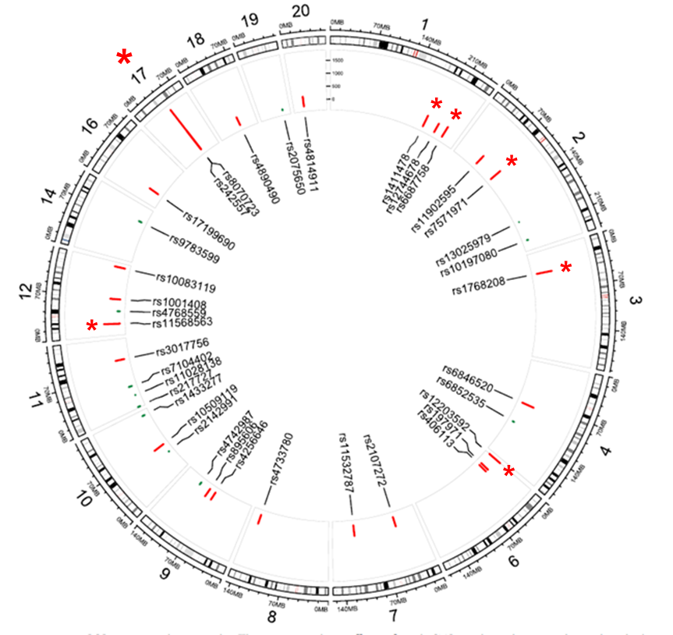

PSP meta-analysis 2018
SLCO1A2 - Solute carrier
DUSP10 - Kinase activator
Meta analysis with 533 new path-confirmed PSP
Controls – Mayo Clinic neurologic normal volunteers
Genotyping 37 SNP’s with p<10⁻⁴ identified from CurePSP GWAS
Genome-wide
  MAPT (H1H2 and H1c) (Chr 17)
  MOBP (Chr 3)
  IRF4 (age-dependent) (Chr 6)
  EIF2AK3 (Chr 2)
  STX6 (Chr 1)
  SLCO1A2 (Chr 12)
  DUSP10 (Chr 1)

Slide 33
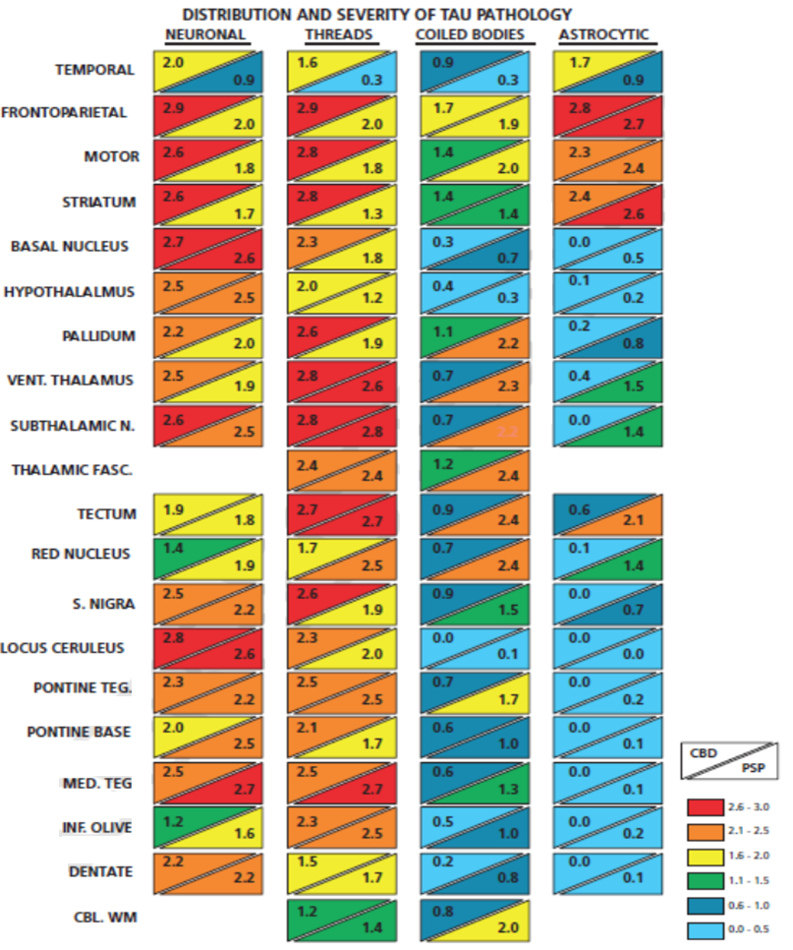
More threads in CBD in most areas
CBD
PSP
Astrocytic tau in both CBD and PSP is mostly in forebrain
CBD – more neuronal tau in forebrain
Semi-quantitative scores for NFT, TA, CB and NT in 19 brain regions
Oligodendroglia tau is more common in PSP than in CBD
PSP – more neuronal tau in hindbrain
Semiquantitative scores: 0 = none,
1 = mild, 2 = moderate, 3 = severe
Dickson DW, et al. Progressive supranuclear palsy and corticobasal degeneration. Neurodegeneration: The Molecular Pathology Of Dementia And Movement Disorders.
Second Edition. 2011.

Slide 34
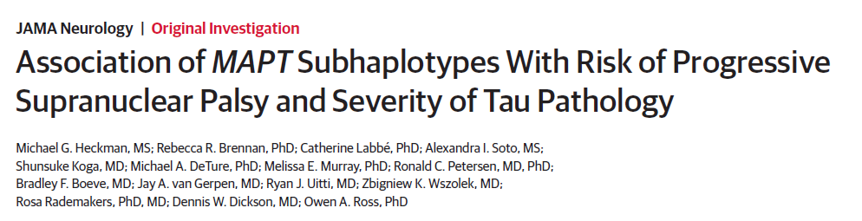
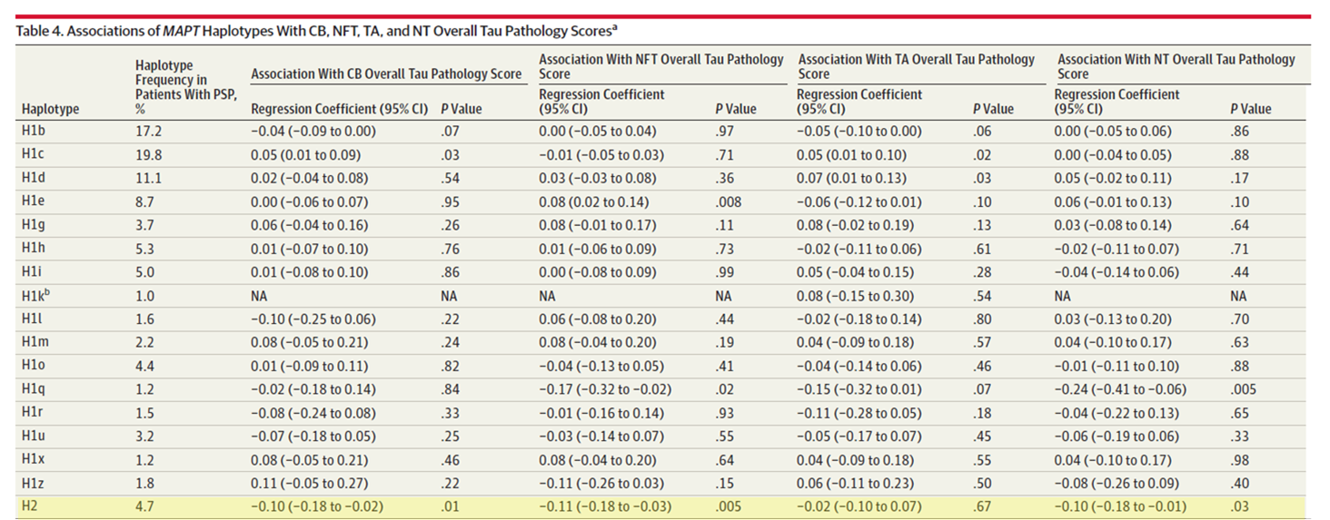
MAPT subhapotypes associated of tau quantitative traits
CB
NFT
TA
NT
H2 negatively associated with both neuronal and glial tau pathology scores

Slide 35
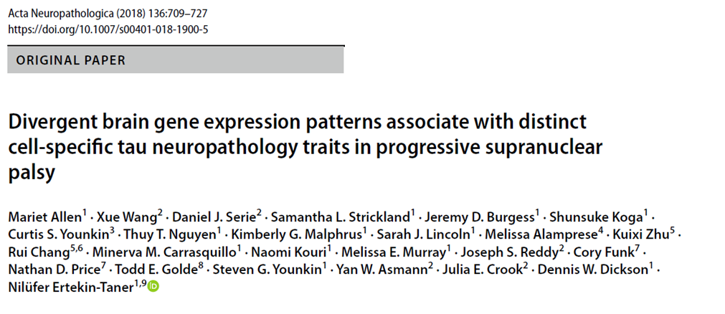
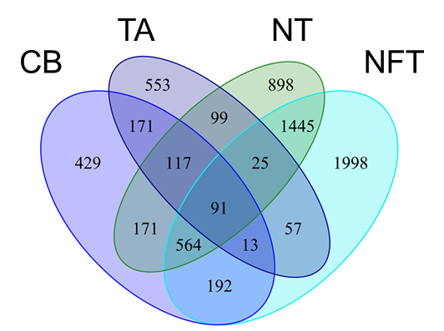
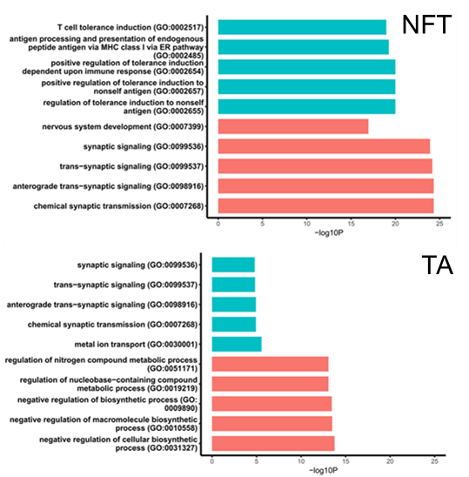
Overlap in gene expression by lesion type
Gene ontology modules
Transcriptome-wide association study of relatively unaffected regions (temporal cortex)
  Neuronal (NFT), Astrocytic (TA), Oligodendroglial (CB), Tau threads (NT)
Novel genes and pathways may underlie distinct aspects of tau neuropathology.
Different mechanisms may drive cell-specific tau pathology in neurons vs. astrocytes.
NFT are associated with brain co-expression network enriched for synaptic genes
TA are associated with immune genes

Slide 36
Summary
PSP is the most common of the parkinsonian tauopathies.
It rarely has autosomal dominant inheritance and in almost all cases this is due to MAPT mutations.
The strongest genetic risk factor for sporadic PSP is MAPT.
Other genetic risk loci have been identified, but their relationship to clinical and pathologic features of PSP are less obvious than MAPT.
  Unfolded protein response (EIF2AK3)
  Vesicle membrane fusion (STX6)
  Myelin structure (MOBP)
Gene expression studies show disrinc profiles for each of the major pathologic tau pathologies (NFT, TA, CB, NT)
  Gene ontology suggests neuronal tau is positively associated with synaptic genes
  Gene ontology suggests astrocytic tau is positively associated with immune genes

Slide 37

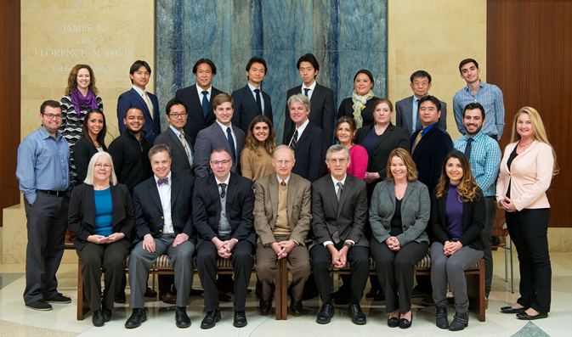



Acknowledgements
  Genetics
    Steve Younkin, MD, PhD, Nilufer Ertekin-Taner, MD, PhD, Rosa Rademakers, PhD, Owen Ross, PhD, Mariet Allen, PhD.
  Neuroscience
    Guojun Bu, PhD; Leonard Petrucelli, PhD; Casey Cook, PhD
  Neurology
    Zbigniew Wszolek, Bradley Boeve, David Knopman,
    Neill Graff-Radford, Keith Josephs
Brain bank coordinators:
Beth Marten, Jessica Tranovich, Rachel LaPaille-Harwood

