Slide 1
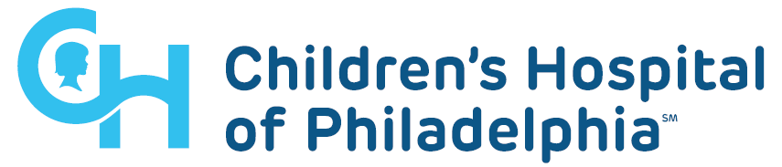
Variant-to-gene mapping for Alzheimer’s disease
Alessandra Chesi, PhD
chesia@email.chop.edu

Slide 2
What is the genetic variant regulating?
Sentinel SNP
X
Proxy
X
X
X
Intronic or intergenic variants
Local promoter?
Promoter further afield?
Notes:
Tell the FTO story: Nature 2014 and NEJM 2015. FTO obesity locus paper Smemo et al., Nature 2014 – 4C, IRX3.
Studies in mice demonstrated that FTO expression levels influence body mass and composition phenotypes. Obesity-associated SNPs are associated with expression of IRX3, but not FTO, in human brains. Irx3-deficient mice exhibit a 25–30% reduction in body weight, primarily through the loss of fat mass and increase in basal metabolic rate with browning of white adipose tissue.
So, like the FTO study, we want to know:
DOES this region harboring the GWAS SNP influence the local promoter or a promoter further away (as an embedded enhancer).

Slide 3
From signals to therapeutic targets
Causal variant in LD block
Relevant cell type
Upstream regulator
Effector gene(s) at given loci
Biological mechanism

Slide 4
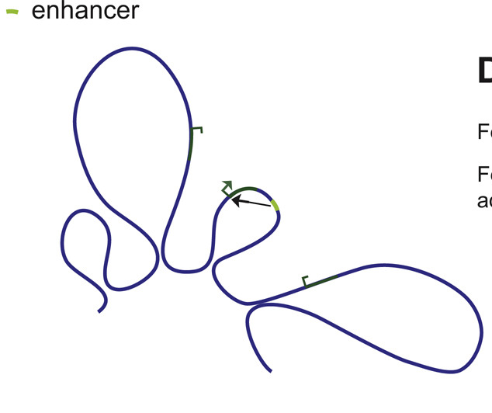
Chromatin Conformation Capture (3C)
3C (1 to 1)
Hi-C (all to all)
4C (1 to all)
Capture C (many to all)
gene expression
SNP
Adapted from Pękowska et al., Cell Systems 2018
Notes:
To solve this problem, we need to take into account a feature of the human genome: 3D folding.
3C-based techniques (since 2002) allow mapping of contacts in 3D space between distant regions of the genome, such as enhancers harboring GWAS signals and gene promoters

Slide 5
Rationale
Develop a massively parallel, high resolution 3C based method
Simultaneously characterize genome-wide interactions of all human promoters
of coding and non-coding genes (including alternative promoters)
Applicable to any cell type
Applied to relevant human cell and tissue types
Notes:
to solve these problems (resolution and sequencing depth) and to have genome-wide coverage we decided to go with Capture C

Slide 6
Genome-scale Promoter ‘Interactome’
Design
Custom Agilent SureSelect library targeting both ends of DpnII restriction fragments overlapping:
Promoters of protein-coding (RefSeq)
Non-coding and Antisense RNA (Refseq)
snoRNA
miRNA
lincRNA transcripts
Totaling 36,691 RNA baited fragments
Sequenced on Illumina Novaseq
Type Total Not designed %Designed
Coding RNA 24326 1283 95%
Non-coding RNA 8309 982 88%
lincRNA 18543 3828 79%
miRNA, snoRNA, etc 101 20 80%
All 51279 6113 88%
Notes:
Capture-C, promoter capture Hi-C, HiChIP: HindIII, H3K427ac
Problems: resolution and sequencing depth. To solve these problems and to have genome-wide coverage we decided to go with Capture C, targeting all gene promoters
Our approach has the higher resolution than standard HindIII based approaches: DpnII (4-cutter) higher resolution (average 450bp) than HindIII (6-cutter) (~4kb).
I designed the library.

Slide 7
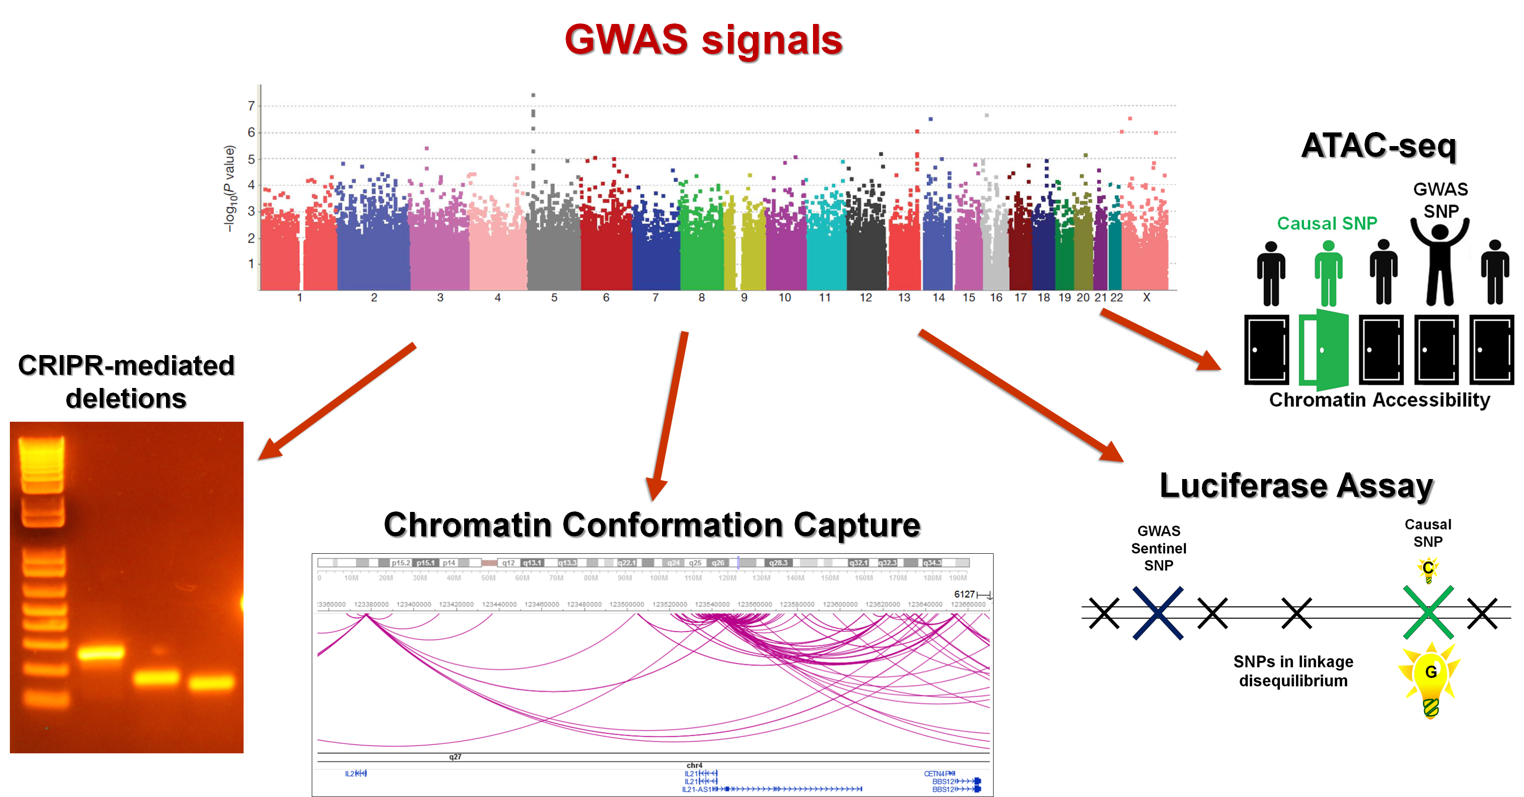
Using ATAC-seq to implicate causal variants
Vast majority of GWAS signals reside within intronic or intergenic regions
X
X
X
X
X
X
Notes:
GWAS studies have identified many loci associated with disease. However, these SNPs are not necessary the causal SNPs. As exemplified here, here are many SNPs that capture the association, but only one of them is causal. Some approaches have been developed to identify the causal SNP such as fine mapping from African genome, Bayesian modeling and looking at chromatin marks and eQTLs
Assay for Transposase-Accessible Chromatin to study chromatin accessibility (2013)
Mutant transposase Tn5 allows for highly efficient cutting of exposed DNA and simultaneous ligation of adapters

Slide 8
Integration of multi-omics datasets
Bioinformatic pipeline
SNiPA tool to generate proxy SNPs
ENCODE pipeline to pre-process ATAC-seq data and perform peak calling
HiCUP (pre-processing) + CHiCAGO (contact calls) for Capture C data
PORT and R for RNA-seq analysis

Slide 9
Visualization
WashU EpiGenome Browser, UCSC Genome Browser

Slide 10
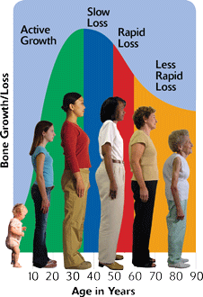
Osteoporosis and BMD
Bone mineral density (BMD) is used for:
the diagnosis of osteoporosis in adults
to assess bone health in children

Slide 11
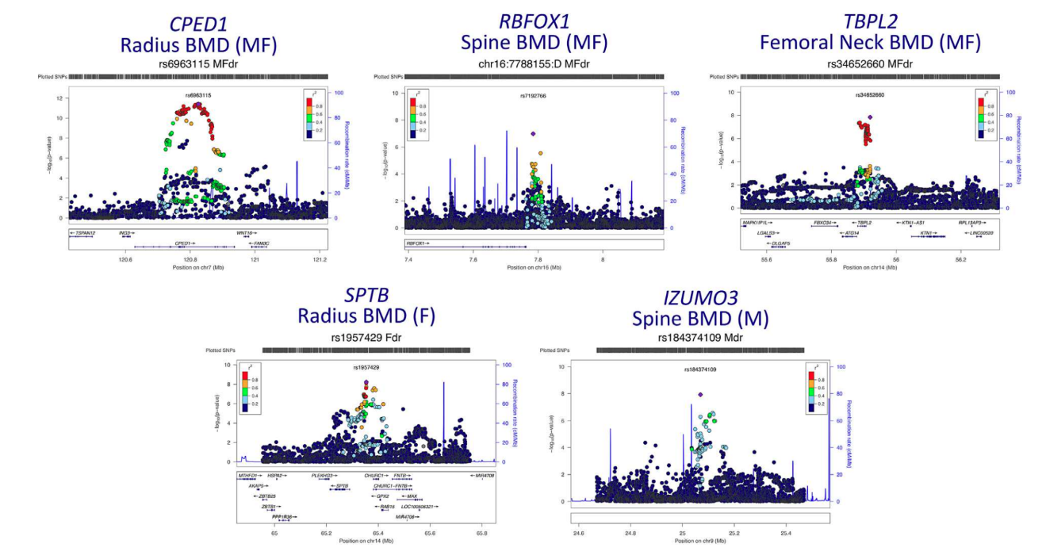
Many BMD GWAS loci reported to date
Chesi et al. JBMR 2017; Chesi et al. Hum Mol Genet 2015
Estrada, Nat Genet 2012
Zheng, Nature 2015
Medina-Gomez, AJHG 2018
Kemp, Nat Genet 2017
Notes:
Estrada 56 loci DEXA
Kemp: 142,487 individuals from the UK Biobank, 307 conditionally independent SNPs at 203 loci; ultrasound heel

Slide 12
Implicating effector genes at BMD GWAS loci
Considerations
Paucity of bone-related cell types in ENCODE, GTEx and other public resources
Elected to carry out direct, high-resolution, physical ‘variant-to-gene’ mapping
Applied to primary human MSC-derived osteoblasts
from bone marrow of 3 healthy individuals
model relevant to bone

Slide 13
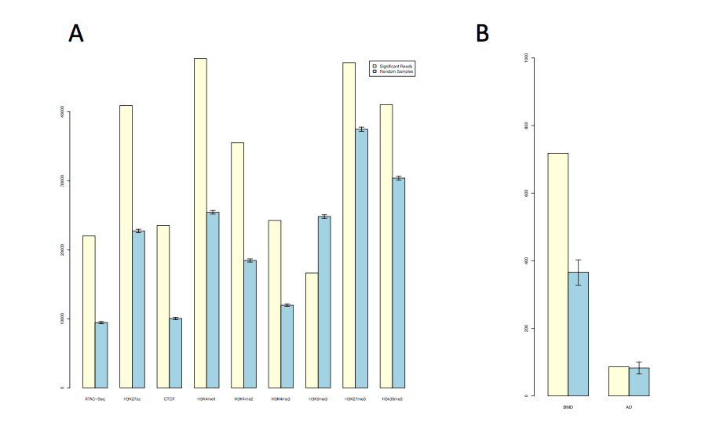
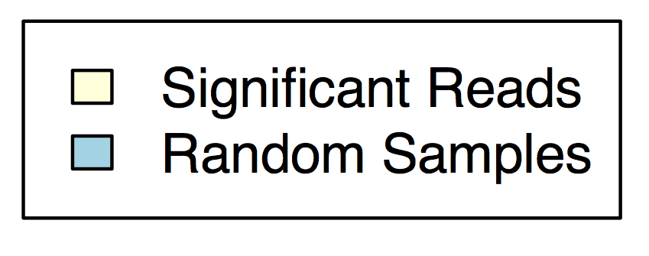
Promoter-interacting regions (PIR) enrichment
Canonical pathways enriched in
implicated genes in osteoblasts are bone-relevant
ATAC-seq
H3K27ac
CTCF
H3K4me1
H3K4me2
H3K4me3
H3K9me3
H3K27me3
H3K36me3
BMD AD
Chesi et al., Nat Commun 2019
Notes:
PIR enriched in active chromatin marks derived from primary osteoblasts (ENCODE) and our own ATAC-seq, proving that the system is working and identifying enhancers; also PIR enriched in BMD GWAS SNPs but not AD, proving that the cell type is relevant. Finally, implicated target genes are in bone-relevant pathways.
Enrichment of PIR in chromatin marks. Yellow bars: number of overlaps with significant (CHiCAGO score>5) cis-interacting fragments (at 4-fragment resolution; bait-to-bait interactions were excluded); blue bars: expected overlaps based on 100 random subsets of fragments with a similar distribution of distances from the baits. ATAC-seq data is from our own experiments in hMSC-derived osteoblasts; other markers are from primary human osteoblasts from the ENCODE project. Error bars represent 95% confidence intervals.
Enrichment of PIR in BMD GWAS signals. As above, but overlaps are computed with BMD or Alzheimer’s disease GWAS SNPs and their proxies (r2>0.4).
BMP, TGFbeta and Wnt/β-catenin signaling pathways

Slide 14
CPED1
close and distant gene (~13% of observations)
CPED1 and ING3
Chesi et al., Nat Commun 2019
Notes:
Sentinel rs13245690 black closed, proxies open R2=0.63
ING3 is part of a histone acetyltransferase (HAT) complex that recognizes H3K4me3, so silencing of ING3 might affect key osteoblastic genes during human osteoblast differentiation
ING3 levels are down-regulated in some cancers. The absence of ING3 may allow cells to avoid differentiation by continuously re-entering the cell cycle; however, our studies are carried out in serum-free media and thus, we did not note any changes in cell proliferation

Slide 15
CPED1 Knockdown of ING3 - but neither WNT16 nor CPED1 - impairs osteoblast differentiation
Chesi et al., Nat Commun 2019
Notes:
We observed consistent contacts for ~17% of the 273 BMD loci investigated
For the other gene EPDR1 there is a mouse model showing a bone phenotype

Slide 16
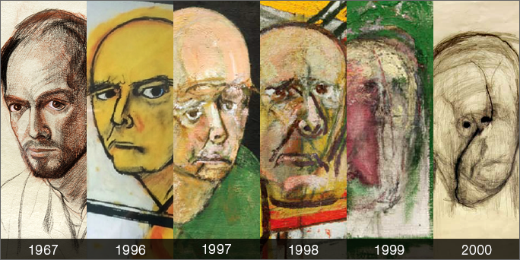
Alzheimer’s disease
Images courtesy of William Utermohlen’s estate and GVArt Gallery, London
Notes:
I am funded (R01) to do this (coinvestigator with Struan Grant).
Famous series of self portraots from an artist (William Utermohlen’s ) with AD: the first, made in 1967, the rest from 1996 the year following his diagnosis of Alzheimer’s disease, to 2000, charting his decline.
- Most common cause of dementia in older adults. Third cause of death after heart disease and cancer
- Memory loss, language problems, and unpredictable behavior

Slide 17
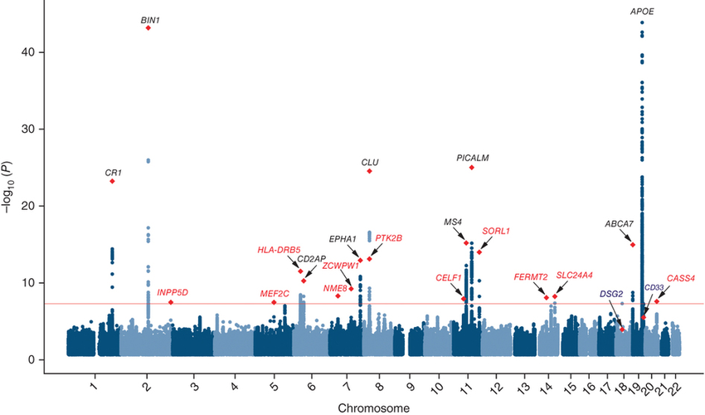
AD GWAS loci
Lambert et al., Nat Genet (2013)
Notes:
21 AD loci. Gerry Schellenberg here at PENN co-directed this work and we are collaborating.
4 new AD loci published IGAP expansion: confirm 20 previous LOAD risk loci and identify four new genome-wide loci (IQCK, ACE, ADAM10, and ADAMTS1). More from AD-by-proxy from UK10K biobank.
13 new loci in total. 33 loci total
FAD: APP, presenilin 1 and 2

Slide 18

From signals to therapeutic targets
Causal variant in LD block
Relevant cell type
Upstream regulator
Effector gene(s) at given loci
Biological mechanism
Mariana Argenziano
Notes:
Highlight relevant cell type

Slide 19
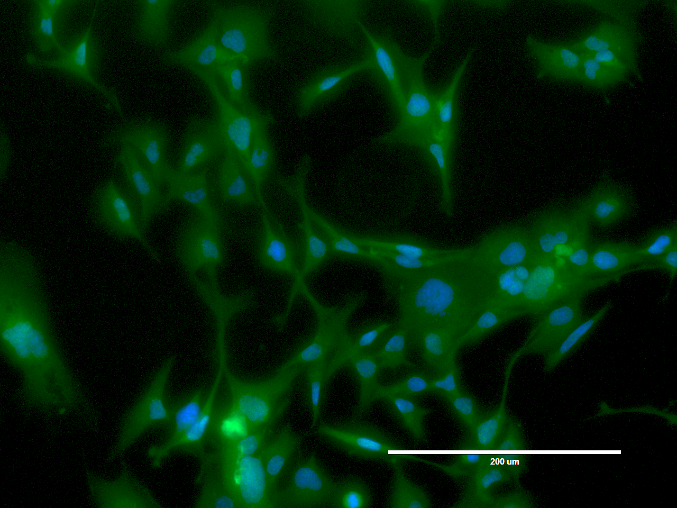
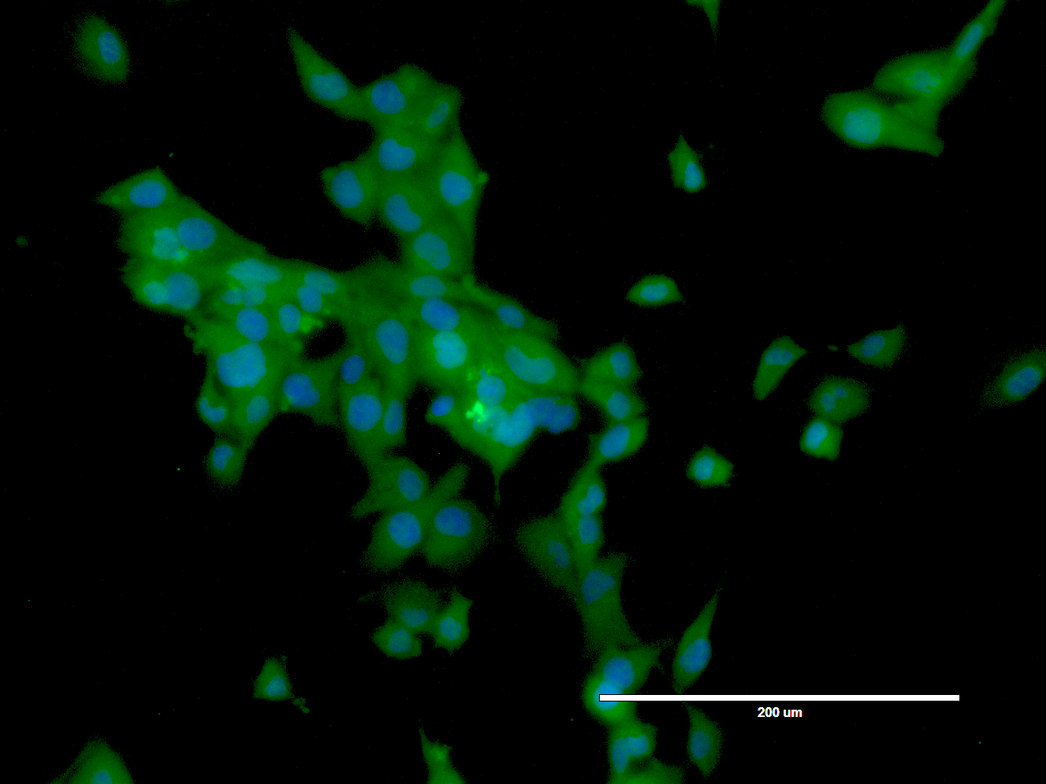
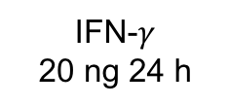
Microglia: HMC3 cell line
IBA1
IFN-$γ$
20 ng 24 h
SV40 immortalized human fetal brain primary microglia culture
Activated with Interferon-γ

Slide 20
Microglia: RNA-seq
Upregulated genes (1418)
Antigen Presentation Pathway
Neuroinflammation Signaling Pathway
Interferon Signaling
Downregulated genes (604)
Unfolded protein response
Endoplasmic Reticulum Stress Pathway
Notes:
network 1 in IPA

Slide 21
Microglia: ATAC-seq
More open in activated cells:
Interferon Signaling
Antigen Presentation Pathway
Death Receptor Signaling
Notes:
4013 differentially accessible chromatin regions
2307 down and 1706 up
500 (12%) of these near promoters of coding genes
183 (5%) near lncRNAs
Down (312 DAR near coding gene): No significant pathways; UP (151 DAR )
Relationship between ATAC-seq promoter openness and RNA-seq expression is being investigated; all of the up genes in these three pathways were more open AND more expressed
IMPORTANT: we mostly use ATAC-seq as a filter for our SNPs and genes

Slide 22
CASS4
Notes:
870 interacts with RTFDC1 and CASS4; 174 with CASS4, AURKA and CSTF1; multiple contacts, some to closest gene, some to distant genes

Slide 23
FERMT2
Notes:
FERMT2 implicated in AD

Slide 24
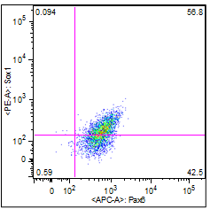
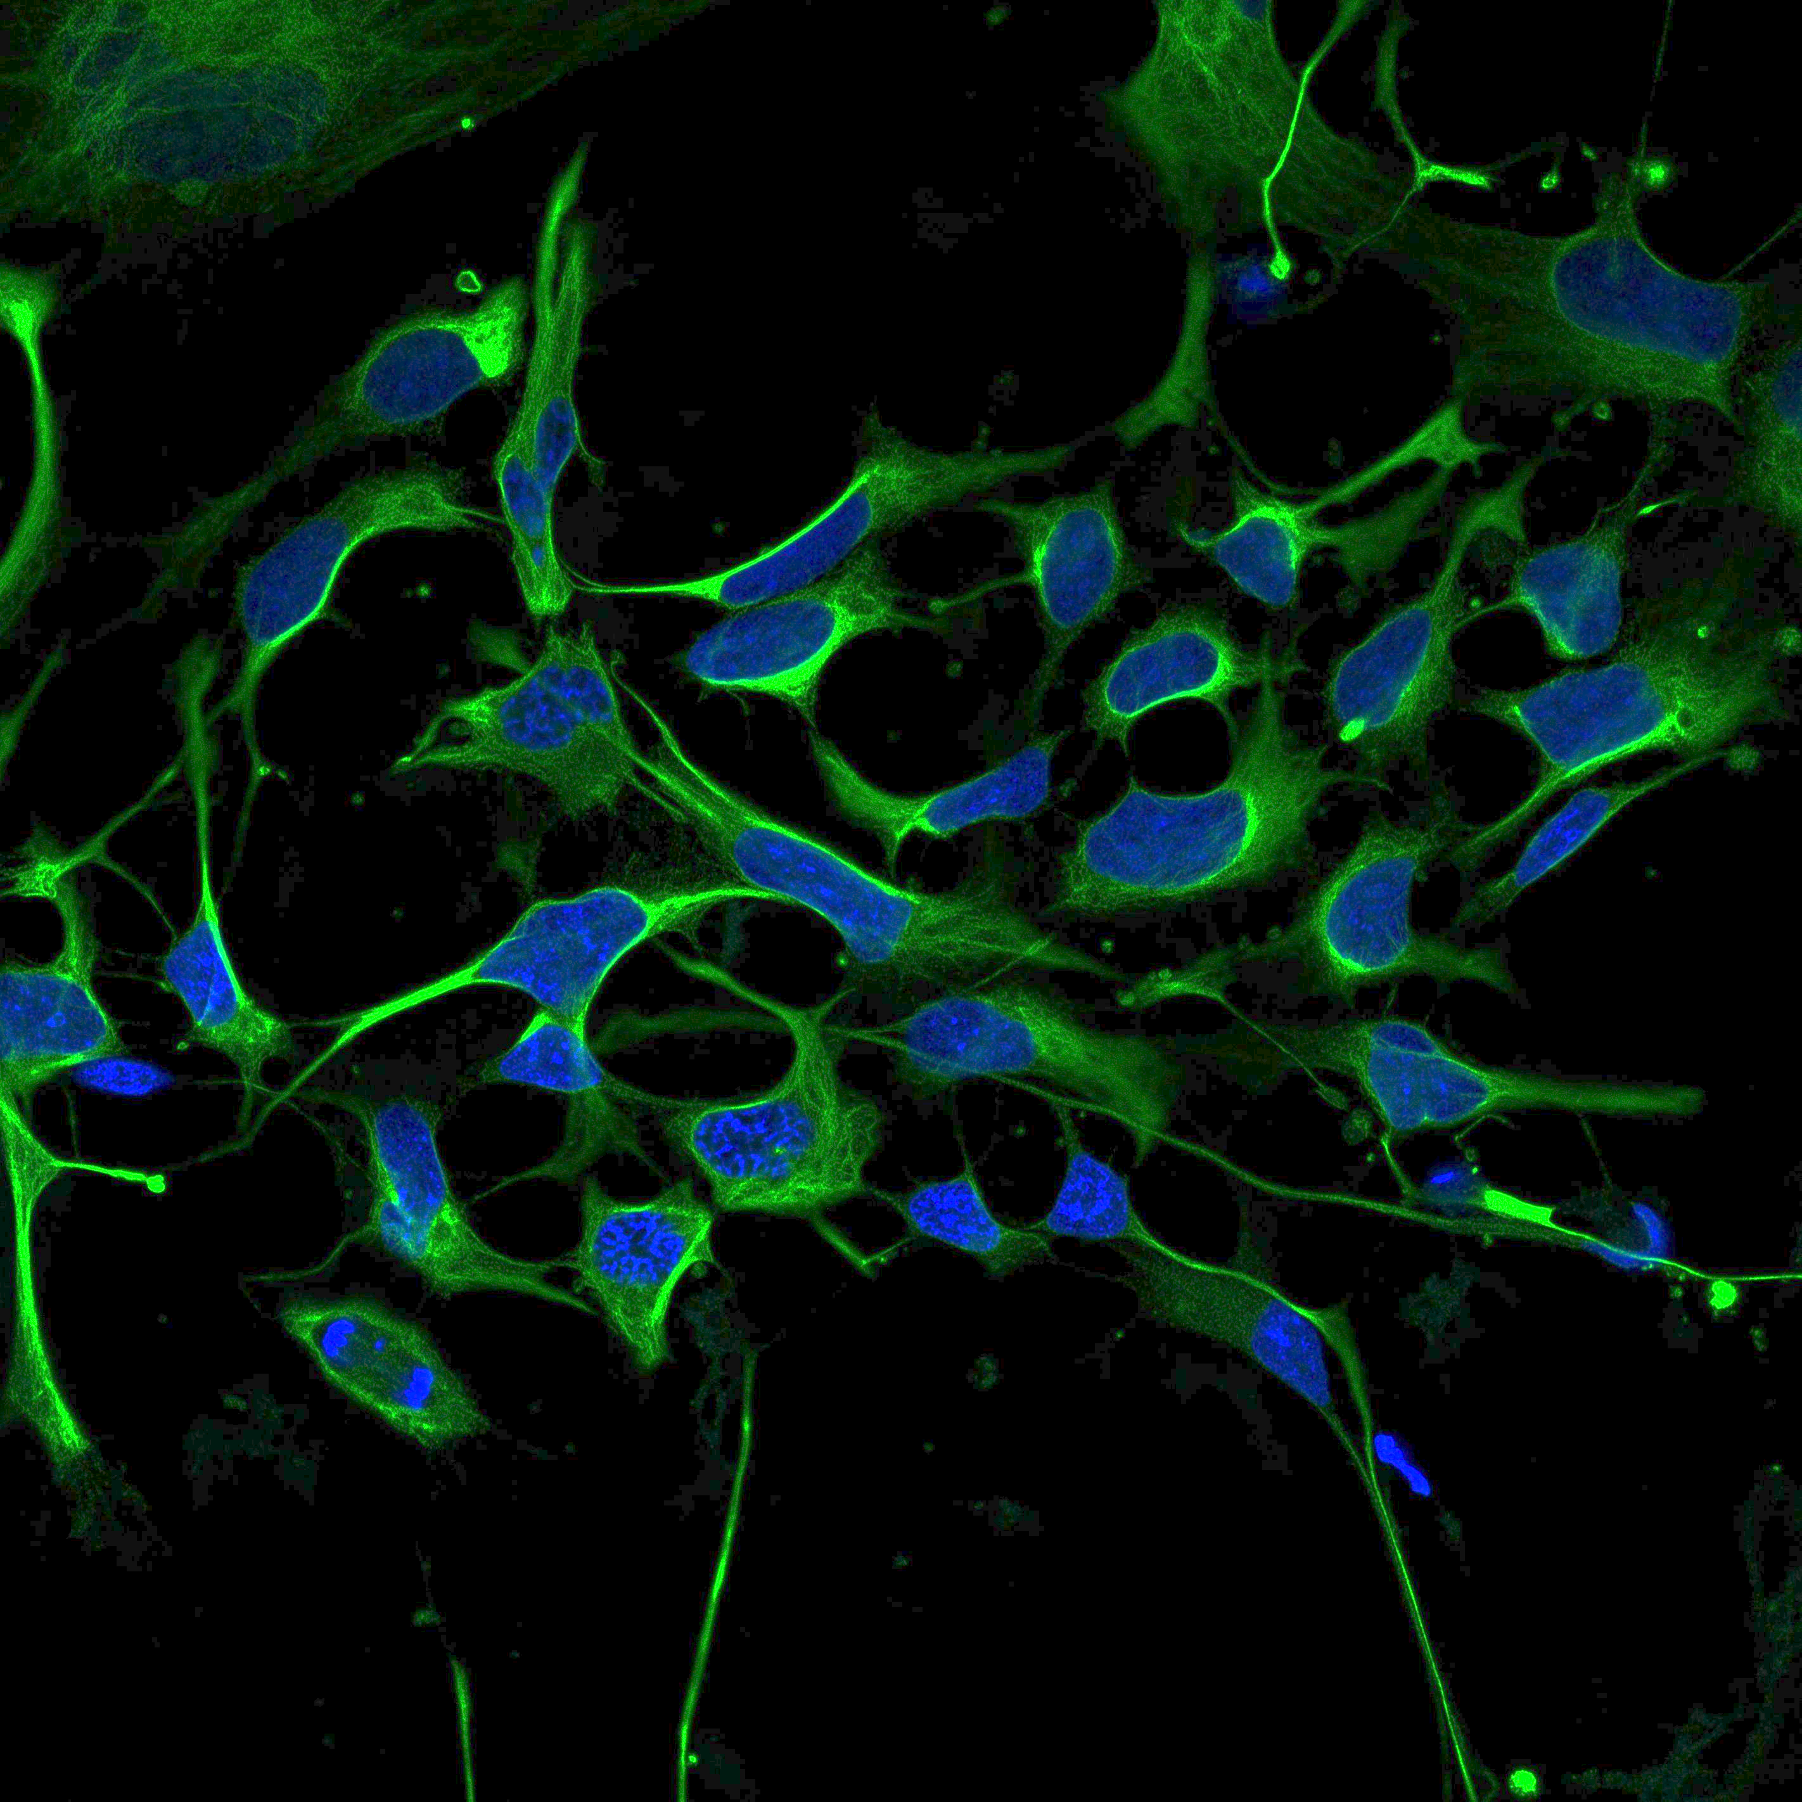
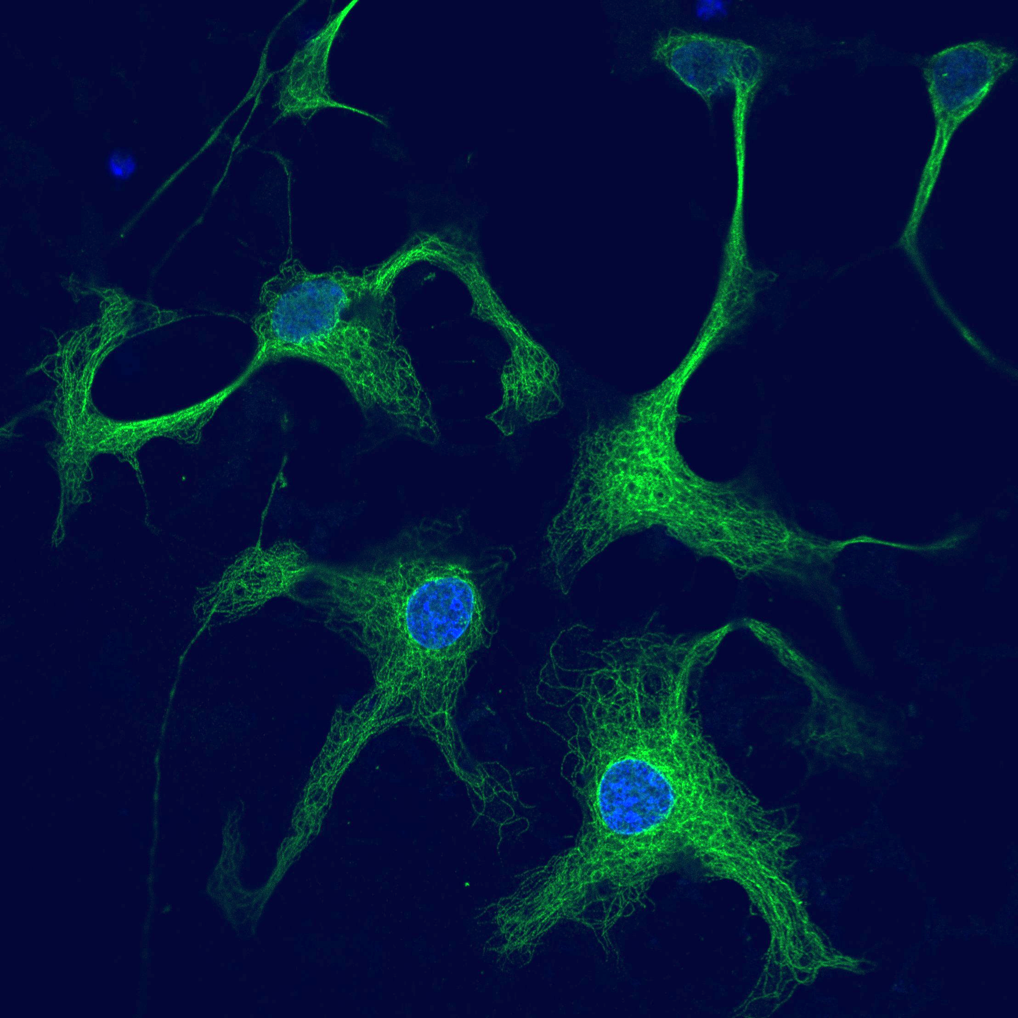
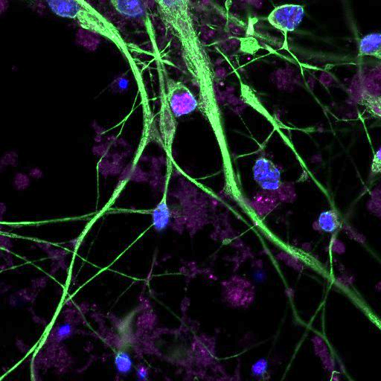
iPSC-derived neural cell types
A
iPSC-derived neural cell lines:
NPCs, neurons, astrocytes, and microglia
AD iPSC-derived NPC cell lines (Axol):
APOE e4 homozygous; PSEN1 L286V
B
Flow cytometry
Nestin
TUJ1
MAP2/CTIP2
Notes:
PSEN1 from 37 yo woman
APOE e4 from 86 yo woman
Flow cytometry profiles of day 6 NPCs (A), in (B) are neurons
In collaboration with Deb French at the Stem Cell core and Stewart Anderson

Slide 25
RNA-seq: PCA and correlation heatmap
PC2 (20%)
PC1 (33%)

Slide 26
‘SORL1’ (sentinel rs11218343) closest gene
rs2282647
Notes:
* Supported by GTEx. APOE receptor; a significant reduction in SORL1 expression has been found in brain tissue of Alzheimer's disease patients.
ApoE enhances proteolytic break-down of a-beta. The isoform ApoE-ε4 is not as effective as the others at promoting these reactions, resulting in increased vulnerability to AD

Slide 27
RNA-seq
eQTLs / GTEx
ENCODE
CRISPR-mediated
deletions
Luciferase / MPRA
Notes:
An arsenal of tools.
Not shown here: gene knock-down or over-expression in a suitable cellular or organism model (like for bone)
Loop back to the genetics: whole exome/genome sequencing of AD cases at PNCG: lookup variants (burden) on candidate genes

Slide 28
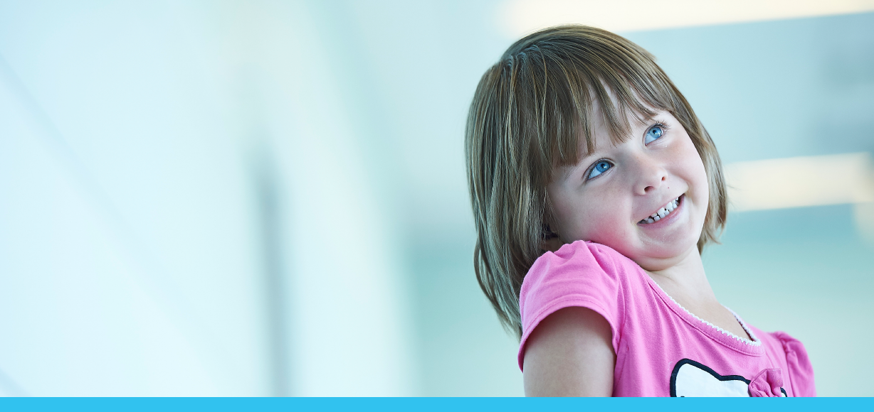
Acknowledgements
Grant Team:
Elisabetta Manduchi
Chun Su
Matthew Johnson
Mariana Argenziano
Elizabeth Burton
Diana Cousminer
Rajashree Mishra
Jim Pippin
Kenyaita Hodge
Michelle Leonard
Sumei Lu
Struan Grant
CHOP/PENN:
Andrew Wells
Gerd Blobel
Deborah French
Jerry Schellenberg
Li-San Wang
Andrea Kelly
Shana McCormack
Jonathan Mitchell
Babette Zemel
University of Michigan
Yadav Wagley
Kurt Hankenson
Funding: R01 AG057516 (S. Grant)

