Slide 1
Genetic and Genomic Contributions to Alzheimer’s Disease from the Caribbean Islands
Richard Mayeux
Columbia University, Department of Neurology
Taub Institute and Sergievsky Center
The New York Presbyterian Hospital

Slide 2
Estudio Familiar de Influencia Genetica en la enfermedad de Alzheimer (EFIGA)
1983 – Dominican family with early onset Alzheimer’s disease in New York with PSEN1 mutation
1991 – Washington Heights and Inwood in northern Manhattan multi-ethnic studies begins
1992 – Familial Alzheimer’s disease in the Dominican Republic investigation
1998 –Collaborators established in Santiago, Santa Domingo and San Juan, Puerto Rico
2007 – SORL1 identified as a genetic risk factor in Caribbean Hispanics and other ethnic groups
2013 – Alzheimer’s Disease Sequencing Project began with majority of families from the Dominican Republic
2017 – First whole genome sequence in Dominican families

Slide 3
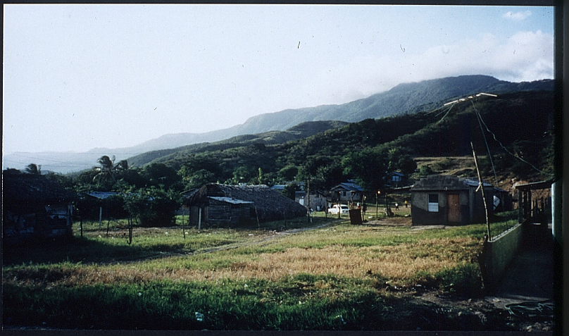

Characteristics of Caribbean Hispanic Cohorts
Inbred island population
Admixture of three parent populations – African, European and native
Adjusted inbreeding coefficient = 0.0034 (second or third cousin)
Recurrence rate in family members is nearly 5 times that of similarly aged individuals living in the US.

Slide 4
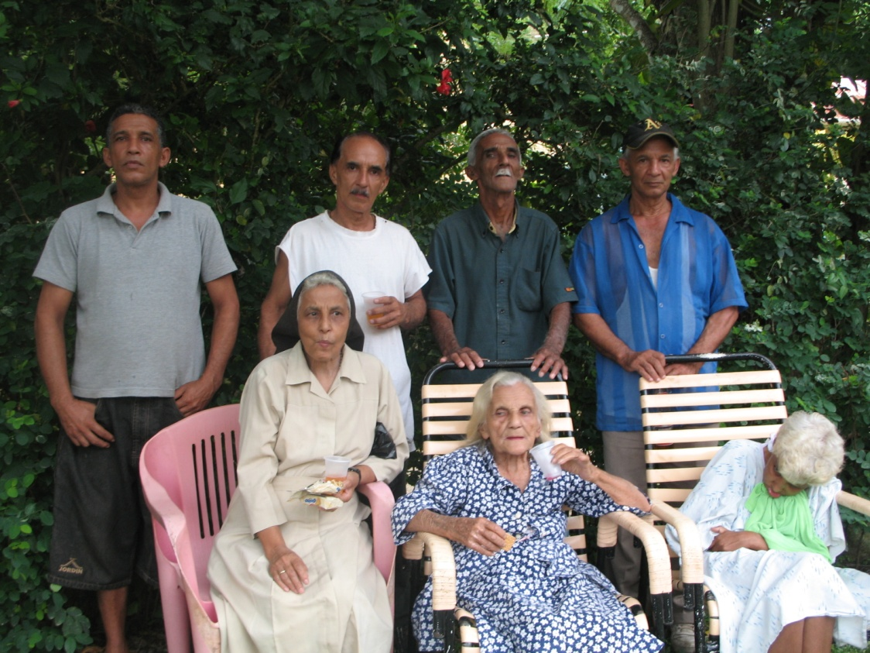
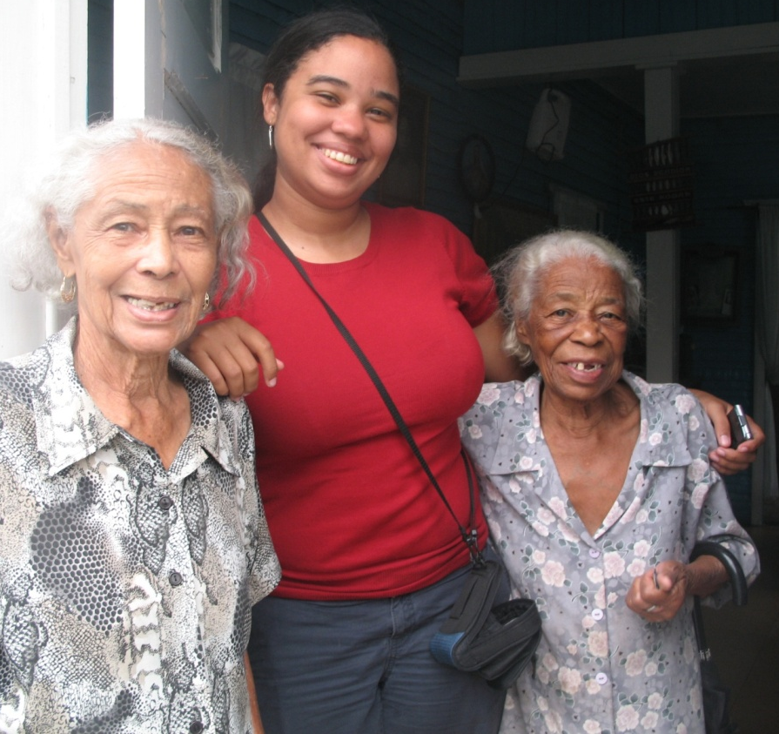
EFIGA

Slide 5
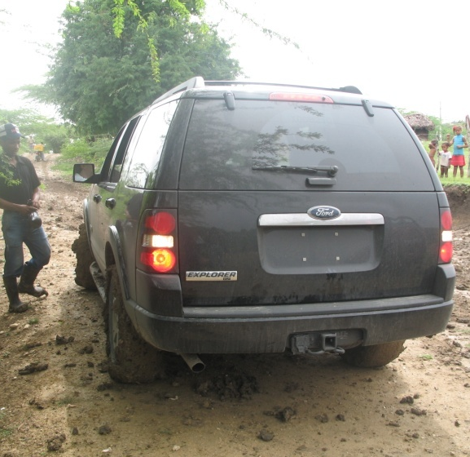

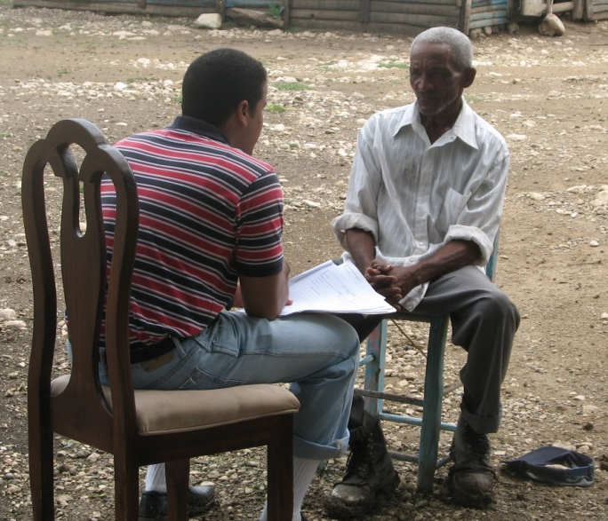
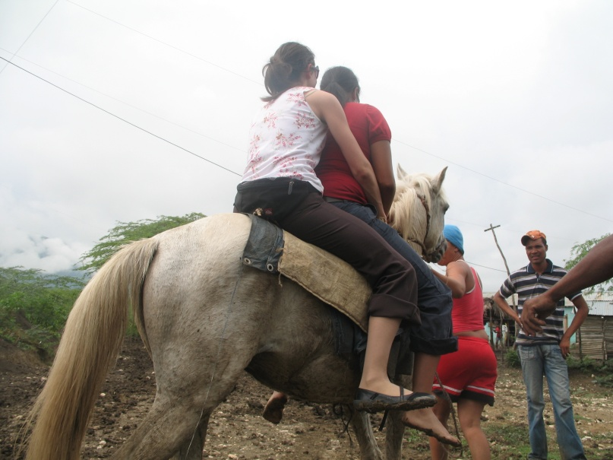
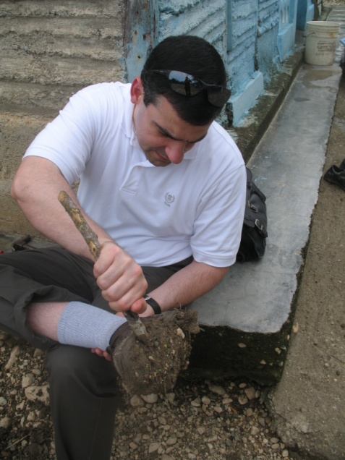
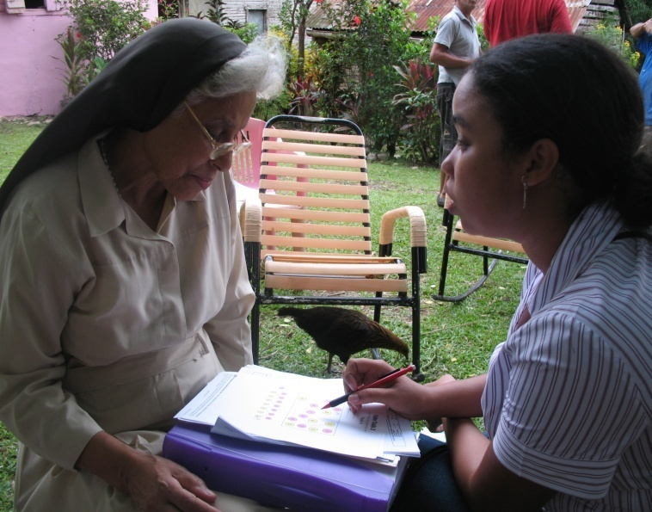
EFIGA

Slide 6
Caribbean Hispanic Family from the Dominican Republic

Slide 7
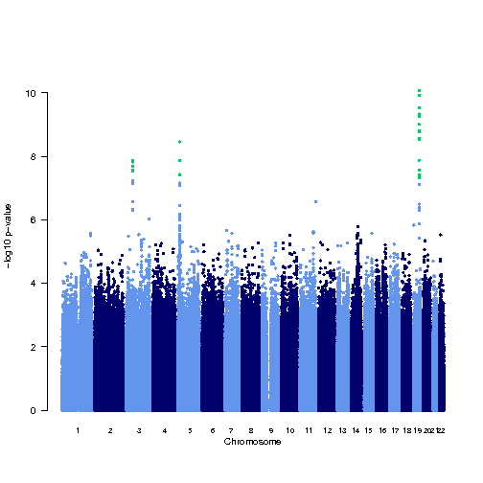
Caribbean Hispanics from the Dominican Republic
FBXL7 is one of the ubiquitin protein ligases called SCFs that play a role in
phosphorylation-dependent ubiquitination of proteins.
Follow-up GWAS involving is underway (DR, PR, MHAS, Spain, Chile, Argentina)
FBXL7
APOE
SORL1
ABCA7
Tosto et al ACTN 2015; 2: 810-20

Slide 8
Early Onset Mutations in Late Onset Alzheimer’s Disease
Rare Variants in APP, PSEN1 and PSEN2 Increase Risk for AD in Late-Onset Alzheimer's Disease Families
Carlos Cruchaga, Sumitra Chakraverty, Kevin
Mayo, Francesco Vallania, Robi Mitra, Kelley Faber, Jennifer Williamson, Tom Bird, Ramon Diaz-Arrastia, Tatiana Foroud, Bradley Boeve, Neill Graff-Radford, Pamela St Jean, Michael Lawson, Margaret Ehm, Richard Mayeux, Alison Goate NIA-LOAD/NCRAD Family Study Consortium
Disease-related mutations among Caribbean Hispanics with familial dementia
Joseph H. Lee, Amanda Kahn, Rong Cheng, Christiane Reitz, Badri Vardarajan, Rafael Lantigua, Martin Medrano, Ivonne Z. Jimenez-Velazquez, Jennifer Williamson, Peter Nagy & Richard Mayeux
Gene | NIA LOAD families n=439 | Hispanic families n=194
APP | 1 (0.2%) | 3 (1.5%)
PSEN1 | 3 (0.6%) | 2 (1.5%)
PSEN2 | 0 | 1 (0.5%)
GRN | 5 (1.1%) | 2 (1.5%)
MAPT | 1 (0.2%) | 2 (1.5%)

Slide 9
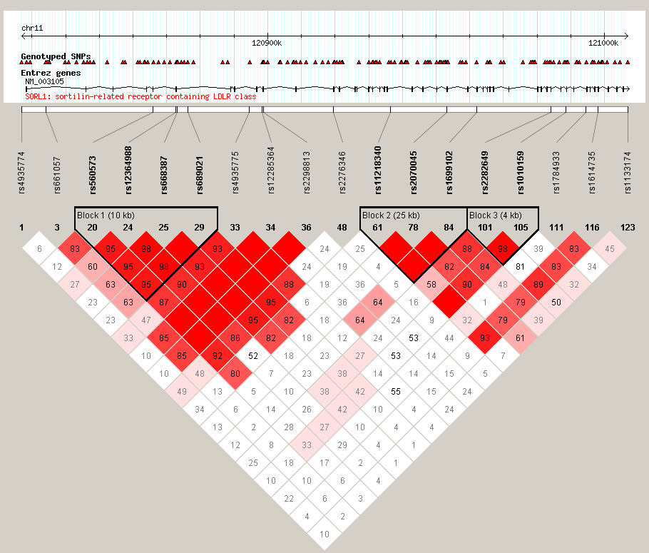
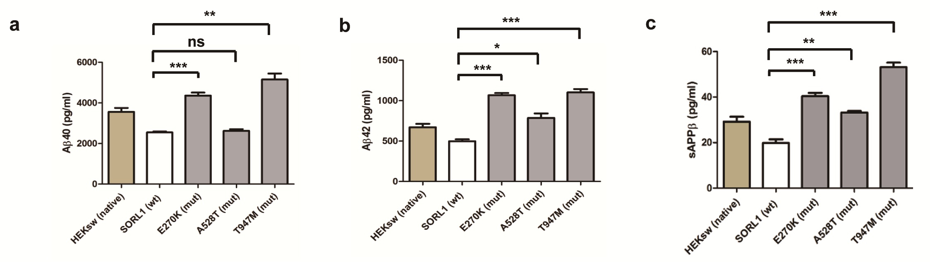
Position of mutations in SORL1 relative to common SNPs associated with LOAD
E270K is one base pair away from SNP 7
T947M is between SNP 17 and 18
A528 is SNP 13
LD Plot of common SNPs significantly associated with AD
(Rogaeva et al, NatureGenetics, Jan 2007)

Slide 10
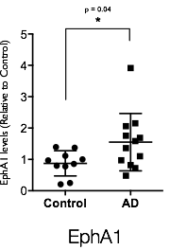
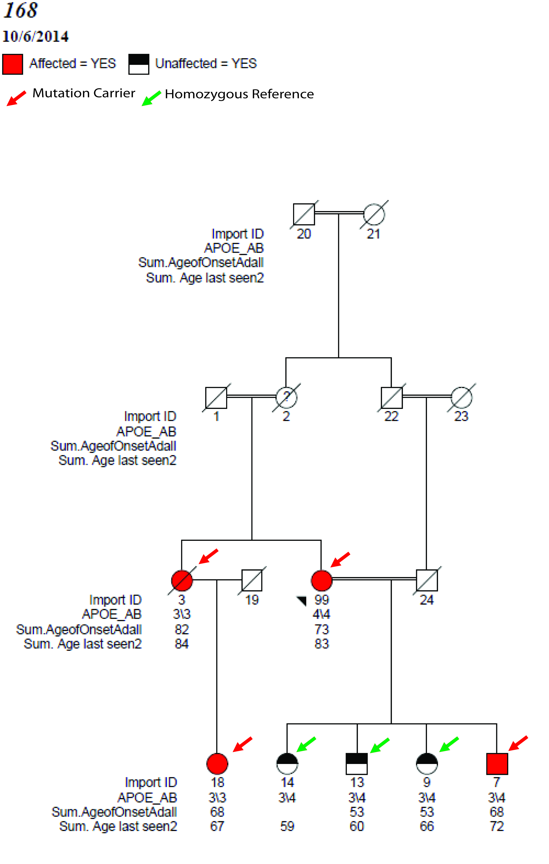
Exome sequence analyses of GWAS Loci
ABCA7, BIN1, CD2AP, CLU, CR1, EPHA1, MS4A4A/MS4A6A and PICALM
CHR | Function | Gene | AA change
2 | nonsynonymous | BIN1 | K358R
6 | nonsynonymous | CD2AP | T374A
6 | nonsynonymous | CD2AP | K633R
7 | nonsynonymous | EPHA1 | P460L
8 | nonsynonymous | CLU | T203I
11 | exonic/splicing | MS4A6A | V218M
11 | nonsynonymous | PICALM | P495A
11 | nonsynonymous | PICALM | H458R
19 | nonsynonymous | ABCA7 | L101R
19 | nonsynonymous | ABCA7 | R880Q
19 | nonsynonymous | ABCA7 | V1599M
19 | stopgain | ABCA7 | E1679X
EPHA1

Slide 11
ABCA7 Deletions and Mutations
African American
Hispanic
Caucasian
A.
5,000 bp
rs142076058
rs115550680
rs3752246
rs3764650
rs4147929
B.
200 aa
Arg578Alafs*168
AAA domain
Glu709Alafs*86
Glu1679*
Tyr622*
c.4416+2
c.5570+5
transmembrane domain
Arg578Alafs*168

Slide 12
Snf2-related cyclic AMP (cAMP)-responsive element-binding protein (SRCAP)- The Floating Harbor gene and Alzheimer’s Disease
10 missense mutations in 12 unrelated families
Compared to the frequency in the Latino population in the ExAC mutations
In LOAD were significantly more frequent (p=1.9e-16).

Slide 13
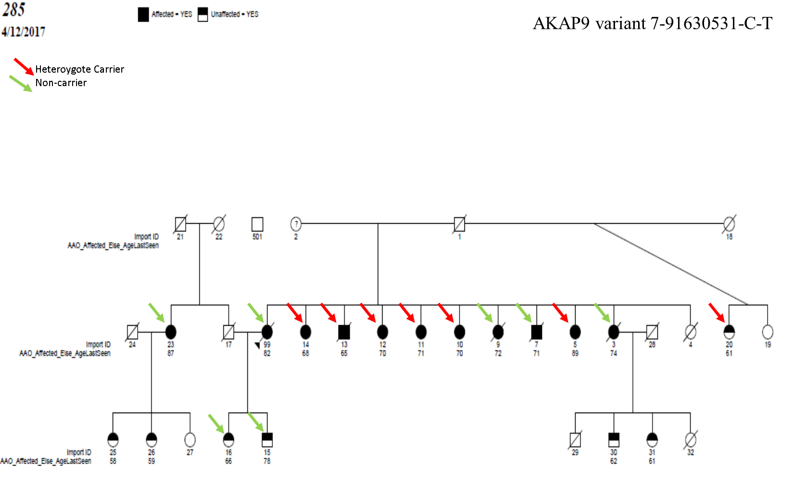
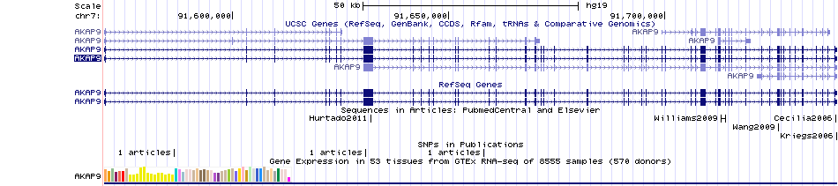
AKAP9 mutations
Scaffolding protein that assembles several protein kinases and phosphatases on the centrosome and Golgi apparatus
p.R434W AKAP9 mutation
rs144662445 identified in African Americans
rs149979685 identified in African Americans

Slide 14
Protective Factors

Slide 15
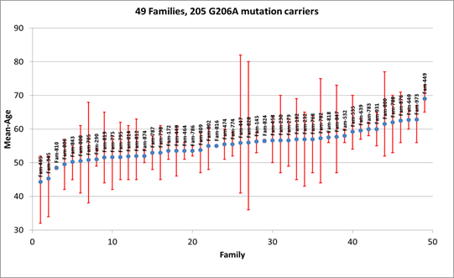
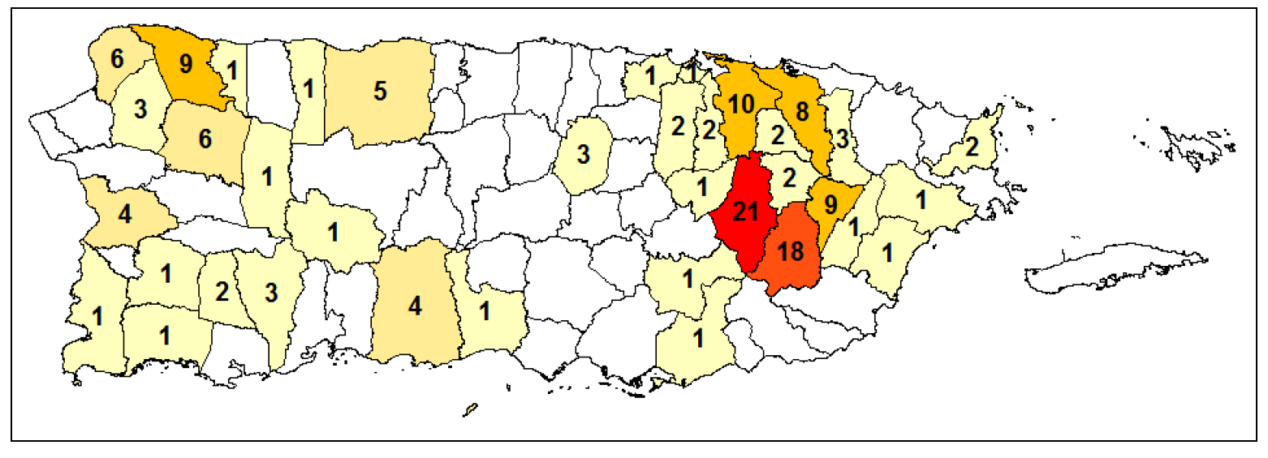
PSEN1 G206A Families N=90
Puerto Rico

Slide 16
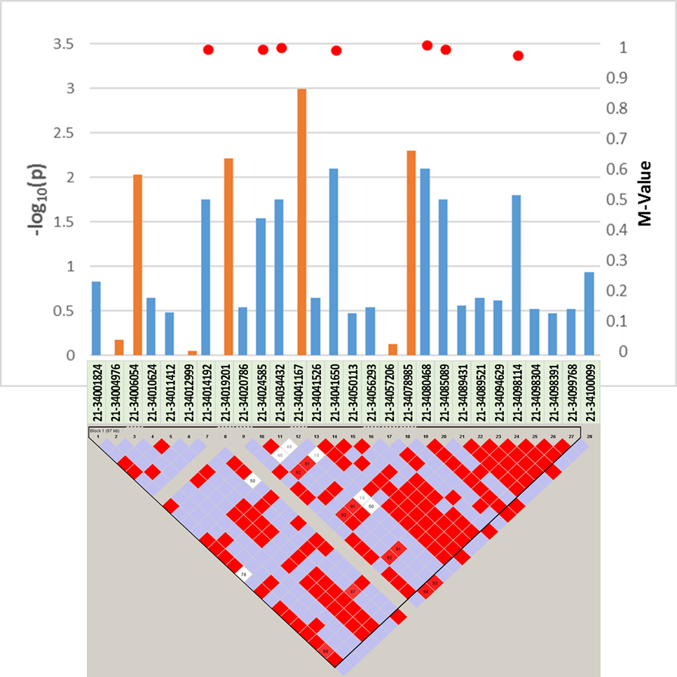
Variants in SYNJ1 were associated with age of onset and long-term memory deficits in families with the PSEN1-G206A mutation.
Variants in SYNJ1 were also associated with age of onset in the EFIGA cohort with late-onset FAD.
Figure. The SNPs identified in SYNJ1 in the association analysis (Table 1, orange bars) are in linkage disequilibrium (LD) with the eQTLs identified in the GTEx dataset (blue bars), Related to Table 1.

Slide 17
APOE 4/4 Unaffected Homozygous
23 non-synonymous variants found in at least 5% of APOE 44 individuals prioritized for genotyping
3 SNVs were not found in any cases (only in e44 unaffected)
Tested association with AD and AAO in the genotyped cohort
Total | 1873
Families | 173
Sporadic | 553
Unaffected | 717
Affected | 1156
APOE (%) | 26.24
Demographics of individuals in the genotyping Project
 | AD~SNP+AGE+SEX+PCs |  |  |  | AAO~ SNP+SEX+PCs (cases only)
 | BETA | SE | Z | P | BETA | SE | Z | P
chr1_27278570 | -0.09 | 0.93 | -0.10 | 9.21E-01 | -5.19 | 1.22 | -4.25 | 2.14E-05
chr2_204053273 | 0.64 | 0.52 | 1.22 | 2.21E-01 | 3.81 | 0.46 | 8.33 | 7.96E-17
chr6_168443267 | 1.75 | 0.72 | 2.42 | 1.53E-02 | 6.81 | 4.27 | 1.60 | 1.11E-01
chr8_22058684 | 0.76 | 0.51 | 1.50 | 1.34E-01 | 3.09 | 0.77 | 4.00 | 6.45E-05
chr11_9608330 | 1.38 | 0.58 | 2.38 | 1.72E-02 | 2.78 | 5.75 | 0.48 | 6.29E-01

Slide 18
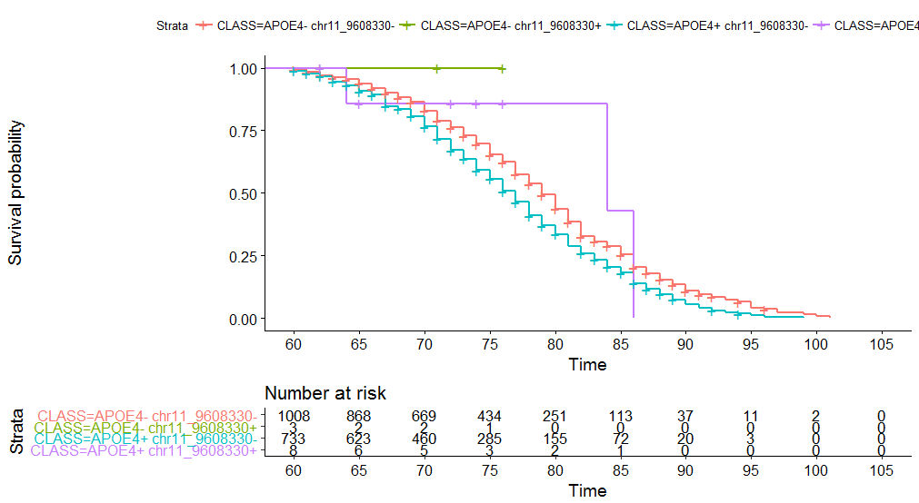
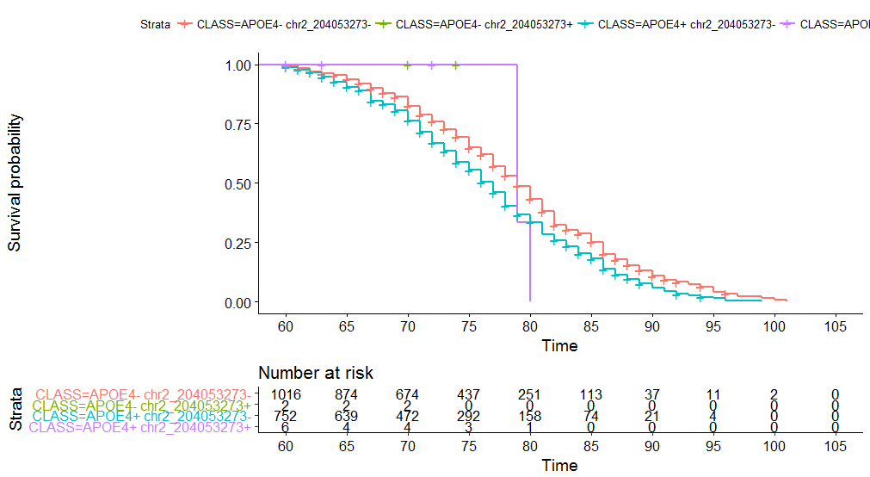
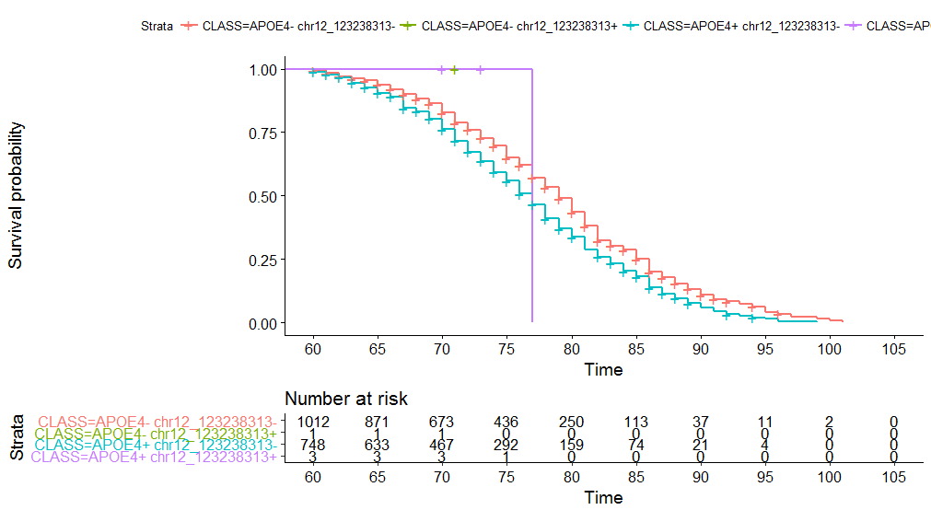
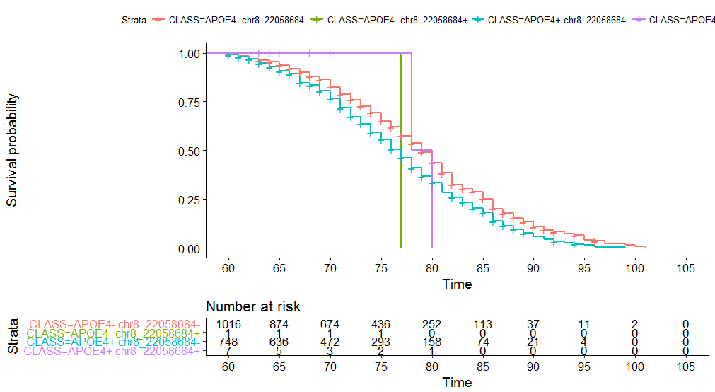
Survival curves (variants that delay AAO)

Slide 19


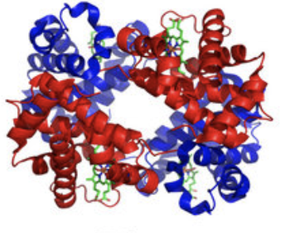
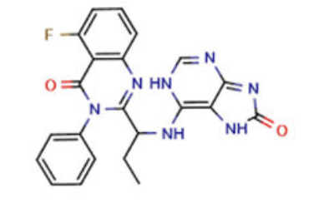
Functional Genomics
Genomics & Epigenomics
Source: Blood
Transcriptomics
Source: Brain, Cells
Alzheimer’s Disease
Proteomics
Source: CSF, Blood
Metabolomics
Source: Blood, CSF?

Slide 20
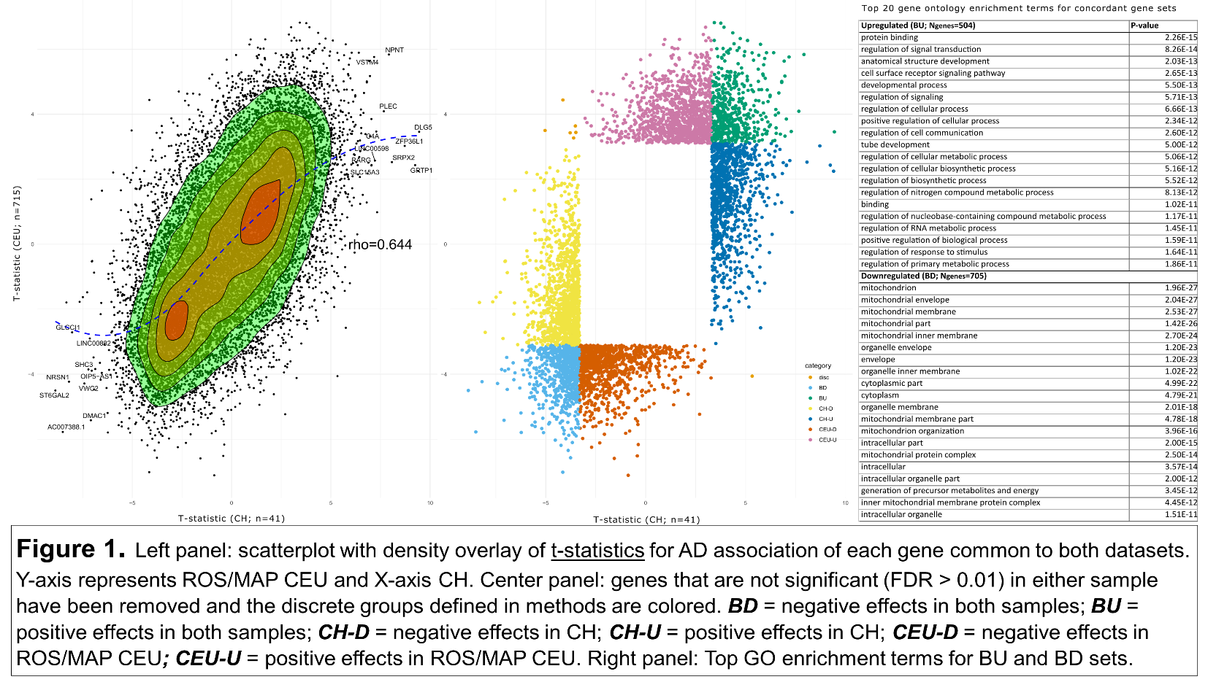
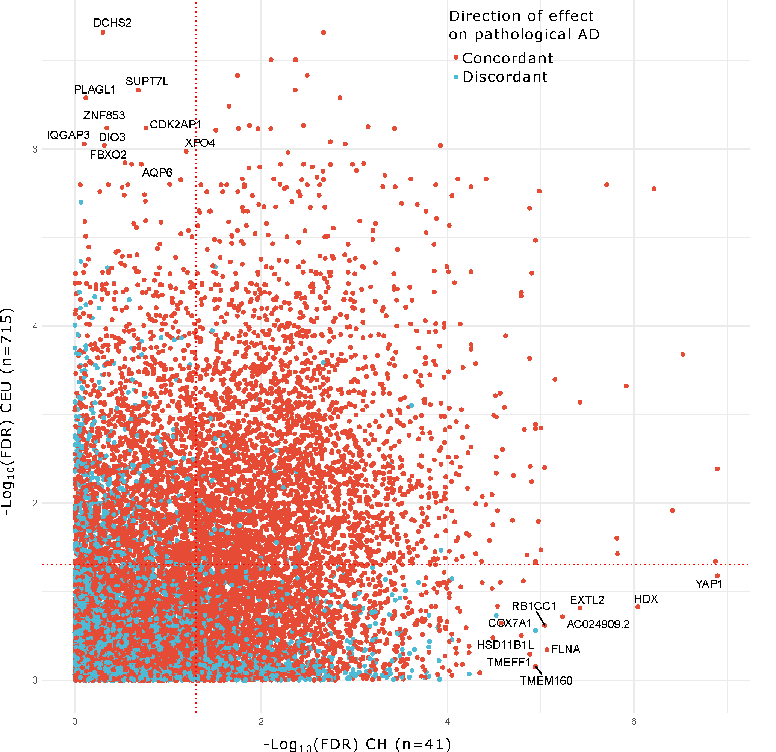
Transcriptomics in Hispanic Brain
YAP1 is one of 17 hub
genes that are important
upstream regulators of
Alzheimer’s disease
NON-HISPANIC WHITES
N = 715
CARIBBEAN HISPANICS
N = 41

Slide 21
CpG-related SNPs for AD risk in Hispanics
C
Sliding window with each window size of 1Kb and sliding by 500bp along the genome.
Within each window, a dosage of allele to create the CpG dinucleotides, the sites of DNA methylation, was calculated based on the QC-ed HRC imputed genotype.
SNP filter: (1) imputation quality > 0.7; (2) MAF>=0.01.
Window filter: (1) > 1 CGS in the window; (2) >=4 batches have dosage for the window
Number of test windows: 1,857,611
Adjusted P value threshold: 5× 10⁻⁸
AD as outcome; scaled CGS dosage (scaled to value range from 0 to 2) as exposure; fixed effect include age, sex, batch, 6 PCs related to ethnicity and AD status; random effect include standard GRM. GMMAT score test
G
Window 1
Window 3
Window 2

Slide 22
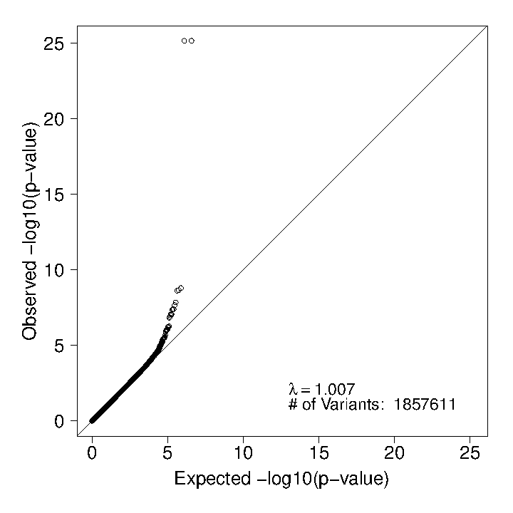
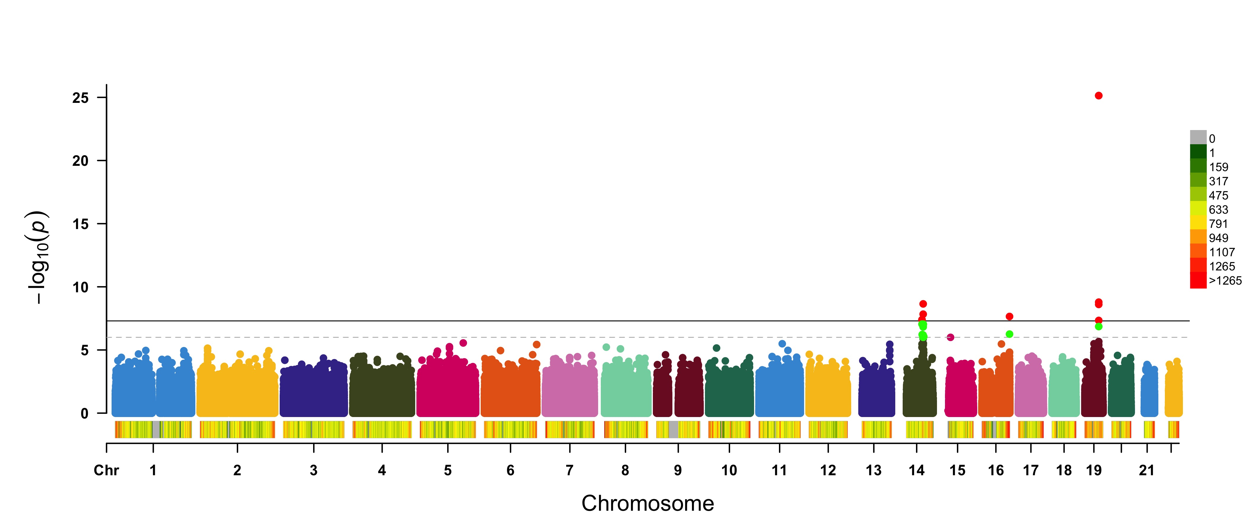
CpG-related SNPs for AD risk in Hispanics
P < 5 × 10⁻⁸
P < 1 × 10⁻⁶
PVRL2
TOMM40
APOE
ADAM20
VTRN to SYNDIG1L
SPG7

Slide 23
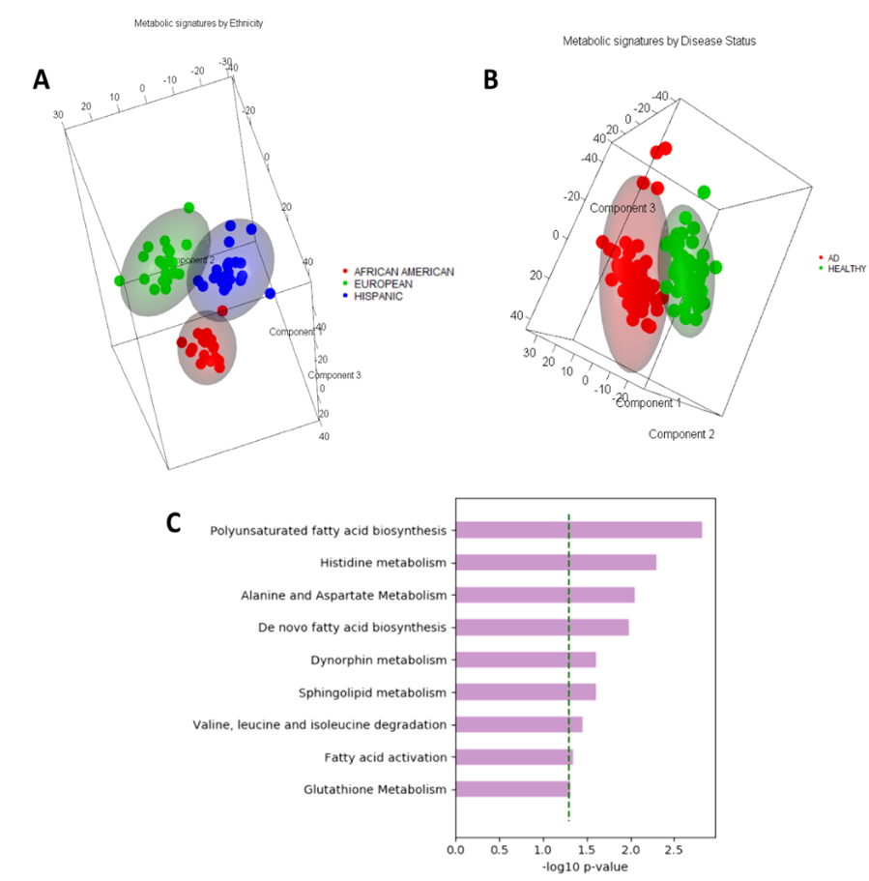
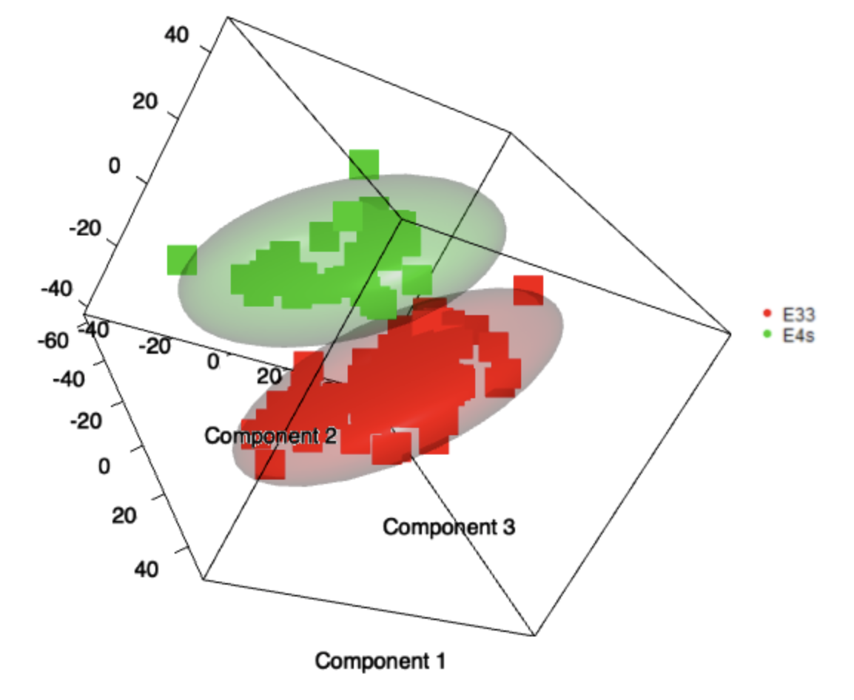
Cross Sectional Analyses of Plasma Metabolomics

Slide 24





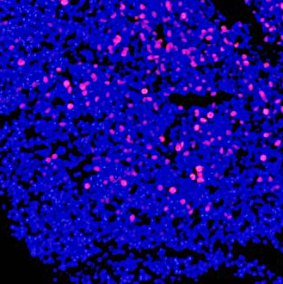
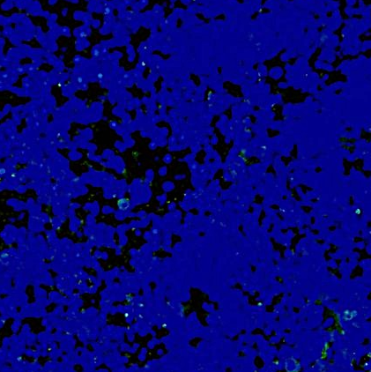
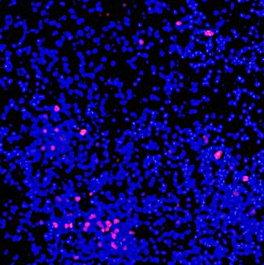
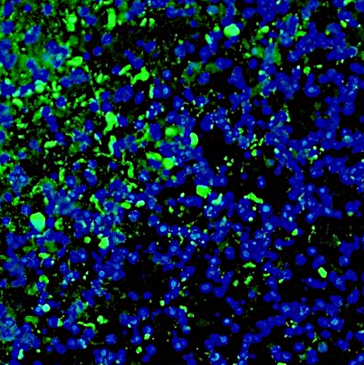
Functional Analysis of SORL1 E270K Variant in iPSC
WT/WT
WT/E270K
pTau (S202,T205)
MAP2
EEA1
MERGE
holo-APP
Isogenic Control
CTFs
p-Tau
Tau
H:Sorl1WT/E270K
GAPDH
WT/WT
WT/E270K
SORL1 ^{WT/E270K} neurons have increased pTau and CTFs.
SORL1 ^{WT/E270K} neurons have enlarged endosomes.
----v
----v
----v
Ki67/DNA
Aβ (6E10)/DNA
Ki67/DNA
Aβ (6E10)/DNA
Ki67/DNA
Aβ (6E10)/DNA
Ki67/DNA
Aβ (6E10)/DNA
d106
d106
d106
d106
d106
d106
d106
d106
SORL1^{WT/WT}
SORL1^{WT/WT}
SORL1^{WT/WT}
SORL1^{WT/WT}
SORL1^{WT/WT}
SORL1^{WT/WT}
SORL1^{WT/WT}
d106
SORL1^{WT/WT}
106
d106
106
d106
106
d106
106
SORL1^{E270K/E270K}
SORL1^{E270K/E270K}
SORL1^{E270K/E270K}
SORL1^{E270K/E270K}
SORL1^{E270K/E270K}
SORL1^{E270K/E270K}
SORL1^{E270K/E270K}
SORL1^{E270K/E270K}

Slide 25
Conclusions
This inbred island population represents a unique population for the study of Alzheimer’s disease.
Multiple rare variants have been identified from large families with many affected individuals, thus far and more are expected.
Some of these putative, novel rare variants have been replicated, and are now undergoing validation and generalization studies.
Discover the functional consequences of the genetic variants that contribute to AD.
Allow functional analyses to determine underlying mechanisms and identify pathways leading to AD.
Guide the validation of a gene as viable and attractive target for drug discovery.

Slide 26


Collaborators
ADSP Principle Investigators
Taub Laboratory of Genetic Epidemiology
International Investigators

Slide 27

Acknowledgements
Funding
National Institute on Aging
National Institutes of Health
Taub Institute for Research on Alzheimer’s Disease and the Aging Brain
The Robertson Gift from the Banbury Fund
Rembrandt 1631

