Slide 1
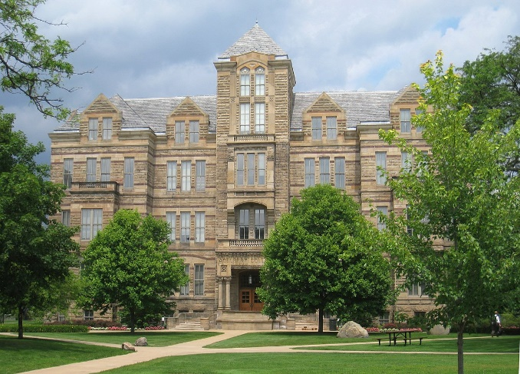
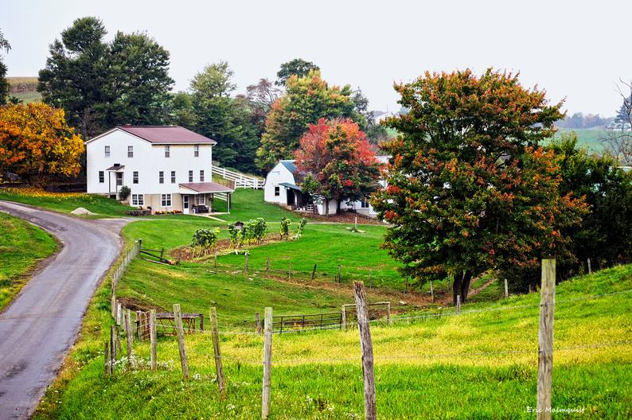
Genetic Studies of Dementia in the Amish
Jonathan L. Haines, Ph.D.
Cleveland Institute for Computational Biology
Dep’t Population & Quantitative Health Sciences
Case Western Reserve University
CWRU
Holmes County
November 13, 2019

Slide 2
APOE in Alzheimer Disease
APOE has 3 common alleles in the population
  APOE-2 (~7%), -3 (~76%), -4 (~17%)
APOE-4
  The APOE-4 allele carries a 3-fold risk of Alzheimer disease per allele. APOE-4/4 individuals have up to a 12-fold increased risk
  May explain up to 10% of all Alzheimer disease
  Corder…Haines, Pericak-Vance, Science, 1993
APOE-2
  The APOE-2 allele carries an independent 2-fold protection against Alzheimer disease
  Corder…Haines, Pericak-Vance, Nature Genetics, 1994
APOE-3
  The APOE-3 allele is the most common and is neutral to Alzheimer risk

Slide 3
Alzheimer Disease Genetics
2019
EOAD:
APP, PS1, PS2: <1%
LOAD:
Rare Variants (10): <1%
GWAS (23 loci) ~18%
APOE: ~25%
Unknown: ~55%

Slide 4
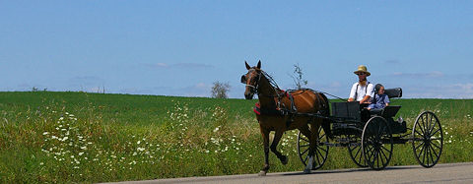
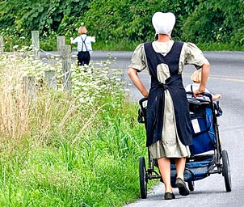
The Amish
Emigrated from Western Europe in the 1700’s and 1800’s due to religious persecution
Religious and cultural isolation from other individuals is required to maintain their beliefs and lifestyle
Their lifestyle increases homogeneity of environmental exposures
  Formal education typically stops at the 8th grade
  Virtually no smoking or alcohol use
  Reduces background variability
Marry mostly within the faith
  Little use of birth control; very large sibships
Large inter-related families
Genetically isolated founder population
  Some rare variants may be at increased frequency
  Opportunity to detect non-additive genetic effects

Slide 5
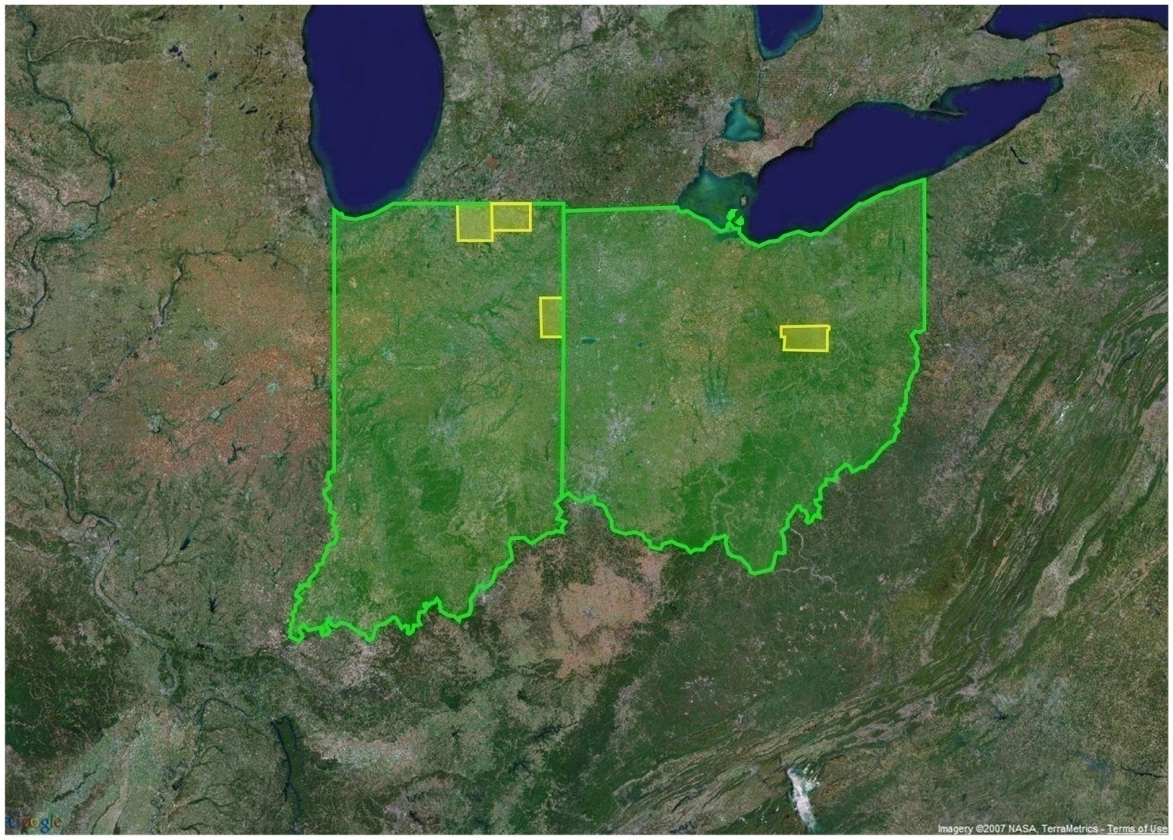
The Amish
Approximately 250,000 Amish in the U.S.
Three largest populations are in:
  Ohio (59,000)
  Pennsylvania (58,000)
  Indiana (45,000)
Our Amish source populations:
  Ohio: Holmes (18,000)
  Indiana: Elkhart (14,000), LaGrange (6,000), Adams (6,000)

Slide 6
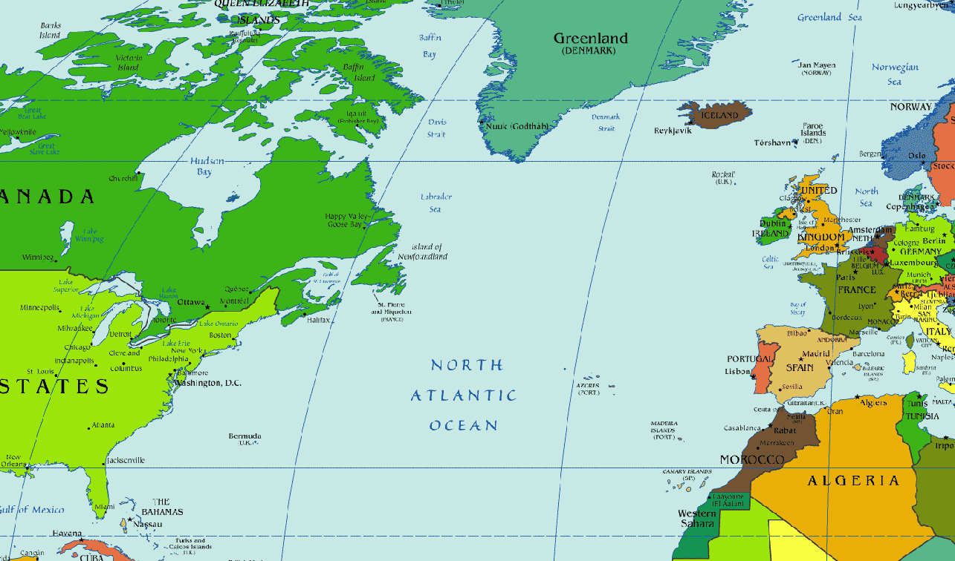
U.S. Amish Population Origins
1700’s

Slide 7
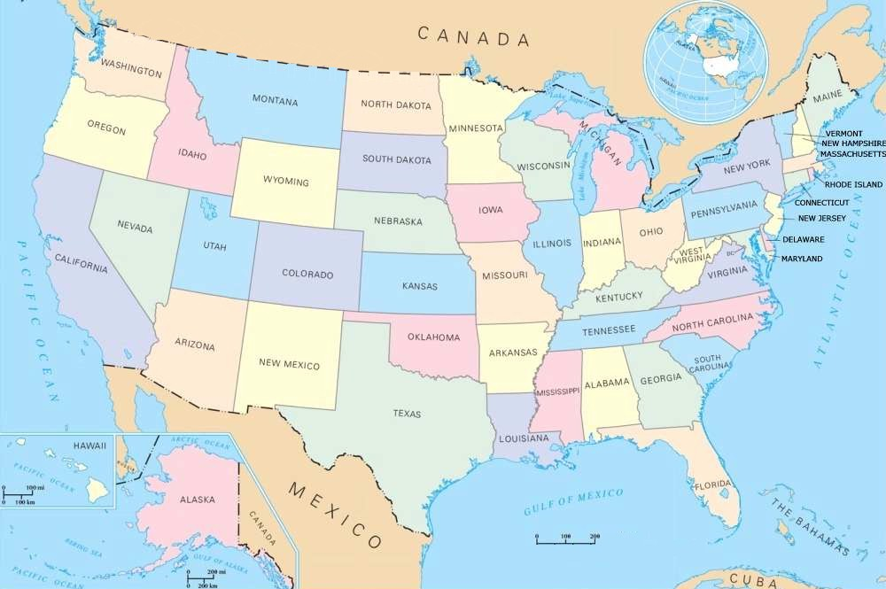
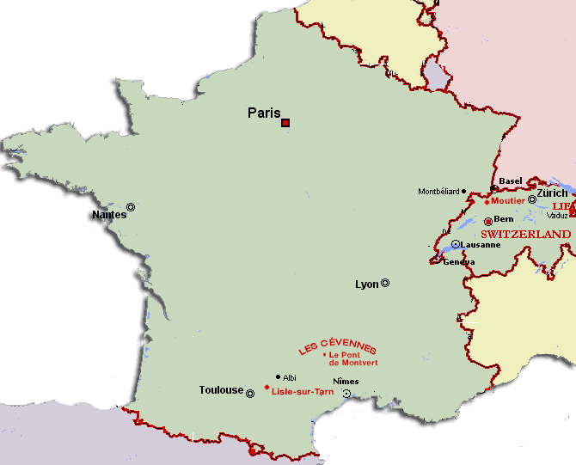
U.S. Amish Population Origins
1800’s
Notes:
Explain how Adams county was established separately from other communities…

Slide 8
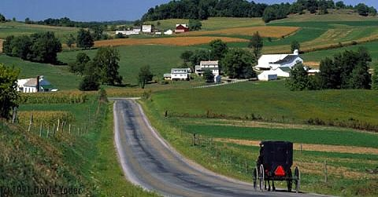

Ascertainment in the Amish
Can’t use usual methods of ascertainment
Little use of phones or modern communication
Contact is generally door to door or by mail
Ascertainment personnel live in the local area
~35% of the Amish population age 65+ have been contacted for one or more of our studies
Complete ascertainment of those >85 in 2006 (Adams County)
~90% overall participation rate

Slide 9
Question:
Is there Alzheimer Disease in the Amish?
Johnson et al., Int. J. Epi. 1997
  Cognitive impairment somewhat lower in frequency in the Amish than in general population.
Pericak-Vance et al., Ann. Neurol, 1996
  Virtually no APOE-4 allele in the Adams County, Indiana Amish community.
  However, evidence of familial clustering of AD in Adams County
These results suggested that examining Alzheimer disease in the Amish might be fruitful
Notes:
Average Age of onset is lowest when affecteds have 4/4 allele and highest when a 2 allele is present and no 4 alle

Slide 10
Question:
Is the APOE-4 Allele Absent in All Amish?
APOE allele | Frequency in the Amish
2 | 0.07
3 | 0.82
4 | 0.11
Collected additional samples from:
Indiana: Elkhart, LaGrange
Ohio: Holmes
N=823 | APOE Genotype
 | 4/4 | 3/4 | 2/4 | 3/3 | 2/3
Unaffected | 6 | 90 | 6 | 308 | 35
Affected | 10 | 34 | 2 | 69 | 12
% Affected | 62.5 | 27.4 | 25.0 | 18.3 | 25.5
Ave age of onset | 71 | 76 | 74 | 80 | 84
Cummings et al, Ann Hum Gen, 2012
Notes:
Average Age of onset is lowest when affecteds have 4/4 allele and highest when a 2 allele is present and no 4 alle

Slide 11
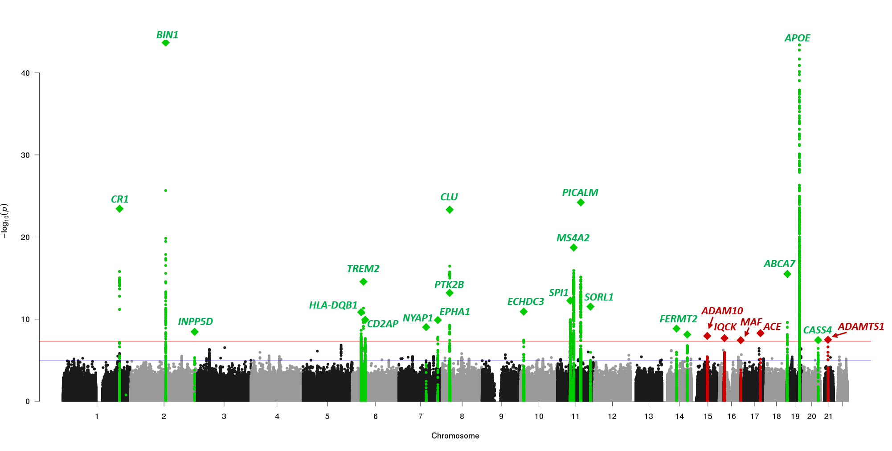
Question:
Is the Genetic Architecture of Alzheimer Disease the Same in the Amish?
Measure using Genetic Risk Scores (GRS) that summarize effects across all loci
94,437 individuals
35,274 cases
59,163 controls
24 Late-Onset AD loci
Kunkle et al., Nat Genet 51(3):414-430, 2019

Slide 12
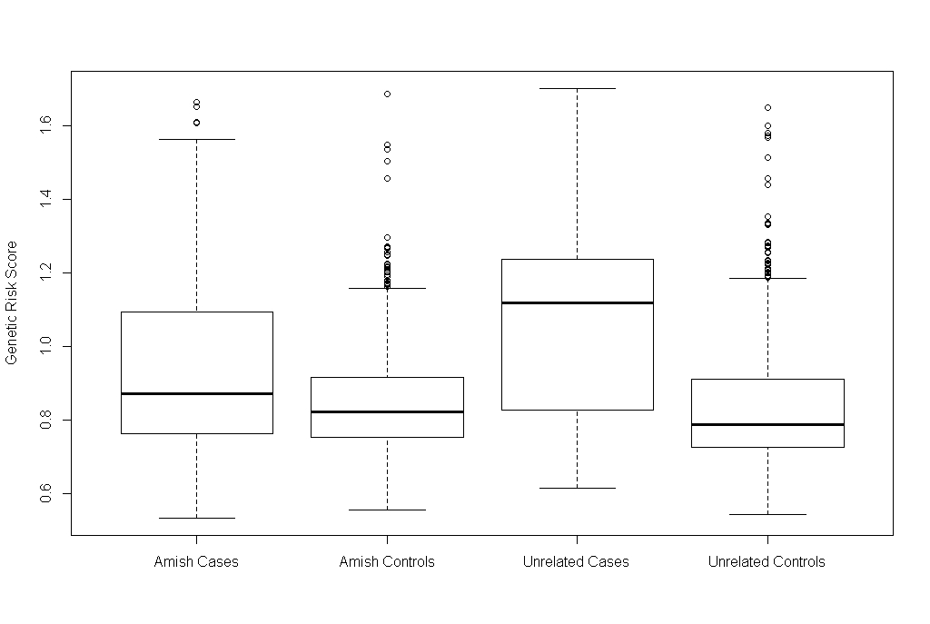
Genetic Architecture of Known Alzheimer Loci in the Amish
p = 0.0046
p = 1.02 x 10⁻⁷
p = 0.0045
p < 2.2 x 10⁻¹⁶
Wilcoxon rank
D’Aoust et al.,
PLoS One, 2015
Genetic Risk Score
Amish Cases
n = 126
μ = 0.95
Amish Controls
n = 503
μ = 0.86
Unrelated Cases
n = 473
μ = 1.10
Unrelated Controls
n = 498
μ = 0.85
Notes:
Known variants do not explain genetic risk in the Amish
MQLS-corrected average counts
IGAP + APOE

Slide 13
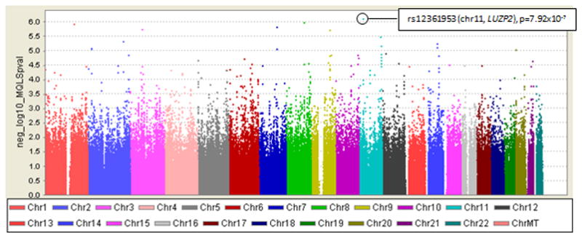
Question:
Are there Novel Loci for Alzheimer Disease in the Amish
GWAS (N=798; 109 affected)
Cummings et al, Ann Hum Gen, 2012

Slide 14
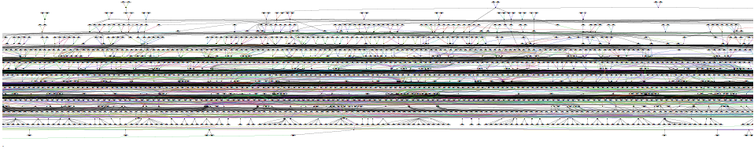
5,444 person, 13-generation family

Slide 15
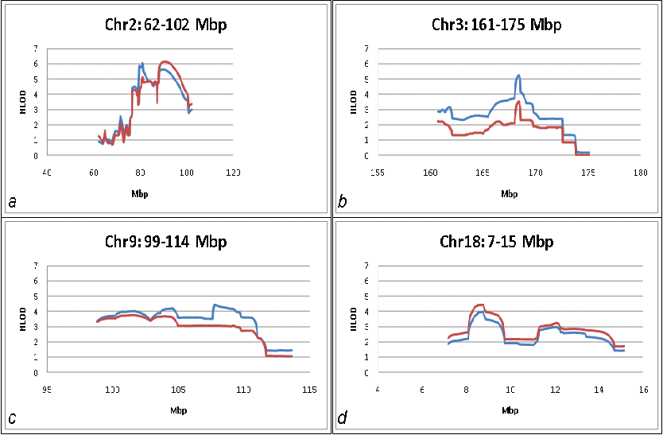
Amish Alzheimer Disease
Genetic Linkage Peaks
Linkage Analysis
Analysis of whole pedigree impossible
Break into smaller pedigrees (PEDCUT)
Analysis using MERLIN
Results variable depending on how the sub-pedigrees are defined (Cummings et al., PLoS One, 2013)
Suggestive evidence of multiple loci
Cummings, et al., Ann Hum Genet. 2012

Slide 16
Amish Alzheimer Disease Genetic Study
Status as of 2013
Enrolled 2,705 individuals
DNA samples on 1,148 individuals
  162 with Dementia
  805 Cognitively Normal
  181 Other (CIND, Unknown)
Strongly suggestive novel results for both association and linkage analyses
Methods for association accounting for complex pedigree structures were limited
Linkage analyses difficult in complex pedigrees
SNP array data incapable of identifying causative variants

Slide 17
Reimagining the Amish Alzheimer Study
Take advantage of advances in genomic, computational, and statistical methods
Design a study to leverage the unique aspects of the Amish:
  Ascertainment in Indiana (Elkhart, LaGrange, Adams) and Ohio (Holmes)
  Identify affected individuals with Alzheimer disease
    Risk Loci
  Identify cognitively normal individuals at high risk of developing AD
    Protective Loci
  Identify all individuals >age 80
    Epidemiology of cognitive status in the elderly
  Perform detailed screening for cognitive status
  Collect blood and plasma
  Revisit all cognitively normal individuals every 2 years
Notes:
Average Age of onset is lowest when affecteds have 4/4 allele and highest when a 2 allele is present and no 4 alle

Slide 18
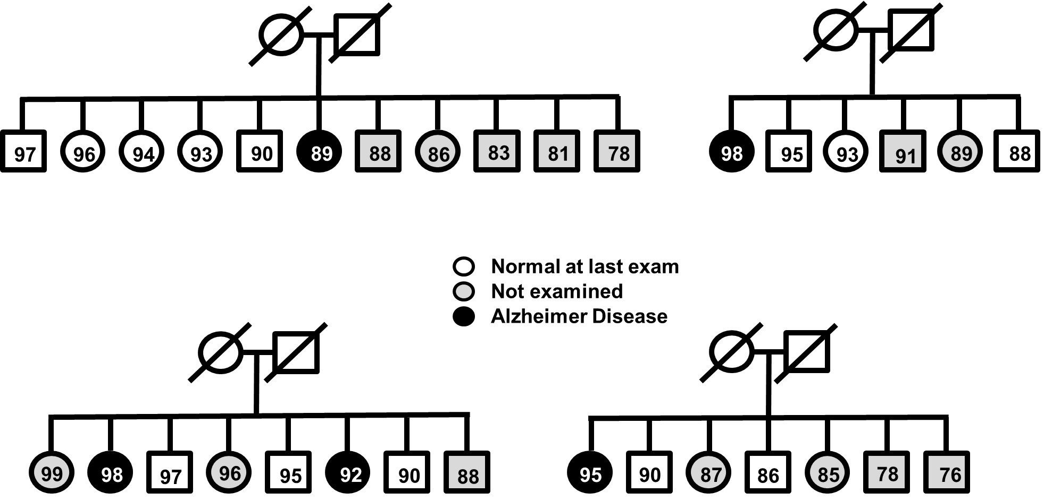
Identifying Protective Genetic Variants for
Alzheimer Disease in the Amish
Examine cognitively normal (CN) individuals who are at high risk of developing AD.
Criteria:
  Cognitively normal on multiple neuropsychological tests
  age ≥ 76 in 2018
  AND one of:
    At least one diagnosed AD sibling with onset <80
    APOE-4 carrier
    Genetic Risk Score >median score for affected individuals
Ascertainment based on previously examined individuals

Slide 19
Amish Protective Variants Project
Progress 10/31/2019
 | Ascertainment |  |  | Adjudication
 | Male | Female | Total | Cognitively Normal | Cognitively Impaired | Unclear
Enrolled | 260 | 377 | 637 | 265 | 101 | 53
Deceased |  |  | 811
Declined Demented |  |  | 36
Declined Other |  |  | 102
Contacts Attempted |  |  | 613
Total |  |  | 2,199
Of those contacted:
Enrolled: 46%
Deceased: 37%
Demented: 3%
Declined: 7%
Genomic data:
GWAS: 1,700
QC underway
WGS: 1,100
Sample selection

Slide 20
Question:
Is Educational Attainment Protective in the Amish?
Numerous studies demonstrate that higher educational attainment is associated with a lower risk of AD.
Due to cultural norms, most Amish receive formal schooling only through the 8th grade.
  Some Amish leave school before completing 8th grade
  Some Amish continue to 9th grade.
We examined the risk of developing AD based on self (or surrogate)-report of grade attainment

Slide 21
Risk of Cognitive Impairment by Education
 | Cognitively Impaired | % | Cognitively Normal | % | Total
# Participants | 337 | 14 | 2,089 | 86 | 2,426
Mean Age | 78.8 |  | 73.7 |  | 74.5
Education
<8 years | 52 | 15 | 142 | 7 | 194
8 Years | 258 | 77 | 1,569 | 75 | 1,827
>8 years | 27 | 8 | 378 | 18 | 405
Ramos et. al., in preparation

Slide 22
Next Steps
Dense SNP Array on 1,700 samples
  Existing SNP array data on an additional 700
  Perform GWAS correcting for genetic relatedness
    Alzheimer Disease
    Cognitive Preservation
  Perform linkage analysis accounting for pedigree substructure
    Alzheimer Disease
    Cognitive Preservation
Whole genome sequence on 1,100 samples
  Identify segregating rare variants
Measure progression of cognitive impairment
  Normal >> MCI >> AD

Slide 23
Acknowledgements
CWRU:
  Jonathan Haines
  Jessica Cooke Bailey
  Renee Laux
  Denise Fuzzell
  Sarada Fuzzell
  Jane Sewell
  Sherri Miller
  Leighanne Main
  Kristy Miskimen
  Michelle Grunin
  Andrea Waksmunski
  Yeunjoo Song
VUMC
  Anna Cummings
  Laura D’Aoust
  Mary Davis
  Josh Hoffman
UHCMC
  Alan Lerner
  Paula Ogrocki
NIH (AGDB)
  Richa Agarwala
  Alejandro Schaffer
U. Miami:
  Margaret Pericak-Vance
  William Scott
  Michael Plough
  Laura Caywood
  Omar Garcia-Rodriguez
  Larry Adams
  Jason Clouse
  Sharlene Herington
  Jeff Vance
  Jairo Ramos
We thank all the Amish families for graciously allowing us into their communities and their homes and for participating in our study.
Notes:
My committee (Dana and Tom Morgan)

