Slide 1



Using the Lens of Local Ancestry to Focus Risk in Alzheimer Disease
Farid Rajabli, PhD
John P. Hussman Institute for Human Genomics
University of Miami

Slide 2
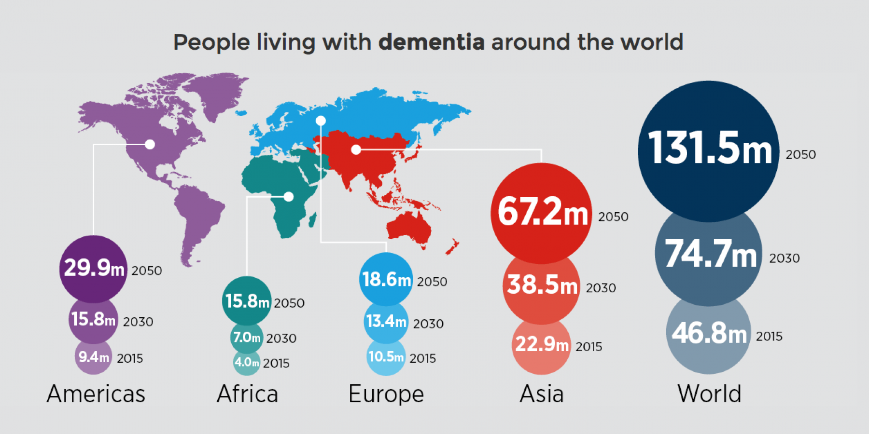
Alzheimer Disease

Slide 3
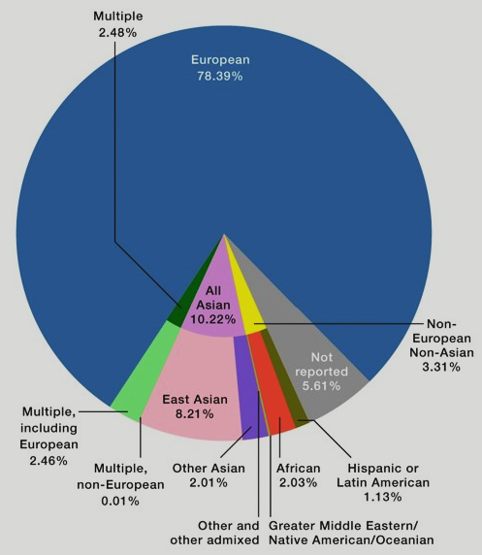
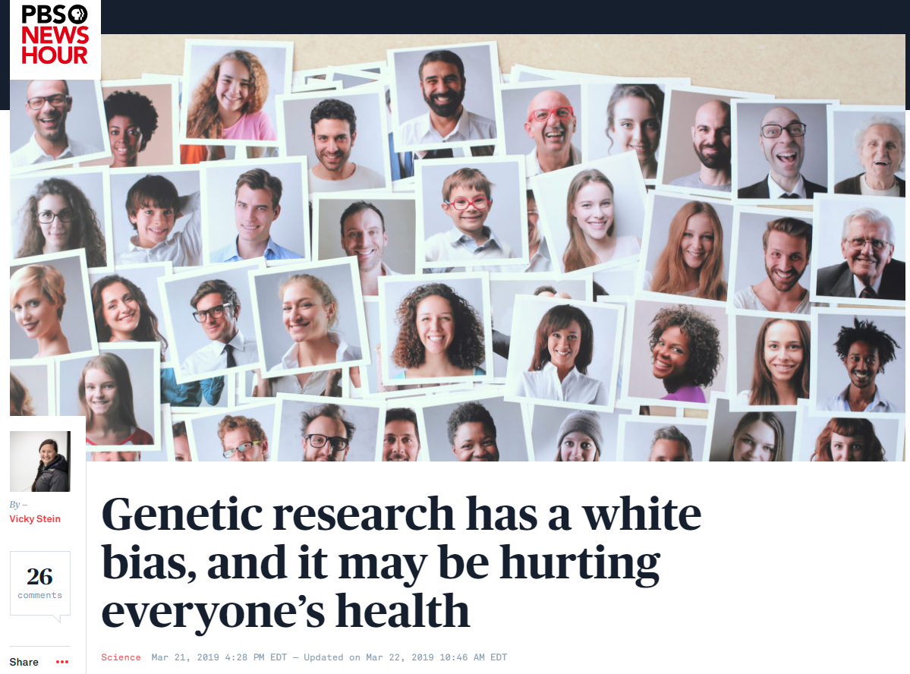
White Bias in Genetic Studies
Sirugo, et al, 2019

Slide 4
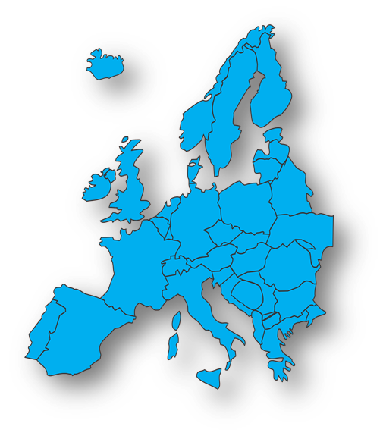
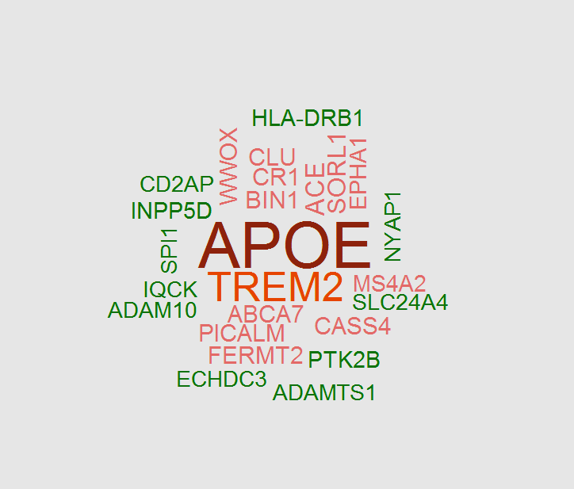

Genetic Studies in Alzheimer Disease
NHW GWAS: ~93,000
Kunkle, et al. 2019
https://all-free-download.com/free-vector/europe-map-transparent-background_sort_by_unpopular.html

Slide 5
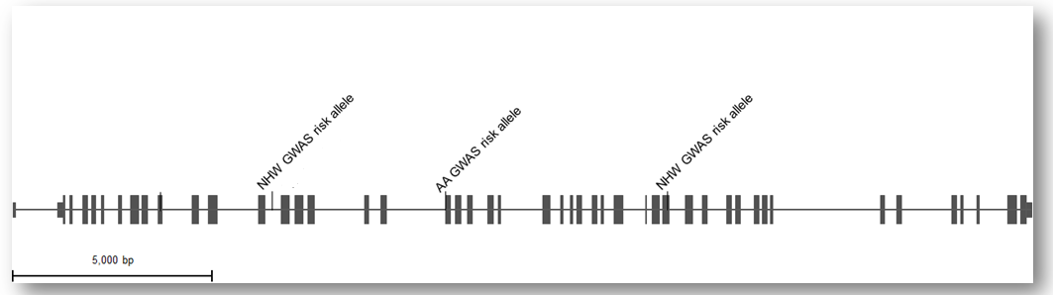
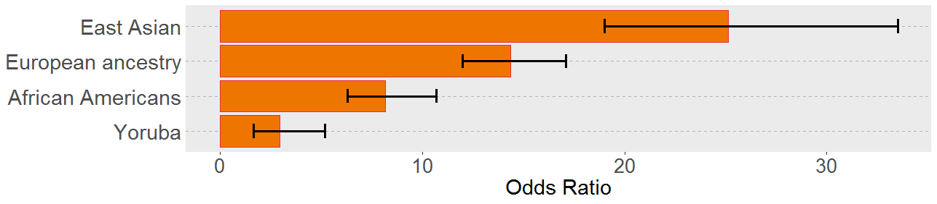
Genetic Distinctions in Alzheimer Disease
ABCA7 (Risk variant variation)
Reitz, et al. 2013
Cukier, et al. 2016
Kunkle ,et al. 2019
APOE (Effect size variation ε4ε4 vs ε3ε3)
Hendrie, et al 2014; Choi, et al. 2019; Reitz, et al. 2013

Slide 6
Hypothesis
These disparities may be due to:
ethnic-related environmental factors / global ancestry proportions
or
population-specific genetic variations around gene of interest
To explore these hypotheses
  Assess admixed populations
  Ancestral methods: global and local ancestry
Notes:
Check format

Slide 7
Hypothesis
These disparities may be due to:
ethnic-related environmental factors / global ancestry proportions
or
population-specific genetic variations around gene of interest
To explore these hypotheses
  Assess admixed populations
  Ancestral methods: global and local ancestry

Slide 8

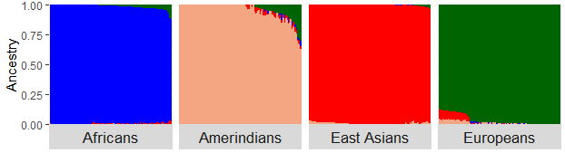
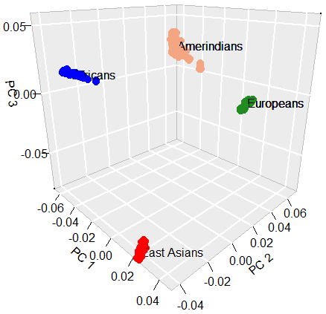
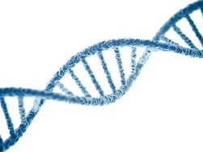
Continental Populations - Global Ancestry
$$\left\{Model Based Ancestry Estimation\right\}$$
$$\left\{Algorithmic ancestry estimation:PCA\right\}$$
https://avopix.com/premium-photo/231214228-shutterstock-illustration-of-a-world-map-drawn-out

Slide 9
Admixture – Global Ancestry
https://www.allaboutexplorers.com/explorers/columbus/

Slide 10
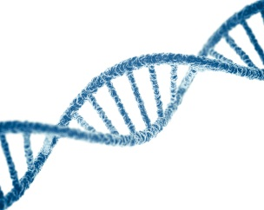

Admixture – Global Ancestry

Slide 11
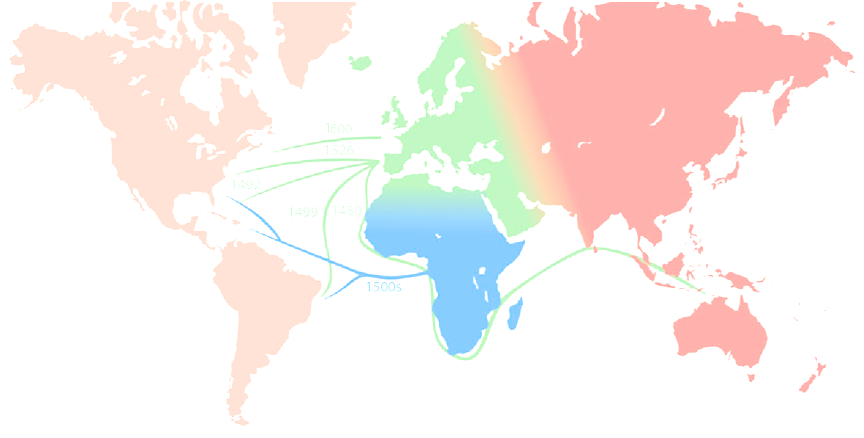
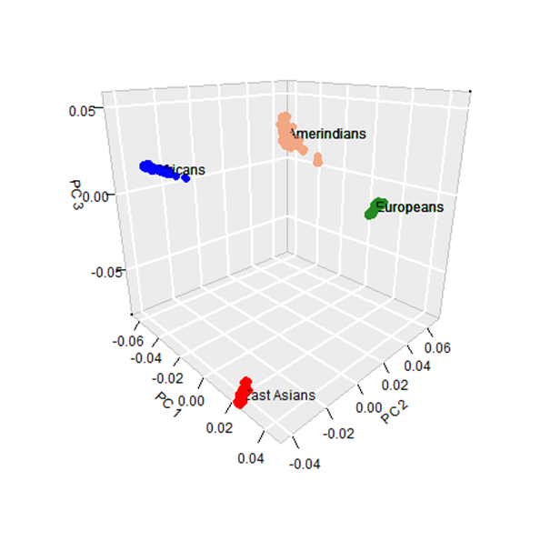

Admixture – Global Ancestry

Slide 12
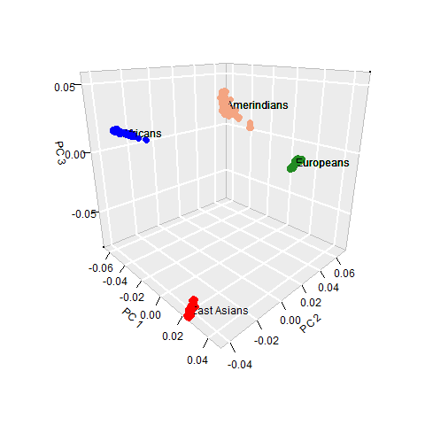
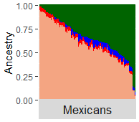
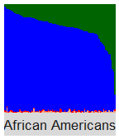
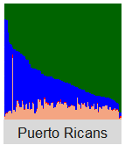
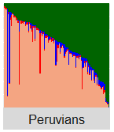
Admixture – Global Ancestry

Slide 13
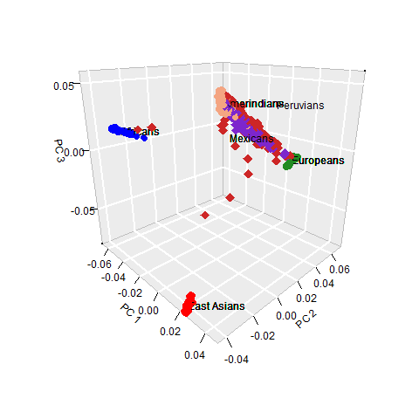
Admixture – Global Ancestry

Slide 14


Admixture – Local Ancestry
Population A
1st Generation
Population B

Slide 15
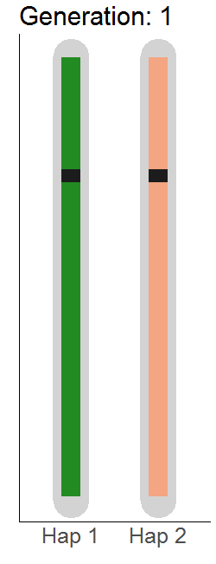
Admixture – Local Ancestry
Admixture – Local Ancestry
Population A
1st Generation
Population B

Slide 16
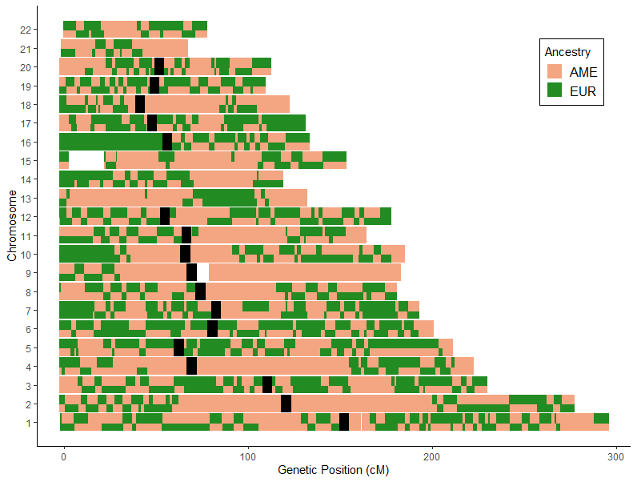
Admixture – Local Ancestry
Mexican
European
Amerindian

Slide 17
Admixture – Local Ancestry – APOE
APOE (Effect size variation ε4ε4 vs ε3ε3)

Slide 18
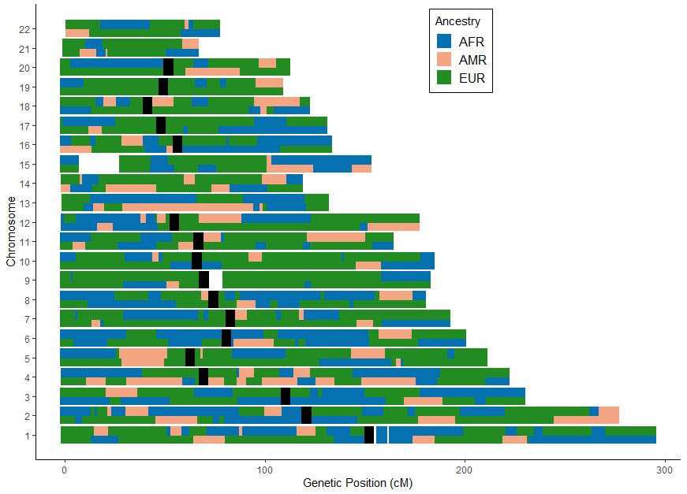
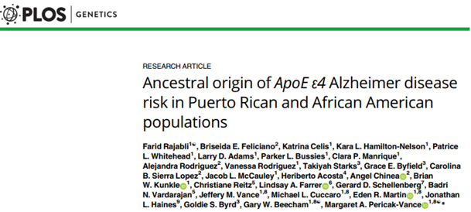
Admixture – Local Ancestry – APOE
APOE
Cohort | Haplotype Ancestry | N* | ε4 OR | p-value
Puerto Rican | European | 307 | 4.49 | 3.70E-05
 | African | 67 | 1.26 | 6.70E-01
African-American | European | 1341 | 3.05 | 4.90E-17
 | African | 5587 | 2.34 | 9.20E-45

Slide 19
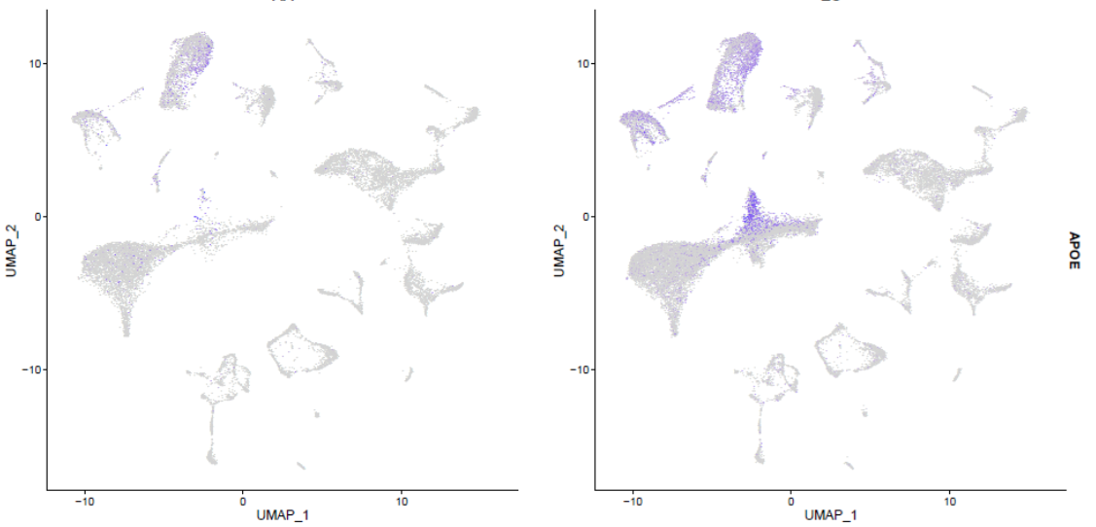
Admixture – Alzheimer – APOE – scRNA-seq
African
European
# of Ind | 4
LA at APOE | EU/EU
APOE | ε4ε4
# of Ind | 4
LA at APOE | AF/AF
APOE | ε4ε4
 | FCh | adj P-val | Cluster
Neuron | -2.52 | 4.78E-54 | 1
 | -1.24 | 1.32E-04 | 8
 | -1.83 | 2.14E-24 | 10
Astrocyte | -1.56 | 8.05E-58 | 4
 | -1.6 | 1.92E-77 | 3
Microglia | -1.44 | 1.74E-10 | 5

Slide 20
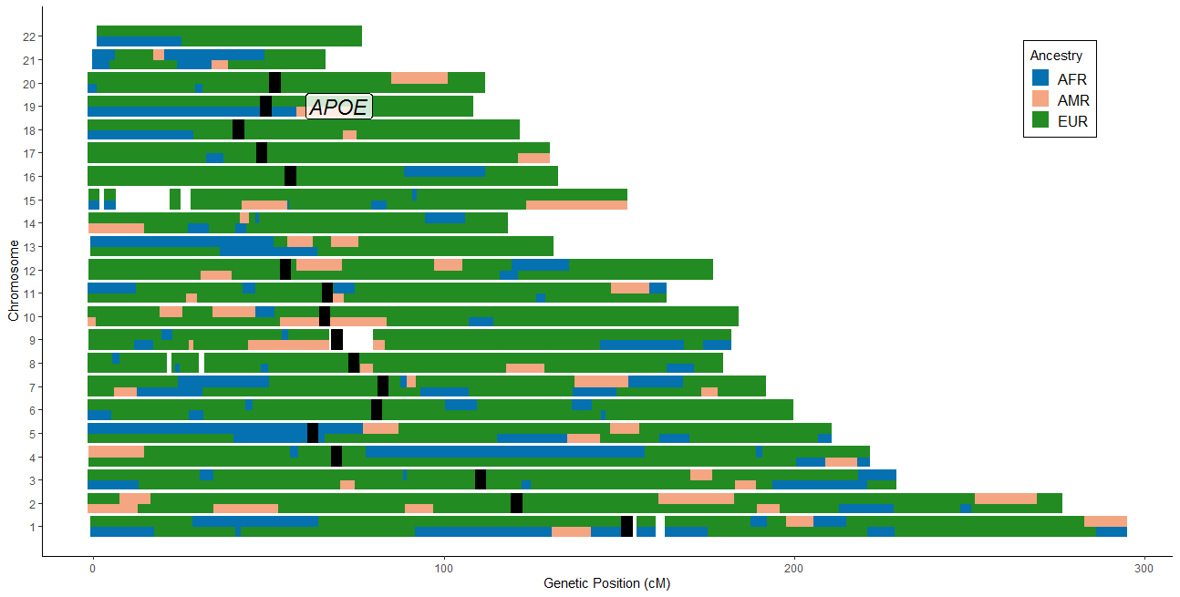
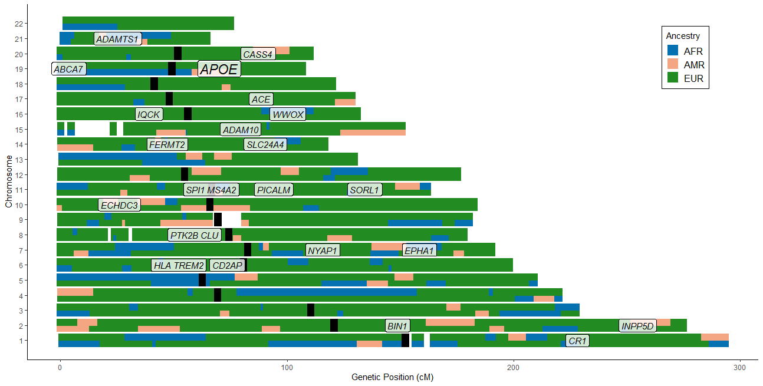
Admixture – Local Ancestry – AD genes

Slide 21
Key Points
Ancestry-specific genetic variations at the gene locus cause genetic distinctions among continental populations
Studies of admixed populations provide unique opportunity to test correlation between genetic factors and ancestry
Expanding admixed cohorts with high Amerindian ancestry is important to assess the impact of genetic factors in Amerindian populations
Are there genetic distinctions among subcontinental populations ???
eg. Southern Europeans vs Northern Europeans

Slide 22
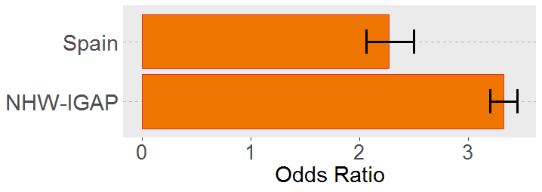
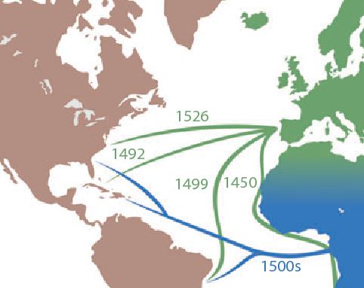
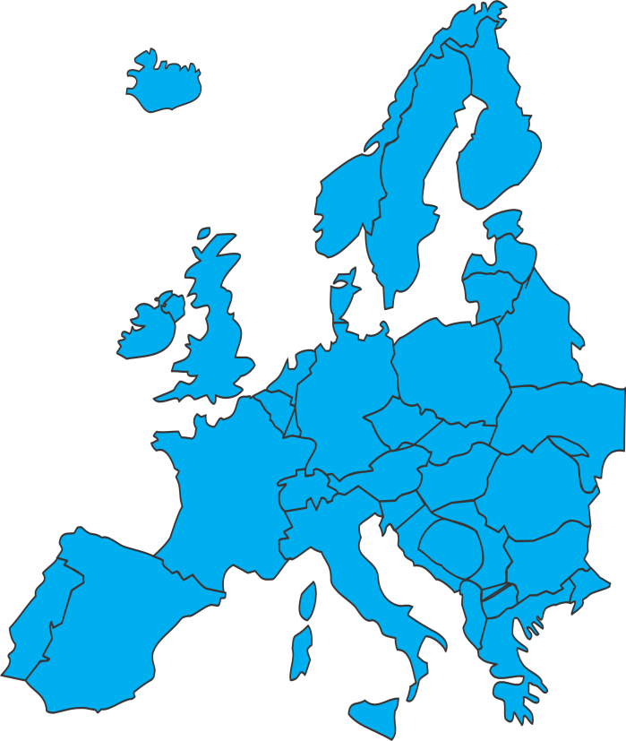
Admixture – Iberian Peninsula
APOE (rs429358 T/C)
S Moreno-Grau et al. 2019
Kunkle, et al. 2019

Slide 23
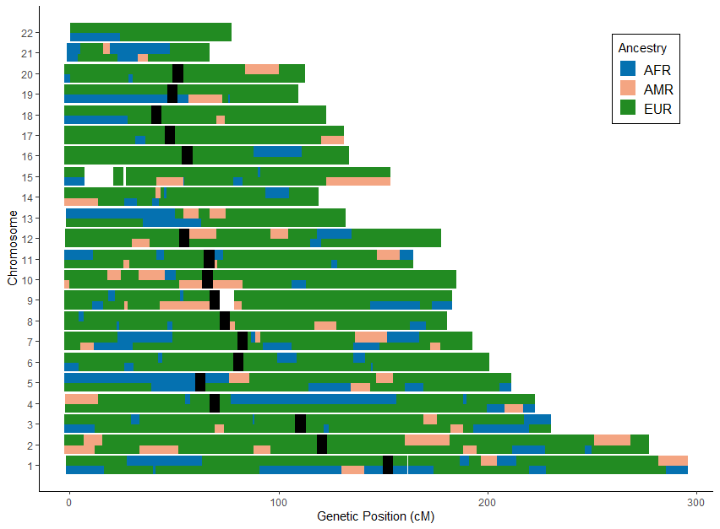
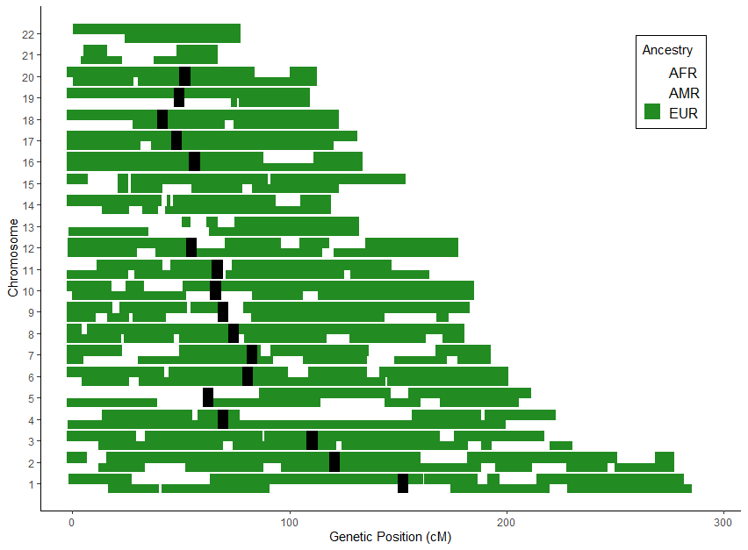
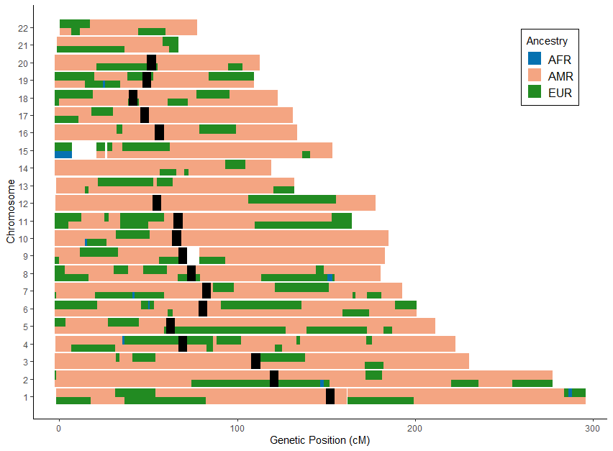
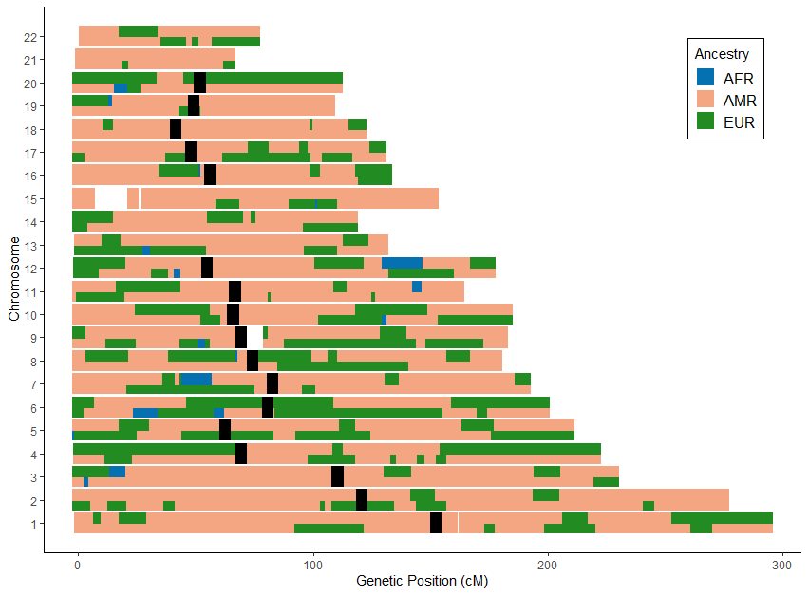
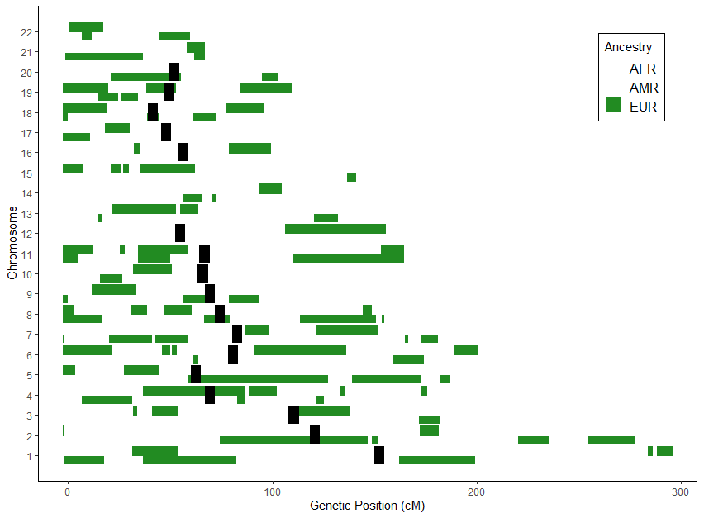
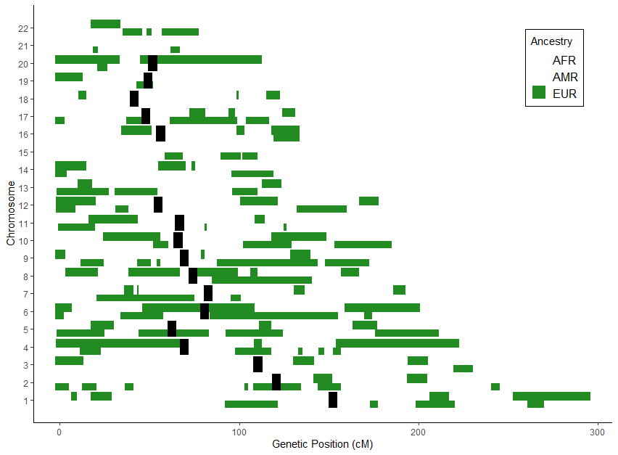
Admixture – Iberian Peninsula ?
Mexican
Puerto Rican
Peruvian

Slide 24
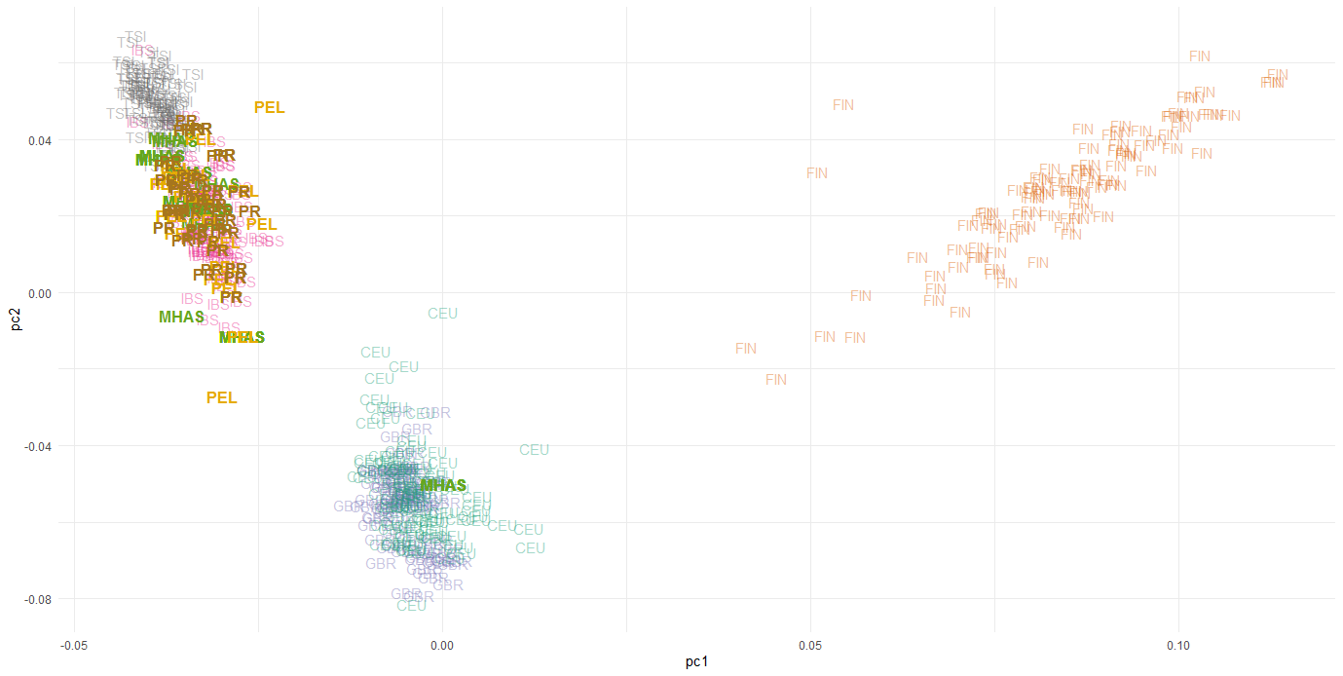
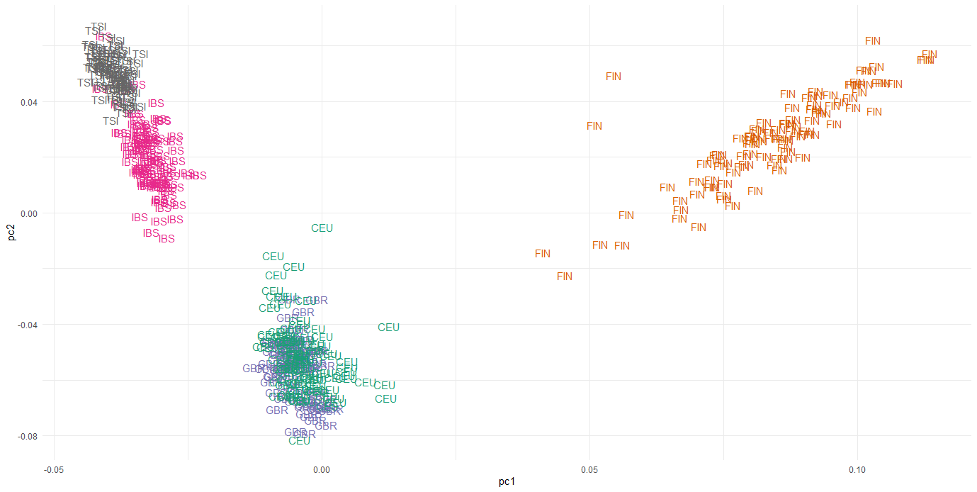
Admixture – Iberian Peninsula
1000 Genome Project European Populations
Southern Europeans
Finnish
Western and Northern Europeans
Notes:
Talk about the ref pops first
Emphasize northern/southern European BEFORE adding in our data

Slide 25
Key Points
Iberian population showed different APOE effect than Northern European populations
Hispanic populations primarily inherited Southern European ancestry
Significance
To better understand the genetics of AD in Hispanics we need to explore the disease genetics in Iberian populations.
Investigating the relationship between genetic ancestry and AD may inform precision medicine initiatives, risk assessment, and development of ancestry-specific therapeutics

Slide 26



Acknowledgements
University of Miami
John P Hussman Institute for Human Genomics
Margaret A. Pericak-Vance
Gary W. Beecham
Jeffery M. Vance
Eden R. Martin
Kara L. Hamilton-Nelson
Michael Cuccaro
Katrina Celis
Larry D. Adams
Patrice L. Whitehead
Brian W. Kunkle
Holly N. Cukier
Vanessa C. Rodriguez
Jim Jaworski
Anthony J. Griswold
Juan I. Young
Pedro Mena
Sergio Tejada
Aja Scott
Faina C. Lacroix
Natalia K. Hofmann
Wake Forest University,
The Maya Angelou Center for Health Equity
Goldie S Byrd
Takiyah Starks
University of Pennsylvania
Gerard D. Schellenberg
Adam C. Naj
Li-San Wang
Columbia University
Richard Mayeux
Badri N. Vardarajan
Christiane Reitz
Instituto Nacional de Ciencias Neurológicas
Mario Cornejo­-Olivas
Pillar Mazzetti
Northwestern University
Eileen H. Bigio
Marek-Marsel Mesulam
Sandra Weintraub
Geula Changiz
Case Western Reserve University
Jonathan L. Haines
William S. Bush
Boston University
Lindsay Farrer
Emory University
Marla Gearing
Universidad Central del Caribe
Briseida E. Feliciano

