Slide 1



Alzheimer’s Disease Genetics Symposium – 2019
Alzheimer’s Disease Genetics Consortium – 10 years of collaboration and progress
Li-San Wang
Laura Cantwell
Marrisa Cranney
Michelle Moon
Zivadin Katanic

Slide 2
Human
disease gene protein
genetics
mechanism/ drug
pathway target
Prediction
Mechanism
Drug targets
Study human disease mechanisms directly in humans
Notes:
The rationale for human genetics I that by identifying genes with variants variants that cause a disease, alter risk or prevent a disease, we gain information that allows us to:
Predict
Uncover mechanisms and most important
And most importantly, Identify drug targets
The power of human genetics is that is directly from man – and of course man is who we want to treat.
So when we identify a gene where mutations alter function or increase expression, these are experiments of nature that give us direct information that if we can alter function or alter levels of the protein pharmacologically, we should be able to influence disease risk. This does not rely on translation from model organisms or in vitro experiments – these are direct observations in man.

Slide 3
Aβ is toxic and causes AD
Increased Aβ causes AD
(decreased Aβ prevents AD)
Aggregation-prone Aβ is toxic
PSEN1/2 are Aβ pathway enzymes
BACE1 is an Aβ pathway enzyme
APOE
PSEN1 cloned
PSEN1 mapped
PSEN2 mapped
APP mutations
PSEN2 cloned
APP cloned
1990
BACE1 cloned
2000
2010

Slide 4
APOE
PSEN1 cloned
PSEN1 mapped
PSEN2 mapped
APP mutations
ACE
PSEN2 cloned
SORL1
APP cloned
Candidate genes
1990
BACE1 cloned
2000
2010

Slide 5
A Genome-Wide Association Study of
Type 2 Diabetes in Finns Detects
Multiple Susceptibility Variants
Laura J. Scott,1 Karen L. Mohlke,2 Lori L. Bonnycastle,3 Cristen J. Willer,1 Yun Li,1
William L. Duren,1 Michael R. Erdos,3 Heather M. Stringham,1 Peter S. Chines,3
Anne U. Jackson,1 Ludmila Prokunina-Olsson,3 Chia-Jen Ding,1 Amy J. Swift,3 Narisu Narisu,3
Tianle Hu,1 Randall Pruim,4 Rui Xiao,1 Xiao-Yi Li,1 Karen N. Conneely,1 Nancy L. Riebow,3
Andrew G. Sprau,3 Maurine Tong,3 Peggy P. White,1 Kurt N. Hetrick,5 Michael W. Barnhart,5
Craig W. Bark,5 Janet L. Goldstein,5 Lee Watkins,5 Fang Xiang,1 Jouko Saramies,6
Thomas A. Buchanan,7 Richard M. Watanabe,8,9 Timo T. Valle,10 Leena Kinnunen,10,11
Gonçalo R. Abecasis,1 Elizabeth W. Pugh,5 Kimberly F. Doheny,5 Richard N. Bergman,9
Jaakko Tuomilehto,10,11,12 Francis S. Collins,3* Michael Boehnke1*
Genome-Wide Association Analysis
Identifies Loci for Type 2 Diabetes
and Triglyceride Levels
Diabetes Genetics Initiative of Broad Institute of Harvard and MIT, Lund University,
and Novartis Institutes for BioMedical Research*†
SCIENCE VOL 316 1 JUNE 2007 1331
SCIENCE VOL 316 1 JUNE 2007 1341
Replication of Genome-Wide
Association Signals in UK Samples
Reveals Risk Loci for Type 2 Diabetes
Eleftheria Zeggini,1,2* Michael N. Weedon,3,4* Cecilia M. Lindgren,1,2* Timothy M. Frayling,3,4*
Katherine S. Elliott,2 Hana Lango,3,4 Nicholas J. Timpson,2,5 John R. B. Perry,3,4
Nigel W. Rayner,1,2 Rachel M. Freathy,3,4 Jeffrey C. Barrett,2 Beverley Shields,4
Andrew P. Morris,2 Sian Ellard,4,6 Christopher J. Groves,1 Lorna W. Harries,4
Jonathan L. Marchini,7 Katharine R. Owen,1 Beatrice Knight,4 Lon R. Cardon,2 Mark Walker,8
Graham A. Hitman,9 Andrew D. Morris,10 Alex S. F. Doney,10 The Wellcome Trust Case Control
Consortium (WTCCC),† Mark I. McCarthy,1,2‡§ Andrew T. Hattersley3,4‡
Fusion: 2,376 cases/2,432 controls
DGI: 6,529 cases/7,525 controls
WTCCC/UK2TD: 5,681 cases/8,284 controls
Total: 14,586 cases/17,968 controls
Five novel loci
SCIENCE VOL 316 1 JUNE 2007 1336

Slide 6
Genome-wide association studies can identify disease loci for complex diseases
Large sample sizes are needed
Collaborative meta-analyses required
Fusion: 2,376 cases/2,432 controls
DGI: 6,529 cases/7,525 controls
WTCCC/UK2TD: 5,681 cases/8,284 controls
Total: 14,586 cases/17,968 controls
Five novel loci

Slide 7
30 Alzheimer Disease Centers (ADCs)
Alzheimer’s Disease Centers
AD cases and controls
Standardized phenotype data and autopsy data
ADCs
blood
DNA
tissue
data
National Alzheimer Coordinating Center
Collect/distribute all ADC data
Manage phenotype definitions
NACC
NACC
Kukull
NCRAD
Foroud
National Cell Repository for Alzheimer disease
Collect tissue/DNA
Distribute samples
NCRAD
ADGC
Alzheimer’s Disease Genetics Consortium
Genetic association studies
Sequencing
Common/rare variant discovery
ADGC
GWAS
sequencing

Slide 8
30 Alzheimer Disease Centers (ADCs)
Cohorts
NIA-LOAD
WHICAP
ACT
etc
blood
DNA
tissue
data
DNA
data
Phenotype
genetic data
NACC
Kukull
NCRAD
Foroud
NIAGADS
Wang
ADGC
NIA Genetics of Alzheimer’s Disease Storage site
Collect/distribute AD genetic and phenotype data
Manage data flow for the ADSP and GCAD
Genotype and Sequence data
NIAGADS
GWAS
sequencing

Slide 9
ADGC Collaborative Network - Analysis groups
University of Miami
Peggy Pericak-Vance
Eden Martin
Gary Beecham
Brian Kunkle
University of Pennsylvania
Gerard Schellenberg
Li-San Wang
Adam Naj
Fanny Leung
LOAD families
Hispanic/African American cohorts
Follow-up Sequence cohorts
Genomic annotation
Amish cohort
Trans-ethnic analyses
MIRAGE cohort
ADC cohort
Data management
Bioinformatics support
Caribbean Hispanic cohorts
NIA-LOAD cohorts
Case-Western
Jonathan Haines
Will Bush
Columbia University
Richard Mayeux
Badri Vardarajan
Christiane Reitz
Boston University
Lindsay Farrer
Gyungah Jun

Slide 10
ADGC Cohorts
Cohort Cases Controls
ACT 532 1,571
ADC1 1,549 512
ADC2 727 156
ADC3 894 586
ADC4 304 377
ADC5 286 505
ADC6 213 338
ADC7 566 878
ADC8 517 664
ADC9 728 896
ADC10 457 724
ADC11* 883 1265 *In process
ADNI 268 173
BIOCARD 6 122
CHAP 27 144
EAS 9 141
GSK 666 712
NIA-LOAD 1,788 1,568
MAYO 658 1,046
MIRAGE 491 738
MTV 256 189
NBB 80 48
OHSU 132 153
PFIZER 696 762
RMAYO 13 233
ROSMAP 354 986
TARCC 323 181
TGEN 668 365
Cohort Cases Controls
UKS 596 170
UMVUMSSM 1,177 1,126
UPITT 1,255 829
WASHU 339 187
WASHU2 38 94
WHICAP 76 560
Totals 17,572 18,999
Grand total 36,571
NIA-funded Alzheimer’s Disease Centers
7,124 cases
6,901 controls
14,025 total

Slide 11
ADGC Multi-ethnic cohorts
Samples with array data
Ethnic group AD MCI NC Total
Non-Hispanic white 16,229 2,333 17,010 35,572
African American 2,845 418 5,271 8,143
Caribbean Hispanics 3,859 - 6,365 10,224
Non-Caribbean Hispanics 351 194 216 761
Asian 2,337 90 3,273 5,700
Totals 25,621 3,035 32,135 57,756
All samples with WES and WGS data will also have genome-wide array data

Slide 12


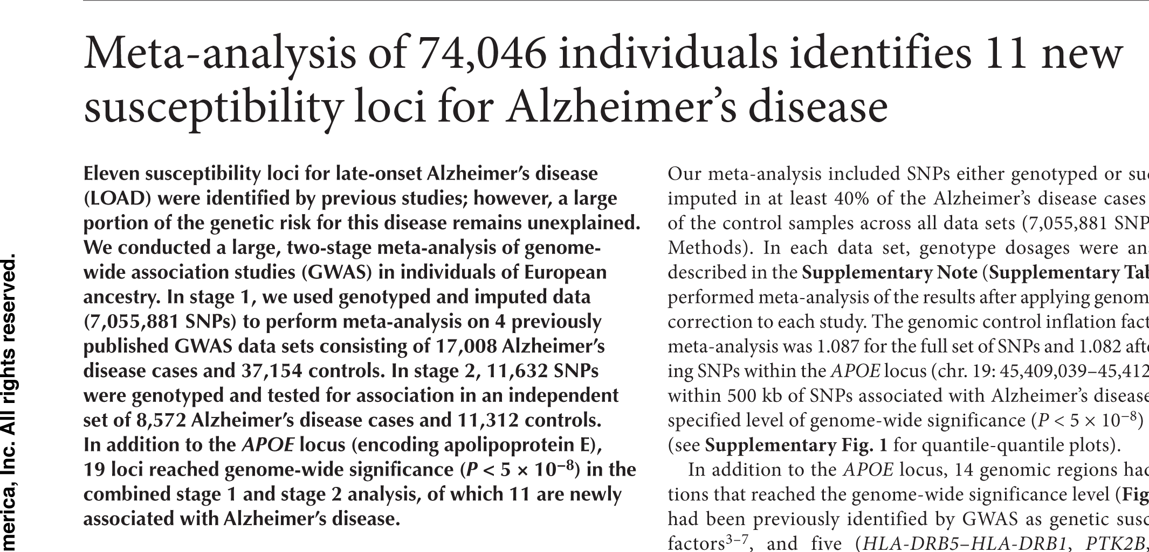

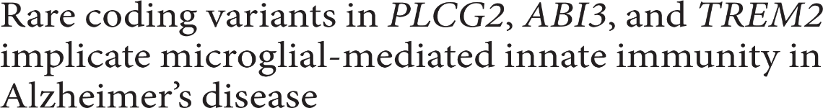
IGAP
GERAD
Genetic and Environmental Risk in Alzheimer's Disease - Williams
CHARGE
Cohorts for Heart and Aging Research in Genomic Epidemiology - Seshadri
EADI
European Alzheimer's Disease Initiative – Amouyel/Lambert
ADGC
Alzheimer’s Disease Genetics Consortia - Schellenberg

Slide 13
Two meetings - Paris (November 28-30, 2018)
AD sequencing groups (ADSP and ADES)
IGAP
co-sponsors: Alzheimer’s Disease Genetics Consortium (ADGC)
French Fondation Alzheimer.
Samples: Country/location
Argentina
Australia
Austria
Belgium
Chile
China
Czech Republic
Denmark
Dominican Republic
Finland
France
Germany
Greece
Iceland
Italy
Japan
Korea
Mexico
Netherlands
Norway
Puerto Rico
Spain
Sweden
Taiwan
United Kingdom
United States
Consortia
ADES: Alzheimer’s Disease Exome sequencing Consortia
ADSP: Alzheimer’s Disease Sequencing Project
ADGC: Alzheimer’s Disease Genetics Consortia
CHARGE: Cohorts for Heart and Aging Research in Genomic Epidemiology
EADB: European Alzheimer’s Disease DNA BioBank
EADI: European Alzheimer's Disease Initiative
Fundació ACE
GERAD: Genetic and Environmental Risk in Alzheimer's Disease
GR@CE
Countries represented
Belgium
Denmark
France
Germany
Netherlands
Spain
United Kingdom
United States
Missing
Investigators from China, Japan, Korea, Taiwan, India, Latin America
Alzheimer’s Disease Asian Consortium (ADAC)
China, Japan, Koreas

Slide 14
IGAP GWAS - 2019
Consortium cases controls
ADGC 15,456 16,142
CHARGE 2,240 13,474
EADI 5,288 7,770
GERAD 12,290 21,777
Totals 35,274 59,163
Grand total 94,437
Kunkle et al. 2019

Slide 15
Innate immune/microglial response
CR1 MS4A4/MS6AE
TREM2 SPI1
PLCG2 CLU
HLA-DRB5/ HLA-DRB1 ABCA7
ABI3 APOE
CR1 CD33 (?) ADAM10
SORL1 BIN1 ADAMTS1
Lipid transport/metabolism
CLU
ABCA7
APOE
APP/Aβ Metabolism
APP PSEN1
PSEN2 ADAM10
SORL1 APP - ADAMTS1
CASP7
Tau toxicity neurons
BIN1
Alzheimer’s Disease Sequencing Project (ADSP)

Slide 16
APP
Aβ
α-secretase
β-secretase
BACE
γ-secretase
PSEN1/2
ADAM10
C31 toxic fragment?
Caspase 7
Notes:
The amyloid precursor gene encodes a transmembrane protein, that is proteolytically cleaved. The products include an N-terminal extracellular product that is presumably a signaling protein, and an intracellular C-terminal that is probably an intracellular peptide that is involved in nuclear gene regulatory events. Cleavage by beta and gamma secretase enzymes results in production of the A-beta peptide found in amyloid plaques. Cleavage by the alpha-secretase destroys the Abeta peptide.
Disease-causing mutations in APP are clustered near cleavage sites, either at the beta secretase site at the N-terminal end, the alpha-secretase site in the center of the Abeta sequence, and immediately after the gamma-secretase site.

Slide 17
Alzheimer’s Disease Sequencing Project
2020
Whole Genome Sequence
 | Cases | Controls | Other
African American | 2,356 | 4,247
Caribbean Hispanic | 1,521 | 2,407
Mexican American | 200 | 2,600
Non-Hispanic White | 4,330 | 6,234 | 2,230
Non-FUS | 2,085 | 1,878 | 3,963
TOTALS | 10,492 | 17,366 | 6,193
Autopsy
Cases | Controls
2,274 | 1,521
Whole exome sequencing
total WES (other funding): 6,701
total WES (ADSP + ADGC): 13,333
total WES: 20,043
Multiplex families
Ethnicity | Cases | Controls | #Families
Hispanics | 1,574 | 926 | 425
African American | 212 | 125 | 77
Non-Hispanic Caucasians | 1,290 | 879 | 470
TOTAL | 3,076 | 1,930 | 1,072

Slide 18
regulatory element
causal variant
gene
promoter
Rare deleterious coding, splicing, or LOF
GWAS signals: 90-95% of causative variants are in non-promoter regulatory elements
eQTLs: only 50% affect the closest gene
ADSP WES Sequence data
Gene Locus
ABCA7 -
TREM2 -
SORL1 -
TREML4 TREM2
TAP2 HLA-DRB1
PSMB2 HLA-DRB1
PIP EPHA1
STYX FERMT2
RIN3 SLC24A4
KCNH6 ACE
Fine-mapping with trans-ethnic studies
Coding mutations
Bioinformatics predictions
eQTL correlations
enhancer assays
Chromatin capture/ATACSeq
CRISPR/CAS9
Deleterious variants
TREM2
CR1
SPI1
MS4A2
IQCK

Slide 19
GWAS
40 loci
13 loci
APOE
PSEN1 cloned
5 loci
PSEN1 mapped
1 locus
PSEN2 mapped
APP mutations
3 loci
ACE
PSEN2 cloned
SORL1
APP cloned
Candidate genes
1990
BACE1 cloned
2000
2010
2020
CASP7
TREM2
NextGen DNA Sequencing

Slide 20
Fresh push for ‘failed’ Alzheimer’s drug
Biogen seeks FDA approval for aducanumab after revisiting clinical-trial data
Genetics-based drug development
APOE
Science, 25 OCTOBER 2019
PSEN1 mutations
PSEN1 mapped
APOE agonist
Aβ immunization
mice
PSEN2 mapped
APP mutations
PSEN2 mutations
Aβ immunization
human
APP cloned
1990
BACE 1 (β-secretase)
cloned
2000
γ-secretase (PSEN1) inhibitor
2010
2020
BACE 1 (β-secretase)
inhibitor

Slide 21
Is this enough?
How do we know when we get there?
~ 70 genes/loci with genome-wide evidence of association
We will be “there” when:
We have a therapy that prevents Alzheimer’s disease without side significant side effects – that is inexpensive enough for people in third-world countries.

Slide 22
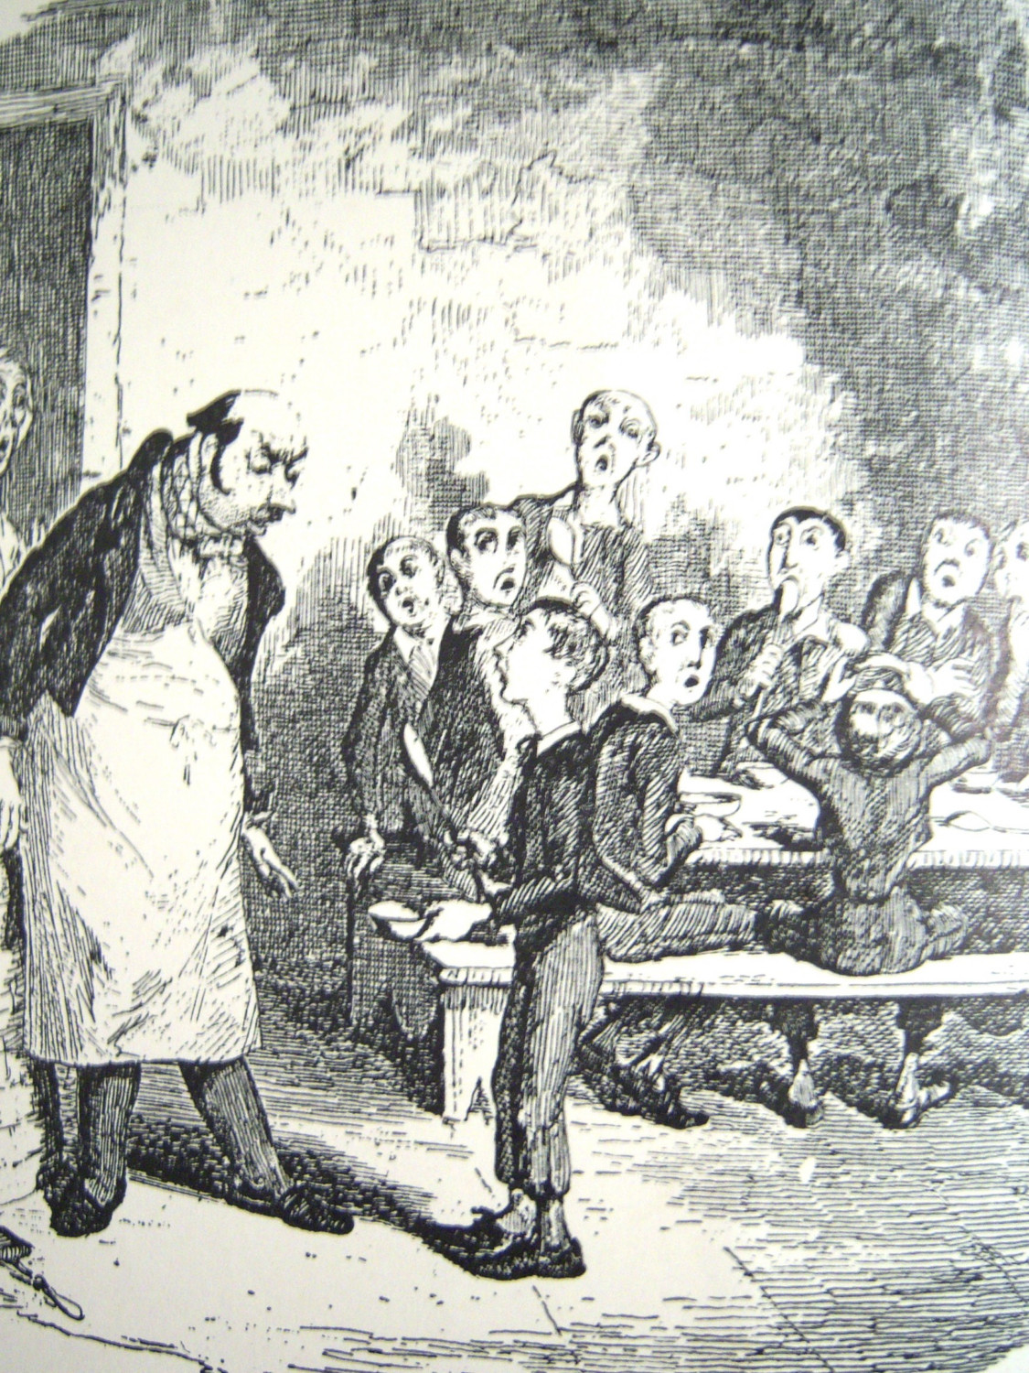
Please sir –
I want some more
More subjects (multiethnic)
Deep phenotypes
More risk/protective genes
More biology
More targets

Slide 23
What’s next?

Slide 24
Brian W. Kunkle*¹, Benjamin Grenier-Boley*^{2,3,4}, Rebecca Sims⁵, Sven J. van der Lee⁶, Adam C. Naj⁷, Céline Bellenguez^{2,3,4}, Nandini Badarinarayan⁵, Johanna Jakobsdottir⁸, Anne Boland⁹, Rachel Raybould⁵, Joshua C. Bis¹⁰, Alexandre Amlie-Wolf¹¹, Eden R. Martin^{1,12}, Stefanie Heilmann-Heimbach^{13,14}, Vincent Chouraki^{15,16}, Amanda Partch¹¹, Kristel Sleegers^{17,18}, Maria Vronskaya⁵, Agustin Ruiz¹⁹, Robert R. Graham²⁰, Robert Olaso⁹, Per Hoffmann^{13,14,21}, Megan L. Grove²², Badri N. Vardarajan^{23,24,25}, Mikko Hiltunen^{26,27}, Markus M. Nöthen^{13,14}, Charles C. White²⁸, Kara L. Hamilton-Nelson¹, Jacques Epelbaum²⁹, Wolfgang Maier^{30,31}, Seung-Hoan Choi^{15,32}, Gary W. Beecham^{1,12}, Cécile Dulary⁹, Stefan Herms^{13,14,21}, Albert V. Smith^{8,33}, Cory C. Funk³⁴, Céline Derbois⁹, Andreas J. Forstner^{13,14}, Shahzad Ahmad⁶, Hongdong Li³⁴, Delphine Bacq⁹, Denise Harold³⁵, Claudia L. Satizabal^{15,16}, Otto Valladares¹¹, Alessio Squassina³⁶, Rhodri Thomas⁵, Jennifer A. Brody¹⁰, Liming Qu¹¹, Pascual Sanchez-Juan³⁷, Taniesha Morgan⁵, Frank J. Wolters⁶, Yi Zhao¹¹, Florentino Sanchez Garcia³⁸, Nicola Denning⁵, Myriam Fornage³⁹, John Malamon¹¹, Maria Candida Deniz Naranjo³⁸, Elisa Majounie⁵, Thomas H. Mosley⁴⁰, Beth Dombroski¹¹, David Wallon^{41,42}, Michelle K Lupton^{43,44}, Josée Dupuis³², Patrice Whitehead¹, Laura Fratiglioni^{45,46}, Christopher Medway⁴⁷, Xueqiu Jian³⁹, Shubhabrata Mukherjee⁴⁸, Lina Keller⁴⁶, Kristelle Brown⁴⁷, Honghuang Lin³², Laura B. Cantwell¹¹, Francesco Panza⁴⁹, Bernadette McGuinness⁵⁰, Sonia Moreno-Grau¹⁹, Jeremy D. Burgess⁵¹, Vincenzo Solfrizzi⁵², Petra Proitsi⁴³, Hieab H. Adams⁶, Mariet Allen⁵¹, Davide Seripa⁵³, Pau Pastor⁵⁴, L. Adrienne Cupples^{16,32}, Nathan D Price³⁴, Didier Hannequin^{41,42,55}, Ana Frank-García^{56,57,58}, Daniel Levy^{14,15,59}, Paramita Chakrabarty⁶⁰, Paolo Caffarra^{61,62}, Ina Giegling⁶³, Alexa S. Beiser^{15,32}, Vimantas Giedraitis⁶⁴, Harald Hampel^{65,66,67}, Melissa E. Garcia⁶⁸, Xue Wang⁵¹, Lars Lannfelt⁶⁴, Patrizia Mecocci⁵⁴, Gudny Eiriksdottir⁸, Paul K. Crane⁴⁸, Florence Pasquier^{69,70}, Virginia Boccardi⁵⁴, Isabel Henández¹⁹, Robert C. Barber⁷¹, Martin Scherer⁷², Lluis Tarraga¹⁹, Perrie M. Adams⁷³, Markus Leber⁷⁴, Yuning Chen³², Marilyn S. Albert⁷⁵, Steffi Riedel-Heller⁷⁶, Valur Emilsson^{8,77}, Duane Beekly⁷⁸, Anne Braae⁷⁹, Reinhold Schmidt⁸⁰, Deborah Blacker^{81,82}, Carlo Masullo⁸³, Helena Schmidt⁸⁴, Rachelle S. Doody⁸⁵, Gianfranco Spalletta⁸⁶, WT Longstreth, Jr^{87,88}, Thomas J. Fairchild⁸⁹, Paola Bossù⁸⁶, Oscar L. Lopez^{90,91}, Matthew P. Frosch⁹², Eleonora Sacchinelli⁸⁶, Bernardino Ghetti⁹³, Pascual Sánchez-Juan³⁷, Qiong Yang³², Ryan M. Huebinger⁹⁴, Frank Jessen^{30,31,74}, Shuo Li³², M. Ilyas Kamboh^{95,96}, John Morris^{97,98}, Oscar Sotolongo-Grau¹⁹, Mindy J. Katz⁹⁹, Chris Corcoran¹⁰⁰, Jayanadra J. Himali¹⁵, C. Dirk Keene¹⁰¹, JoAnn Tschanz¹⁰⁰, Annette L. Fitzpatrick^{88,102}, Walter A. Kukull⁸⁸, Maria Norton¹⁰⁰, Thor Aspelund^{8,103}, Eric B. Larson^{48,104}, Ron Munger¹⁰⁰, Jerome I. Rotter¹⁰⁵, Richard B. Lipton⁹⁹, María J Bullido^{57,58,106}, Albert Hofman⁶, Thomas J. Montine¹⁰¹, Eliecer Coto¹⁰⁷, Eric Boerwinkle^{22,108}, Ronald C. Petersen¹⁰⁹, Victoria Alvarez¹⁰⁷, Fernando Rivadeneira^{6,110,111}, Eric M. Reiman^{112,113,114,115}, Maura Gallo¹¹⁶, Christopher J. O’Donnell¹⁶, Joan S. Reisch^{59,117}, Amalia Cecilia Bruni¹¹⁶, Donald R. Royall¹¹⁸, Martin Dichgans^{119,120}, Mary Sano¹²¹, Daniela Galimberti¹²², Peter St George-Hyslop^{123,124}, Elio Scarpini¹²², Debby W. Tsuang^{125,126}, Michelangelo Mancuso¹²⁷, Ubaldo Bonuccelli¹²⁷, Ashley R. Winslow¹²⁸, Antonio Daniele¹²⁹, Chuang-Kuo Wu¹³⁰, ADGC, EADI, GERAD/PERADES, CHARGE, Oliver Peters¹³¹, Benedetta Nacmias^{132,133}, Matthias Riemenschneider¹³⁴, Reinhard Heun³¹, Carol Brayne¹³⁵, David C Rubinsztein¹²³, Jose Bras^{136,137}, Rita Guerreiro^{136,137}, John Hardy¹³⁶, Ammar Al-Chalabi¹³⁸, Christopher E Shaw¹³⁸, John Collinge¹³⁹, David Mann¹⁴⁰, Magda Tsolaki¹⁴¹, Jordi Clarimón^{58,142}, Rebecca Sussams¹⁴³, Simon Lovestone¹⁴⁴, Michael C O'Donovan¹, Michael J Owen¹, Timothy W. Behrens²⁰, Simon Mead¹³⁹, Alison M. Goate^{98a}, Andre G. Uitterlinden^{6,110,111}, Clive Holmes¹⁴³, Carlos Cruchaga^{97,98}, Martin Ingelsson⁶⁴, David A. Bennett¹⁴⁵, John Powell⁴³, Todd E. Golde^{60,146}, Caroline Graff^{45,147}, Philip L. De Jager¹⁴⁸, Kevin Morgan⁴⁷, Nilufer Ertekin-Taner^{51,109}, Onofre Combarros³⁷, Bruce M. Psaty^{10,88,104,149}, Peter Passmore⁵⁰, Steven G Younkin^{51,109}, Claudine Berr^{150,151,152}, Vilmundur Gudnason^{8,33}, Dan Rujescu⁶³, Dennis W. Dickson⁵¹, Jean-Francois Dartigues¹⁵³, Anita L. DeStefano^{16,32}, Sara Ortega-Cubero^{58,154}, Hakon Hakonarson¹⁵⁶, Dominique Campion^{41,42}, Merce Boada¹⁹, John "Keoni" Kauwe¹⁵⁷, Lindsay A. Farrer¹⁵, Christine Van Broeckhoven^{17,18}, M. Arfan Ikram^{6,158}, Lesley Jones⁵, Johnathan Haines¹⁵⁹, Christophe Tzourio^{160,161}, Lenore J. Launer⁶⁸, Valentina Escott-Price⁵, Richard Mayeux^{23,24,25}, Jean-François Deleuze⁹, Najaf Amin⁶, Philippe Amouyel^{2,3,4,69}, Cornelia M. van Duijn⁶, Alfredo Ramirez^{13,31,74}, Li-San Wang¹¹, Peter A Holmans**⁵, Sudha Seshadri^{15,16}, Julie Williams⁵, Gerard D. Schellenberg**¹¹, Jean-Charles Lambert**^{2,3,4}, Margaret A. Pericak-Vance**~^{1,12}.
ADGC
IGAP
ADSP
Brian Kunkle et al.

Slide 25
University of Pennsylvania
Li-San Wang
Fanny Leong
Amanda Kuzma
Alex Amile-Wolfe
Jessica King
Laura Cantwell
Beth Dombroski
Sherry Beecher
Adam Naj
NACC
Bud Kukull
NCRAD
Tatiana Foroud
Kelly Michelle Faber
University of Miami
Peggy Pericak-Vance
Brian Kunkle
Gary Beechem
Eden Martin
Kara Hamilton
Boston University
Lindsay Farrer
Gyungah Jun
Yiyi Ma
Xiaoling Zhang
Kathlyn Lunetta
Dan Lancour
John Farrell
Dan Patel
Case Western
Jonathan Haines
Will Bush
IGAP
ADGC – Gerard Schellenberg
CHARGE – Sudha Seshadri
EADI – Philippe Amouyel
EADB – Jean-Charles Lambert
GERAD – Julie Williams
Columbia University
Richard Mayeux
Badri Vardarajan
Sandra Barral
Christiane Reitz
NIA/NIH
Marilyn Miller
Deborah Blacker
Debbie Tsuang
Tom Montine
Alison Goate
Andy Saykin
Advisors
Mike Boehnke
Steven Rich
Nancy Cox

Slide 26
The End
Notes:
26 minutes total

Slide 27
ADGC Cohorts
Cohort Cases Controls
ACT 532 1,571
ADC1 1,549 512
ADC2 727 156
ADC3 894 586
ADC4 304 377
ADC5 286 505
ADC6 213 338
ADC7 566 878
ADC8 517 664
ADC9 728 896
ADC10 457 724
ADC11* 883 1265 *In process
ADNI 268 173
BIOCARD 6 122
CHAP 27 144
EAS 9 141
GSK 666 712
NIA-LOAD 1,788 1,568
MAYO 658 1,046
MIRAGE 491 738
MTV 256 189
NBB 80 48
OHSU 132 153
PFIZER 696 762
RMAYO 13 233
ROSMAP 354 986
TARCC 323 181
TGEN 668 365
Cohort Cases Controls
UKS 596 170
UMVUMSSM 1,177 1,126
UPITT 1,255 829
WASHU 339 187
WASHU2 38 94
WHICAP 76 560
Totals 17,572 18,999
Grand total 36,571
NIA-funded Alzheimer’s Disease Centers
7,124 cases
6,901 controls
14,025 total
IGAP
Consortium Cases Controls
ADGC 17,572 18,999
CHARGE 2,240 13,474
EADI 5,288 7,770
GERAD 12,290 21,777
Totals 37,390 62,020
Grand total: 99,410

Slide 28
APP
Aβ
α-secretase
β-secretase
BACE
γ-secretase
PSEN1/2
ADAM10
C31 toxic fragment?
Caspase 7?
Notes:
The amyloid precursor gene encodes a transmembrane protein, that is proteolytically cleaved. The products include an N-terminal extracellular product that is presumably a signaling protein, and an intracellular C-terminal that is probably an intracellular peptide that is involved in nuclear gene regulatory events. Cleavage by beta and gamma secretase enzymes results in production of the A-beta peptide found in amyloid plaques. Cleavage by the alpha-secretase destroys the Abeta peptide.
Disease-causing mutations in APP are clustered near cleavage sites, either at the beta secretase site at the N-terminal end, the alpha-secretase site in the center of the Abeta sequence, and immediately after the gamma-secretase site.

Slide 29
GWAS
13 loci
APOE
PSEN1 cloned
5 loci
PSEN1 mapped
1 locus
PSEN2 mapped
APP mutations
3 loci
PSEN2 cloned
SORL1
APP cloned
Candidate genes
UNC5C
1990
BACE1 cloned
2000
2010
CASP7
TREM2
NextGen DNA Sequencing

Slide 30
Is this enough?
How do we know when we get there?
Kunkle et al. 2019
IGAP GWAS 2019
35,274 cases
59,163 normal elderly controls
94,437 total
~ 70 genes/loci with genome-wide evidence of association

Slide 31
We will be “there” when:
We have a therapy that prevents Alzheimer’s disease without side significant side effects – that is inexpensive enough for people in third-world countries.
More targets

Slide 33
IGAP
GERAD
Genetic and Environmental Risk in Alzheimer's Disease - Williams
CHARGE
Cohorts for Heart and Aging Research in Genomic Epidemiology - Seshadri
EADI
European Alzheimer's Disease Initiative – Amouyel/Lambert
ADGC
Alzheimer’s Disease Genetics Consortia - Schellenberg

Slide 34
IGAP
GERAD
Genetic and Environmental Risk in Alzheimer's Disease - Williams
Kunkle et al. 2019
CHARGE
Cohorts for Heart and Aging Research in Genomic Epidemiology - Seshadri
Chr. Closest gene MAF OR (95% CI) Meta P
15 ADAM10 0.295 0.93 (0.91-0.95) 6.8 x 10⁻⁹
16 IQCK 0.180 0.92 (0.89-0.95) 2.4 x 10⁻⁸
17 ACE 0.020 1.30 (1.19-1.42) 5.3 x 10⁻⁹
21 ADAMTS1 0.308 0.93 (0.91-0.96) 2.6 x 10⁻⁸
16 WWOX,MAF 0.116 1.16 (1.10-1.23) 3.7 x 10⁻⁸
6 OARD1 0.030 1.32 (1.22-1.42) 2.1 x 10⁻¹³
    6 TREM2 0.008 2.08 (1.73-2.49) 2.7 x 10⁻¹⁵
10 ECHDC3 0.390 1.08 (1.06-1.11) 1.8 x 10⁻¹¹
17 MIR142/TSPOAP1-AS1 0.440 0.94 (0.91-0.96) 5.3 x 10⁻⁸
EADI
European Alzheimer's Disease Initiative – Amouyel/Lambert
ADGC
Alzheimer’s Disease Genetics Consortia - Schellenberg

Slide 35
Human
disease gene protein
genetics
mechanism/ drug
pathway target
Prediction
Mechanism
Drug targets
Study human disease mechanisms directly in humans
APP - Aβ
Presenilin 1 and 2
BASE
MAPT (Tau)
APOE
Fresh push for ‘failed’ Alzheimer’s drug
Biogen seeks FDA approval for aducanumab after revisiting clinical-trial data
Science, 25 OCTOBER 2019
Notes:
The rationale for human genetics I that by identifying genes with variants variants that cause a disease, alter risk or prevent a disease, we gain information that allows us to:
Predict
Uncover mechanisms and most important
And most importantly, Identify drug targets
The power of human genetics is that is directly from man – and of course man is who we want to treat.
So when we identify a gene where mutations alter function or increase expression, these are experiments of nature that give us direct information that if we can alter function or alter levels of the protein pharmacologically, we should be able to influence disease risk. This does not rely on translation from model organisms or in vitro experiments – these are direct observations in man.

Slide 36
ADGC Cohorts
Cohort Cases Controls
ACT 532 1,571
ADC1 1,549 512
ADC2 727 156
ADC3 894 586
ADC4 304 377
ADC5 286 505
ADC6 213 338
ADC7 566 878
ADC8 517 664
ADC9 728 896
ADNI 268 173
BIOCARD 6 122
CHAP 27 144
EAS 9 141
GSK 666 712
NIA-LOAD 1,788 1,568
MAYO 658 1,046
MIRAGE 491 738
MTV 256 189
NBB 80 48
OHSU 132 153
PFIZER 696 762
RMAYO 13 233
ROSMAP 354 986
TARCC 323 181
TGEN 668 365
Cohort Cases Controls
UKS 596 170
UMVUMSSM 1,177 1,126
UPITT 1,255 829
WASHU 339 187
WASHU2 38 94
WHICAP 76 560
Totals 16,229 17,010
Grand total 33,129
5,771 cases
4,912 controls
10,683 total
Fully QC’ed
Ready for use
New
Cohort Cases Controls Total
MESA 8,224
WHICAP2 1,011
NIA-LOAD2 345 1,062 1,407 (672 families)
Totals 10,642
IGAP
Consortium Cases Controls
ADGC 14,428 14,562
CHARGE 2,137 13,474
EADI 2,240 6,631
GERAD 3,177 7,277
Totals 21,972 41,935

Slide 37
ADGC Cohorts
Cohort Cases Controls
ACT 532 1,571
ADC1 1,549 512
ADC2 727 156
ADC3 894 586
ADC4 304 377
ADC5 286 505
ADC6 213 338
ADC7 566 878
ADC8 517 664
ADC9 728 896
ADNI 268 173
BIOCARD 6 122
CHAP 27 144
EAS 9 141
GSK 666 712
NIA-LOAD 1,788 1,568
MAYO 658 1,046
MIRAGE 491 738
MTV 256 189
NBB 80 48
OHSU 132 153
PFIZER 696 762
RMAYO 13 233
ROSMAP 354 986
TARCC 323 181
TGEN 668 365
Cohort Cases Controls
UKS 596 170
UMVUMSSM 1,177 1,126
UPITT 1,255 829
WASHU 339 187
WASHU2 38 94
WHICAP 76 560
Totals 16,229 17,010
Grand total 33,129
5,771 cases
4,912 controls
10,683 total
IGAP
Consortium Cases Controls
ADGC 14,428 14,562
CHARGE 2,137 13,474
EADI 2,240 6,631
GERAD 3,177 7,277
Totals 21,972 41,935

Slide 38
APP
Aβ
α-secretase
β-secretase
BACE
γ-secretase
PSEN1/2
β-secretase
BACE
γ-secretase
PSEN1/2
α-secretase
Aβ
Notes:
The amyloid precursor gene encodes a transmembrane protein, that is proteolytically cleaved. The products include an N-terminal extracellular product that is presumably a signaling protein, and an intracellular C-terminal that is probably an intracellular peptide that is involved in nuclear gene regulatory events. Cleavage by beta and gamma secretase enzymes results in production of the A-beta peptide found in amyloid plaques. Cleavage by the alpha-secretase destroys the Abeta peptide.
Disease-causing mutations in APP are clustered near cleavage sites, either at the beta secretase site at the N-terminal end, the alpha-secretase site in the center of the Abeta sequence, and immediately after the gamma-secretase site.

Slide 39
GWAS
13 loci
APOE
PSEN1 cloned
5 loci
PSEN1 mapped
1 locus
PSEN2 mapped
APP mutations
3 loci
PSEN2 cloned
SORL1
APP cloned
Candidate genes
UNC5C
1990
BACE1 cloned
2000
2010
PLD2
TREM2
NextGen DNA Sequencing

Slide 40
Genetics-based drug development
APOE
PSEN1 cloned
PSEN1 mapped
APOE agonist
Aβ immunization
mice
PSEN2 mapped
APP mutations
PSEN2 cloned
Aβ immunization
human
APP cloned
1990
BACE1 cloned
2000
γ-secretase inhibitor
2010
BACE1 inhibitor

Slide 41
Collaborative Network PIs
Lindsay Farrer
Jonathan Haines
Richard Mayeux
Peggy Pericak-Vance
Gerard Schellenberg
Li-San Wang
Tatiana Foroud
Walter “Bud” Kukull
University of Pennsylvania
Amanda Kuzma
Adam Naj
Laura Cantwell
Beth Dombroski
Otto Valladeras
Sherry Beecher
Fanny Leong
Washington University
Alison Goate
NACC
Duane Beekly
NCRAD
Kelly Michelle Faber
University of Miami
Gary Beecher
Eden Martin
Kara Hamilton
Brian Kunkle
Boston University
Kathryn Lunett
Jaeyoon Chung
Case Western
Will Bush
Columbia
Christiane Reitz
Badri Vardarajan
Jennifer Manly
NIA
Marilyn Miller
NIA/NIH, Alzheimer’s Association

Slide 42
Genetics-based drug development
APOE
PSEN1 mutations
PSEN1 mapped
APOE agonist
Aβ immunization
mice
PSEN2 mapped
APP mutations
PSEN2 mutations
Aβ immunization
human
APP cloned
1990
BACE 1 (β-secretase)
cloned
2000
γ-secretase (PSEN1) inhibitor
2010
BACE 1 (β-secretase)
inhibitor

